Slide 2
Methodology
Labeled job seekers as Easy/ Medium/ Hard cases based on:
Job seekers’ initial conditions
Education, Security Clearance
Responsiveness
How active they were in attending activities from Hire Hero
Calculate number of Easy/ Medium/ Hard cases assigned to each case owner
Calculate successful rate and compare performance of the case owners

Slide 3
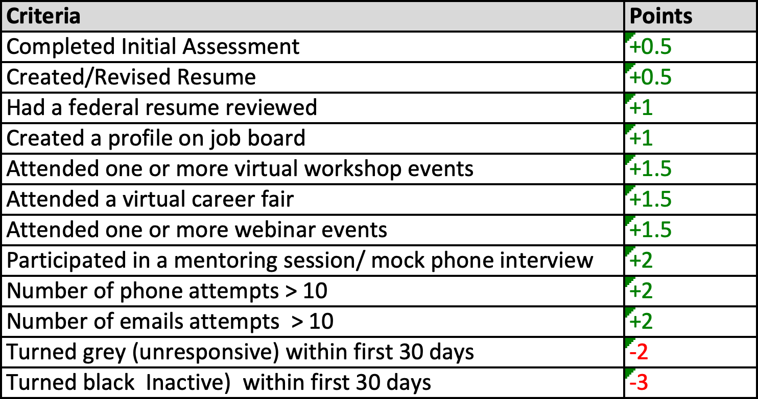
Responsiveness
Responsiveness were calculated based on responsive points.
Each client started with 0 points.
Points are then added/ subtracted based on their activities.
Notes:
How points were assigned for each criteria/ activity?
Overall attendance rate
Helpfulness of the activities ( By compare attendance rate between the hire group and the non_hire group)
Heuristics

Slide 4
Appendix

Slide 5
How points were assigned for each criteria/ activity?
Overall attendance rate
Helpfulness of the activities
Compare attendance rate between the hire group and the non_hire group
Heuristics

