Slide 1
SparkNet: Training Deep Networks in Spark
Philipp Moritz, Robert Nishihara, Ion Stoica, Michael I. Jordan
ICLR 2016

Slide 2
Introduction
Deep learning is awesome
Training of deep networks often rely on asynchronous, lock-free optimization
At odds is the rise of batch processing frameworks (MapReduce, Spark)
Competing objectives!

Slide 3
SparkNet
Scalable, distributed deep network training framework
Works well out-of-the-box in bandwidth-limited environments
Convenient to integrate model training with existing data-processing pipelines
Improved SGD parallelization strategy (main contribution)

Slide 4
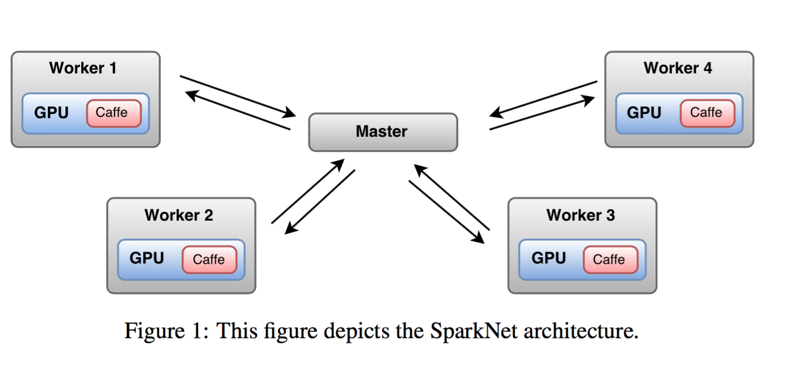
SparkNet Architecture
Notes:
Main idea:
- spark for inter-node parallelism
- GPUs / Caffe for intra-node parallelism

Slide 5
SparkNet Implementation
Coded in Scala
Built on Apache Spark
Java implementation of Google Protocol Buffers (protobufs)
Caffe deep learning framework
All models are compatible with Caffe
Java Native Access (JNA)
Foreign function interface (ffi) to dynamically invoke native code—no compile step
Used to access Caffe data and weights natively from within Scala

Slide 6
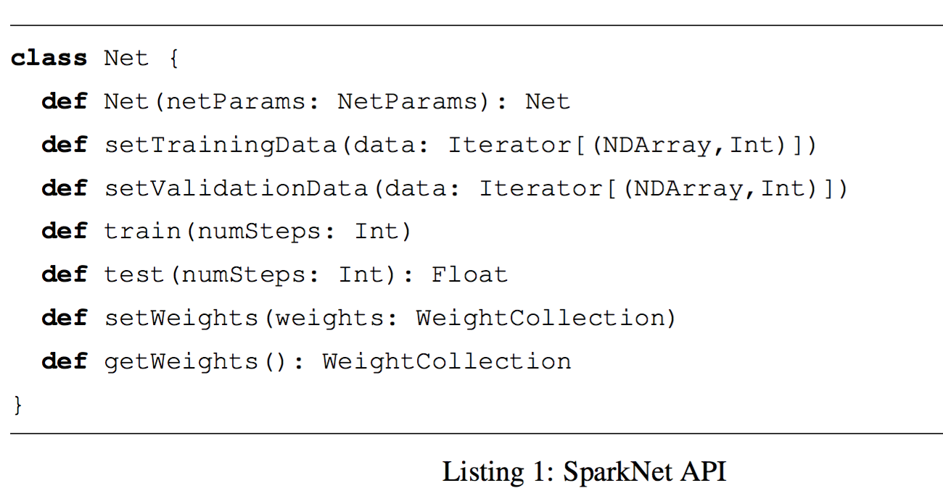
SparkNet API
Specifies network architecture
Custom-built lightweight multi-dimensional tensor library
Map from layer names to lists of weights
Notes:
To facilitate manipulation of data and weights without copying memory from Caffe, we implement the NDArray class, which is a lightweight multi-dimensional tensor library.

Slide 7
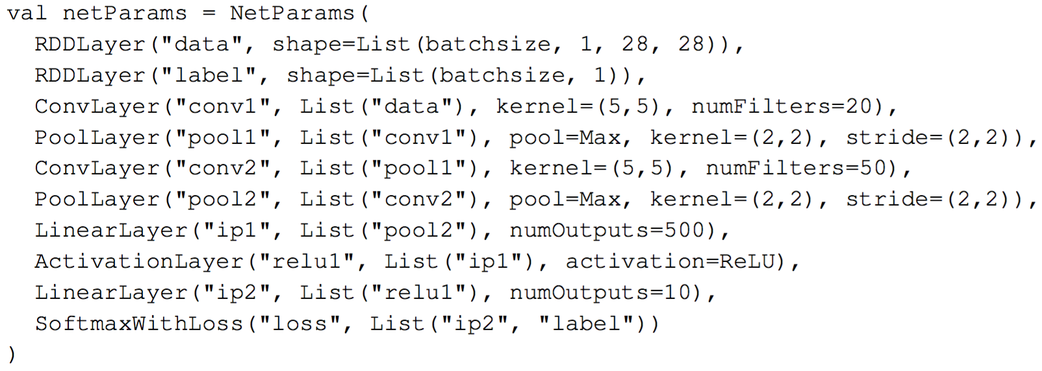
Example SparkNet network architecture

Slide 8
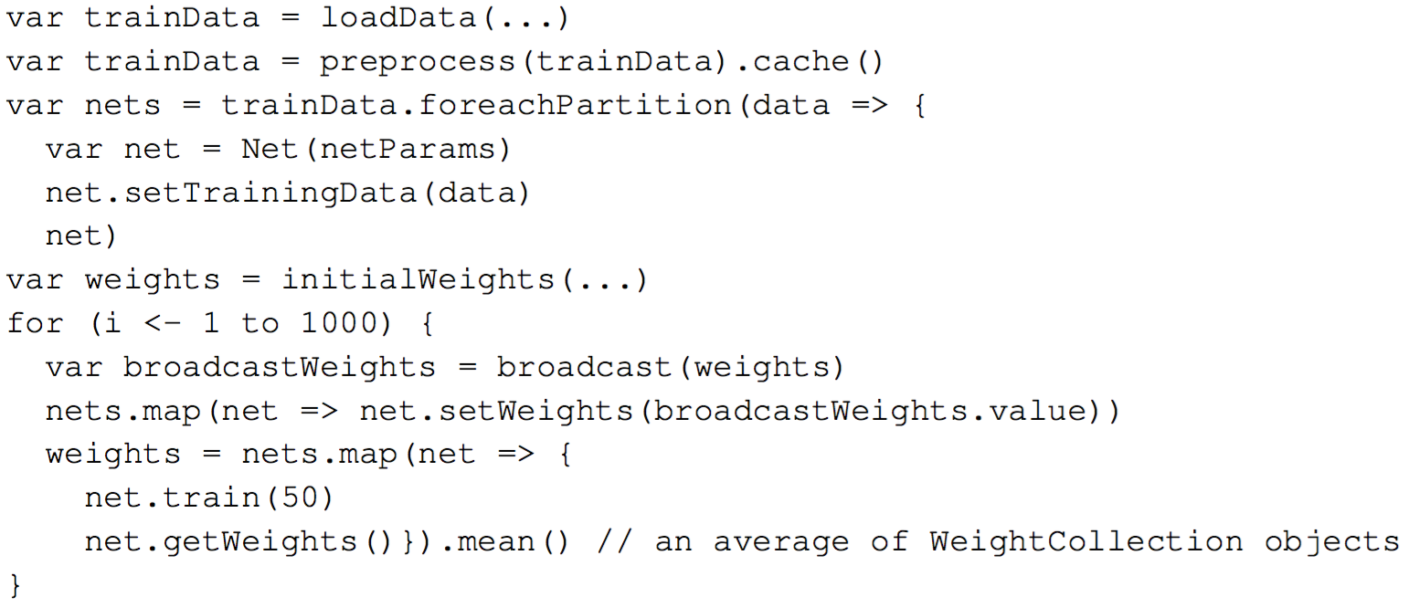
SparkNet training procedure
Notes:
- The data is split among the Spark workers. In every iteration, the Spark master broadcasts the model parameters to each worker.
- Each worker then runs SGD on the model with its subset of data for a fixed number of iterations τ (we use τ = 50 in example code) or for a fixed length of time
- Resulting model parameters on each worker are sent to the master and averaged to form the new model parameters

Slide 9
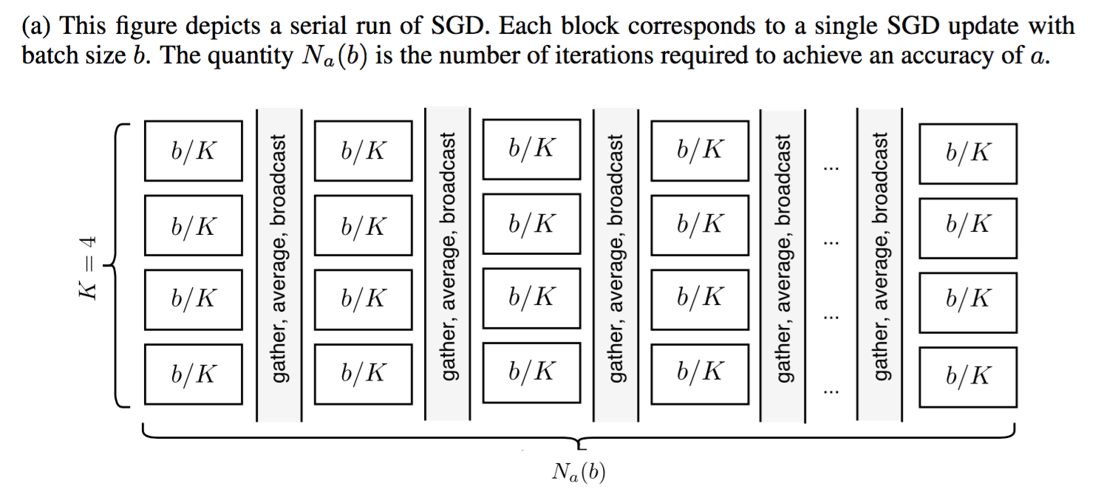
Naïve SGD Parallelization
Notes:
This figure depicts a parallel run of SGD on K = 4 machines under a naive parallelization scheme. At each iteration, each batch of size b is divided among the K machines, the gradients over the subsets are computed separately on each machine, the updates are aggregated, and the new model is broadcast to the workers. Algorithmically, this approach is exactly equivalent to the serial run of SGD in Figure 2a and so the number of iterations required to achieve an accuracy of a is the same value Na(b).

Slide 10
Problems with “naïve” approach
Batch size b
Testing accuracy a
N_{a}(b) = number of serial SGD iterations required to achieve accuracy a with batch size b
C(b) = units of time required to compute gradient over batch size b
Training time: N_{a}(b)C(b)
In principle, for K machines—
Computation on a single node: C(b/K)
Training time: N_{a}(b)C(b) / K
In practice…
Notes:
The standard approach to parallelizing each gradient computation requires broadcasting and collect- ing model parameters (hundreds of megabytes per worker and gigabytes in total) after every SGD update, which occurs tens of thousands of times during training.
On our EC2 cluster, each broadcast and collection takes about twenty seconds, putting a bound on the speedup that can be expected using this approach without better hardware or without partitioning models across machines.
Our approach broadcasts and collects the parameters a factor of τ times less for the same number of iterations. In our experiments, we set τ = 50, but other values seem to work about as well.
We note that Caffe supports parallelism across multiple GPUs within a single node. This is not a competing form of parallelism but rather a complementary one. In some of our experiments, we use Caffe to handle parallelism within a single node, and we use the parallelization scheme described in Listing 3 to handle parallelism across nodes.

Slide 11

Problems with “naïve” approach
K must be much smaller than b
Communication overhead assumed to be 0 in principle…but in practice?
Aggregating and broadcasting model parameters requires S units of time
(C(b)/K) + S per iteration
N_{a}(b)(C(b) / K + S) to achieve a accuracy
Maximum achievable speedup:
$$\frac{C(b)}{\frac{C(b)}{K}+S}≤\frac{C(b)}{S}$$
Notes:
K must be much smaller than b, limiting the number of machines we can use to effectively parallelize the minibatch computation. One might imagine circumventing this limitation by using a larger batch size b. Unfortunately, the benefit of using larger batches is relatively modest. As the batch size b increases, Na(b) does not decrease enough to justify the use of a very large value of b.
If aggregating the gradients and broadcasting the model parameters requires S units of time, then the time required by this approach is at least C(b)/K + S per iteration and Na(b)(C(b)/K + S) to achieve an accuracy of a

Slide 12
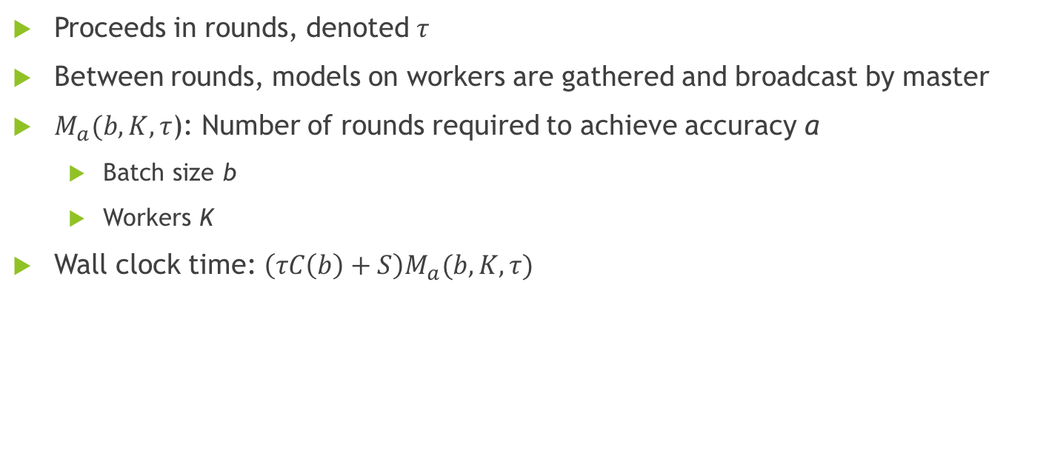
SparkNet Parallelization
Proceeds in rounds, denoted $τ$
Between rounds, models on workers are gathered and broadcast by master
$M_{a}(b, K, τ$): Number of rounds required to achieve accuracy a
Batch size b
Workers K
Wall clock time: $\left(τC\left(b\right)+S\right)M_{a}(b, K,τ)$
Notes:
To measure the sensitivity of SparkNet’s parallelization scheme to the parameters τ and K, we consider a grid of values of K and τ . For each pair of parameters, we run SparkNet using a modified version of AlexNet on a subset of ImageNet (the first 100 classes each with approximately 1000 data points) for a total of 20000 parallel iterations. For each of these training runs, we compute the ratio τMa(b,K,τ)/Na(b). This is the speedup achieved relative to training on a single machine when S = 0.

Slide 13
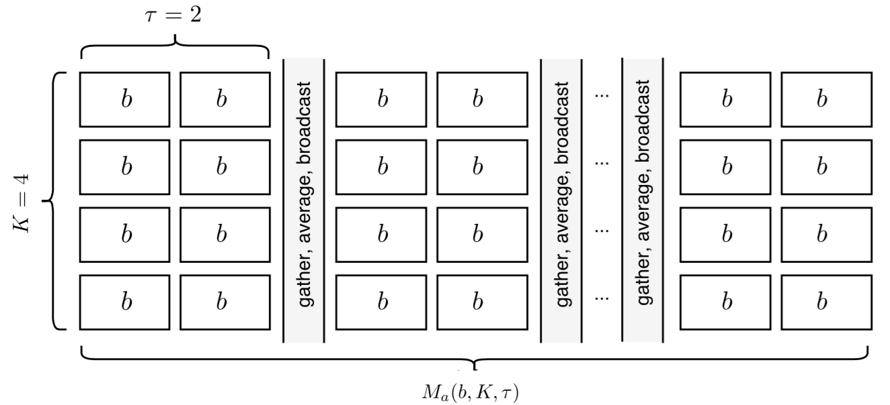
SparkNet Parallelization
Notes:
This figure depicts a parallel run of SGD on K = 4 machines under SparkNet’s parallelization scheme. At each step, each machine runs SGD with batch size b for τ iterations, after which the models are aggregated, averaged, and broadcast to the workers. The quantity Ma(b,K,τ) is the number of rounds (of τ iterations) required to obtain an accuracy of a. The total number of parallel iterations of SGD under SparkNet’s parallelization scheme required to obtain an accuracy of a is then τMa(b, K, τ).

Slide 14
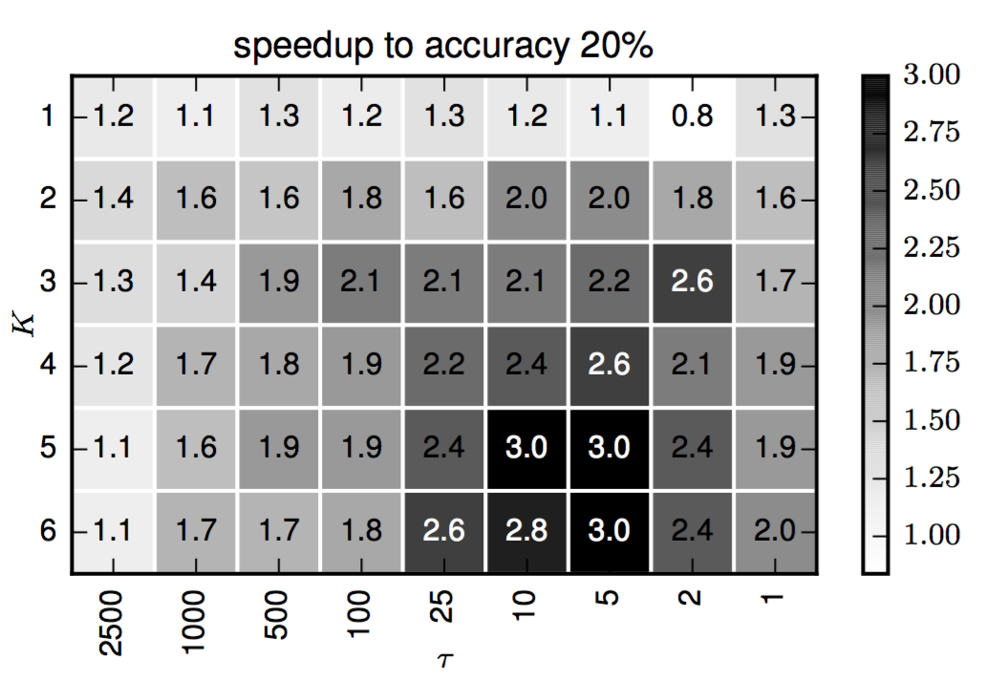
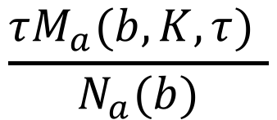
SparkNet Parallelization Speedup
$$\frac{τM_{a}(b, K,τ) }{N_{a}(b)}$$
Notes:
This figure shows the speedup τMa(b,τ,K)/Na(b) given by SparkNet’s parallelization scheme relative to training on a single machine to obtain an accuracy of a = 20%. Each grid square corresponds to a different choice of K and τ. We show the speedup in the zero communication overhead setting. This experiment uses a modified version of AlexNet on a subset of ImageNet (100 classes each with approximately 1000 images). Note that these numbers are dataset specific. Nevertheless, the trends they capture are of interest

Slide 15
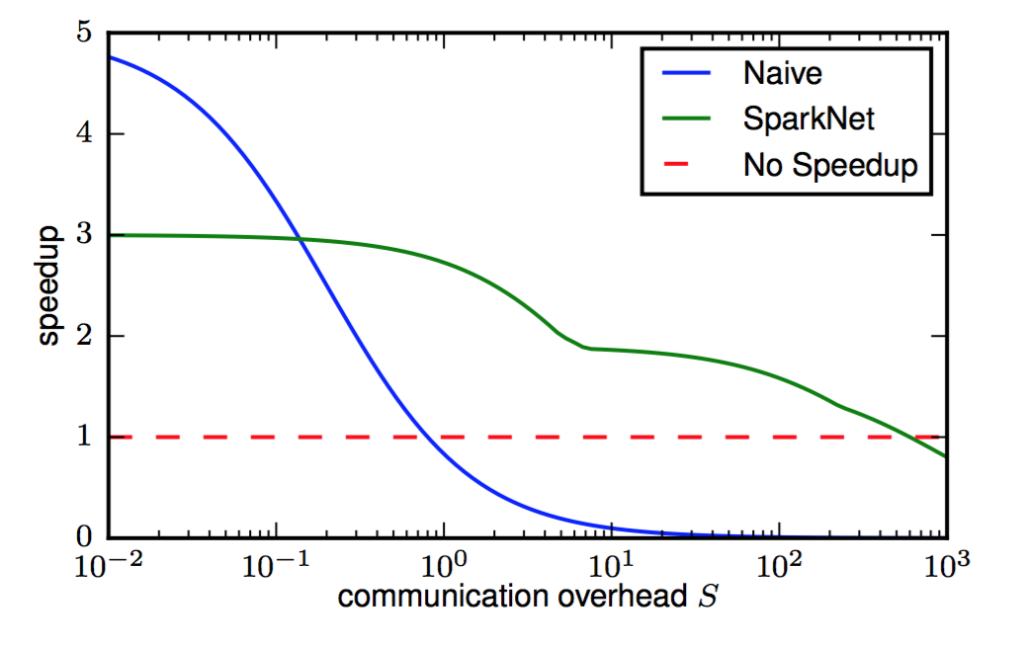
Comparison of parallelization strategies
Notes:
What plotting library did they use? ^_^
This figure shows the speedups obtained by the naive parallelization scheme and by SparkNet as a function of the cluster’s communication overhead (normalized so that C(b) = 1). We consider K = 5. The data for this plot applies to training a modified version of AlexNet on a subset of ImageNet (approximately 1000 images for each of the first 100 classes). The speedup obtained by the naive parallelization scheme is C(b)/(C(b)/K + S). The speedup obtained by SparkNet is Na(b)C(b)/[(τC(b) + S)Ma(b,K,τ)] for a specific value of τ. The numerator is the time required by serial SGD to achieve an accuracy of a, and the denominator is the time required by SparkNet to achieve the same accuracy (see Equation 1 and Equation 2). For the optimal value of τ , the speedup is maxτ Na(b)C(b)/[(τC(b) + S)Ma(b,K,τ)]. To plot the SparkNet speedup curve, we maximize over the set of values τ ∈ {1, 2, 5, 10, 25, 100, 500, 1000, 2500} and use the values Ma(b,K,τ) and Na(b) from the experiments in the fifth row of Figure 3. In our experiments, we have S ≈ 20s and C(b) ≈ 2s.

Slide 16
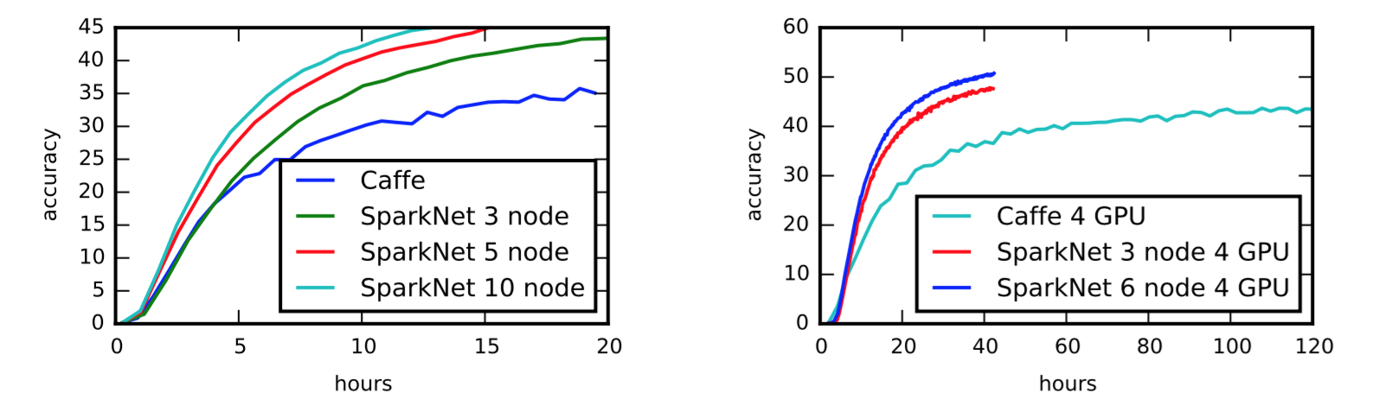
Results

Slide 17
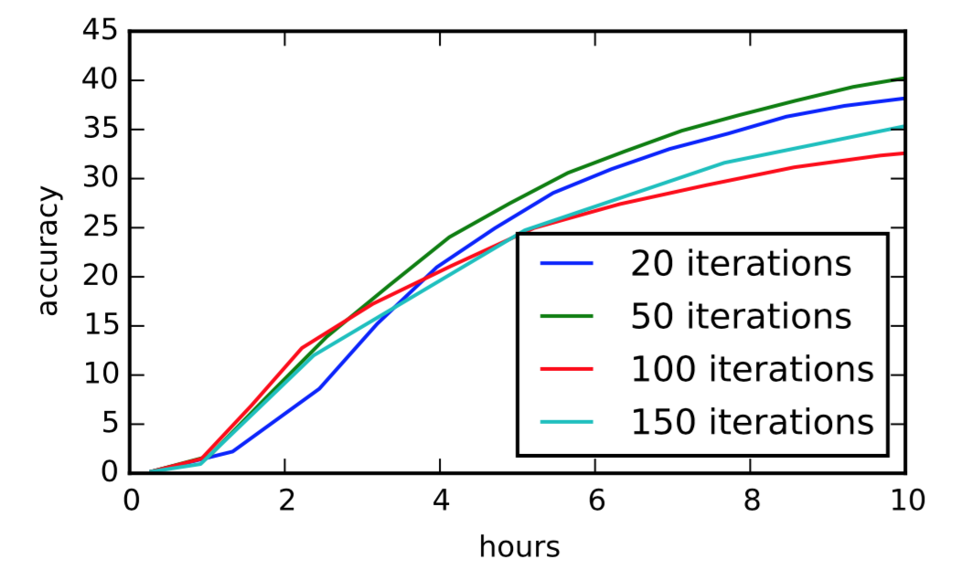
Results
Notes:
This figure shows the dependence of the parallelization scheme described in Section 2.1 on τ (number of iterations). Each experiment was run with K = 5 workers. This figure shows that good performance can be achieved without collecting and broadcasting the model after every SGD update.

Slide 18
Conclusions
SparkNet is built on existing software: Apache Spark and Caffe
Easy to use
Portable with existing models
Achieve comparable accuracy with nearly-comparable clock time
Use cluster parallelization in Spark, node parallelization in Caffe
https://github.com/amplab/SparkNet
(last commit was April 29, 2016)

Slide 19
Questions

