Slide 1
Performing massive documentation classifications by Naive Bayes (NB) method through pySpark2.0
Project No.1 lightening talk
Group: ChickenBurger Group
Mojtaba Sedigh-Fazli
BahaaEddin AlAila
Shawn(Shengming) Zhang

Slide 2
Method: why NB?
We choose NB method also because it is easily applicable on text. ( good results without excessive preprocessing)
Intuitively interpretable ( clearly interpretable )
MAP Category = argmax P(cj)*Π(P(xi|cj)/p(xi);
where P(cj) is: (docu. number in Cj)/(total docu. number); Π(P(xi|cj) = p(x1|cj)*p(x2|cj)*...*p(xn|cj), where xi is the word in this document and Cj is the word's category.

Slide 3
General Pipeline:
1) combine training documents with labels
2) clean labels only save the 4 labels
3) clean the words and then labels the words
4) count the number for each category to calculate the prior
5) calculate P(xi|cj) for each word
6) based on the training data set to calculate the MAP category of each testing document
7) using Laplace smoothing and take log() values
Notes:
1) xRDD.zip(yRDD) is not working
Using

Slide 4
Cont’d

Slide 5
Highlights on our work
1) stopwords
1.1) Just White Space ( 94%)
1.2) White Space And Stopwords (highest Score = 95.5%)
1.3) White Space + Stopwords+ Number Removal (e.g. $600,000->$)
1.4) Only Alphabetical Tokens (only English Character)

Slide 6
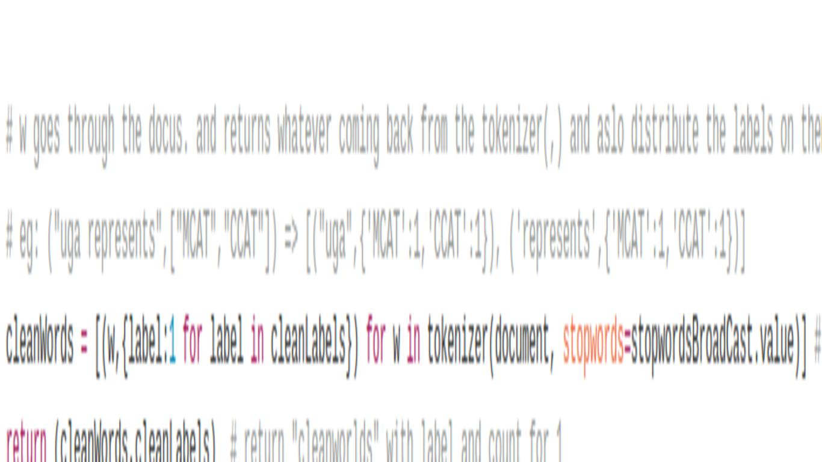
Highlights on our work
Only consider the words are not stopwords and using a dictionary data type as the second part of the return list to save computation resources.

Slide 7
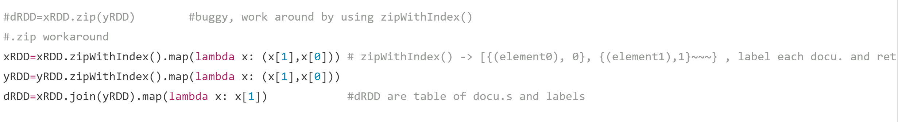
Find X.zip(y) bug
Using zipWithIndex() and join to work around the bug

Slide 8
Thank you and questions!

