Slide 1
Scalable Document Classification: Naïve Bayes Classifier
Dharamendra Kumar
Yash Shrivastava
Sharmin Pathan

Slide 2
Technology Used
Java 1.8
Apache Spark 2.0
IDE: Eclipse

Slide 3
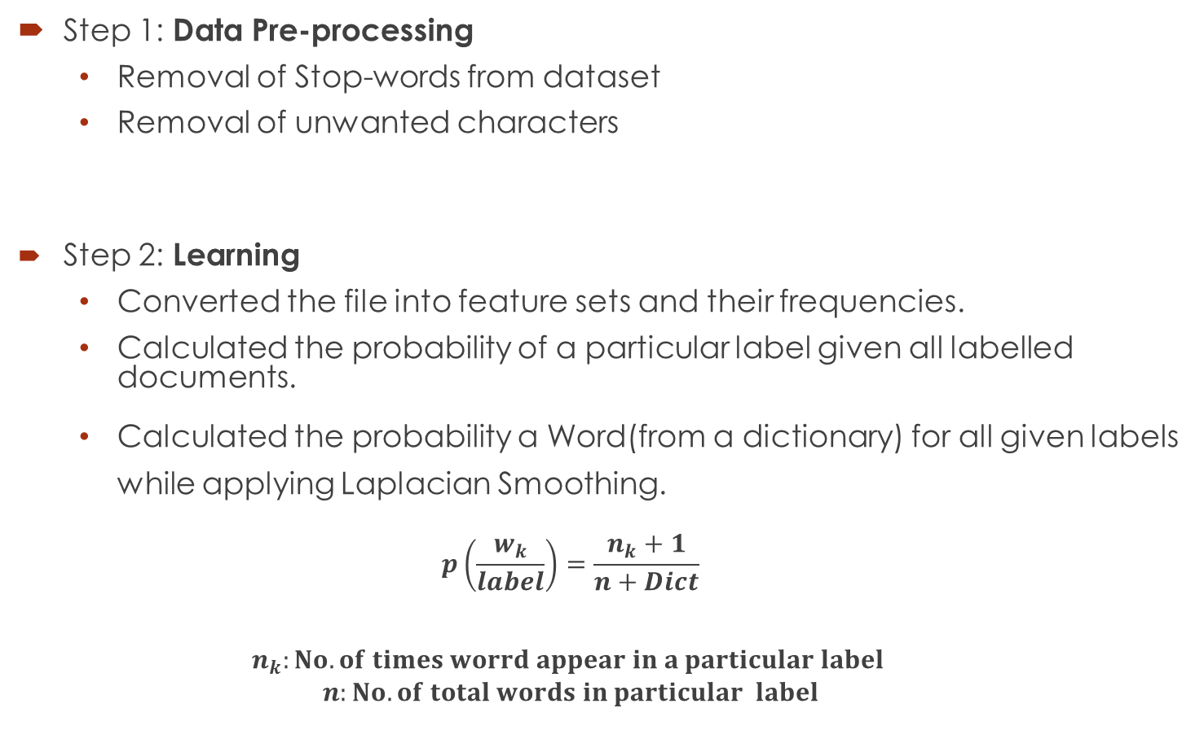
3 Step Approach:
Step 1: Data Pre-processing
Removal of Stop-words from dataset
Removal of unwanted characters
Step 2: Learning
Converted the file into feature sets and their frequencies.
Calculated the probability of a particular label given all labelled documents.
Calculated the probability a Word(from a dictionary) for all given labels while applying Laplacian Smoothing.
$$p\left(\frac{w_{k}}{label}\right)=\frac{n_{k}+1}{n+Dict}$$
$$n_{k}:No. of times worrd appear in a particular label$$
$$n:No. of total words in particular label$$

Slide 4

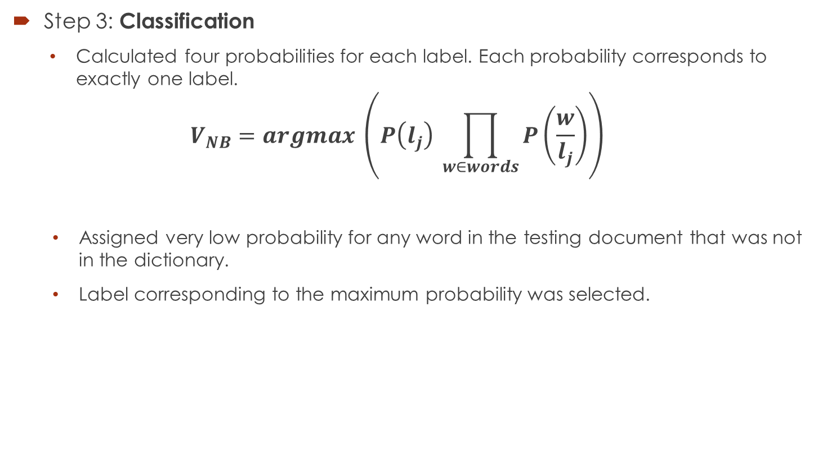
3 Step Approach:
Step 3: Classification
Calculated four probabilities for each label. Each probability corresponds to exactly one label.
$$V_{NB}=argmax \left(P\left(l_{j}\right) \prod_{w∈words}{P\left(\frac{w}{l_{j}}\right)}\right)$$
Assigned very low probability for any word in the testing document that was not in the dictionary.
Label corresponding to the maximum probability was selected.
$$l_{j} ∈L$$

Slide 5
Result
Obtained 94.3 % accuracy on the dataset X_test_small.txt.

Slide 6
Challenges
For handling a large dataset in Java we faced an “Out of Memory” issue.
To overcome this issue we applied splitting of data using RDD and Data Frame filter.

Slide 7
QUESTIONS?

