Slide 1
Click Through Rate Prediction
TEAM PROVECTUS
Dharamendra Kumar
Pranjay Patil
Shubhi Jain
Yash Shrivastava

Slide 2
OVERVIEW
Introduction
Problem Statement / Why CTR ?
About the Dataset
Work plan
Random forest
Wide and deep learning
Results
Challenges
Future work

Slide 3
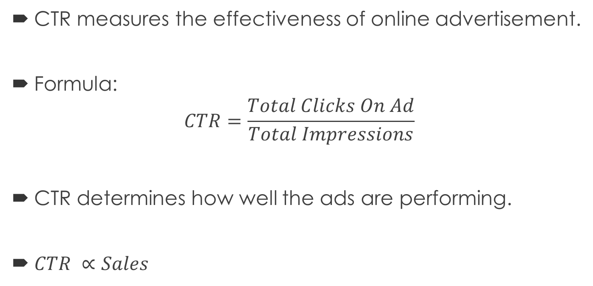
Click Through Rate
CTR measures the effectiveness of online advertisement.
Formula:
$$CTR=\frac{Total Clicks On Ad}{Total Impressions}$$
CTR determines how well the ads are performing.
$CTR ∝Sales$

Slide 4
Problem Statement
Kaggle Competition – Display Advertising Challenge
The Machine Learning Problem here is to predict CTR For an add.
Predicting CTR involves predicting a conditional probability that the ad will be clicked by the user given the predictive features of the ad. Predictive features include:
Ad’s historical performance
Advertiser and ad content info
Publisher info
User Info (eg: search/ click history)
Given all the features, the task would be to predict if ad will be clicked or not.

Slide 5
About the Criteo Dataset
Criteo is an organization in the digital advertising space and they have made samples of their traffic available for this Kaggle competition.
Each row in the dataset corresponds to a display ad served by Criteo. The semantics of these features are undisclosed.
DATA FIELDS
Label (0 or 1)
I1 – I13
Continuous Features
C1-C26
Categorical
Features

Slide 6
About the Criteo Dataset
Sample Train File
Number of Rows – Approx. 0.1 million records
Large Train File
Number of Rows – Approx. 45 million records
Test File
Number of Rows – Approx. 6 million records
All tab separated with a large number of missing values.
Categorical features represent information about the displayed ad including website the ad was displayed, the advertiser, user features, etc.

Slide 7
WORK-PLAN

Slide 8
WORK-PLAN
Implementing two ML algorithms for CTR prediction:
Random Forest (PySpark.ml)
XGBoost (GBDT)
Wide and Deep Learning (TensorFlow, Pandas)

Slide 9
Random Forest Implementation
Data Preparation
Missing values in categorical features replaced with hexadecimal of “unknown”
Missing values in continuous features replaced by median.
Initial data processing without feature selection had trouble in writing to HDFS.
Feature selection using Chi Squared Selector – not applied on continuous features.
Some categorical features have more than 10,000 distinct values, so we did not apply Chi Squared selector on those since Spark Chi Squared selector has a 10,000 limit (not in documentation).
Model: Trees 128, Depth 8

Slide 10
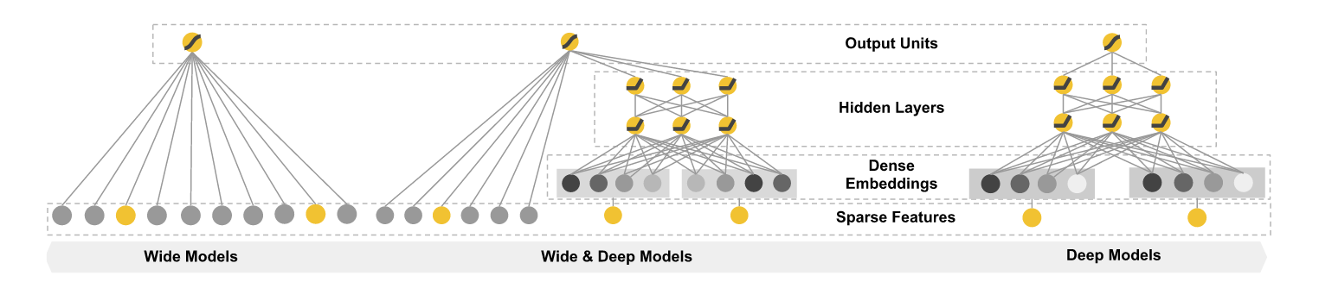
WIDE AND DEEP LEARNING (TensorFlow)

Slide 11
Pandas Pre-Processing
Reading data into Pandas Dataframe in Batches
Filling missing values in Continuous data with MEDIAN
Filling missing values in Categorical data with MODE
Writing the Dataframe as CSV in batches

Slide 12
TensorFlow Feature Engineering
Categorical Columns
Crossed Columns
Categorical Columns
Crossed Columns
WIDE COLUMNS
DEEP COLUMNS

Slide 13
Initial Results
Tested on 1.8 millions rows randomly selected from 9 million rows. Precision of 72.66%
Initial Random Forest accuracy of 75.66%
Accuracy of Wide and Deep learning 78.87%
GBDT accuracy of 78.73%

Slide 14
Challenges Faced
Frequent out of memory errors while pre-processing during conversion of categorical features using StringIndexer.
Writing pre-processed parquet file failed, apparently writing large number of dataframe columns is not very efficient.
Random Forest got stuck on training probably due to presence of large number of distinct values in some features.
Streaming the data in wide and deep model.

Slide 15
Work in Progress
Improving accuracy – Feature Engineering, Model Design
Tensorflow - Wide and Deep to be run with more data in batches.
A better XGBoost model.
Train Random Forest model on all data together.
Sample a part of data with set proportion of click and non click instances for training to improve accuracy.

Slide 16
Questions? Thank You!

