Slide 1
Eating Nails
Naïve Bayes for Text Classification in Apache Spark
Shang Gao
Pranjay Patil
Neo Hao

Slide 2
Preprocessing
Eliminate all punctuation, lowercase all words.
Remove stopwords. The python NLTK stopwords corpus is used as the set of stop words to remove.
Stem words. The python NLTK snowball stemmer is used to stem words.
Create tokens using unigrams and bigrams of word combinations.
Remove any tokens that appear in the training corpus less than three times.
Convert tokens into numerical vector using based on term frequency - inverse document frequency.

Slide 3
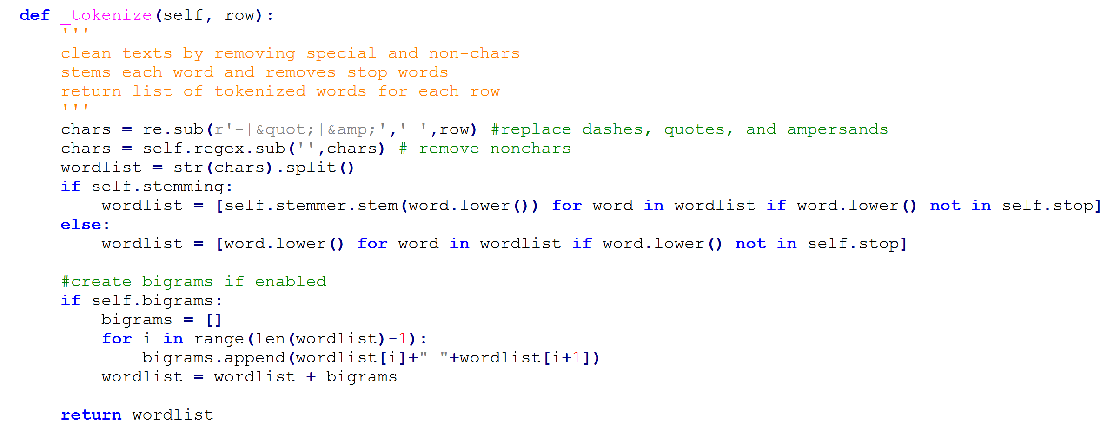

Slide 4
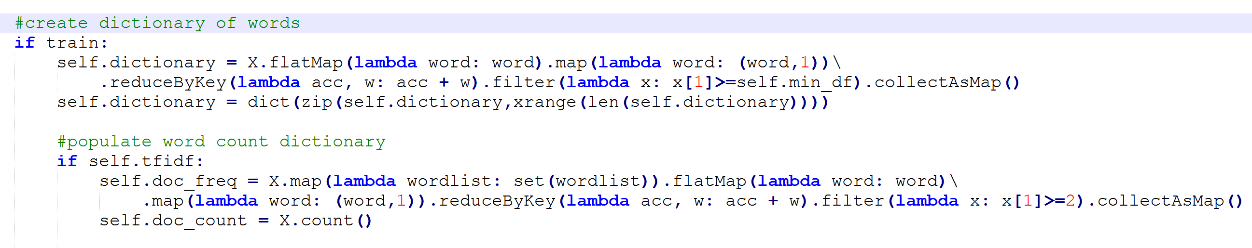

Slide 5
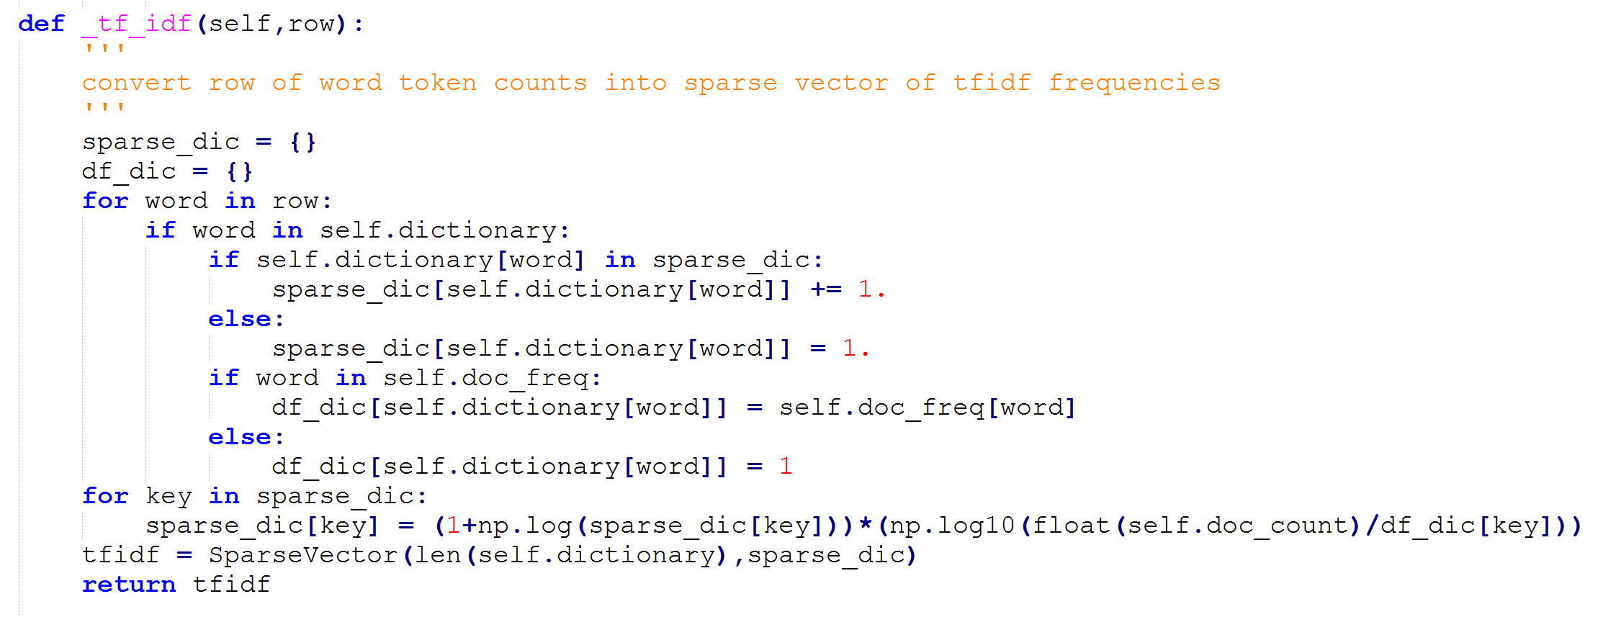

Slide 6
Naïve Bayes
Standard Naive Bayes classifier.
Laplace (add one) smoothing.
Sum log probabilities for numerical stability.
Because each article can have multiple labels, four separate Naive Bayes models are trained, one for each category.
For each article, the category with the highest sum log probability of its input vector is chosen as the category for the article.

Slide 7
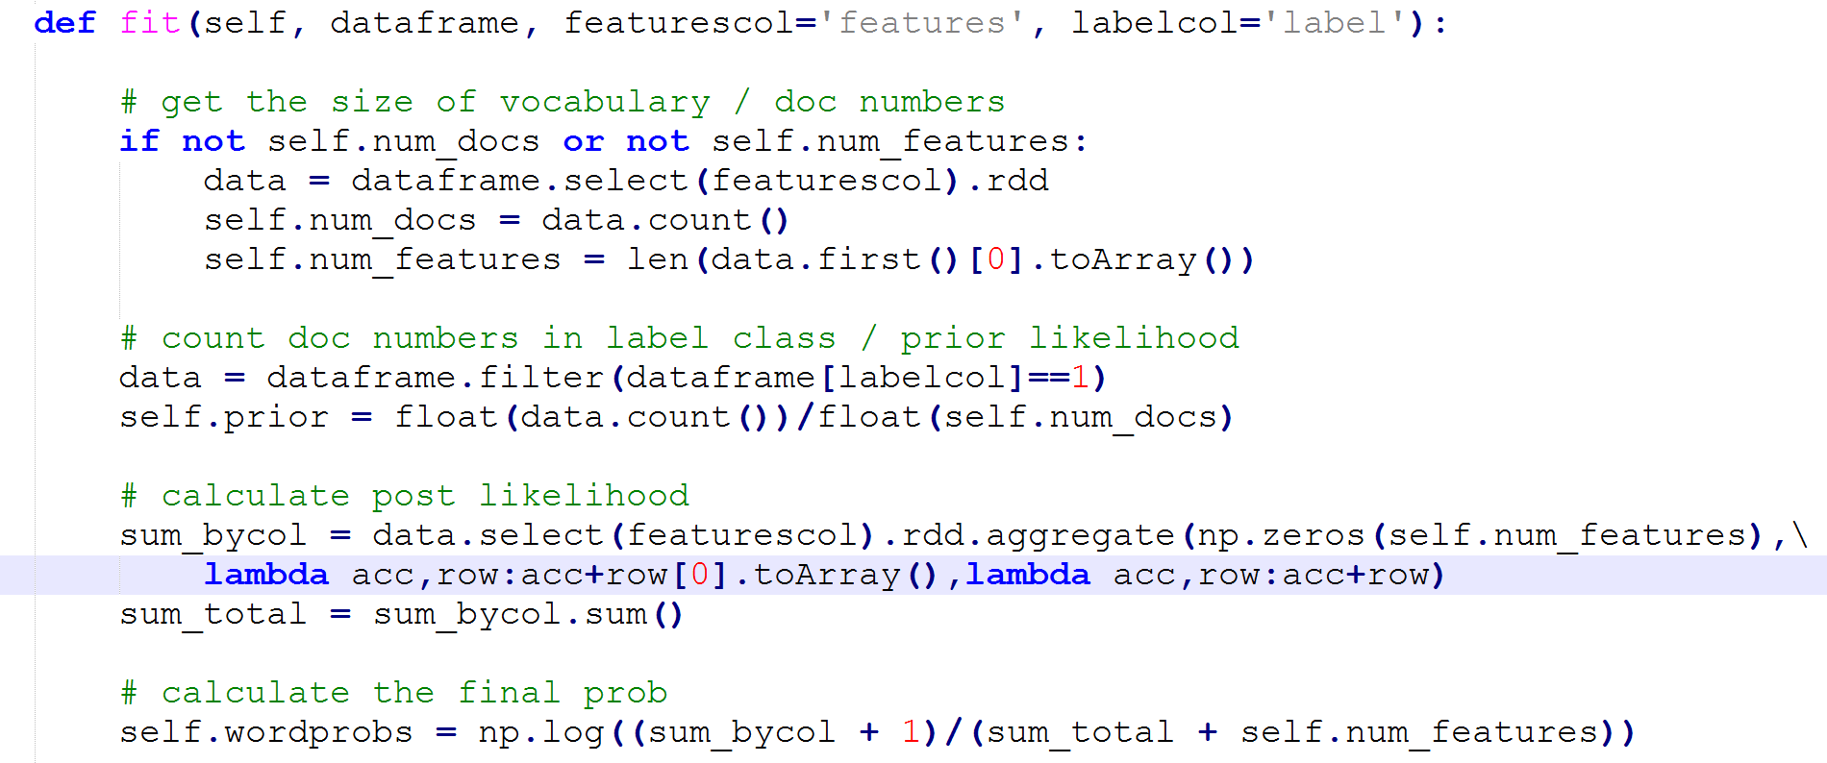

Slide 8
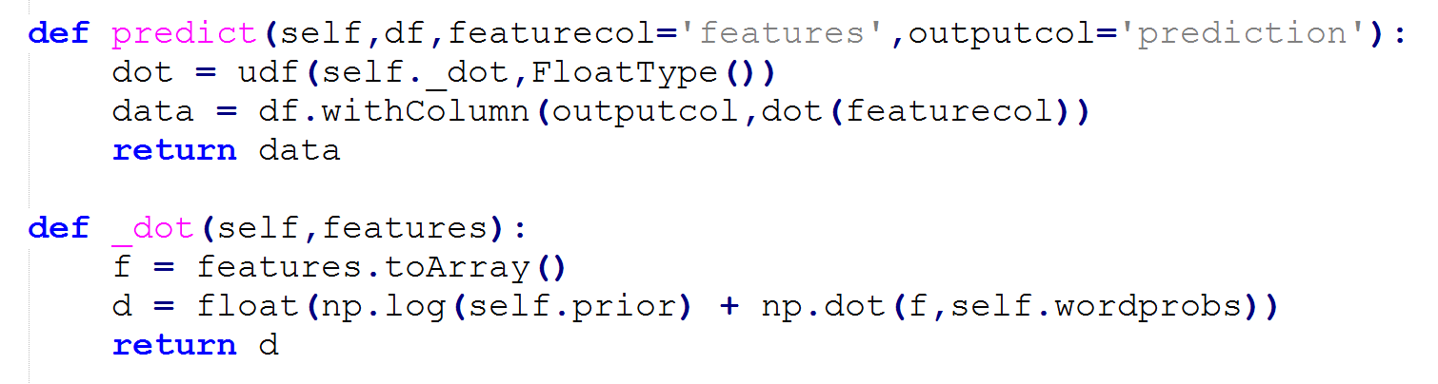

Slide 9
Running Spark on AWS
Launched Spark using Flintrock.
Launched Cluster with 4 m4.2xlarge slaves (8 cpus, 32g ram).
Ran code on Spark using 16 executors, 2 cores per executor, 7g of ram per executor, 30g of ram for driver.
Increased Spark Driver MaxResultSize to 3g.
Code took 1.2 hours to run.

Slide 10
Things That Didn’t Work
Hashing TF and Hashing TF-IDF dropped accuracy to 30%, likely due to the number of collisions.
Logistic Regression trained using gradient descent with L1 regularization gave accuracy of 50%, likely due to large number and sparsity of features. Also took forever to train (at least 20x longer than Naïve Bayes).

