Slide 1
Predicting Red Hat Business Value
- Chirag Jain
- Sharmin Pathan

Slide 2

Introduction
Red Hat is able to gather a great deal of information over time about the behavior of individuals who interact with them.
They are in search of better methods of using this behavioral data to predict which individuals they should approach—and even when and how to approach them.
Notes:
World’s open source leader
Pioneers and problem solvers. Established enterprises and energetic newcomers.
Financial Services: FICO
Government Aid and public sector: ATOS

Slide 3
Problem Description
Create a classification algorithm that accurately identifies which customers have the most potential business value for Red Hat based on their characteristics and activities.
With an improved prediction model in place, Red Hat will be able to more efficiently prioritize resources to generate more business and better serve their customers.
Binary-classification problem

Slide 4
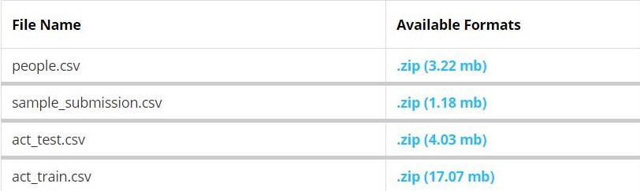
Dataset
The people file contains all of the unique people (and the corresponding characteristics) that have performed activities over time.
The activity file contains all of the unique activities (and the corresponding activity characteristics) that each person has performed over time.
Training dataset contains 2,197,291 rows and 15 columns
People dataset contains 189,118 rows and 41 columns
Testing dataset contains 498,688 rows
Notes:
Each row in the people file represents a unique person. Each person has a unique people_id.
Each row in the activity file represents a unique activity performed by a person on a certain date. Each activity has a unique activity_id.

Slide 5
People data – people.csv
Columns span upto char_38
char_1 to char_9 – String values
char_10 to char_37 – Boolean values
char_38 – Numerical values

Slide 6
Training data – act_train.csv
Type 1 activities are different from type 2-7 activities because there are more known characteristics associated with type 1 activities (nine in total) than type 2-7 activities (which have only one associated characteristic)
The business value outcome is defined by a yes/no field attached to each unique activity.
Notes:
The outcome field indicates whether or not each person has completed the outcome within a fixed window of time after each unique activity was performed.

Slide 7
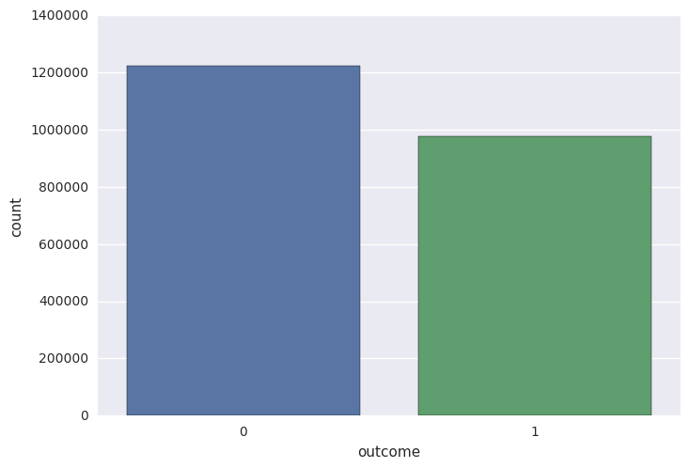
Exploratory Data Analysis (EDA) Training dataset

Slide 8
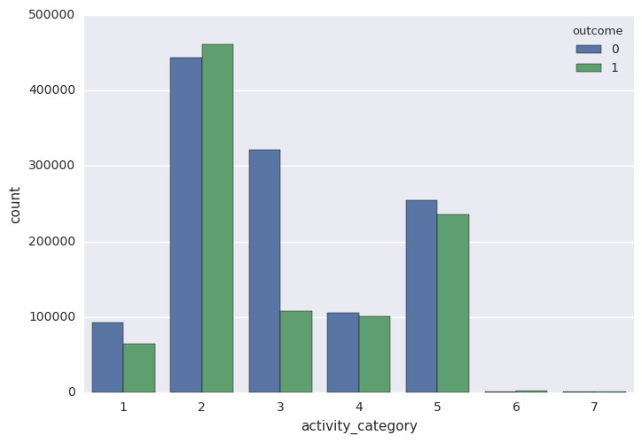
Exploratory Data Analysis (EDA) Training dataset

Slide 9
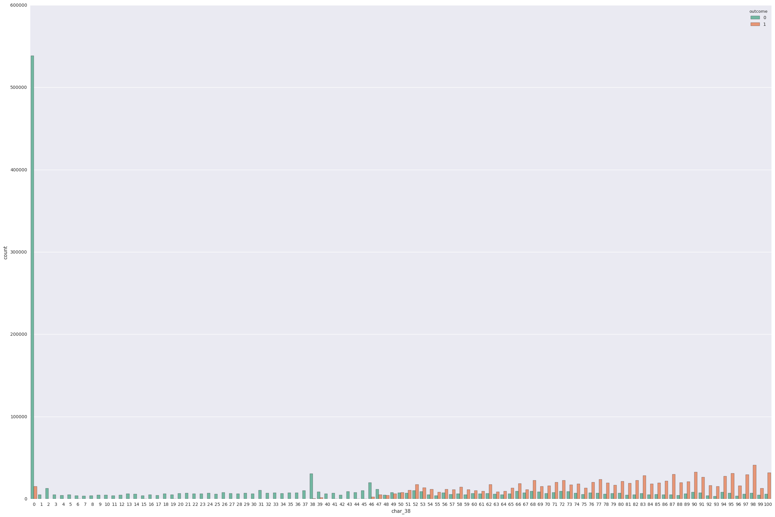
Exploratory Data Analysis (EDA) Merged dataset

Slide 10
Preprocessing
Convert the categorical values into numerical ones
Convert boolean attributes to numerical ones
Break date column into three separate columns, namely date, month, and year
Merge people and activity files
Fill ‘-1' for the missing values
Drop people_id column
Separate the data and labels

Slide 11
Feature Selection
Recursive Feature Elimination (RFE)
The Recursive Feature Elimination (or RFE) works by recursively removing attributes and building a model on those attributes that remain.
Column Headers: ['activity_category', 'char_1_x', 'char_2_x', 'char_3_x', 'char_4_x', 'char_5_x', 'char_6_x', 'char_7_x', 'char_8_x', 'char_9_x', 'char_10_x', 'year_x', 'month_x', 'day_x', 'char_1_y', 'group_1', 'char_2_y', 'char_3_y', 'char_4_y', 'char_5_y', 'char_6_y', 'char_7_y', 'char_8_y', 'char_9_y', 'char_10_y', 'char_11', 'char_12', 'char_13', 'char_14', 'char_15', 'char_16', 'char_17', 'char_18', 'char_19', 'char_20', 'char_21', 'char_22', 'char_23', 'char_24', 'char_25', 'char_26', 'char_27', 'char_28', 'char_29', 'char_30', 'char_31', 'char_32', 'char_33', 'char_34', 'char_35', 'char_36', 'char_37', 'char_38', 'year_y', 'month_y', 'day_y']
Num Features: 14
Selected Features: [ True False False False False False False False False False True True True True True True False False False False False False False False True False False False False False True False False False False False False False False True False False False False False False False False False False False False True True True True]

Slide 12
RFE Output
Column Headers: ['activity_category', 'char_10_x', 'year_x', 'month_x', 'day_x', 'char_1_y', 'group_1', 'char_10_y', 'char_16', 'char_25', 'char_38', 'year_y', 'month_y', 'day_y']

Slide 13
Further work
Principal Component Analysis (PCA)
PCA visualization to understand the variance for decided components
Training using a few evaluating algorithms like Random Forest, Logistic Regression, XGBoost

Slide 14

Questions?

