Slide 1
Human Activity Recognition
From Accelerometer Data
Shang Gao

Slide 2
Problem Description
Attempt to identify what someone is doing based on accelerometer readings (or readings from external devices such as video cameras) taken while that person is performing the activity
Using more accelerometers/devices yields more accurate predictions, but is less practical for real-life applications
Difficult because different people perform the same activity in different ways and readings can be noisy

Slide 3
Applications
Health – calorie counting, fitness reminders
Advertising – identify individuals with active lifestyles for product targeting
Task and performance monitoring – ensure physical tasks are performed correctly
Fall monitoring – detect falls for elderly individuals and automatically call for help

Slide 4
Literature Review
NIAZI et al - A Hierarchical Meta-Classiﬁer for Human Activity Recognition (2016)
Tested performance of random forests on time and frequency based features from accelerometer data
Francisco Javier Ordóñez and Daniel Roggen - Deep Convolutional and LSTM Recurrent Neural Networks for Multimodal Wearable Activity Recognition
Tested the performance of convolutional nets and convolutional LSTM nets on raw accelerometer data

Slide 5
Dataset
Triaxial hip-worn accelerometer data measurements across 77 subjects performing various activities
Accelerometer recorded 100 data points per second (X, Y, and Z)
Data collection carried out by Arizona State University, subjects were recruited from the Phoenix, AZ and surrounding area and were between 18-64 years old

Slide 6
Activity Description | No of Subjects | Duration/Distance
Treadmill at 1 mph @ 0% grade | 29 | 3 min
Treadmill at 2 mph @ 0% grade | 21 | 3 min
Treadmill at 3 mph @ 0% grade | 28 | 3 min
Treadmill at 3 mph @ 5% grade | 29 | 3 min
Treadmill at 4 mph @ 0% grade | 33 | 3 min
Treadmill at 5 mph @ 0% grade | 21 | 3 min
Treadmill at 6 mph @ 0% grade | 34 | 3 min
Treadmill at 6 mph @ 5% grade | 26 | 3 min
Seated, folding/stacking laundry | 74 | 3 min
Standing/Fidgeting with hands while talking | 77 | 3 min
1 minute brushing teeth + 1 minute brushing hair | 77 | 2 min
Driving a car | 21 | -
Hard surface walking w/ sneakers | 76 | 400m
Hard surface walking w/ sneakers hand in front pocket | 33 | 100m
Hard surface walking w/ sneakers while carry 8 lb. object | 30 | 100m
Hard surface walking w/ sneakers holding cell phone | 24 | 100m
Hard surface walking w/ sneakers holding ﬁlled coffee cup | 26 | 100m
Carpet walking w/ high heels or dress shoes | 70 | 100m
Grass walking barefoot | 20 | 134m
Uneven dirt walking w/ sneakers | 23 | 107m
Up hill 5% grade w high heels or dress shoes | 27 | 58.5m x 2 times
Down hill 5% grade w high heels or dress shoes | 26 | 58.5m x 2 times
Walking up stairs (5 ﬂoors) | 77 | 5 ﬂoors x 2 times
Walking down stairs (5 ﬂoors) | 77 | 5 ﬂoors x 2 times

Slide 7
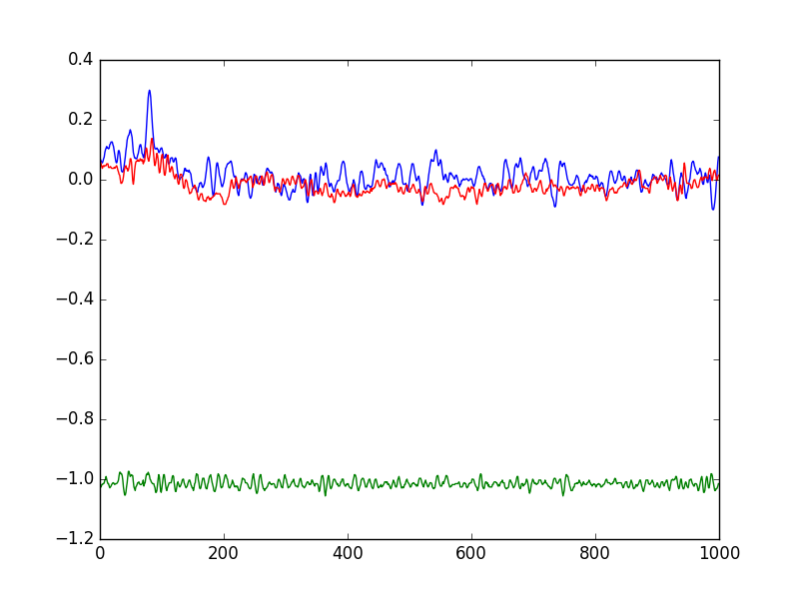
Sample Data for Nonambulatory Activity

Slide 8
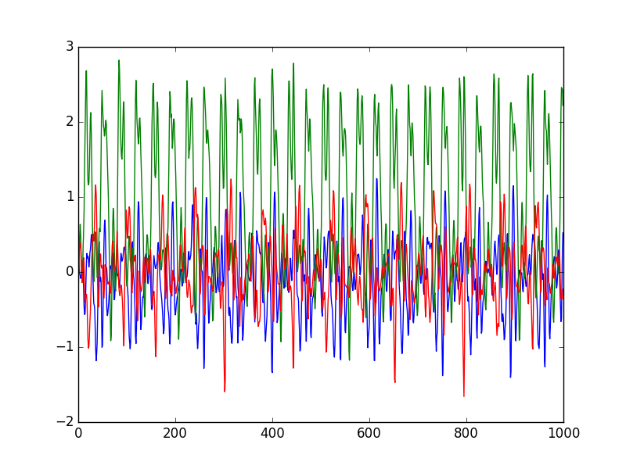
Sample Data for Running Activity

Slide 9
Dataset
Raw data is approximately 17 million rows and 7 columns (rowid, subject id, activity id, timestamp, x-accel, y-accel, z-accel)
In addition, there is demographic data for each subject (77 rows, 8 columns--id, age, height, sex, weight, bmi, weight group, overall group)
This dataset is relatively large compared to other human activity recognition datasets in terms of number of subjects and number of activities

Slide 10
Data Preprocessing
Data was broken into 10-second windows. For each window, the following statistics were calculated for the readings on each axis (X,Y,Z), the combined magnitude of all three axis, and the first differential of each axis and magnitude:
Mean and standard deviation
10,25,50,75,90 percentiles
Min, max, range, interquartile range
Median crossings
Correlation with other axis
Normalized demographic data was also included (age, height, sex, weight, bmi, overweight, obese)
Total of 109 features per window

Slide 11
Classification Levels
The performance of classifiers were tested at different levels of classification:
Nonambulatory vs Ambulatory
Nonambulatory vs Walking vs Running vs Upstairs vs Downstairs

Slide 12
Within Subject vs Between Subject
The performance of classifiers were tested using different methods of test/train splitting
In within subject testing, data from all subjects was included in the training set. The test set is composed of a subset of data taken from each subject.
In between subject testing, all data from some subjects were withheld in the training set. The withheld subjects were used as the test set.

Slide 13
Models Used
Random Forests
Generally high performance and fast training time, was used in similar studies
XGBoost
Reputation for extremely high performance
LSTM Networks
Neural networks designed for time series data
Convolutional LSTM Networks
Can learn own features without human preprocessing

Slide 14
Random Forest Model
Tree-based ensemble method
Select subset of total features, fit best model on selected features, repeat
Take average prediction across all trees
Used default scikitlearn random forests model, 100 trees, no max depth
10-fold Cross Validation Accuracy:
 | Ambulatory vs Non-Ambulatory | Non-Amb/Walking/Running/ Upstairs/Downstairs
Within Subjects | 98.16 | 93.67
Between Subjects | 96.90 | 83.74

Slide 15
Extreme Gradient Boosting Model
Tree-based ensemble method
Extension of gradient-boosted trees with added regularization and optimization
Keep fitting additional trees on residuals of cumulative previous trees until model converges
Used Python xgboost package, 300 trees, max depth 5, 0.1 learning rate
10-fold Cross Validation Accuracy:
 | Ambulatory vs Non-Ambulatory | Non-Amb/Walking/Running/ Upstairs/Downstairs
Within Subjects | 98.71 | 95.68
Between Subjects | 97.35 | 88.65

Slide 16
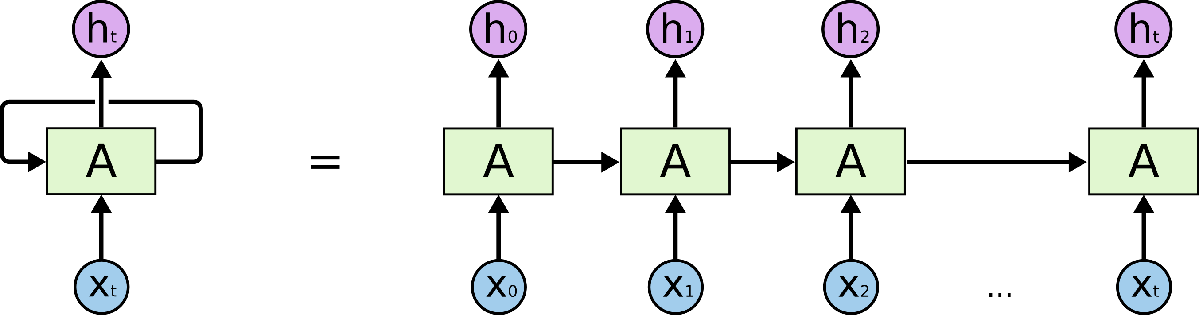
Long Short Term Memory Network Model
Recurrent neural networks are an extension of regular feedforward neural networks by propagating input signals through time
Each neuron in a recurrent net takes two inputs:
Input features at current timestep
Output of neurons at previous timestep

Slide 17

Long Short Term Memory Network Model
Recurrent neural networks can lose signals from earlier inputs after just a few timesteps
Long short term memory networks fix this problem by adding memory cells that can store information across many timesteps

Slide 18
Long Short Term Memory Network Model
Instead of calculating summary statistics across entire 10-second window, summary statistics were calculated for .50-second increments and fed into the LSTM network (20x109 matrix)
Model architecture:
Layer 1: 128 LSTM units
Layer 2: 128 LSTM units
Layer 3: Softmax
orthogonal weight initialization, adam gradient descent, lr 0.0002
 | Ambulatory vs Non-Ambulatory | Non-Amb/Walking/Running/ Upstairs/Downstairs
Within Subjects | 98.32 | 94.83

Slide 19
Long Short Term Memory Network Model
For between-subject testing, a simpler LSTM model was used to reduce overfitting. 1-second increments of statistics were also used instead of 0.5-second increments.
Model architecture:
Layer 1: 32 LSTM units
Layer 2: Softmax
orthogonal weight initialization, adam gradient descent, lr 0.0002
 | Ambulatory vs Non-Ambulatory | Non-Amb/Walking/Running/ Upstairs/Downstairs
Between Subjects | 96.29 | 80.11

Slide 20
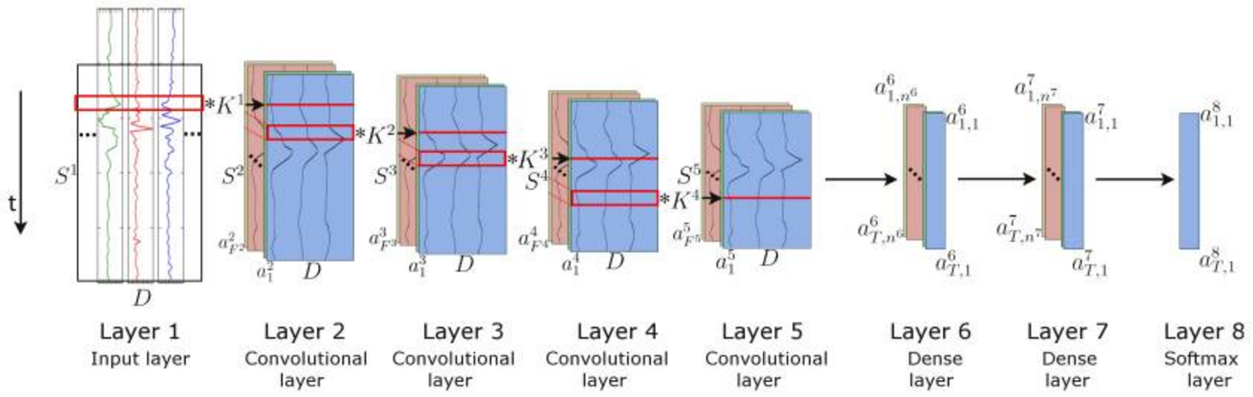
Convolutional LSTM Network Model
Instead of hand-crafting features from the raw data (via summary statistics), convolutional layers can be used to automatically identify relevant features
For example, a convolutional filter reads the accelerometer data and demographic data over a 20 ms time window with a stride of 5 ms

Slide 21
Convolutional LSTM Network Model
Convolutional layers were used to generate features from the raw accelerometer/demographic data, which was then fed into the LSTM network.
Model architecture:
Layer 1: Convolutional Layers (64x1x10x10 filter with stride 5x1), ELU activation
Layer 2-4: Convolutional Layers (64x64x3x1 filter with stride 2x1) , ELU activation
Layer 5-6: 64 LSTM units
Layer 7: Softmax
orthogonal weight initialization, adam gradient descent, lr 0.0002
 | Ambulatory vs Non-Ambulatory | Non-Amb/Walking/Running/ Upstairs/Downstairs
Within Subjects | 97.55 | 94.24

Slide 22
Convolutional LSTM Network Model
For between-subject testing, a simpler model was used to reduce overfitting.
Model architecture:
Layer 1: Convolutional Layers (64x1x10x10 filter with stride 5x1), ELU activation
Layer 2-4: Convolutional Layers (64x64x3x1 filter with stride 2x1) , ELU activation
Layer 5: 32 LSTM units
Layer 6: Softmax
orthogonal weight initialization, adam gradient descent, lr 0.0002
 | Ambulatory vs Non-Ambulatory | Non-Amb/Walking/Running/ Upstairs/Downstairs
Between Subjects | 95.08 | 85.42

Slide 23
Result Comparison
 | Within Subject 2 classes | Within Subject 5 classes | Between Subject 2 classes | Between Subject 5 classes
Random Forest | 98.16 | 93.67 | 96.90 | 83.74
XGBoost | 98.71 | 95.68 | 97.35 | 88.65
LSTMs | 98.32 | 94.83 | 96.29 | 80.11
Conv-LSTMs | 97.94 | 94.64 | 95.08 | 85.42

Slide 24
Result Comparison

Slide 25
Conclusions
The more granular the classification level, the more difficult the problem (expected)
Between-subject prediction is harder than within-subject prediction (expected)
XGBoost is really good (and relatively fast)
LSTMs work well for within-subject classification but overfit on between-subject classification
Convolutional-LSTM networks can learn features that have comparable performance with human-selected features

Slide 26
Future Work
Classification using cell-phone accelerometers (which are less accurate than the scientific-grade accelerometers used for this experiment)
Classification on free-living datasets, in which data is collected from subjects while they are going through their daily routines as opposed to in rigorous lab settings. Free-living better reflects what real-life data may look like.

