Slide 1
Recommender Systems: Collaborative Filtering
Usman Nisar
Data Science Practicum
Fall 2016

Slide 2
Recommender Systems
Problem: Some field of activity where users buy, view, consume or otherwise experience items
Examples:
Movie recommendation on Netflix
Product recommendation on Amazon
News article recommendations on news websites
Many more …

Slide 3
Process
Users rate items they have interacted with
Data saved as tuples <User, Item, Rating>
Build a system that can predict how well the user u will rate an item i that it has not interacted with before

Slide 4
Ratings
Ratings can be in many different forms
Binary: Like/Dislike buttons on YouTube video
Rating Scale: Netflix/Amazon rate on a scale of 1 to 5
Explicit:
Or can be implicit
Browsing pattern, items in a shopping cart that you never checked out

Slide 5
Types of Recommender Systems
Two main types:
Content-Based Systems:
Explicit characteristics of users and items
Example, I like suspense thriller movies, what other suspense thriller movies are there?
Collaborative Filtering
Based on implicit characteristics determined by the similarity of user’s preferences to those of other users
Example, I like the movies you like, what other movies do you like that I haven’t seen?

Slide 6
Content-based systems
Consume explicit features
Pros:
Easy to setup if have elaborate features available.
Cons:
Explicit features are not always available.

Slide 7
Collaborative Filtering Algorithms
A vast array of algorithms:
Global effects
Matrix Factorization
Alternating Least Squares
Singular Value Decomposition
….
Nearest Neighbor
Graph Recommendations
Clustering
Etc.

Slide 8
Collaborative Filtering Algorithms
A vast array of algorithms:
Global effects
Matrix Factorization
Alternating Least Squares
Singular Value Decomposition
….
Nearest Neighbor (Item-Item)
Graph Recommendations
Clustering
Etc.

Slide 9
Global Effects
Average of either user or item for rating
User\Item | Jurassic Park | Gladiator | The Revenant
A | 3 | 3 | 3
B |  | 4
C | 2
D | 1 |  | 1
E | 5 |  | 4
F |  | 2

Slide 10
Global Effects
Average of either user or item for rating
User\Item | Jurassic Park | Gladiator | The Revenant
A | 3 | 3 | 3
B |  | 4
C | 2
D | 1 |  | 1
E | 5 |  | 4
F | ? | 2

Slide 11
Global Effects
Average of either user or item for rating
User\Item | Jurassic Park | Gladiator | The Revenant
A | 3 | 3 | 3
B |  | 4
C | 2
D | 1 |  | 1
E | 5 |  | 4
F | 2 | 2
User’s Average

Slide 12
Global Effects
Average of either user or item for rating
User\Item | Jurassic Park | Gladiator | The Revenant
A | 3 | 3 | 3
B |  | 4
C | 2
D | 2 |  | 1
E | 5 |  | 4
F | 3 | 2
Product’s Average

Slide 13
Matrix Factorization
Alternating Least Squares
Singular Value Decomposition

Slide 14
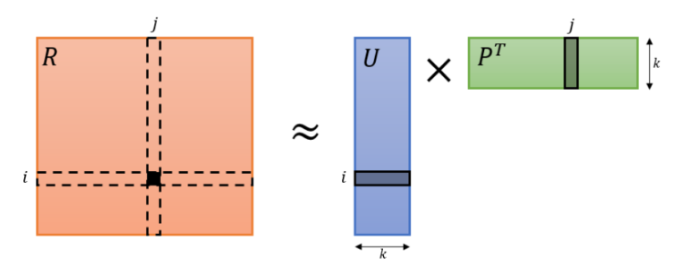
Alternating Least Squares
Read the input as a user x product utility matrix R, where R_{i,j} is the rating of user i on item j
Goal of matrix factorization: U_{m*k} . P^{T}_{k*n} ≈ R_{m*n}
Once we have U & P, just a dot product gives the value

Slide 15
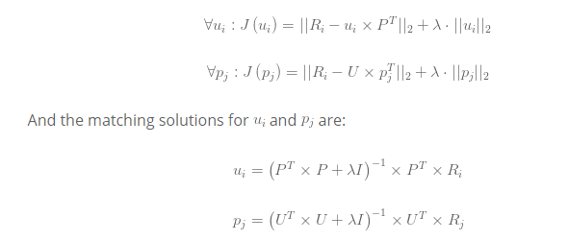
Alternating Least Squares
Extension of Ordinary Least Squares method

Slide 16
Singular Value Decomposition
Preprocessing:
For sparse datasets, need to fill-up matrix
Two approaches: Pick best of Global Effects approach
Normalize matrix: Subtraction of customer average from each rating
Obtaining Approximation:
Decompose the matrix into, U_{T}, S_{k} and V_{T}
Compute the square-root of matrix S_{k} to obtain S_{k}^{1/2}
Compute two resultant matrices U_{k}S_{k}^{1/2} and S_{k}^{1/2}V_{k}^{T}
Get prediction as a dot product and offset the effect of normalization

Slide 17
Item-based collaborative filtering
User-based collaborative filtering methods have been used before
Idea is to figure out similar customers based on common ratings and use that to predict for the new unknown item
Been effective but item-based approaches have fared better recently – A variant used by Amazon

Slide 18
Item-based collaborative filtering
Two main steps:
Similarity:
Compute similarity between all items in the system. An n*n matrix for n items
Expensive step, generally done offline
Prediction:
Weighted Sum

Slide 19
Item-based collaborative filtering
Two main steps:
Similarity:
Compute similarity between all items in the system. An n*n matrix for n items
Expensive step, generally done offline
Prediction:
Weighted Sum

Slide 20
Item-based collaborative filtering
Similarity:
Calculating the n*n matrix is not efficient
For each item in product catalog, P₁
For each customer C who purchased P₁
For each item P₂ purchased by Customer C
Record that a customer purchased P₁ and P₂
For each item P₂
Compute the similarity between P₁ and P₂
Complexity: O(MN²)

Slide 21

Item-based collaborative filtering
Similarity metrics:
Cosine
Correlation
Adjusted Cosine

Slide 22

Item-based collaborative filtering
Prediction: Weighted Sum

Slide 23
experiments
Dataset: MovieLens 20M †
20 Million Ratings
Movies: 27000
Users: 138000
Public Dataset
Accuracy: RMSE

Slide 24
results

Slide 25
Conclusion
Vast number of approaches
ALS is surprisingly fast and gives good results
Item-Item outperformed other approaches

Slide 26
THANKS
Sarwar, Badrul, et al. Application of dimensionality reduction in recommender system-a case study. No. TR-00-043. Minnesota Univ Minneapolis Dept of Computer Science, 2000.
Sarwar, Badrul, et al. ”Item-based collaborative filtering recommendation algorithms.” Proceedings of the 10th international conference on World Wide Web. ACM, 2001.
Deerwester, Scott, et al. ”Indexing by latent semantic analysis.” Journal of the American society for information science 41.6 (1990): 391.

