Slide 1
NeuroFinder with CNMF
tooYoungTooSimple
Department of Statistics
The University of Georgia

Slide 2
Overview
Introduction
Methodology
Results

Slide 3
Introduction
Objective detection in Calcium images
19 training set and 9 testing set with time varying
Detect the neuro areas

Slide 4
Methodologies
Treat as unsupervised learning.
Patch TIFF images and convert to a single TIF file.
Source extraction with CNMF.

Slide 5
Constrained Non-negative Matrix Factorization
Decompose the spatiotemporal activity into spatial and temporal components.
Enforce the dynamics of the calcium indicator.
Spatiotemporal spike inference.
Find the largest principal submatrix where all the correlation coefficients are above a certain threshold.
Reference: A structured matrix factorization framework for large scale calcium imaging data analysis

Slide 6
Operation and Platform
Scikit-Learn
Tifffile
cvxpy for solving optimization problems.
ipyparallel for parallel processing.
Runtime: approximately 20-30 minutes for saving the results and .mmap files for each dataset.

Slide 7
Results
Very good Avg. Inclusion and Exclusion.
Not satisfied Avg. Precision and Recall - with 4 submissions.
Further improvement with Results-Oriented-Validation.

Slide 8
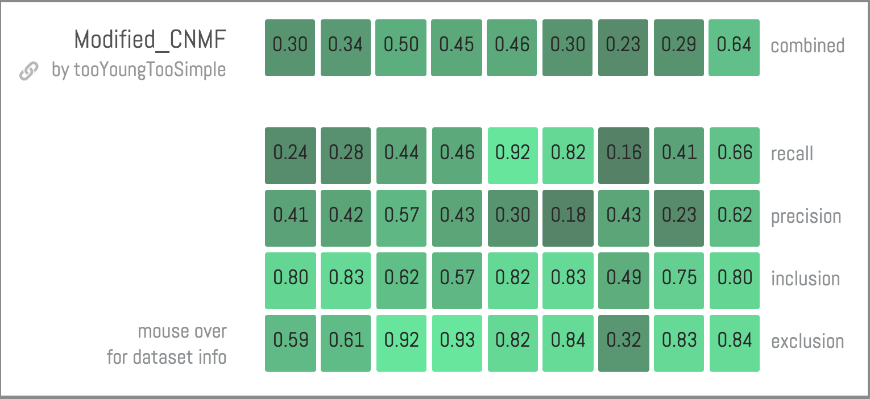
Results

Slide 9
Thank You !

