Slide 1
Object Recognition in Images
CSCI 8360: Data Science Practicum
Team Provectus
Dharmendra, Pranjay, Shubhi, Yash

Slide 2
The Problem
Recognise object in CIFAR-10 dataset images.
Each object belongs to one of 10 classes.
Images with 32 * 32 resolution. 50,000 Train and 10,000 Test instances.

Slide 3
Frameworks we used
CNN on the following
Tensorflow (easy on CPU, difficult on GPU)
MXNet (easy on both CPU and GPU)
Keras with Tensorflow backend (no GPU support)
DeepLearning4J (just explored, didn’t work, documentation was not easy to understand)

Slide 4
Building the Network
We built initial “small” network with one convolutional layer, one dense layer and a softmax output layer.
Accuracy went on decreasing as we added more layers.
Understood the role of Dropout, max-pooling, number of epochs, optimizer, Image Augmentation in CNNs.

Slide 5
Building the Network
Used many optimizers, AdaGrad worked.
Tensorflow on Multi-GPU: TF Record Format, images need to be converted to this format first.
Epoch time reduced due to the use of batch runner in tensorflow.

Slide 6
Challenges deep-dive
Challenge 1
Challenge 2
Challenge 3
Understanding CNNs
All team members had little or no experience in CNNs. We had to understand how CNNs work and operate on images.
Developing Network Architecture
Coming up with the network architecture that worked the best and gave best accuracy.
Making everything work on GPU(s)
The code to make the model work on multi-gpu environment on Tensorflow consumed a lot of dev time.

Slide 7
What didn't work
Deeplearning4J
Parallel Convolutional Layers - Two parallel convolutional layers getting data from the say input layer

Slide 8
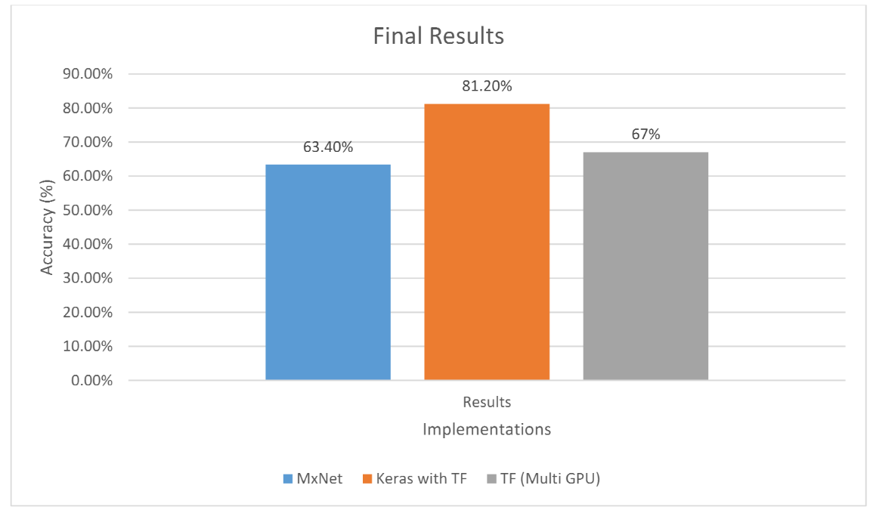
Results

Slide 9
Conclusions
Keras is a good framework, for starters.
Tensorflow allows us to have fined grained control.
MXNet can have better documentation, but is powerful if you have enough time to understand the framework, super fast.
Should have implemented a network based on some published work for improved performance.
Enjoyed a lot.

