Slide 1

From the Creators of

Slide 2

Snakes-in-the-Box™ Presents

Slide 3

See-Snake

Slide 4

DeepLearning4Java

Slide 5
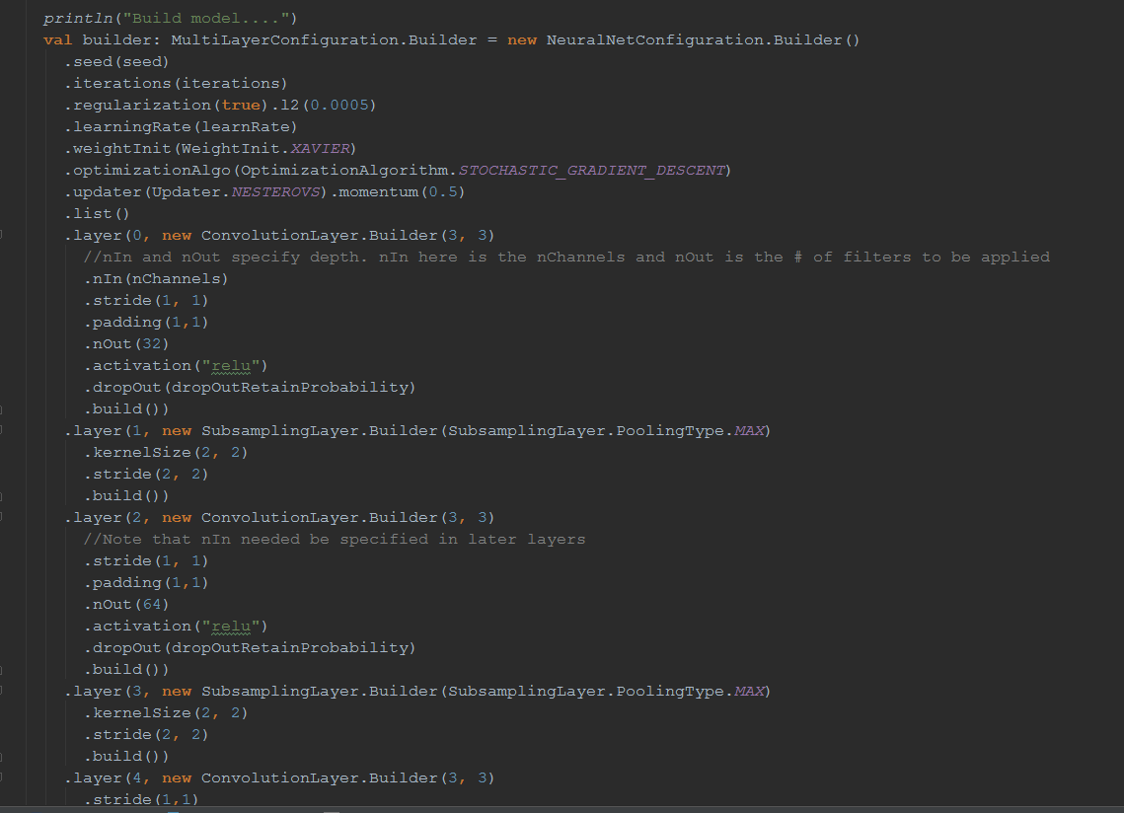
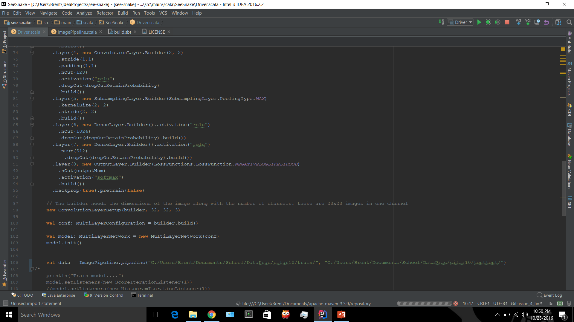

Slide 6
[error] (run-main-0) java.lang.IllegalStateException: Invalid input configuration (layer name = "null") for height: inHeight=15, kernelH=2, padH=0, strideH=2; (15-2+2*0)/2 is not an integer
java.lang.IllegalStateException: Invalid input configuration (layer name = "null") for height: inHeight=15, kernelH=2, padH=0, strideH=2; (15-2+2*0)/2 is not an integer
at org.deeplearning4j.nn.conf.layers.InputTypeUtil.getOutputTypeCnnLayers(InputTypeUtil.java:45)
at org.deeplearning4j.nn.conf.layers.SubsamplingLayer.getOutputType(SubsamplingLayer.java:85)
at org.deeplearning4j.nn.conf.MultiLayerConfiguration$Builder.build(MultiLayerConfiguration.java:432)
at org.deeplearning4j.nn.conf.NeuralNetConfiguration$ListBuilder.build(NeuralNetConfiguration.java:223)
at SeeSnake.Driver$.main(Driver.scala:118)
at SeeSnake.Driver.main(Driver.scala)
at sun.reflect.NativeMethodAccessorImpl.invoke0(Native Method)
at sun.reflect.NativeMethodAccessorImpl.invoke(NativeMethodAccessorImpl.java:62)
at sun.reflect.DelegatingMethodAccessorImpl.invoke(DelegatingMethodAccessorImpl.java:43)
at java.lang.reflect.Method.invoke(Method.java:497)
[trace] Stack trace suppressed: run last compile:run for the full output.
java.lang.RuntimeException: Nonzero exit code: 1
at scala.sys.package$.error(package.scala:27)
[trace] Stack trace suppressed: run last compile:run for the full output.
[error] (compile:run) Nonzero exit code: 1
[error] Total time: 8 s, completed Oct 8, 2016 7:26:41 PM

Slide 7
def pipeline(path:String):DataSetIterator =
try {
val parentDir: File = new File(path)
val filesInDir: FileSplit = new FileSplit(parentDir, allowedExtensions)
val labelMaker: ParentPathLabelGenerator = new ParentPathLabelGenerator()
val pathFilter: BalancedPathFilter = new BalancedPathFilter(randNumGen, allowedExtensions, labelMaker)
val filesInDirSplit: Array[InputSplit] = filesInDir.sample(pathFilter, 100, 0)
val record: ImageRecordReader = new ImageRecordReader(height, width, channels, labelMaker)
record.initialize(filesInDirSplit(0))
val data: DataSetIterator = new RecordReaderDataSetIterator(record, 10, 1, outputNum)
data
} catch {
case ex:Exception => println(ex.toString)
System.exit(-1)
return null
}
}

Slide 8
Weird Cuda Thing

Slide 9
Documentation = Necessary

