Slide 1
Neuro finder project
Csci8360 project4
Team ChickenBurger
Mojtaba, Bahaa, Shawn, Priyanka and Yang

Slide 2
Online:
Introductions to this problem
Picture and video demos
Methods of choice
nmf/Cnmf with post-merging
network
4) Results
5) Q and As

Slide 3
Distributed CNMF
A spark cluster of 3 nodes
Preprocess the images with erosion and median filters size 3x3
Grid search over different:
K: range(1,15)
Overlap: (0.1,0.05,0.04,0.03,0.02,0.01,0.001)
chunk size: (16,25,32)
Threshold: (.15,.25,.35)
Sigma: (3,5,7)

Slide 4
Distributed CNMF - Post Merging
Stochastic agglomerative grouping :
1-Randomly choose one region 2- calculate the centroid distances to all other regions 3- merge with the closest region within a threshold Enhanced the best score we had by a tiny bit
Greedy agglomerative grouping didn’t perform any better

Slide 5
network approach
Original plan: Stateful Convolutional LSTM over patches of 64x64: Input: ~3k 64x64 patches (over time) output: the corresponding patch constructed from the json file
ie , one label per ~3k inputs
out
BOS
LSTM
LSTM
LSTM
LSTM
...
Conv net
Conv net
Conv net
EOS
Input
@1
Input
@2
Input
@3k

Slide 6
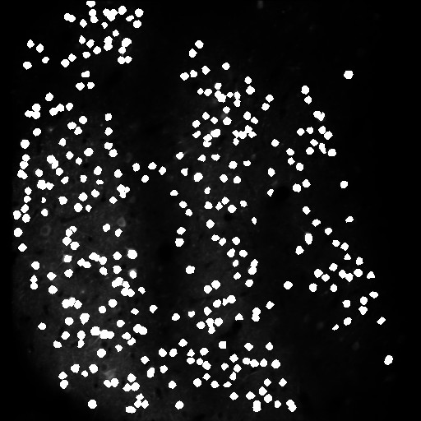
Know our data and target:
The merged image between
Ground truth .json file with 00.00
vid

Slide 7
network approach - stateful
Issues: too big to do one forward-backward iteration
Workarounds:
Avg all 3k => neurons that fire very infrequently get discarded Sampling from ~3k => misrepresentation of state transitions Smart sampling: after eroding, group similar patches through time (~ run length encoding) => still too big ~400 patches

Slide 8

network approach
Stateless approach: Generate a true “label” for each time patch: Given a patch in some time frame: Erode => mask with json patch=> dilate 4 times=> mask again => threshold
Original eroded mskd+dil mskd+thrsh mask(json) NN Input NN label

Slide 9
network approach - stateless cont’d
Advantages: One patch one label (simple feedfwd) label preparation can be done image-wide (one time frame one Disadvantages: Output is also ~3k patches over time, simple averaging is suboptimal Need to train another NN on top to map to full json label
Can be seen as denoising then aggregation

Slide 10


network approach - stateless cont’d
Architecture choice:
Successive layers of conv with padding to keep the dims the same Experimented with different number of layers and filters
Very long time to train because of I/O for swapping patches

Slide 11
network approach - stateless cont’d
Resnet approach:
Since the output patch should very much resemble the input patch and the human eye can make out the neurons:
Network is just to denoise: Output = Input + modifications
ResNet!
Experimented with different Architectures output = input + delta
Res nodes
delta
Initial conv
input
out

Slide 12
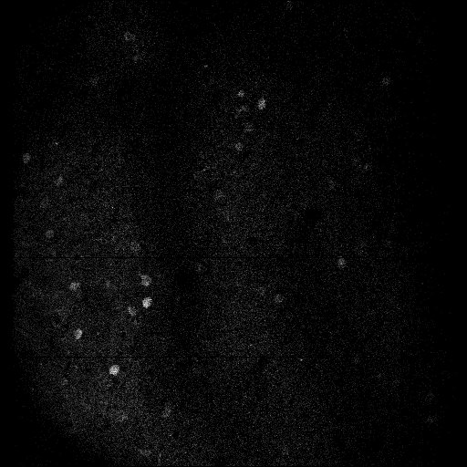
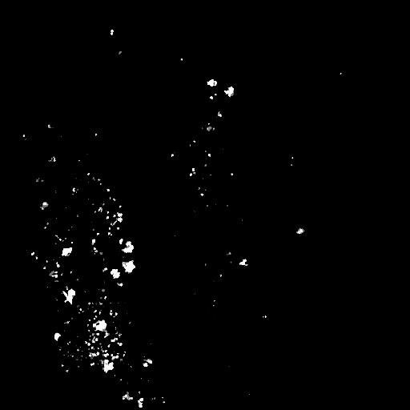
Using model to predict
Normalized image00067 from 00.00 Predicted

Slide 13

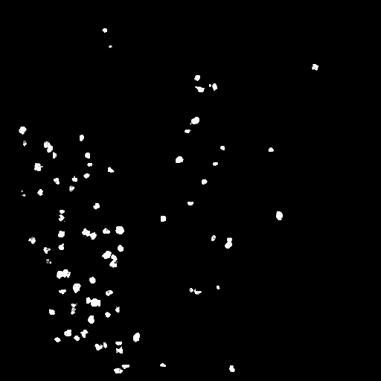
Results of our Resnet
Normalized image00067 from 00.00 True

Slide 14
network approach - resnet
Issues and suggestions Training still takes exorbitant amount of time (I/O) => not do 64x64 and downsample the whole image 512x512 to 128x128 and upsample again.
Zero Padding=>manual mirror padding 512x512 => 514x514 Keras and TF are not memory efficient, limiting the architectures options=> considering distributed mxnet
Resnet through time (~LSTM)
Applying post processing and post-merging

