Slide 1
Neuron Finder
Team Provectus
Dharamendra Kumar
Pranjay Patil
Shubhi Jain
Yash Shrivastava

Slide 2
Project Specifications
Language
Python 2.7
Applications
Apache Spark 2.0
Thunder 1.4

Slide 3
Project Specifications
Problem Statement
The problem is identifying neurons in a time-series image dataset. This can best be described as object-finding or image segmentation
Approach
We decided to use Image Registration and Source Extraction using Non-Negative Matrix Factorization.

Slide 4
Implementation flow
Reading TIF Images
Applying Gaussian Filter
Image Registration
NMF and Extraction of Spatial Regions
Merging of Regions using KNN

Slide 5
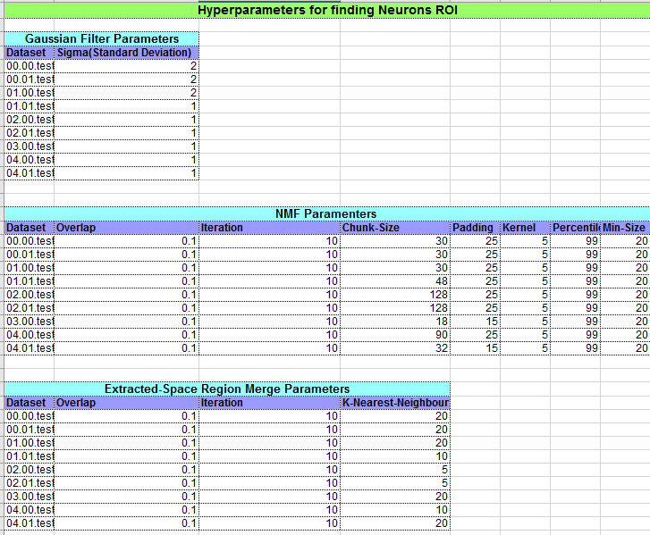

Slide 6
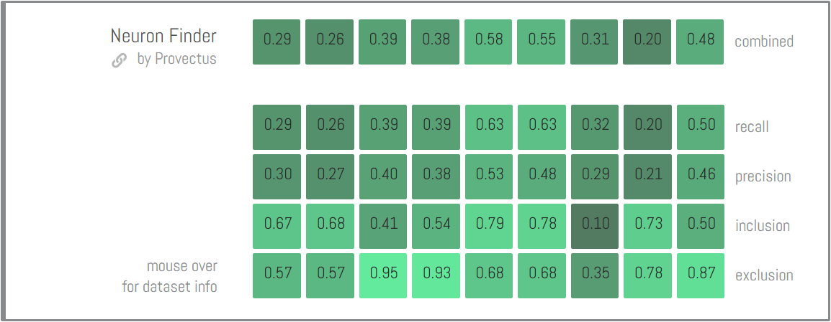
Results

Slide 7
Questions?

