Slide 1
Neuron Finder
Team Name: minions
Team Members: Chirag Jain, Sharmin Pathan

Slide 2
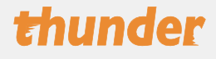
Thunder
Analysis of Image and time series in python
Analyses in Thunder are designed to scale to very large data sets through the distributed computing engine Spark

Slide 3
Preprocessing
Structured matrix factorization approach
Demix spatially overlapping regions
Denoise and deconvolve spiking activity
Median Filtering
Converting to grayscale

Slide 4
NMF(Non-negative matrix factorization)
Spatiotemporal fluorescence activity as a product of two matrices: a spatial matrix that encodes location of each neuron, and a temporal matrix that characterizes the calcium concentration of each neuron over time.
Constructed using following attributes:
k=5
max_iter=50
percentile=99
overlap=0.1

Slide 5
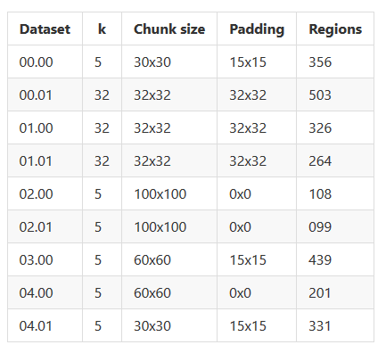
Tuning the accuracy

Slide 6
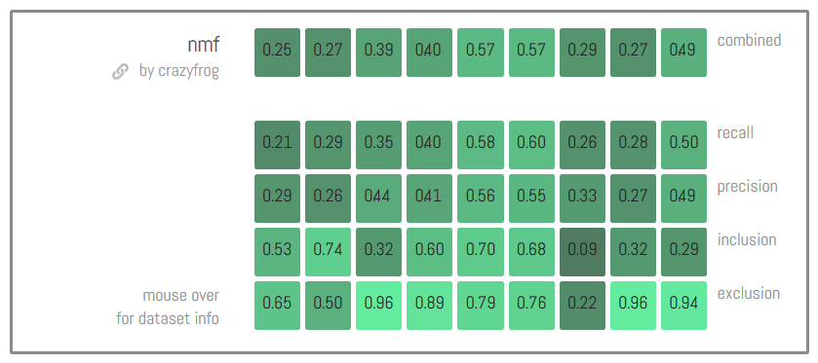
Performance
Best precision on Autolab

Slide 7
Stuff we tried
Image Registration

Slide 8
Thank you!

