Slide 1
Data Science Practicum
Spring 2019 Wrap-up Lecture

Slide 2
Outline
Some fun stats
Course feedback
Wrap-up

Slide 3
Commits
2,013 commits
5,851,325 additions, 956,094 deletions
4,895,231 new lines of code

Slide 4
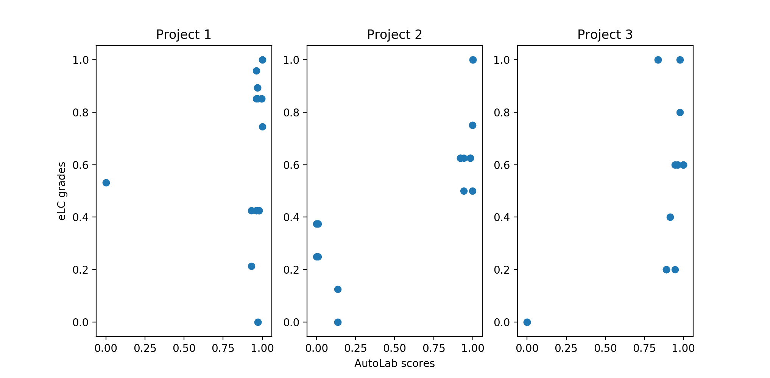
Normalized Project Performance
Takeaway:
Good AutoLab performance != High marks

Slide 5
Takeaways
Reuseability is critical in academia and industry frameworks
Documentation
READMEs
Comments
Development process (Issues, Pull Requests, Gitter/Slack/Listservs)
The real world operates in teams
Reusability + teamwork = effective communication is absolutely essential
More important than Kaggle leaderboard position (what’s the point if only you can understand it)
More important than raw coding talent (raw coding talent is dime/dozen)

Slide 6
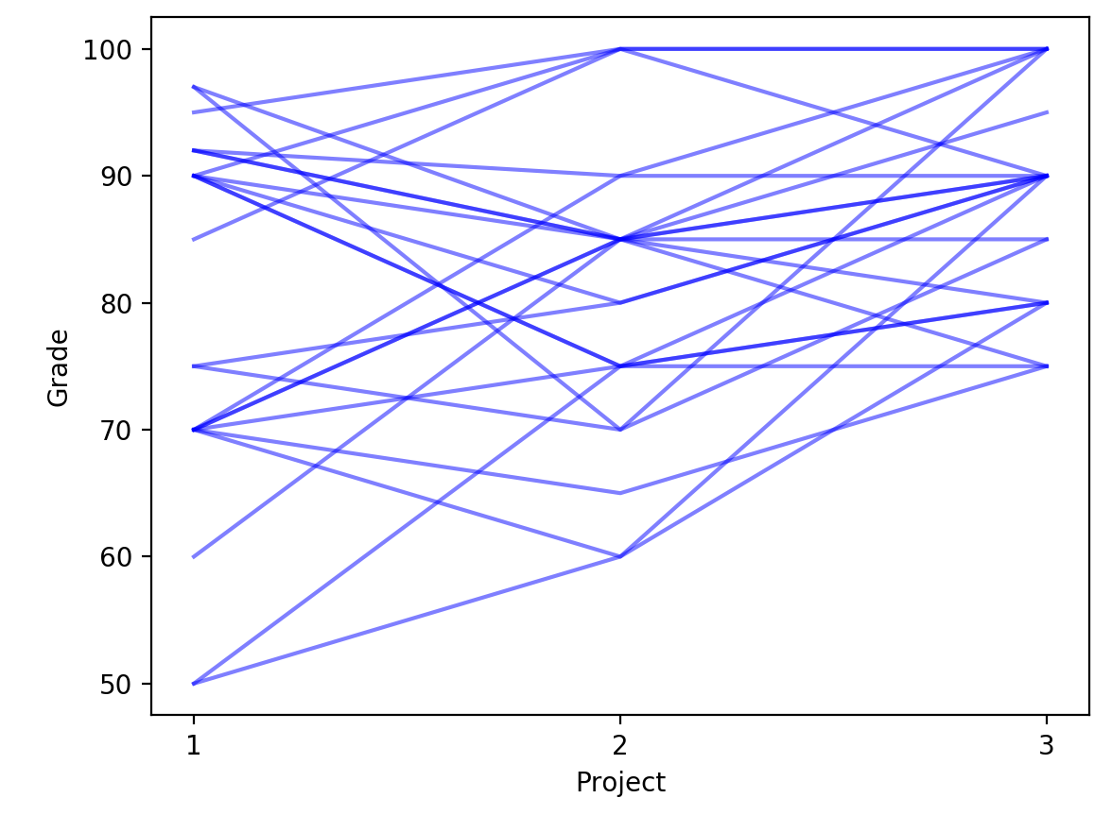
Individual Grade Progression
Takeaway:
Improvement over time!

Slide 7
Feedback
Activity time!
Three categories of feedback:
STOP: What would you remove or eliminate from the course?
START: What would you add to the course?
CONTINUE: What would you keep or retain that is already present in the course?
Individually, write down one item for each category (5 minutes)
Get in groups and develop a consensus list (10 minutes)

Slide 8
Feedback
My thoughts
Your thoughts
STOP
Two computer vision projects is too much
START
New category of projects like unsupervised clustering, matrix factorization, reinforcement learning
CONTINUE
Project 0 (maybe extend in length a tad)
Project feedback forms
Notes:
I haven’t computed the distribution of commits by time, but from observing: no matter how long you have to start the project, 75% of people start in the last 1.5 weeks
- played out in each project (2-3 weeks each)
- played out in the final project (5 weeks)
Hence my hesitation to go to 3 projects vs 4

Slide 9
Other Thoughts
Teams aren’t going anywhere
Lectures will be tweaked for additional background knowledge
Also, 3360 Data Science I is proposed to become a 4000/6000 course to allow graduate enrollment
When that happens, DS1 will be a required prerequisite to 8360 (no more “toughing it out”)
Switch from Spark to dask
Submit programs to AutoLab, rather than just predictions
EXTRA CREDIT: By midnight, April 26, propose a new project idea. Needs:
A clear, unambiguous ground-truth (or evaluation metric) to put in AutoLab
An openly available dataset (or one that can be acquired, e.g., CodeNeuro or cilia)
Can achieve a reasonable solution in 2-3 weeks
Up to 5 points on your final grade
Notes:
Spark to dask would vastly simplify the projects, also give us a cutting-edge framework
- doesn’t have any deep learning attached to it (yet)
- only available in Python

Slide 10
Other thoughts
Course evaluations!
http://eval.franklin.uga.edu/

Slide 11
Final Presentations
Tuesday, April 23
Gormogon
Mangalyan
Wednesday, April 24
Squadron
Abhishek, Anant, Priyank
Thursday, April 25
Natus Vincere
MH
Einstein
Tuesday, April 30
Abolfazl, Jonathan, Saed
Jupiter
Bestfitter
Friday, May 3, 11:59pm: ALL PROJECT MATERIALS DUE

Slide 12
Final notes
Raw scores aren’t everything
…but they’re a reasonable indicator
Balance exploration (examining the data, testing multiple approaches) with exploitation (designing, testing, and documenting a complete pipeline)
Corollary: start early!!!!!!!!!!!!!!!!!!!!!!!!!!!!!!!!
Communicate. Communicate. Communicate.
Questions?

Slide 13
Thank you!

