Slide 1
CSCI 8360 Team Booth P3 Abhishek Chatrath Priyank Malviya Jonathan Myers

Slide 2
NMF and Image Normalization
Download all images
Thunder-Extraction:
- NMF Calculation to build model
- Fit model to image using size and padding
- Merge models together
- Derive results for regions defined
CV2:
- Normalize all images
Combine results for submission

Slide 3
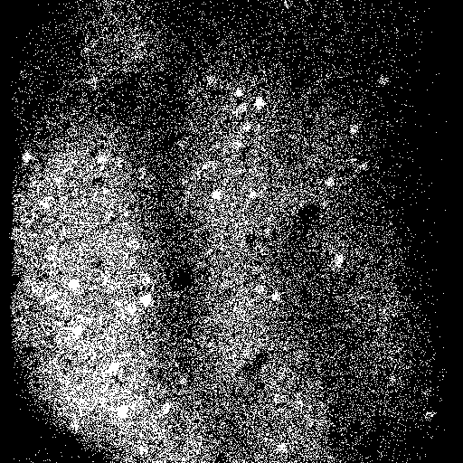

Idea – Find Consistency in Images
Eliminate Shades
Compare successive images (ex. 5) with AND operation on pixels
Apply blurFilter to resulting image
Split image into distinct images based on content
Eliminate images contained predominantly in other images
Derive rings by circling remaining images

