Slide 1
CSCI 8360: Neuron Finding Team Lovelace
Denish khetan
Jayant parashar
Vishakha atole

Slide 2
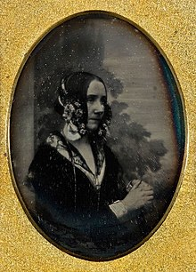
We believe that our group was named after – Ada Lovelace (1815-1852)
She was an English mathematician , who was first to recognize the power of computing machine and considered one of the first computer programmers.

Slide 3
Techniques Implemented
Unets
Our unets implementation was not complete due to “Mask to regions” issue. We tried some methods, but they missed many regions in even the masks generated from training regions.
NMF
Non negative matrix factorization is a technique we all know is unusually good at this problem.

Slide 4
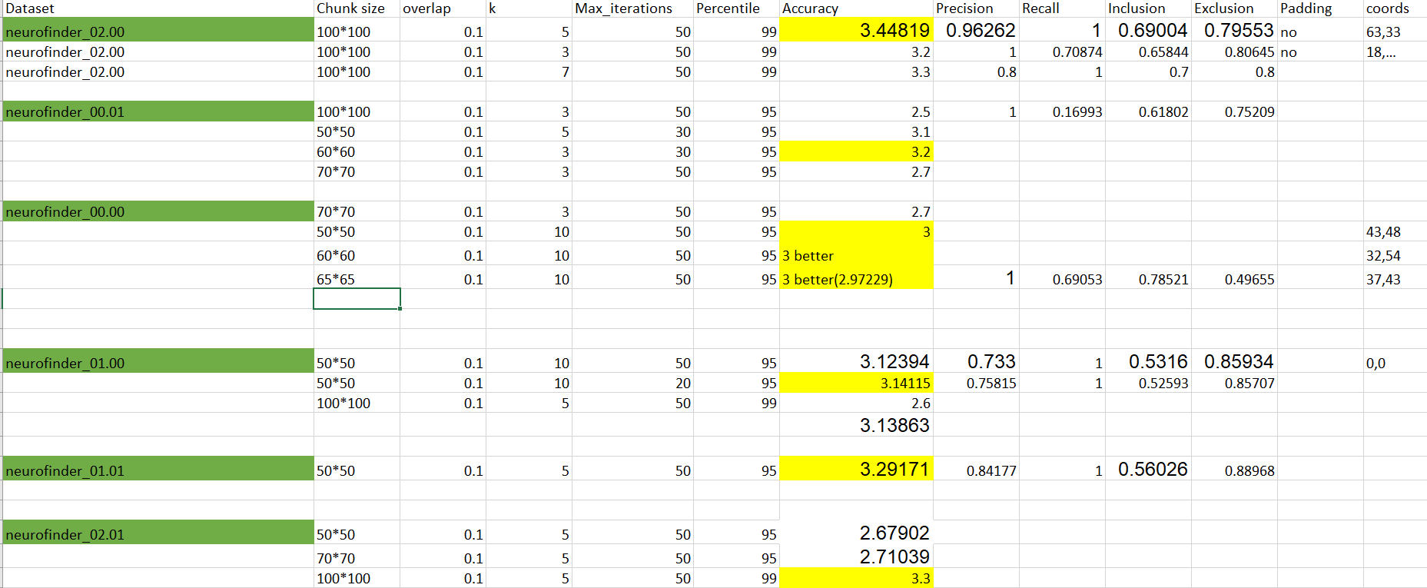
Experiments with NMF

Slide 5
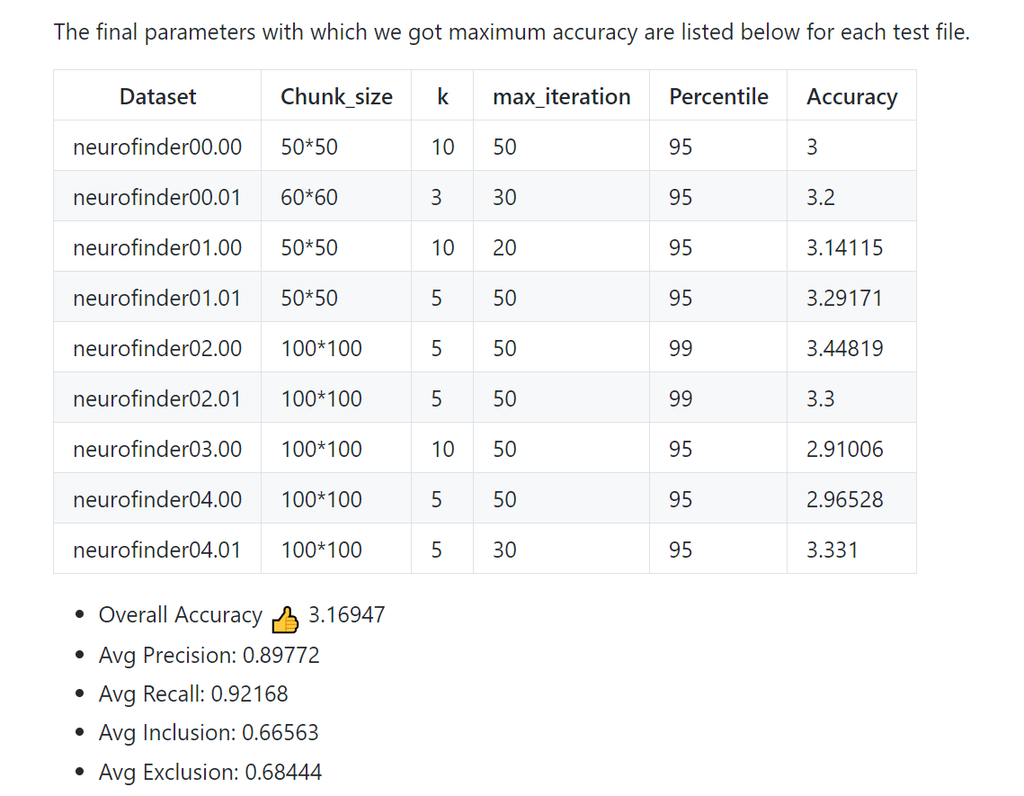

Slide 6
Thank You !
Any Questions?

