Slide 1


Neuron Finding
2019.4.3

Slide 2
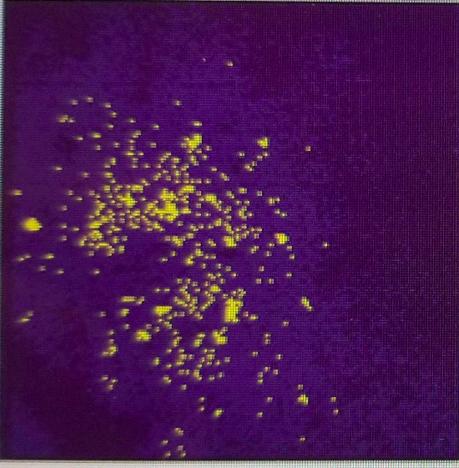
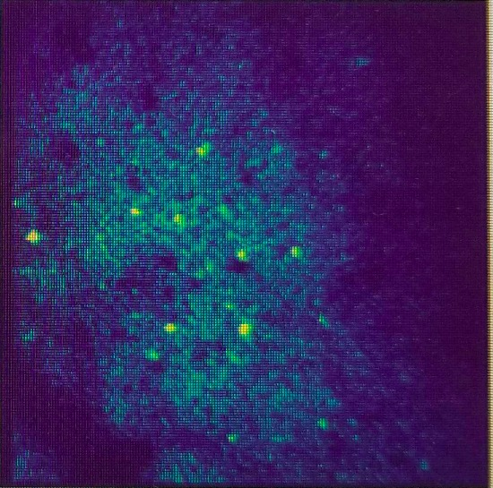
Data
Median Filter
Gaussian Filter

Slide 3
Method
NMF
Thunder-Extraction

Slide 4
NMF Flow
Use thunder library on dataset
NMF
Fit the model in our algorithm With various parameters
Transform and merge the overlapping coordinates.

Slide 5
NMF Flow Result
k | percentile | max_iter | overlap | score
10 | 98 | 50 | 0.1 | 3.00907
10 | 98 | 100 | 0.1 | 2.98822
10 | 97 | 50 | 0.1 | 2.96129
20 | 99 | 100 | 0.2 | 2.95583

Slide 6
Discussion
Threshold and Segmentation
Thunder Extraction
Watershed
Gaussian filter
Media filter
Ostu Threshold
Models
LSTM model, RNN deal with the sequence data.
Convert the file to a graph.
CNN
UNET
Notes:
Person of interest

Slide 7
Thank you !

