Slide 1

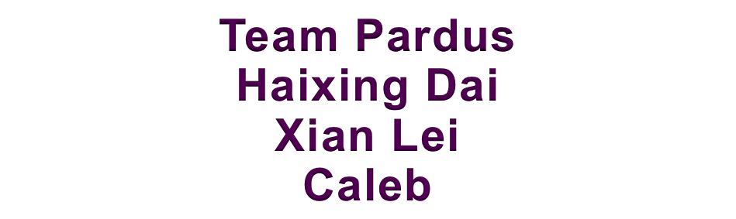
Malware Classification
2019.2.13

Slide 2
Feature Extraction
Content
Filesize
Malware Data
Tf-Idf
ngram

Slide 3
N-gram
Using small sample to gather useful n-gram
N-gram
Feature
Extract ngram list in data
Predict

Slide 4
N-gram
2 gram
256*256 2-gram
Filter
3 gram
6000 3-gram
Filter (WF > 5000)
4 gram
3000 4-gram
Filter (WF > 2000)

Slide 5
Models
1
Decision Tree Classifier
2
Random Forest Classifier
3
Extra Trees Classifier

Slide 6
Accuracy
 | Content | File-size | 2-gram | 3-gram | 4-gram | All-features | Best Solution
Accuracy | 30% | 80% | 92% | 97% | 99% | 96% | 99.2%

Slide 7
Future Discussion
Find more golden features
Asm Data
Word2vec
xg-boost to make a combined model
Using more models
LSTM model, RNN deal with the sequence data.
Convert the file to a graph.
Notes:
Person of interest

Slide 8
Thank you !

