Slide 1
Neuron Finding
Team Hopper
Aashish Yadavally, Caleb Crumley, Rutu Gandhi
CSCI8360 Data Science Practicum
Prof. Dr. S. Quinn

Slide 2
Task: Object Finding
Major challenges of the dataset:
Temporal
Large scale
Dark neurons

Slide 3
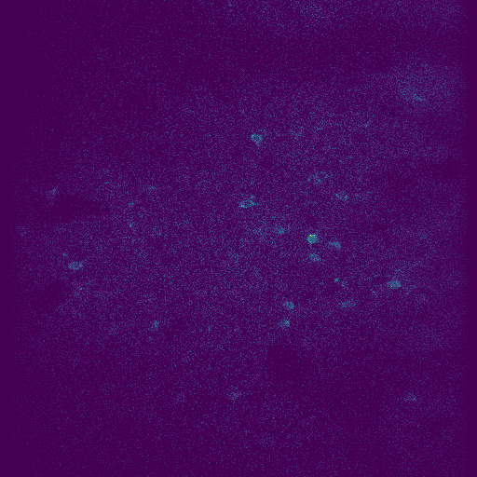
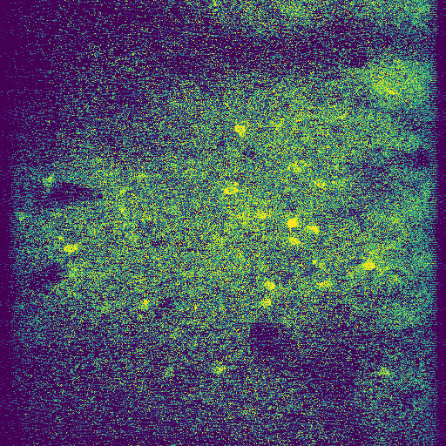
Preprocessing
Histogram Equalization was used to bring out the contrast between darker areas and lighter areas of the image.
Creates one histogram to redistribute the pixel values.
Also used Adaptive Histogram Equalization (not pictured) that creates many histograms per different areas of the image.
Original
Histogram Equalization

Slide 4
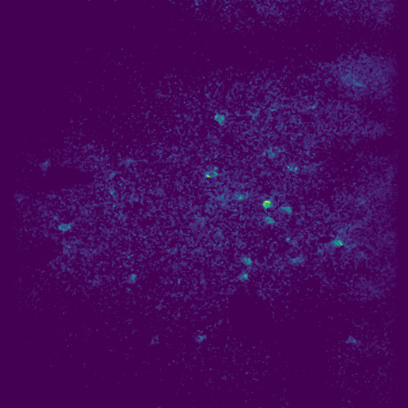
Preprocessing
Median and Gaussian filtering to reduce the noise in the image.
The idea was it would bring out the dormant neurons more
Original
Median Filter

Slide 5
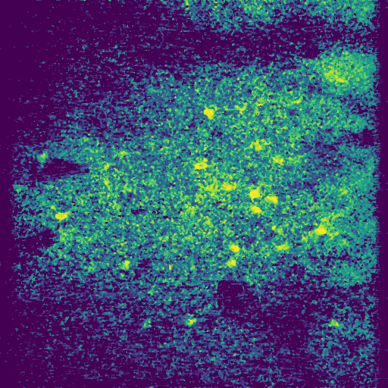
Preprocessing
We even tried to combine the two techniques.
The idea here was that the filter would help in reducing the noise that was brought out by the histogram equalization
Original
Histogram equalization and Median filtering

Slide 6
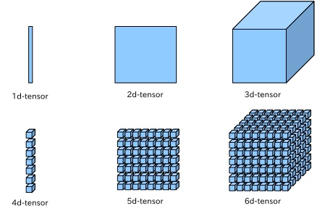
UNet
Used the 3D version of all layers (Conv3D, UpSampling3D, MaxPooling3D)
Sampled frames from videos and treated it as an image segmentation problem
Input: 5D tensor with shape:
(batch, conv_dim1, conv_dim2, conv_dim3, channels)
2) Sampled some frames and treated the data as images instead of videos

Slide 7
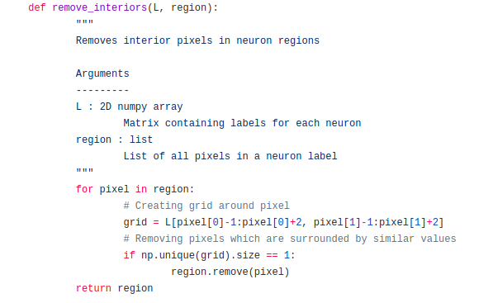
Mask to Region conversion
Used Matlab’s bwbackground for this conversion using pymatbridge
The interiors were removed using the following:

Slide 8
SparsePCA
SparsePCA is popularly used for foreground-background separation
We subclassed the thunder API and modified it to use this.
A particular disadvantage of ordinary PCA is that the principal components are usually linear combinations of all input variables. Sparse PCA overcomes this disadvantage by finding linear combinations that contain just a few input variables.

Slide 9
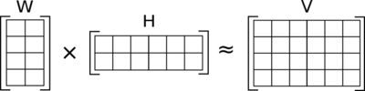
NMF
Factorization algorithm
The problem is not exactly solvable in general, it is commonly approximated numerically.

Slide 10
Metrics
Recall: TP/TP+FN
Precision: TP/ TP+FP
Inclusion: Number of intersecting pixels divided by the number of total pixels in
the ground-truth regions
Exclusion: Number of intersecting pixels divided by the number of total pixels in
your regions

Slide 11
NMF
k (components): If this is not set, all features are kept. k number of features are used for identifying similar data. Seems to have an effect on the recall. Recall answers the question: What proportion of actual positives was identified correctly?
More number of features = more accurate predictions
percentile: thresholding ( higher the percentile lower the number of features being considered). It directly affects Inclusion and can have an effect on Exclusion in terms of number of intersecting regions.

Slide 12
What we learned
Ethical Implications
These questions are important to address before the project, and can shape how the project is setup and how the data is collected.
Its needed to address the alternative applications of this model and results.
Even though improving the accuracy of the model is the goal, checking if there exist and disparate errors is a necessity
Assuring that the summary statistics and metrics used that appropriate for the research project.
Better software engineering techniques
Unit testing and test cases
Addressing a solid directory structure before the project takes off
Testing the span of the applications

