Slide 1

Malware Classification
Team Anthony: Zhongliang Zhou, Shivam Chandan ,Nathan Wynn

Slide 2

The good:
Our team was able to achieve 99.55% accuracy(98.2 on Autolab rankings)
We are able to examine many features and model structures

Slide 3
The bad:
Covid 19
Time was lost many time to find the correct approach
Sometimes a bit frustrating

Slide 4
Learning:
Using GCP
Naïve Bayes
Random Forest
Py Spark Experience

Slide 5
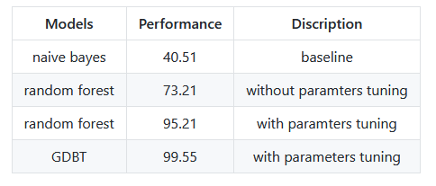
Results:

