Slide 1

Elastic Computing Crash Course
CSCI 8360 Data Science Practicum

Slide 2
GCP and AWS
From Google and Amazon, respectively

Slide 3

Google Cloud Platform
https://cloud.google.com/

Slide 4
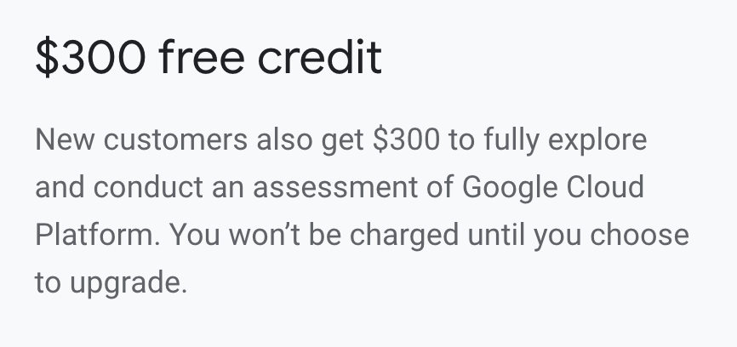
GCP: New “customers”
If you’ve never used GCP before, you are entitled to a one-time $300 credit!
Look into this before you redeem your class credits

Slide 5
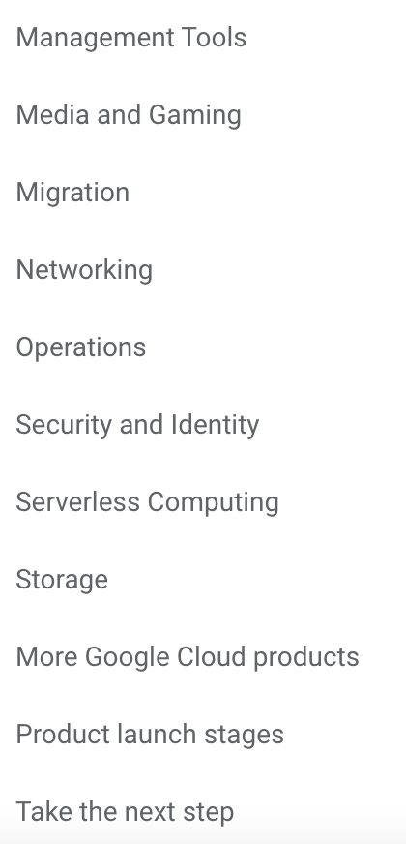
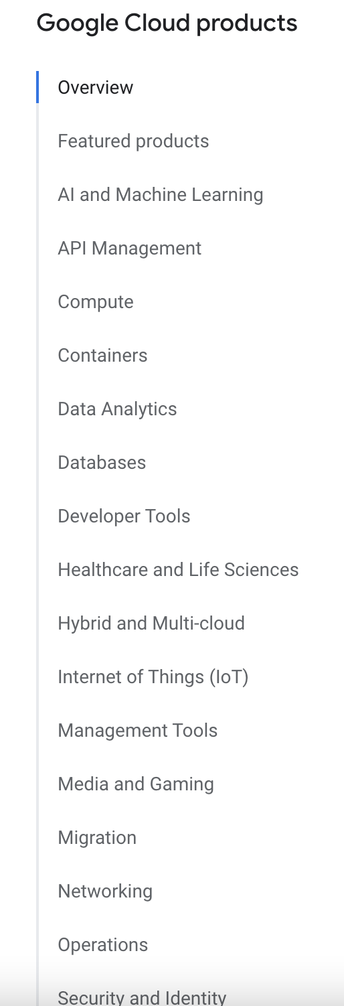
GCP Product Lineup

Slide 6
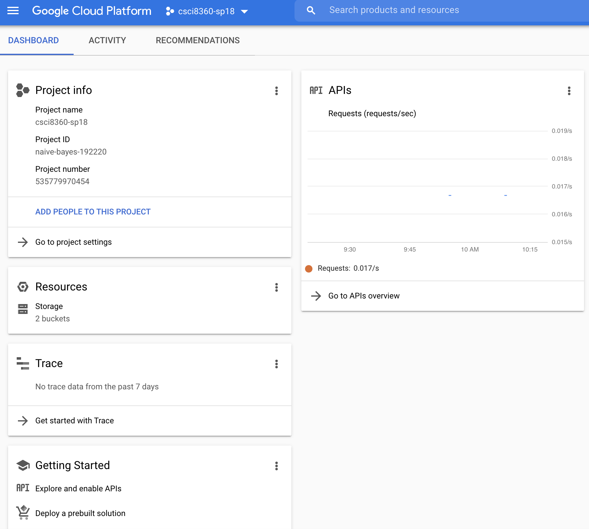
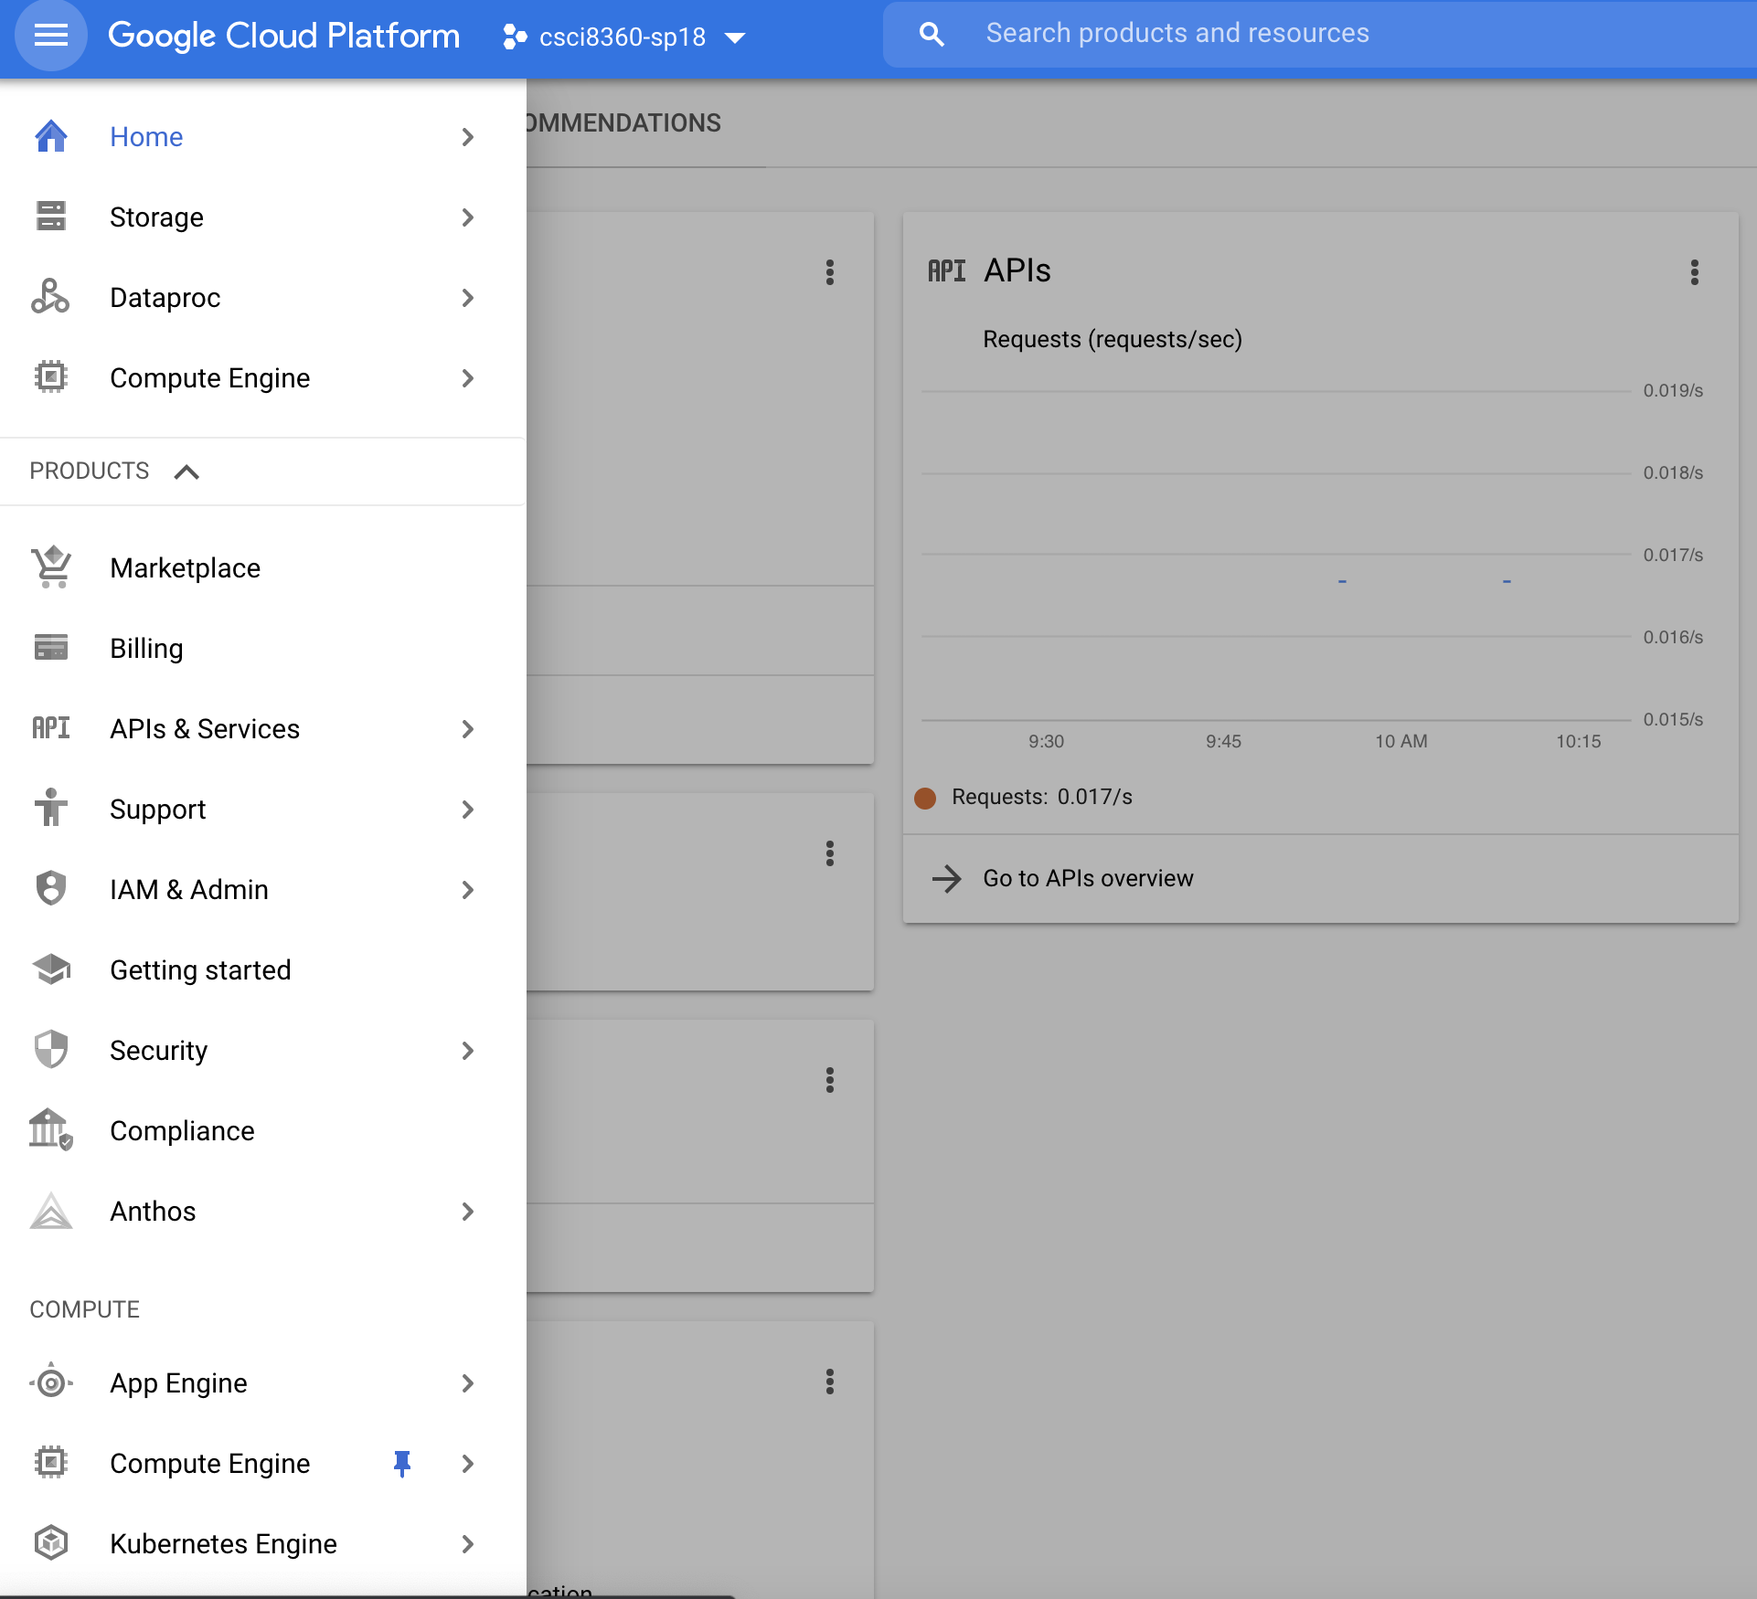
Google Dashboard
Heads-up display of your active projects and their usage, billing, and associated resources
Sidebar for *all* GCP products, quicklink-able

Slide 7
GCP Compute Engine
This is your generic “virtual compute instances” product
Different VM templates optimized for different tasks (and priced accordingly)
General-purpose compute
Compute-optimized (high CPU count)
Memory-optimized (high RAM)
Storage-optimized (large SSD/HDD)
GPU instances

Slide 8
GCP Compute Engine
Each compute instance has a (1) region, and an (2) hourly rate
Region denotes the physical geographic location of the VM
Probably want to stick with east coast VMs; latency is better
Rate denotes hourly cost of running the VM
60 minutes and 1 second is billed as 2 hours
Billed as long as the VM is on; does not need to be doing anything! Shut down your VMs when you are done to avoid extra charges

Slide 9
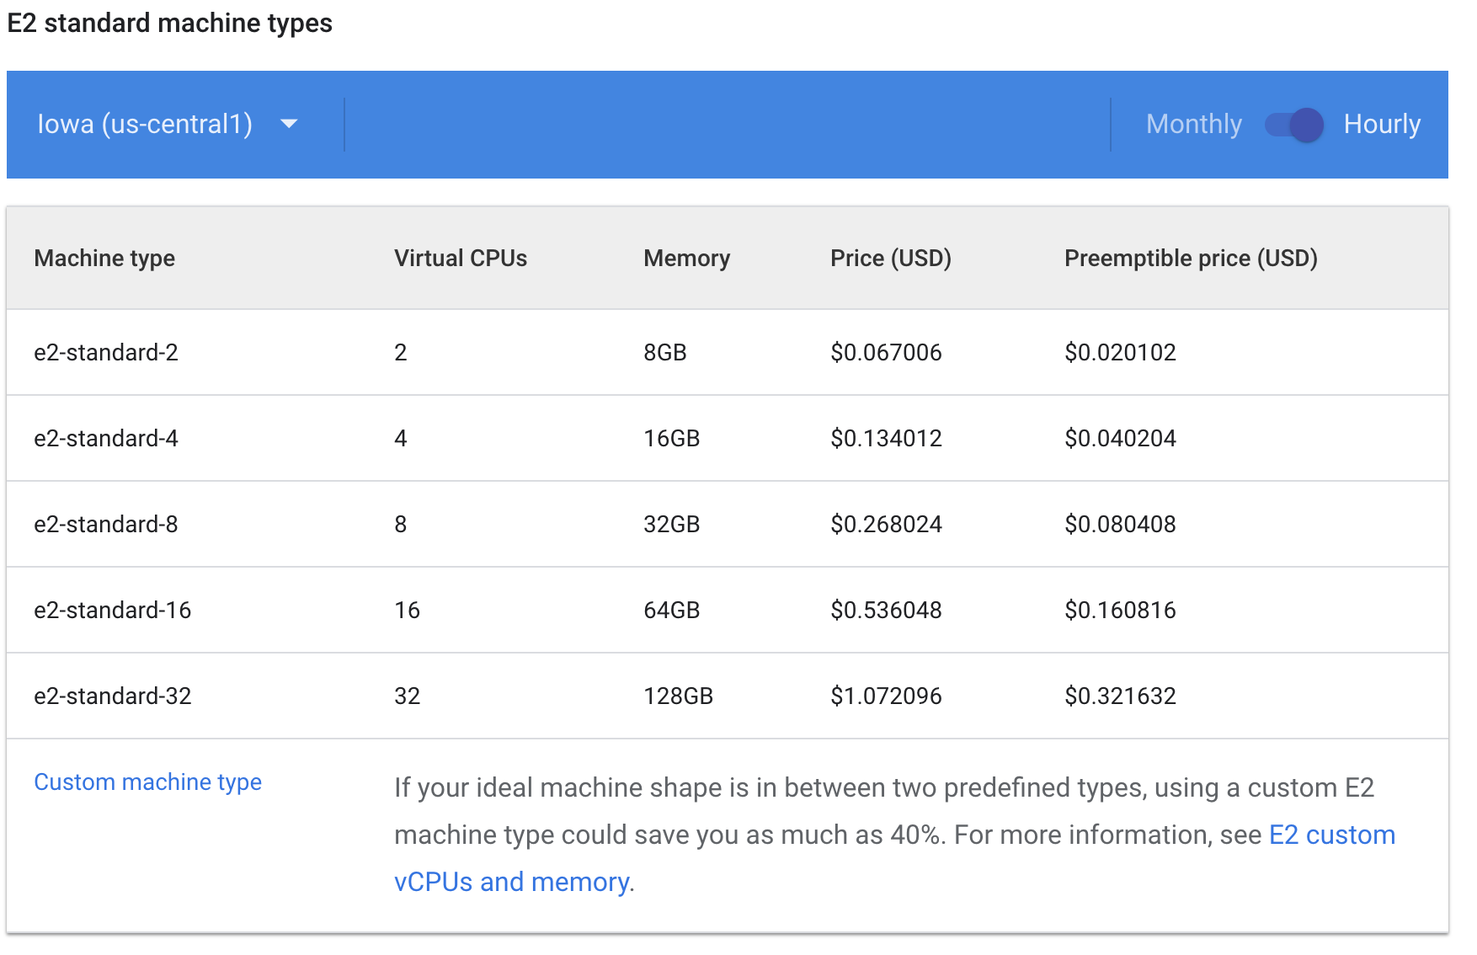
GCP Compute Engine

Slide 10
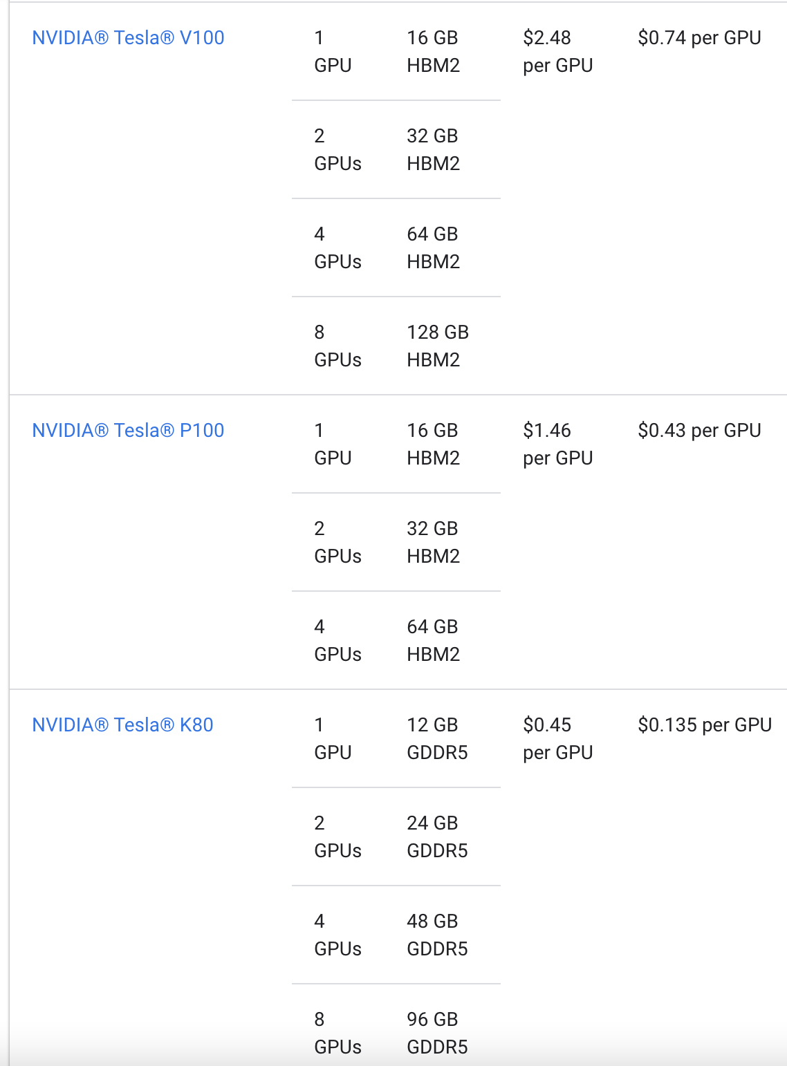
GCP Compute Engine
Note: GPUs are not cheap!
Keep this in mind for projects when you’re training deep learning models

Slide 11
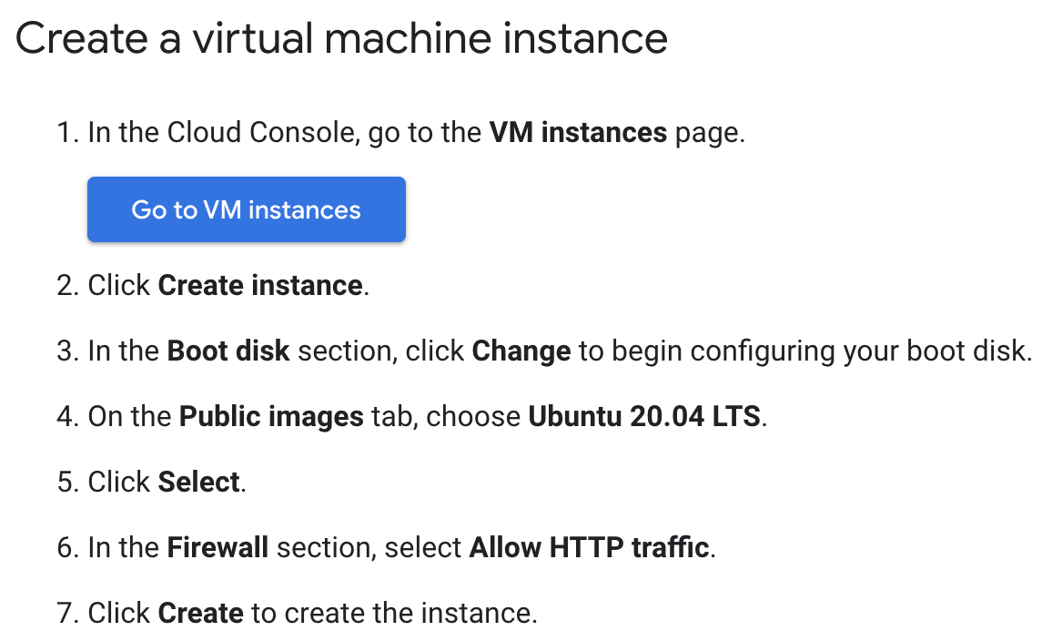
Build a VM

Slide 12
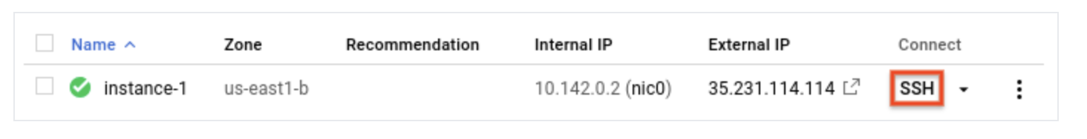
Build a VM
Once your VM is running, it should show up in your VM Instances dashboard
You can connect directly to it via SSH by clicking the icon
Once you’re done with the VM, delete it

Slide 13
VM Images
There is an entire library of public pre-built Compute Engine images available!
Look into these before you try to install Tensorflow / PyTorch from scratch!
Involves simply attaching an existing ”image” in the form of a storage disk to a brand-new VM

Slide 14
DataProc
This is where clusters are spun up and down
Also where jobs are executed on those clusters
“Hadoop-based clusters” – this is where Spark clusters are born!

Slide 15
Command line utilities
gcloud
gsutil
Interacting directly with GCP products
Spin up VM or cluster, manage instances
Delete clusters
Can do everything the web UI can and then some, but definitely harder to use
Low-level file management, permissions, access control
Useful for moving files around
pip-installable with easy environment integration and autocomplete

Slide 16
Need command line utility spin up dask clusters on DataProc
gcloud dataproc clusters create ${CLUSTER_NAME} \
--region ${REGION} \
--zone ${ZONE} \
--master-machine-type n1-standard-16 \
--worker-machine-type n1-standard-16 \
--image-version preview-ubuntu \
--optional-components JUPYTER \
--initialization-actions gs://goog-dataproc-initialization-actions-${REGION}/dask/dask.sh \
--metadata dask-runtime=yarn \
--enable-component-gateway
https://cloud.google.com/blog/products/data-analytics/improve-data-science-experience-using-scalable-python-data-processing

Slide 17

Amazon Web Services
https://aws.amazon.com/

Slide 18
Amazon Web Services
Home to CSCI 8360 in fall 2016
Moved to GCP after that, following some high-profile AWS key thefts from GitHub project repos O_O
DON’T PUT YOUR AUTH KEYS IN CODE THAT IS COMMITTED TO PUBLIC REPOS
Also moved to GCP because AWS places considerably less emphasis on education vs research ¯\_(ツ)_/¯

Slide 19
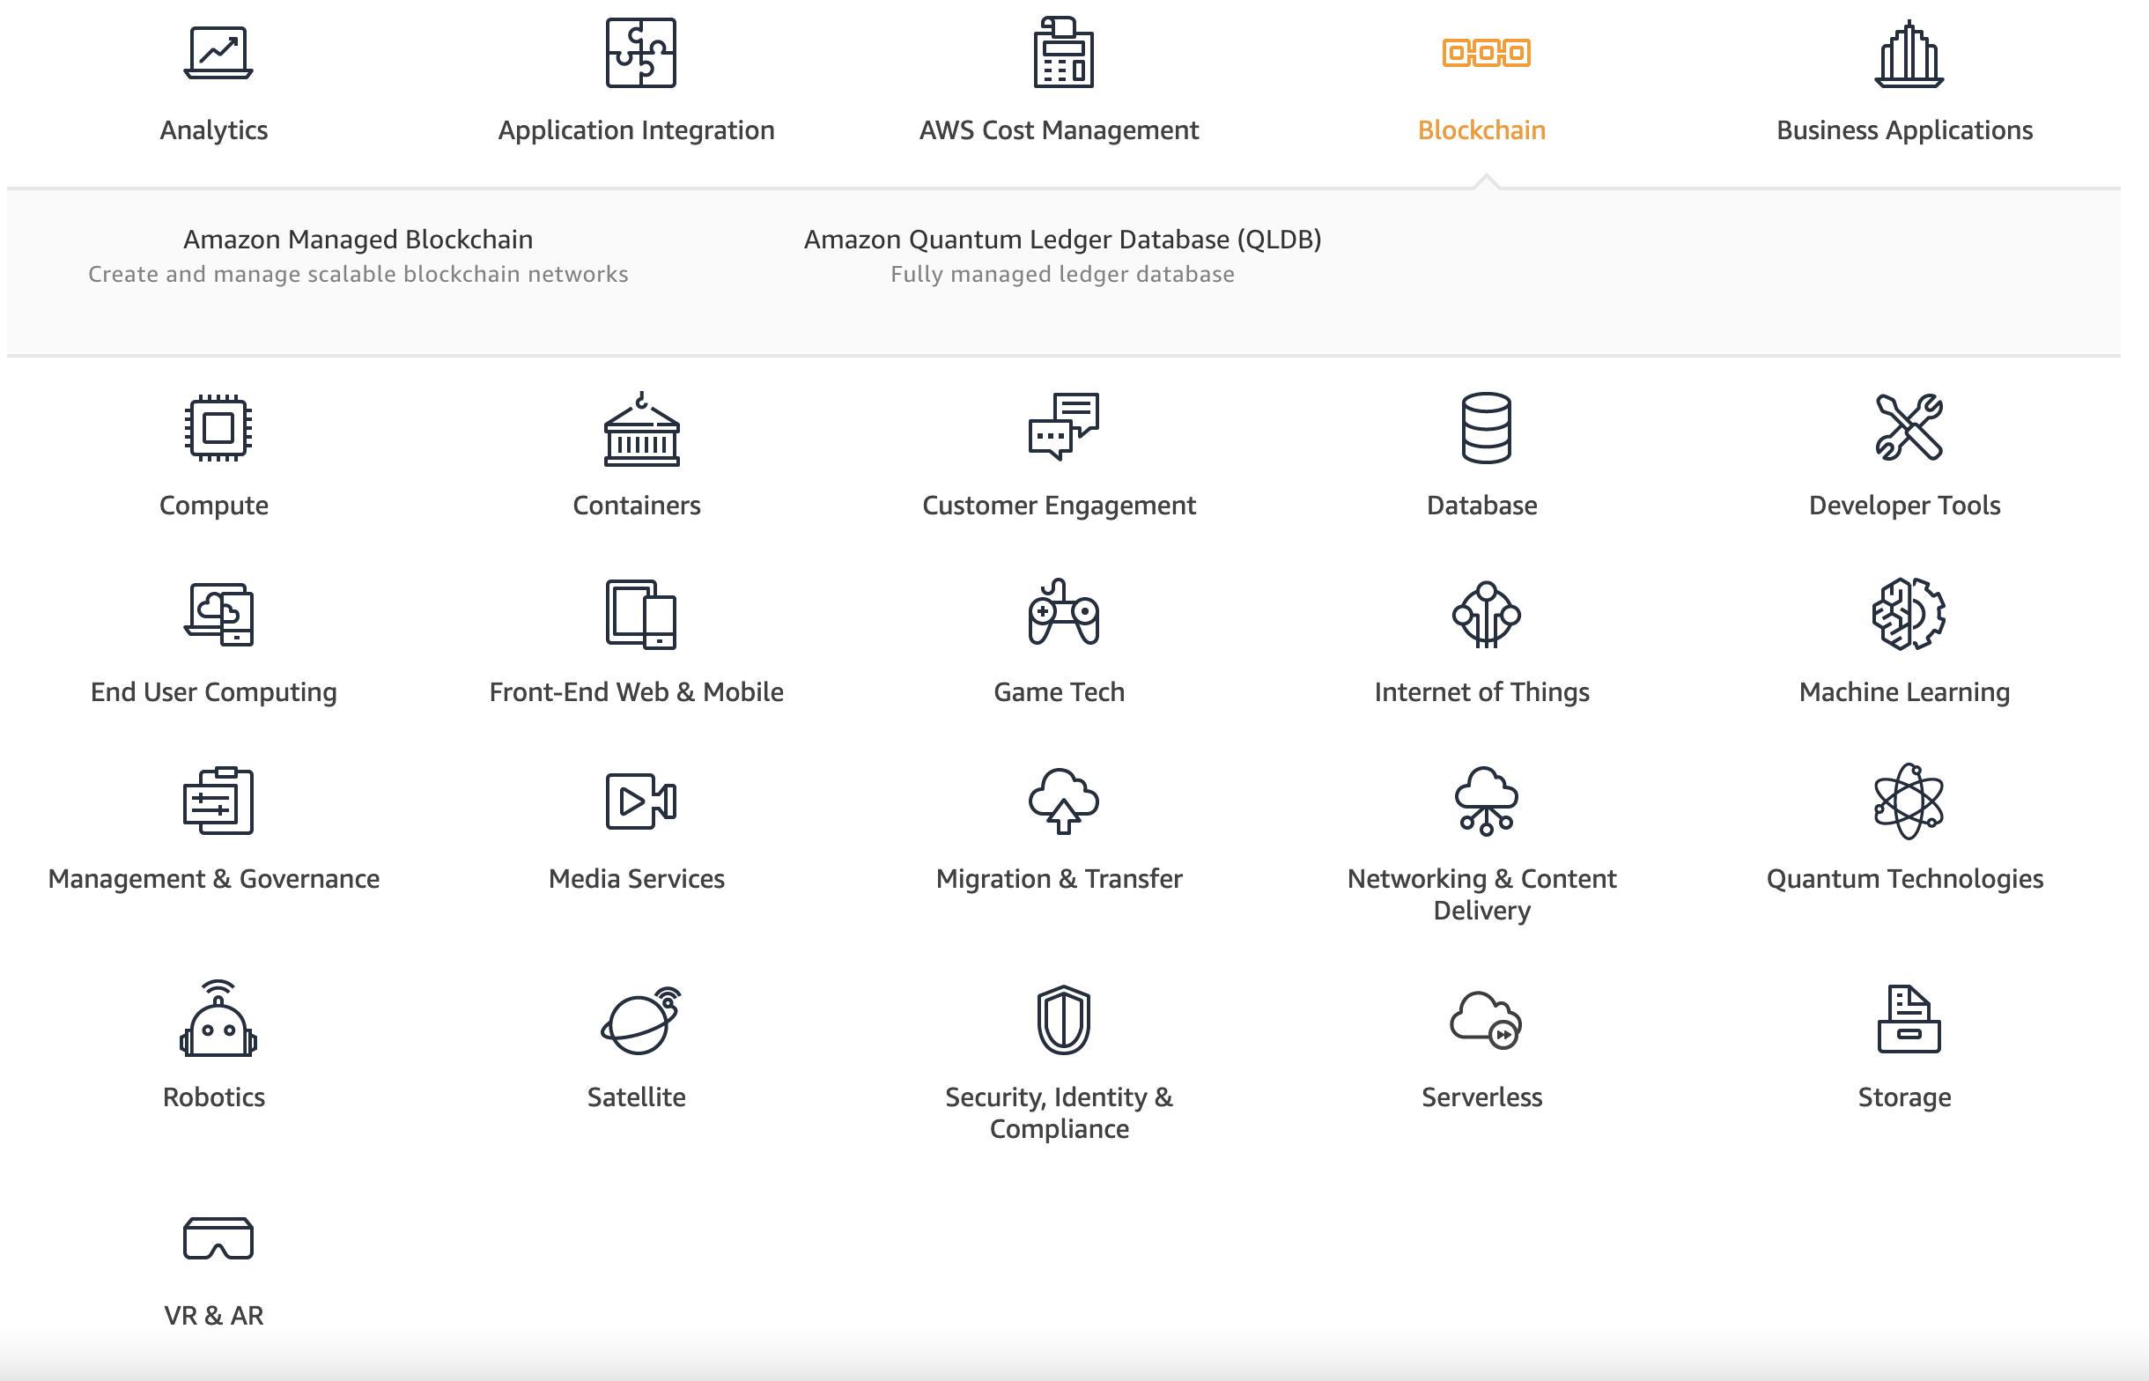
AWS Product Lineup
Comparable to GCP

Slide 20
AWS and GCP
Plenty of equivalencies between the two
GCP Compute Engine == AWS EC2 (Elastic Compute Cloud)
GCP DataProc == AWS EMR (Elastic MapReduce)
GCP Storage == AWS S3 (Simple Storage Solution)
GCP gcloud + gsutil == AWS awscli (also pip installable!)

Slide 21
CSCI 8360 GCP Storage
All datasets for DSP spring 2021 projects will be stored here:
gs://uga-dsp/

