Slide 1

Data Science Practicum
Spring 2021 Wrap-up Lecture

Slide 2
Outline
Some fun stats
Course feedback
Wrap-up

Slide 3
Commits
511 commits
2,771,822 additions, 186,181 deletions
2,585,641 new lines of code
* as of Wednesday, April 21 at 11:20am
Notes:
Spring 2019 stats:
2,013 commits
5,851,325 additions, 956,094 deletions
4,895,231 new lines of code

Slide 4
Takeaways
Reuseability is critical in academia and industry frameworks
Documentation
READMEs
Comments
Development process (Issues, Pull Requests, Gitter/Slack/Listservs)
The real world operates in teams
Reusability + teamwork = effective communication is absolutely essential
More important than Kaggle leaderboard position (what’s the point if only you can understand it)
More important than raw coding talent (raw coding talent is dime/dozen)

Slide 5
Feedback
Activity time!
Three categories of feedback:
STOP: What would you remove or eliminate from the course?
START: What would you add to the course?
CONTINUE: What would you keep or retain that is already present in the course?
Individually, write down one item for each category (5 minutes)
Get in groups and develop a consensus list (10 minutes)

Slide 6
Feedback
My thoughts
Your thoughts
STOP
GCP (maybe Azure?)
START
Self-proposed / self-organized final project (existed in Spring 2019, eliminated this semester due to COVID)
CONTINUE
Project peer feedback forms
Notes:
I haven’t computed the distribution of commits by time, but from observing: no matter how long you have to start the project, 75% of people start in the last 1.5 weeks
- played out in each project (2-3 weeks each)
- played out in the final project (5 weeks)
Hence my hesitation to go to 3 projects vs 4

Slide 7
Feedback
START
STOP
CONTINUE

Slide 8


Feedback From Spring 2019
STOP
Two computer vision projects is too much
Did both Neuron Segmentation (didn’t do this year) and Ciliary Segmentation (our P3) in Spring 2019
START
New category of projects like unsupervised clustering, matrix factorization, reinforcement learning
Almost got a StarCraft RL project working; ran out of time (but should be ready for next 8360)
Project peer feedback forms
Add Dask as an alternative to Spark
CONTINUE
Project 0 (maybe extend in length a tad)
From 1 week to 2 weeks

Slide 9
Other Thoughts
Teams aren’t going anywhere
Lectures will be tweaked for additional background knowledge
Also, 3360 Data Science I is proposed to become a 4000/6000 course to allow graduate enrollment
When that happens, DS1 will be a required prerequisite to 8360 (no more “toughing it out”)
Submit programs to AutoLab, rather than just predictions
EXTRA CREDIT: By midnight, Friday April 30, propose a new project idea. Needs:
A clear, unambiguous ground-truth (or evaluation metric) to put in AutoLab
An openly available dataset (or one that can be acquired, e.g., Faces or web documents)
Can achieve a reasonable solution in 2-3 weeks
Notes:
Spark to dask would vastly simplify the projects, also give us a cutting-edge framework
- doesn’t have any deep learning attached to it (yet)
- only available in Python

Slide 10
Other thoughts
Course evaluations!
Open until May 3!
https://webapps.franklin.uga.edu/evaluation/

Slide 11
Final notes
Raw scores aren’t everything
…but they’re a reasonable initial proxy
Balance exploration (examining the data, testing multiple approaches) with exploitation (designing, testing, and documenting a complete pipeline)
Corollary: start early!!!!!!!!!!!!!!!!!!!!!!!!!!!!!!!!
Communicate. Communicate. Communicate.
Questions?

Slide 12
Thank you!

Slide 13
Other Slides

Slide 14
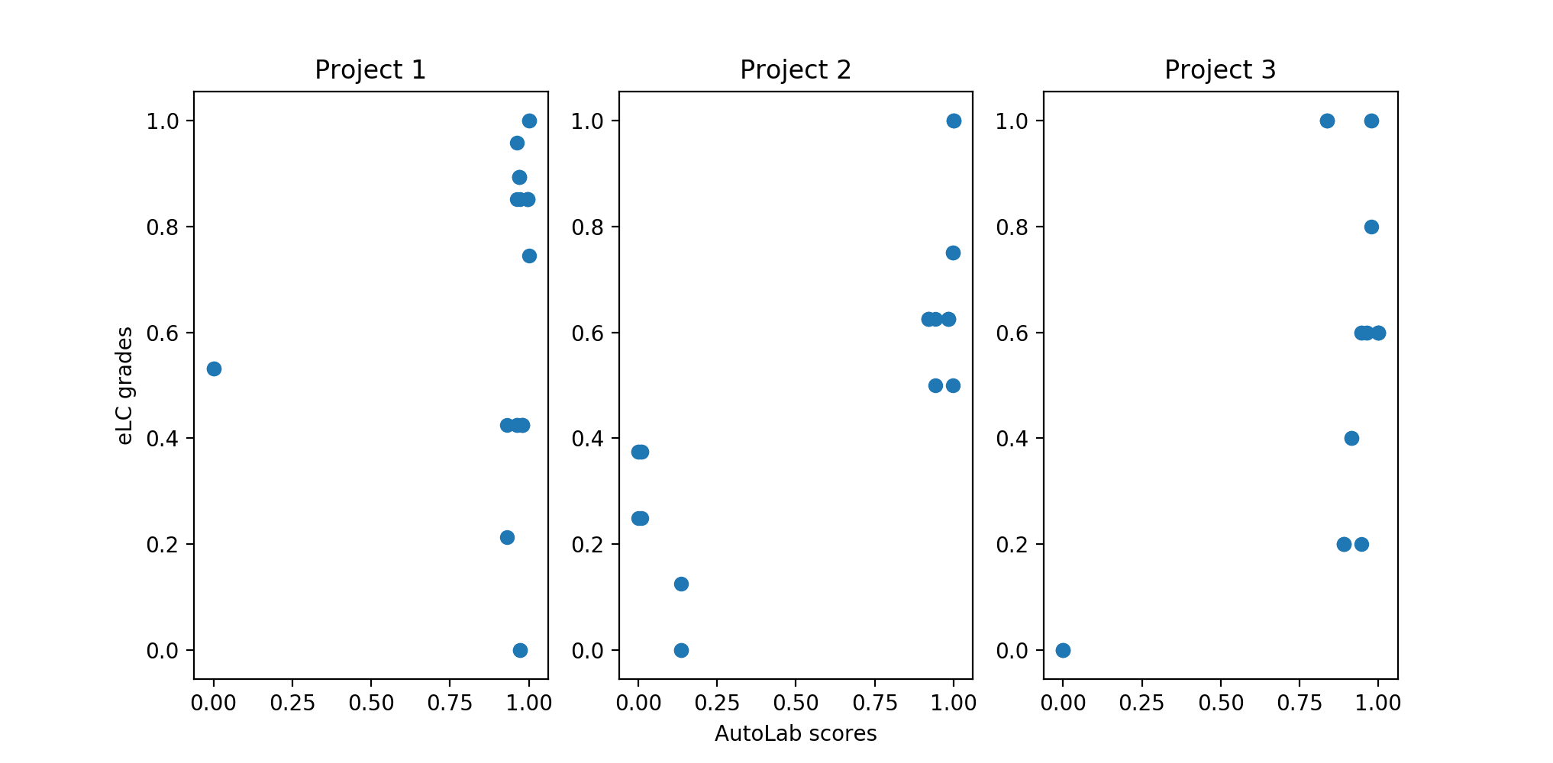
Normalized Project Performance
Takeaway:
Good AutoLab performance != High marks

Slide 15
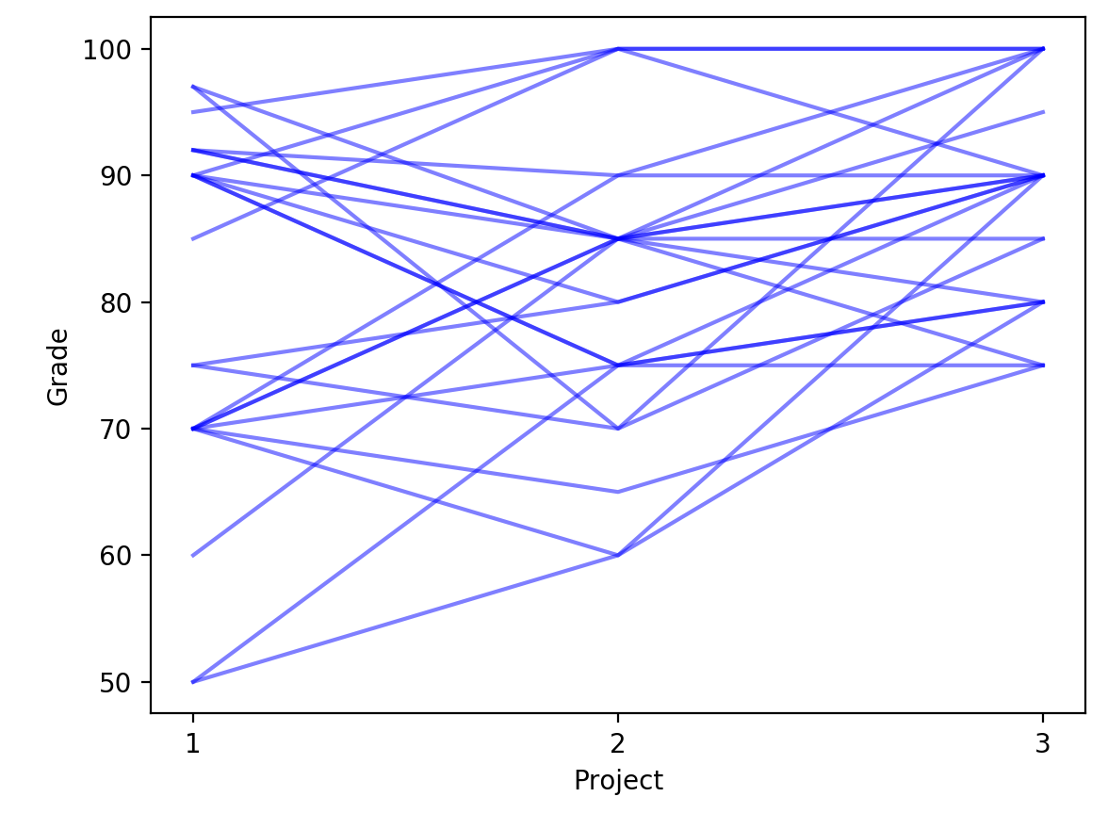
Individual Grade Progression
Takeaway:
Improvement over time!

Slide 16
Final Presentations
Tuesday, April 23
Gormogon
Mangalyan
Wednesday, April 24
Squadron
Abhishek, Anant, Priyank
Thursday, April 25
Natus Vincere
MH
Einstein
Tuesday, April 30
Abolfazl, Jonathan, Saed
Jupiter
Bestfitter
Friday, May 3, 11:59pm: ALL PROJECT MATERIALS DUE

