Slide 1
Team Nahiri Lightning Talk
RuiliF, Clint Morris, Ankit Lalwani

Slide 2
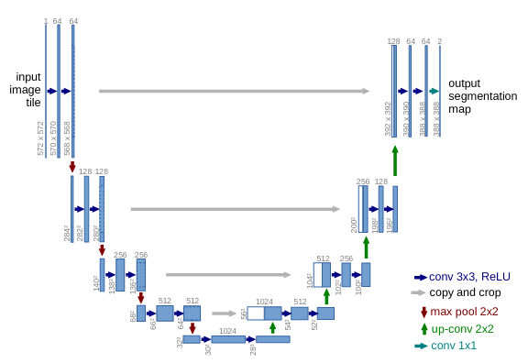
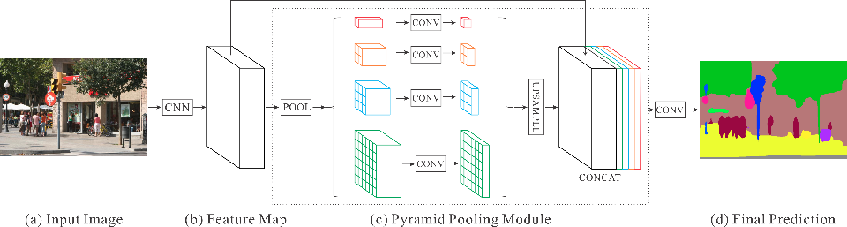
Approach
Models:
Unet
Pspnet

Slide 3
Limitations/Problems
Local machine crashes
GCP Dataproc Cluster configuration problems
GPU Resources!!!!

Slide 4
Lessons Learned
Make a concerted effort to push changes early and often
Local crashes let to further research about optimal torch data loaders
Dependencies of the libraries are important (when building the environment)

