Slide 1
Project 3: Cilia Segmentation
Team Vraska: Aishwarya, Nathan, & Yogesh

Slide 2
Problem to be solved and goal
Problem Statement: Given a dataset of several folders and each folder containing 100 consecutive images of a video of cilia identify the segment of cilia.
Input: grayscale frames of a video of cilia
Output: A mask image with each pixel colored separately.(2 for cilia, 1 for cell and 0 for background)

Slide 3
Approach & model & algorithm
U-Net Model
This approach was done using python in jupyter notebook on GCP
The data was downloaded, extracted and divided into train, test and mask folders.
Data: The image folders and corresponding mask file
Libraries used: Tensorflow, skimage, matplotlib
Initially: Train using the first frame of the video over multiple epochs
Train the model 100 times with a new frame on each iteration.

Slide 4
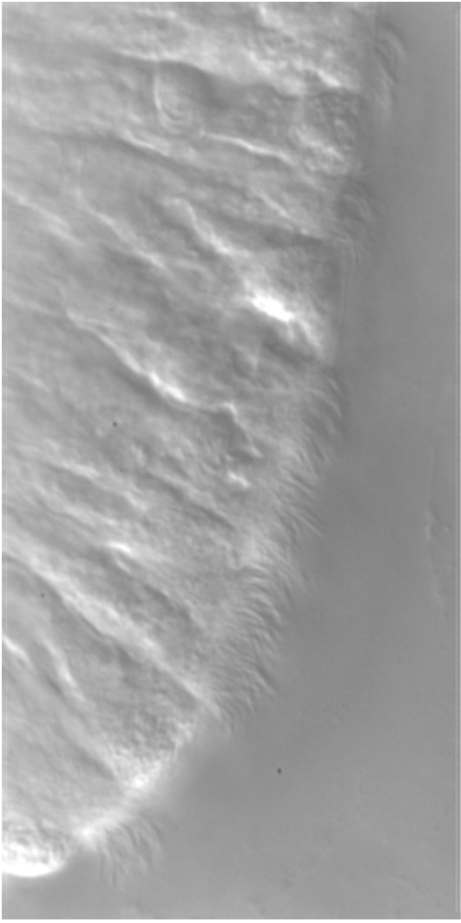
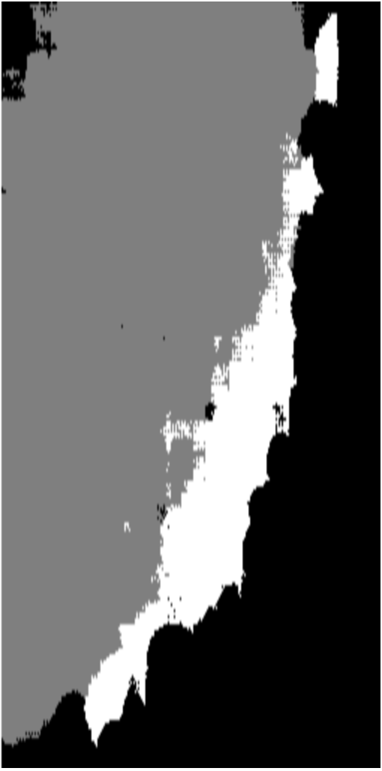
Preliminary Result
Results after 10 epochs with 16 steps per epoch.

Slide 5
Problems Encountered
Encountered problems with directly using the images from the google storage.
Spent extra time attempting to use the Tiramisu Model [1]. Ultimately, we decided to scrap the work and go with the U-Net model.
While running the model for all 100 images we faced some OS level issues and it was unsuccessful.
Model was overfitting.
[1] Jégou, Simon, et al. "The one hundred layers tiramisu: Fully convolutional densenets for semantic segmentation." Proceedings of the IEEE conference on computer vision and pattern recognition workshops. 2017.

Slide 6
Lessons Learned
The image segmentation was a completely new topic, so we had fun learning.
It was difficult, so we did a lot of reading on the topic.
Should have experimented with different loss functions and architectures.
Should have started a little early.

Slide 7
Result & Accuracy
The accuracy obtained by running the model for 10 images - 0.09
Tried to run the model twice for 100 images but it was unsuccessful.

