Slide 1
Image comparison using one-shot learning
M Hamza Gul Kakar
p136102@nu.edu.pk

Slide 2
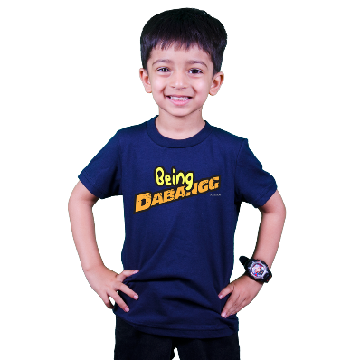
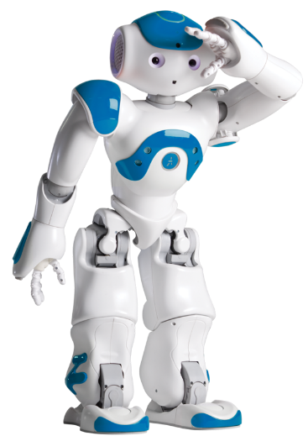
Learning (Humans vs Machines):
One-Shot Learning
Enough learning to recognize a giraffe.
Learn
Human
Learn
Learning almost never enough.
Machine

Slide 3
Object Categorization Problem
Traditional Machine learning models:
extensive, incremental training on large data sets
one-shot learning:
Training from one, or only a few data. (image)
Using:
Memory Augmented Neural Network
Neural Turing Machine
Siamese Networks

Slide 4
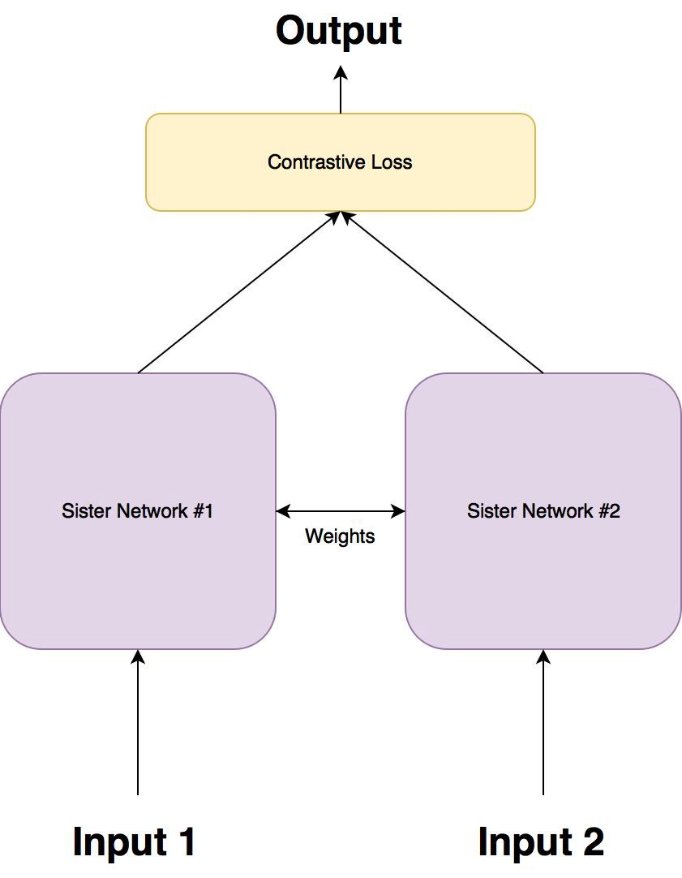
Siamese Networks:
Two sister networks,
which are identical neural networks,
with the exact same weights
Each image in the image pair is fed to one of these networks.
Networks are optimized using a contrastive loss function.

Slide 5
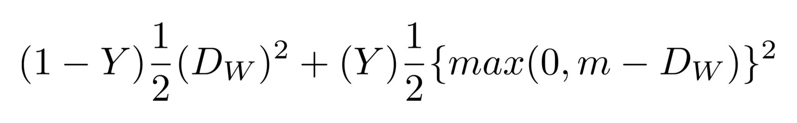
Contrastive Loss function (1/2):
Why Contrastive Loss function:
Siamese architecture is not to classify input images, but to differentiate between them.
Contrastive loss function:

Slide 6
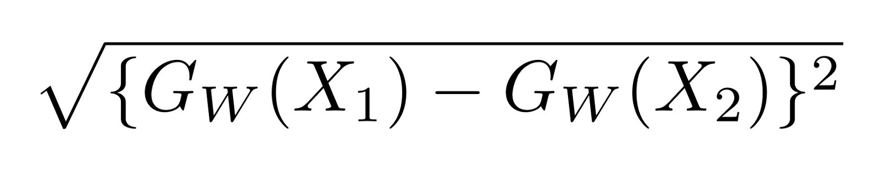
Contrastive Loss function (2/2):
Loss Function:
Dw:
Dw is the Euclidean distance between the outputs of the sister siamese networks.
max() is a function denoting the bigger value between 0 and m-Dw.
Y is either 1 or 0. If the inputs are from the same class , then the value of Y is 0 , otherwise Y is 1.
m is a margin value

Slide 7
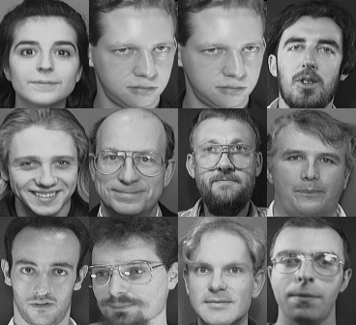
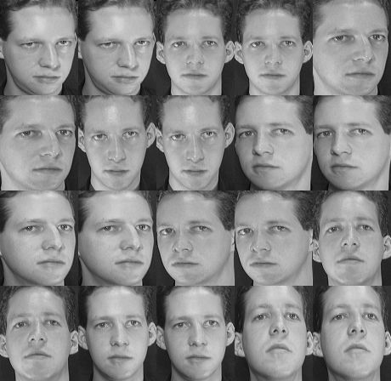
The Dataset:
AT&T faces dataset:
Sample from different classes
Sample from one object

Slide 8
Training the Siamese Network
The training process of a siamese network is as follows:
Pass the first image of the image pair through the network.
Pass the 2nd image of the image pair through the network.
Calculate the loss using the outputs from 1 and 2.
Back propagate the loss to calculate the gradients.
Update the weights using an optimiser.

Slide 9
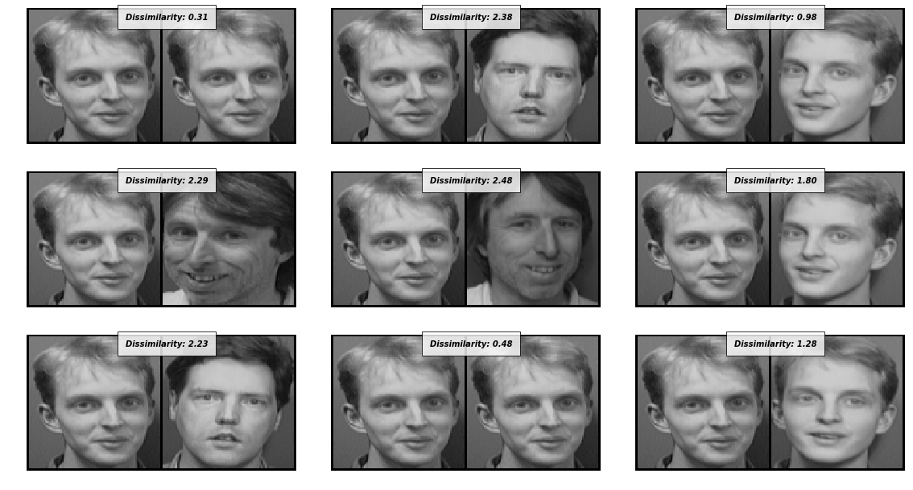
Results:

Slide 10


