Slide 1
Introduction to Cloud computing and AWS 101

Slide 2
Hello !
I am Deepak Patil.
Worked as Dot net developer and DevOps consultant @ Tavisca Solutions Pvt Ltd.
LinkedIn : https://www.linkedin.com/in/dpatil1410/
Github : https://github.com/dspatil

Slide 3
Agenda/Goal
- Understand what cloud computing is.
- Types.
- What is AWS?
- History and Why AWS?
- AWS services
- Getting started with AWS (Free tier)
- AWS console demo.

Slide 4
What is cloud computing?
The delivery of computing services like servers, storage, databases, networking, software, analytics and more-over the Internet (“the cloud”).
A decade old technology. (e.g. gmail , yahoo mail etc)
Sudden boom and gaining momentum for all the good reasons.
Tiny startups to global corporations, government agencies to non-profits. Everybody leveraging the advantages of cloud.

Slide 5
Advantages.
Cost
Speed
Global scale
Productivity
Performance
Reliability

Slide 6
Types of cloud services:
IaaS, PaaS, SaaS
IaaS
You rent IT infrastructure—servers and virtual machines (VMs), storage, networks, operating systems—from a cloud provider.
- Examples : AWS EC2, EBS etc.
PaaS
- on-demand environment for developing, testing, delivering and managing software applications.
- Examples : AWS beanstalk, Heroku etc
SaaS
- On demand software applications over the Internet
- Example : AWS elastic search service , Elastic cache, any mail providers like gmail etc

Slide 7
Cloud Providers
AWS
Azure
Digital Ocean
Google (GCP)
Rackspace
IBM
HP
And so on….

Slide 8
Amazon web services (AWS)
History :
Amazon (amazon.com) started with selling only Books.
Unable to handle traffic at pick hours.
They wanted their infrastructure to be scaled dynamically to handle pick load and demand.
And AWS was born.
What is AWS?
Amazon Web Services (AWS) is a secure cloud services platform,
offering compute power, database storage, content delivery and
other functionality to help businesses scale and grow with increased flexibility, scalability and reliability.

Slide 9
Why AWS?
Undisputed leader in current cloud market. (10x bigger than next 9 competitors, combined.)
Cost-Effective : Pay as you go model
Secure : IAM etc
Reliable
Global footprint.
Scalable and high performance.
Flexible : OS, Dbs, programming platforms etc.
Easy to use : Console, SDK’s, CLI and documentation etc.

Slide 10
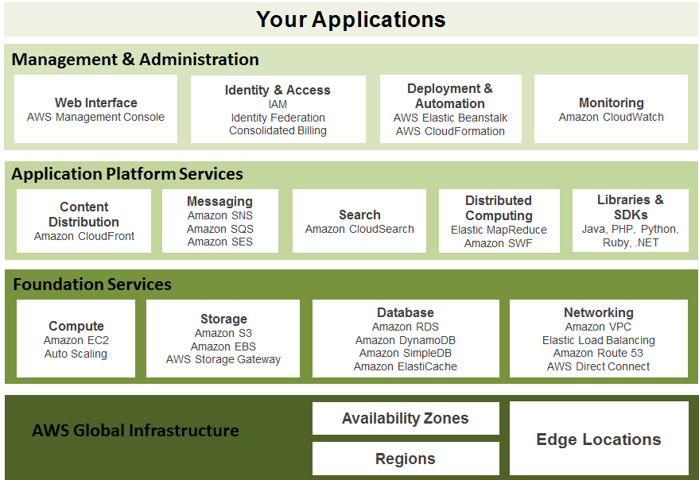
Overview :

Slide 11
Login to AWS console

Slide 12
Some key concepts and services

Slide 13
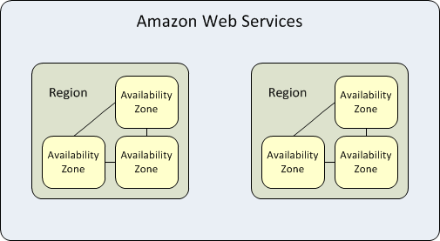
AWS regions and availability zones (AZ’s).
Region is separate distinct geographic area. (14 as of now.)
Availability zones are isolated locations within the region.

Slide 14
Compute
EC2
Lambda
Elastic Beanstalk
EC2 container service.
Lightsail etc

Slide 15
Storage
S3 (Simple storage service)
EFS
Glacier
Storage Gateways

Slide 16
Networking
VPC
CloudFront
Direct Connect
Route 53

Slide 17
Database
RDS
DynamoDB
ElastiCache
Redshift

Slide 18
And many more…
Management Tools
Game Development
AI
IOT
Developer Tools
Analytics
Mobile services
Migration

Slide 19
So what we covered?
Cloud computing
Introduction to basic AWS products and services.
What you SHOULD do now ?
Create free tier account on AWS
https://aws.amazon.com/free/
Its only costs 2 rupees, that too refundable.
Free for ONE year.
Play around services.

Slide 20
Koi Shak ???

