Slide 1

Viet Nam National University Ho Chi Minh City,
Internation University
School of Computer Science & Engineering
Major: Data Science
Subject: Principles of Database Management (IT079IU)
Final Project:
College Data Management

Slide 2

Project team
Phan Mạnh Sơn (ITDSIU21116)
Phạm Huỳnh Thanh Quân (ITDSIU21110)
Phan Danh Đức (ITDSIU21012)
Văn Phú Minh Sang (ITDSIU21112)
Nguyễn Bá Duy (ITDSIU21014)

Slide 3
Topic Information
College Data Management is the process of managing all the data related to the educational institution, including student records, staff information, academic schedules, and financial transactions. It is a crucial aspect of running a college efficiently and effectively. The College Management System, which is a software tool used to manage college data, helps college administrators to streamline their operations and make data-driven decisions. With a College Management System in place, colleges can improve their efficiency, reduce administrative workload, and provide better services to their students.

Slide 4
Table of Content
Part I
Part II
1.Introduction and Background
2.Purpose of the Project
3.Problem Statement
4.Solution
5.Features and Scope
6.Requirements
7.Functional and Non-Functional Requirements
8.The Entity Relationship Diagram (ERD)
9.Challenges
10.Implementation Details using SQL and Java

Slide 5

Introduction & Background
In today's world, where technology is rapidly advancing, colleges need a way to manage their data more efficiently. This is where the College Database Management System comes in. It is a software application that helps colleges manage their data effectively. With the help of this system, colleges can store, manage, and retrieve data with ease.

Slide 6
Purpose of the Project
Store the data of College
Show relational database
Design Jframe to retrieve the data
Develop a College database management system

Slide 7
.Problem Statement
The problem that this project aims to solve is the inefficiency of the current college data management systems. Many colleges still use manual data entry methods or outdated software that are not user-friendly. This leads to delays, errors, and inconsistencies in the data management process.

Slide 8
Solution
College DBMS will allow colleges to manage their data in a more efficient and effective way.
With the help of this system, colleges can easily store, manage, and retrieve data, which will help them save time and reduce errors.

Slide 9
Features and Scope:
Our goal is to streamline all college operations through the implementation of a College Management System.
This system is an educational management tool designed specifically for colleges.
As educational institutions, colleges have a primary responsibility to provide quality education to students.
The system enables administrators to efficiently record, manage, and control all college data.
Additionally, the system simplifies data accessibility for administrators.

Slide 10
.Requirements
Java Development Kit (JDK)
MySQL Database Management System 2019
Apache Netbeans 2017

Slide 11
Functional and Non-Functional Requirements
Functional Requirements
Non-Functional Requirements:
The system should allow the user to add, edit, and delete student records, instructor details, course details, department details, enrollment details
The system should be able to generate reports like student attendance reports, faculty performance reports, and more..
The system should be user-friendly and easy to use.
The system should be secure and prevent unauthorized access..
The system should be scalable and able to handle a large amount of data.
The system should be reliable and available 24/7.

Slide 12
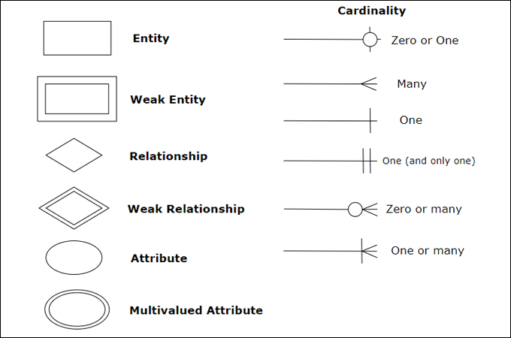
System Design
The Entity Relationship Diagram (ERD)

Slide 13
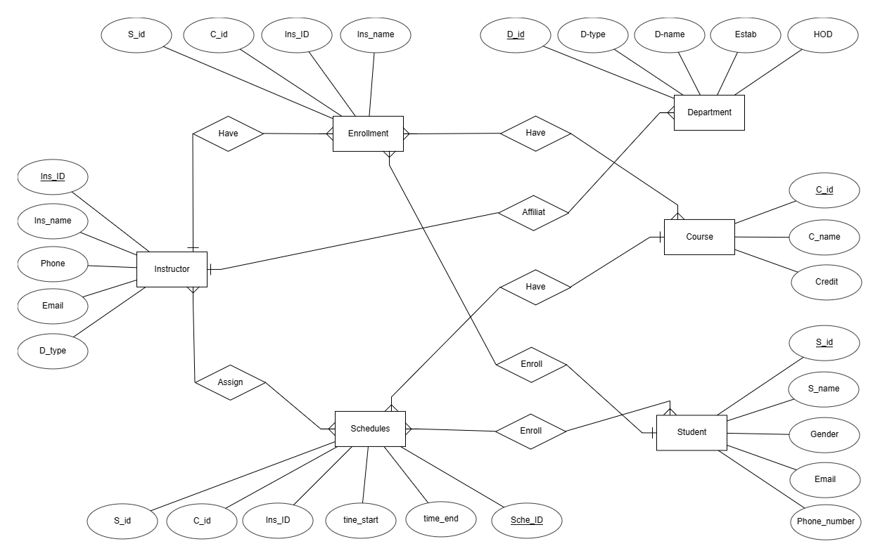

Slide 14
The ERD shows the following entities:
Student: stores information about each student, such as their name, student ID, and email address.
Course: stores information about each course offered by the college, such as the course code, title, and credit hours.
Enrollment: stores information about each enrollment, linking students to the courses they are enrolled in.
Department: store information about each department, such as the department name and department code.
Instructor: storing essential information related to courses, students, and academic performance.
Schedules: the college administration can create, manage and update schedules for various academic and non-academic activities.

Slide 15
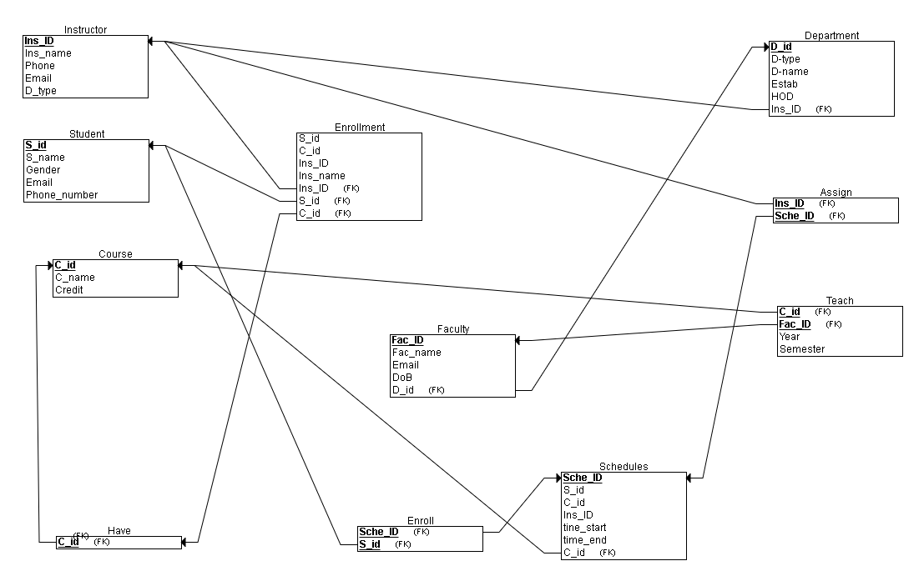
Relational Database Schema

Slide 16
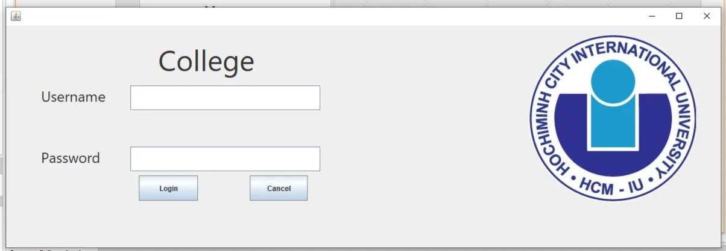
Login
ImplementationDetails using SQL and Java

Slide 17
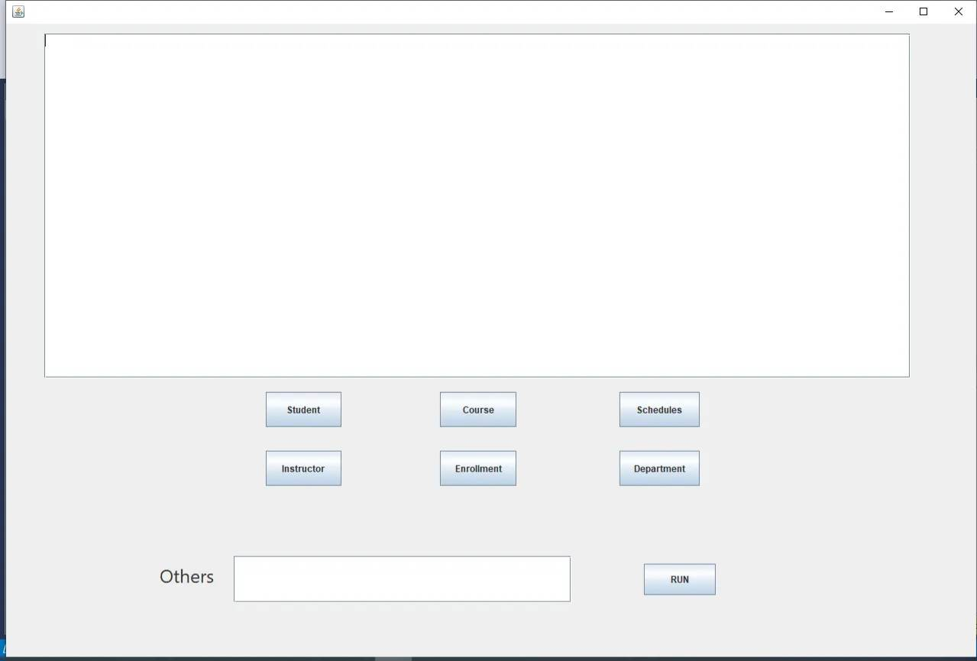
Demo

Slide 18
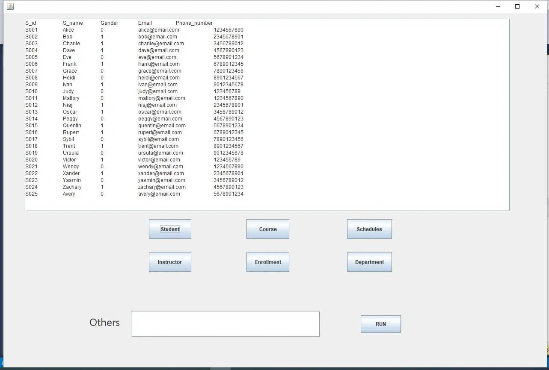
Student Table

Slide 19
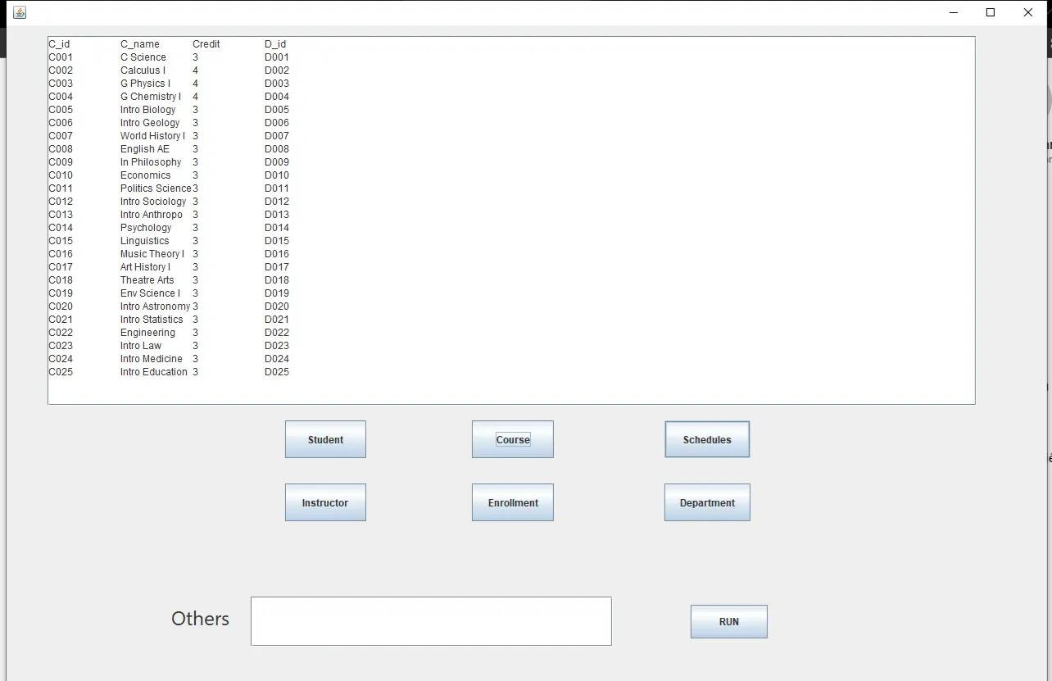
Course Table

Slide 20
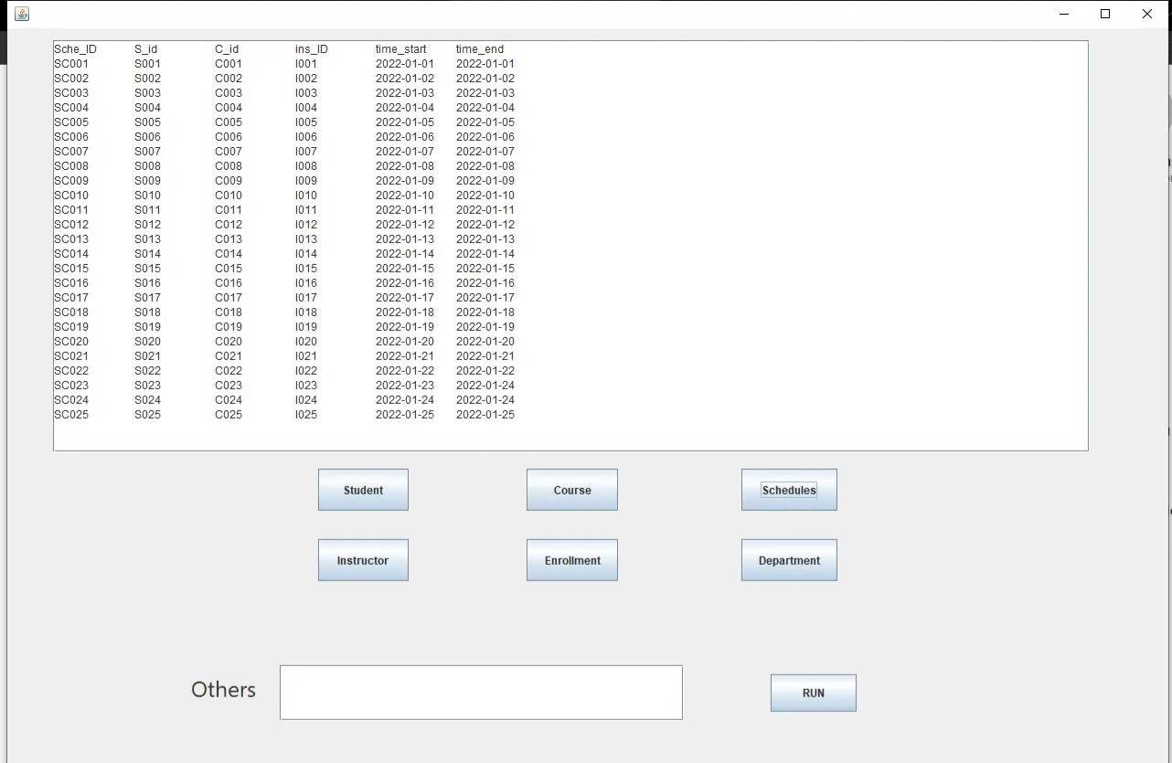
Schedules Table

Slide 21
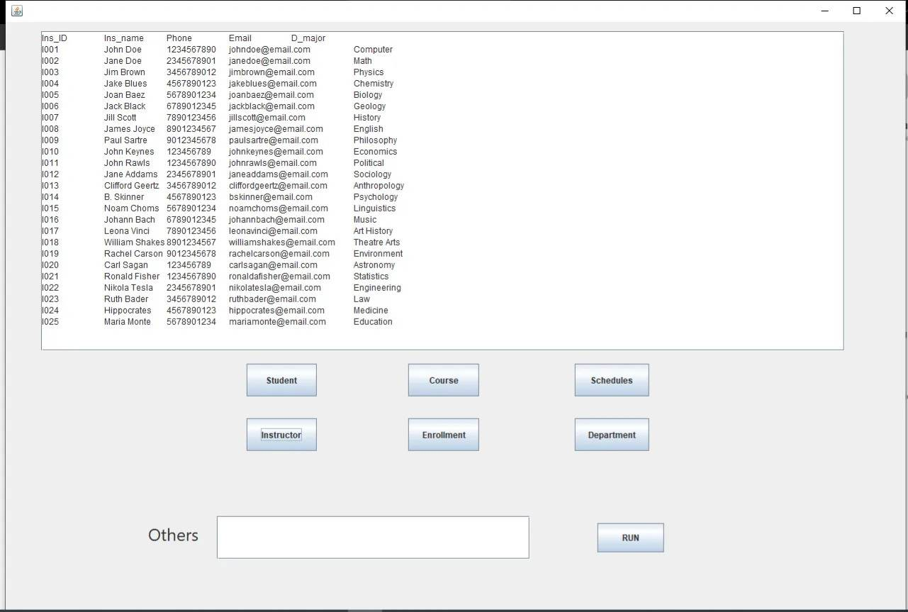
Instructor Table

Slide 22
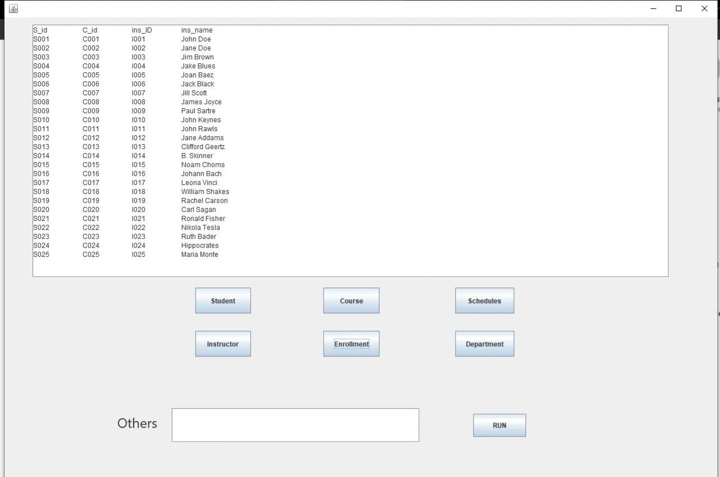
Enrollment Table

Slide 23
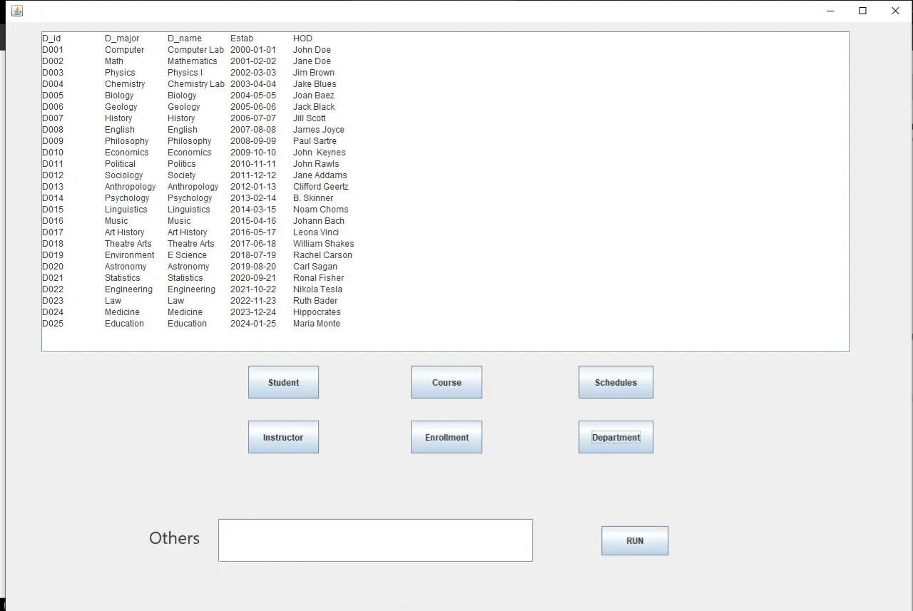
Department Table

Slide 24
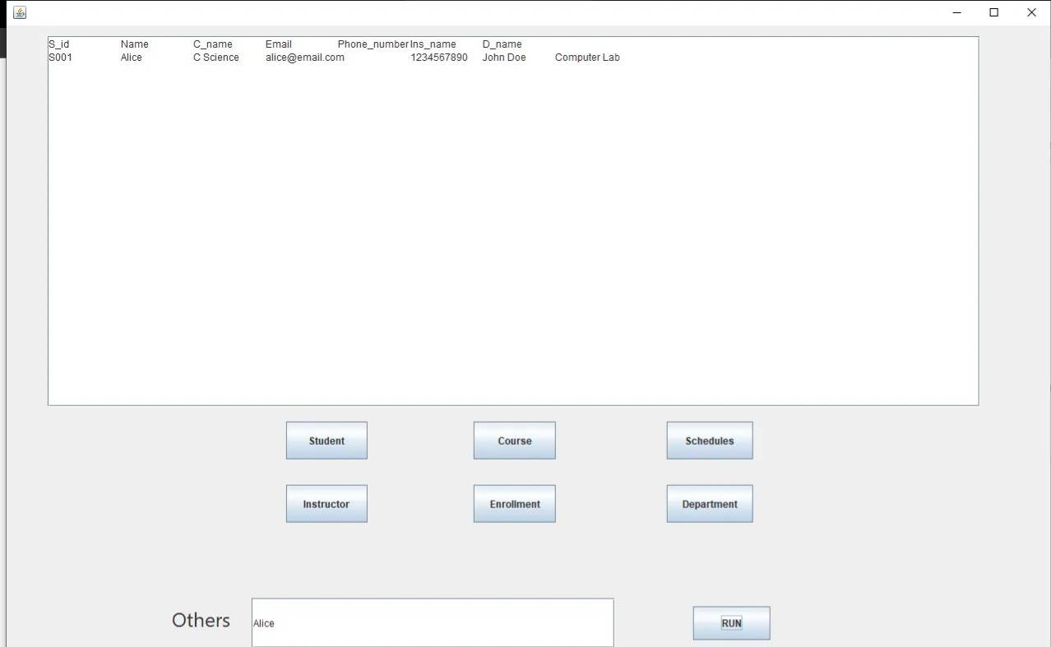
EXAMPLE: Student Alice

Slide 25
Challenges
Integrating the Java code with the MySQL database.
Ensuring that the system is secure and preventing unauthorized access.
Handling enormous amounts of data and ensuring that the system remains scalable.

