Slide 1
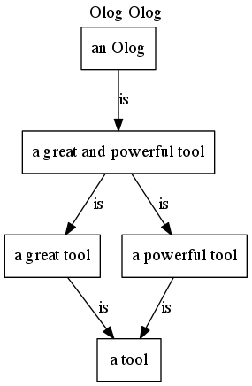
English to Olog Translation
or: how I learned to stop worrying and love the Olog.
Olog
English
Magic?
An Olog is a great and powerful tool.
A proof of concept
by Dylan Erb

Slide 2
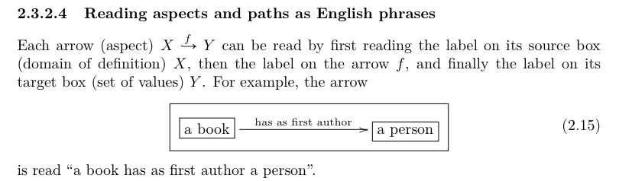
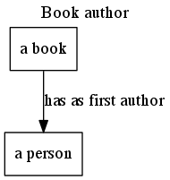
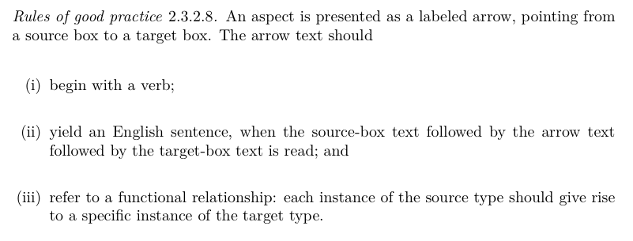
Inspiration

Slide 3
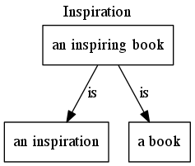
Inspiration continued
If aspects can be read as English sentences… can English sentences be turned into aspects?
Could we take a list of aspects written in English, and back out the Olog?
Perhaps even more inferences could be made
DISCLAIMER – Because English is not always functional… we will not always get true Ologs out of our sentences…
Monads are the solution

Slide 4
Kleisli Category – relations are cool
Instead of X->Y
Where the arrows in the Olog represent functions
We can use X->PY
Where the arrows in this context represent relations
The powerset of Y contains all possible subsets of Y, and so any relation from X to Y is kosher.
This allows arrows in the Olog to represent relations instead of functions.

Slide 5
Mission Statement and Approach
Mission Statement
Create a proof of concept that can take a list of English sentences, pull out some relationships, and display them as an Olog.
People speak English… why can’t we translate for them?
Decompose the problem
Convert English sentences to parts of speech
Given parts of speech, find boxes and arrows
Given boxes and arrows, display the resulting Olog automatically

Slide 6
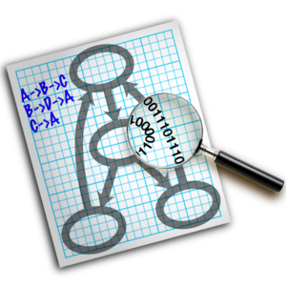

Draw Ologs Automatically
Searched for a tool for drawing graphs
Found a program called Graphviz
“Graph Visualization Software” developed by AT&T
Uses DOT language scripts.
It’s free
The kicker… it has a Python wrapper called PyGraphviz!
A.add_edge(1,2)

Slide 7
English sentences to parts of speech
Searched for a tool for identifying parts of speech (POS) in a sentence
Found a python module called topia.termextract
This module can tokenize a sentence…
>>> tagger.tokenize('This is a simple example.’)
['This', 'is', 'a', 'simple', 'example', '.’]
And then determine the parts of speech
>>> tagger('This is a simple example.')
[['This', 'DT', 'This'],
['is', 'VBZ', 'is'],
['a', 'DT', 'a'],
['simple', 'JJ', 'simple'],
['example', 'NN', 'example'],
['.', '.', '.']]

Slide 8
Given POS, find boxes and arrows
With PyGraphviz and topia.termextract both available for free, coding the POS -> (boxes and arrows) portion in Python made the most sense
After looking at a few Ologs, a method for doing this was determined (assuming a NF, VF, NF structure):
First NF starts at the beginning and goes until the first verb.
VF starts at the verb and goes until the first “a” or “an”.
And the second NF goes from the “a” or “an” to the end.

Slide 9
A simple example
Book author
A book has as first author a person.

Slide 10
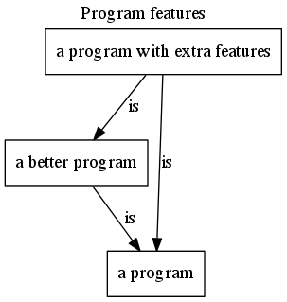
More features
Recursively tear down adjective phrases
Deal with prepositional phrases
Remove adverbs from verb phrases
Check box for verbose output
Open Source
Decided to avoid pull outs for now
Blows up quickly

Slide 11
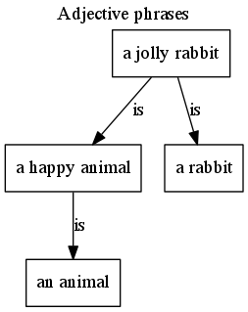
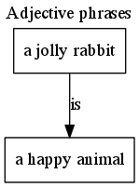
Adjective phrases
Standard Output
Verbose Output
Adjective phrases
A jolly rabbit is a happy animal.
Adjective phrases
A jolly rabbit is a happy animal.

Slide 12
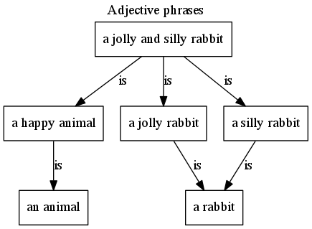
More Adjective Phrases
What happens if we add more adjectives?
Adjective phrases
A jolly and silly rabbit is a happy animal.

Slide 13
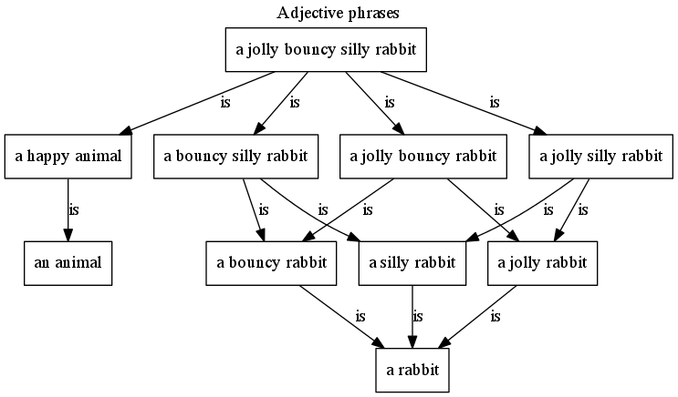
Even More Adjective Phrases
What happens if we add even more adjectives?
Adjective phrases
A jolly bouncy silly rabbit is a happy animal.

Slide 14
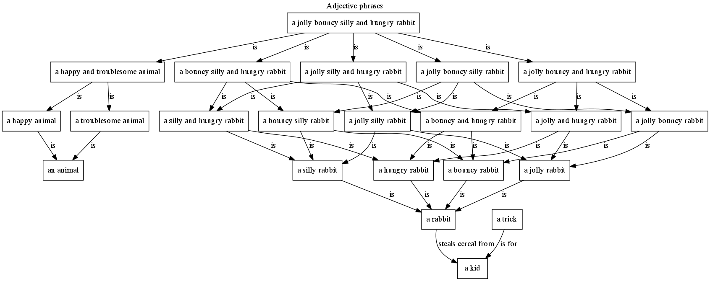
Even More Adjective Phrases
What happens if we add even more adjectives?
Adjective phrases
A jolly bouncy silly and hungry rabbit is a happy and troublesome animal.
A rabbit steals cereal from a kid.
A trick is for a kid.

Slide 15
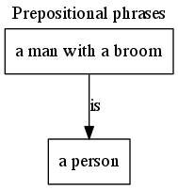
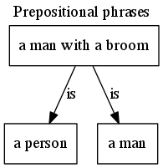
Prepositional phrases
Standard Output
Verbose Output
Prepositional phrases
A man with a broom is a person.
Prepositional phrases
A man with a broom is a person.

Slide 16
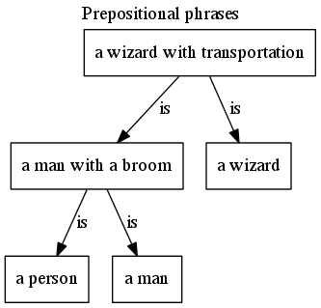
More Prepositional Phrases
What happens if we add more sentences?
Prepositional phrases
A man with a broom is a person.
A wizard with transportation is a man with a broom.

Slide 17
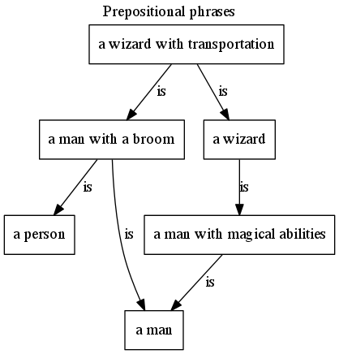
Even More Prepositional Phrases
What happens if we add even more sentences?
Prepositional phrases
A man with a broom is a person.
A wizard with transportation is a man with a broom.
A wizard is a man with magical abilities.

Slide 18
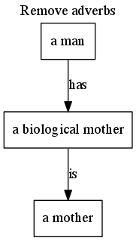
Adverbs
We can remove adverbs from verb phrases…
Remove adverbs
A man always has a biological mother.

Slide 19
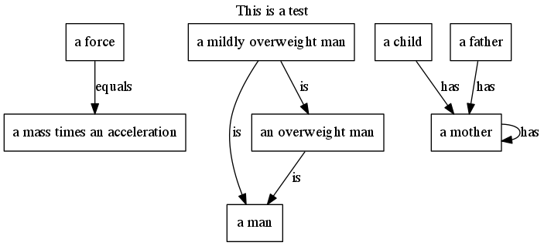
More examples
This is a test
A force equals a mass times an acceleration.
A mildly overweight man is a man.
A child has a mother.
A mother has a mother.
A father has a mother.

Slide 20
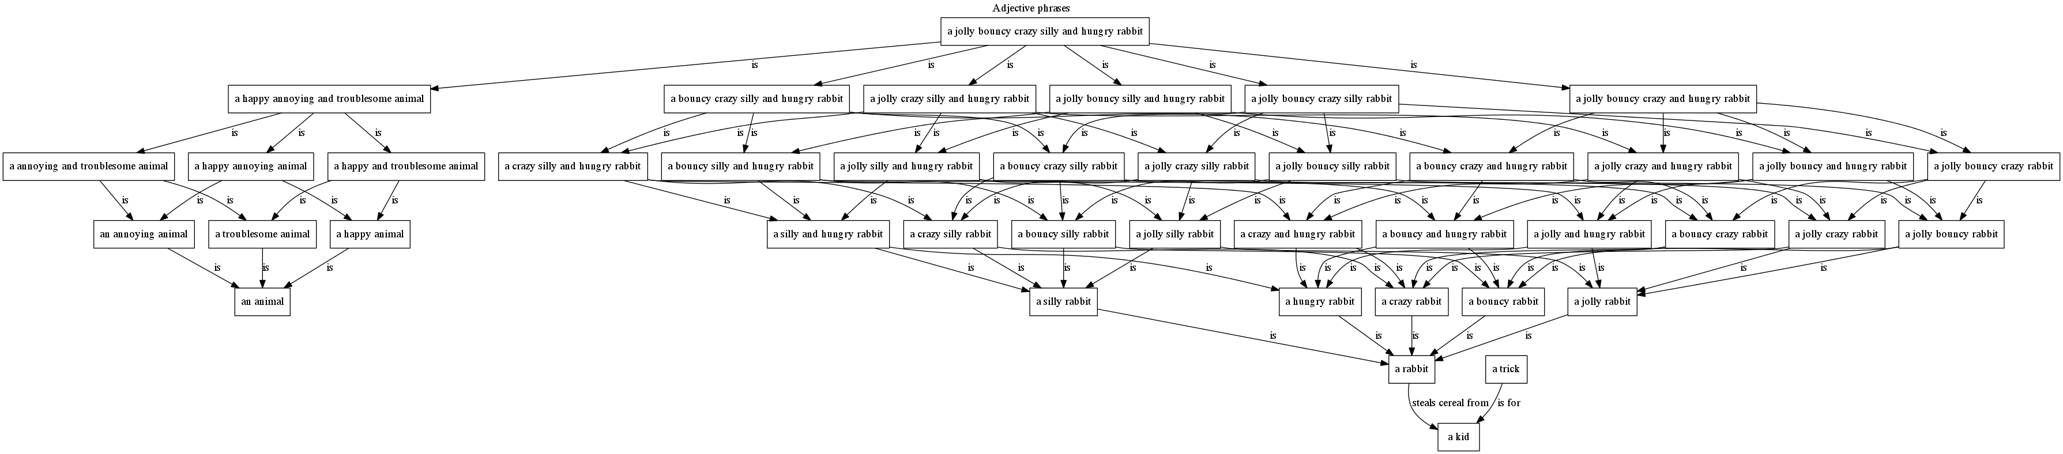
More examples
Adjective phrases
A jolly bouncy crazy silly and hungry rabbit is a happy annoying and troublesome animal.
A rabbit steals cereal from a kid.
A trick is for a kid.

Slide 21
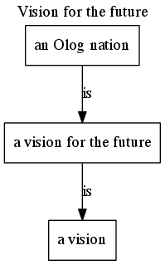
A vision for the future
Additional Features
Web/graphical interface
Like Google translate
Noun phrase parsing
Olog to English output
FQL output
Proper nouns to data
Future applications
Olog wikipedia and the dictionary
Scientific paper Ologging
Vision for the future.
An Olog nation is a vision for the future.

Slide 22
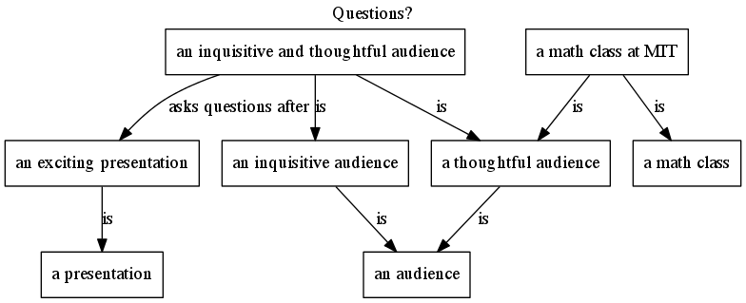
Questions and comments?
Questions?
An inquisitive and thoughtful audience asks questions after an exciting presentation.
A math class at MIT is a thoughtful audience.
http://sourceforge.net/projects/olognation/files/English2Olog.py/download

