Slide 1
Figures

Slide 2
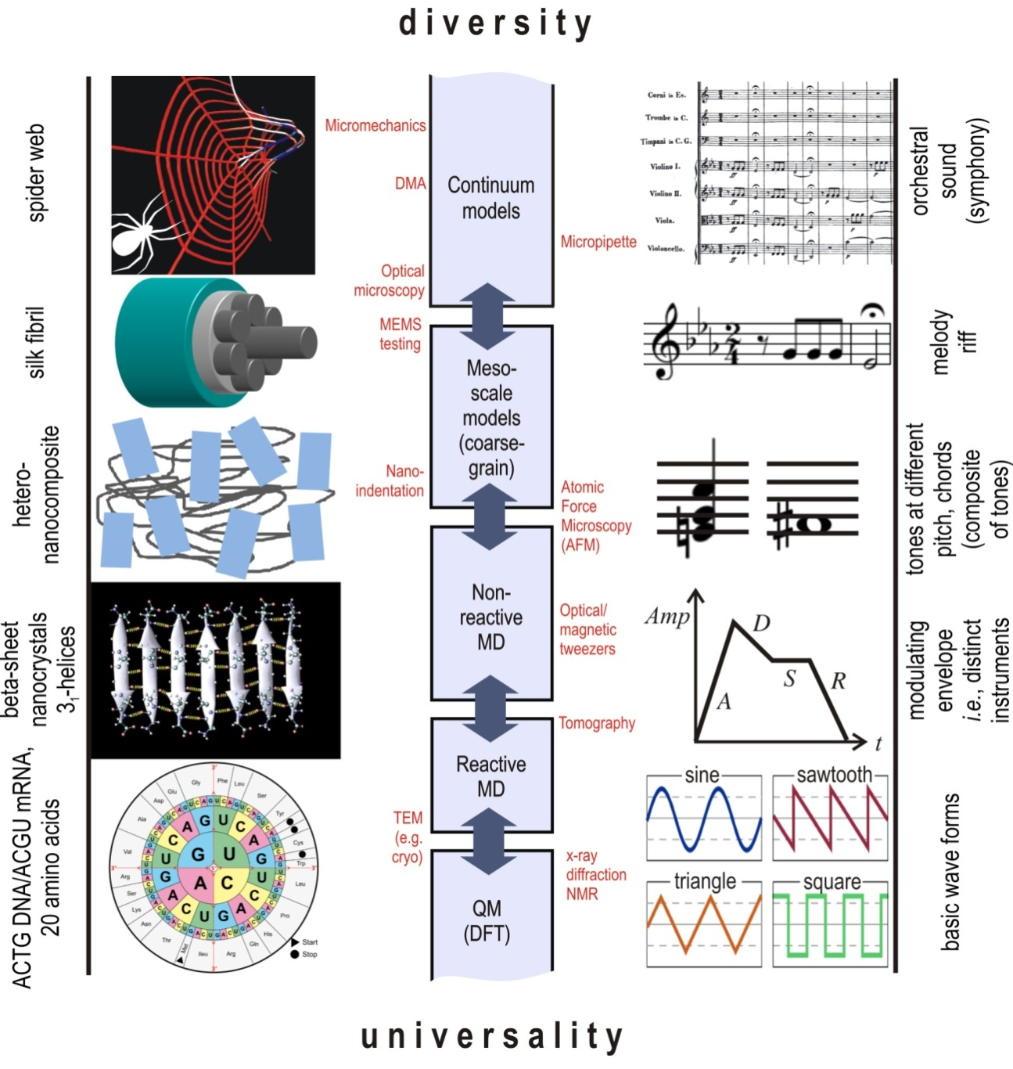
Notes:
FIGURE 1

Slide 3
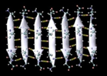
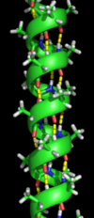
A
Building blocks
C
Protein w/o lifeline (amyloid)
Resting With force
brick
Assemble
without or with lifeline
glue
D
Protein w/ lifeline (alpha-helix)
Resting With force
lifeline
B
Failure extension
for building blocks
E
Ductile
Brittle
Notes:
FIGURE 2

Slide 4
1: A→E
by hypothesis will be
A:
a one-dimensional system
of bricks, glue, and lifeline
B:
a one-dimensional system
of bricks and glue
without lifeline
2:A→F
is, in particular,
5: B→C
by hypothesis will be
3:A→D
is structured as
6: B→F
is, in
particular,
C:
a brittle system (S) of
bricks (b) and glue (g)
4:A→G
is, in particular,
D:
a “chain” graph
*→*→* ... →*
12:F→D
is structured as
7:C→F
is, in particular,
E:
a ductile system (S) of
bricks (b) and glue (g)
G:
a system consisting of bricks
connected by glue and lifeline,
both structured as in graph G
9:D→H
is, in particular,
F:
a one-dimensional
system (S) of bricks (b) and glue (g)
10:E→F
is, in
particular,
16:G→I
is composed of
15:G→H
is structured as
H:
a graph
20:J→H
is structured as
13:F→J
is, in particular,
8:C→M
yields, by setting
x=failure extension of S,
y=failure extension of g
I:
a threesome (b,g,L) of
building blocks, serving as
bricks, glue, and lifeline
J:
a system consisting of
bricks connected by glue,
structured as in graph G
17:I→M
yields, by setting
R=resting extension of L
r=failure extension of g
11:E→O
yields, by setting
x=failure extension of S,
y=failure extension of g
18:I→K
is, with S=L,
K:
a threesome (b,g,S) of building
blocks, serving as
bricks, glue, and strong-glue
22:K→Q
yields, by setting
R=resting extension of S
r=failure extension of g
14:F→Q
yields, by setting
x=failure extension of S,
y=failure extension of g
21:J→N
is composed of
23:K→L
includes
24:K→N
includes
M:
a pair (R,r) of real
numbers such that
R is roughly equal to r
L:
a pair (b,S) of building blocks,
serving as bricks and strong-glue
25:L→M
yields, by setting
R=failure extension of b
r=failure extension of S
29:N→O
yields, by setting
R=failure extension of b
r=failure extension of g
26:L→P
is, with B1=b
and B2=S
N:
a pair (b,g) of building blocks,
serving as bricks and glue
O:
a pair (R,r) of real
numbers such that
R>>r
19:I→T
includes as L
27:L→R
includes as b
28:M→Q
yields, by setting
x=R and y=r
31:N→S
includes as g
32:N→P
is, with B1=b
and B2=g
34:P→Q
yields, by setting
x=failure extension of B1
y=failure extension of B2
30:N→R
includes as b
P:
a pair (B1,B2) of building blocks,
such that B2 can connect two
instances of B1
Q:
a pair (x,y) of
real numbers
33:O→Q
yields, by setting
x=R and y=r
R:
a brick
S:
a glue
38:Q→V
includes as y
40:S→U
is
35:P→U
includes as B1
36:P→U
includes as B2
37:Q→V
includes as x
T:
a lifeline
39:R→U
is
U:
a building block
42:U→V
has, as failing extension,
V:
a real number
41:T→U
is
43:U→W
has
W:
a resting extension
44:W→V
is
Notes:
FIGURE 3

Slide 5




A
Building blocks
C
…
brick
Assemble
without or with lifeline
Experimenter
Experimenter
D
glue
…
lifeline
Experimenter
Experimenter
B
Failure extension
for building blocks
E
Ductile
Brittle
Notes:
FIGURE 4

Slide 6
Tables

Slide 7
Starting point | Ending point | Path 1 | Path 2 | Same result
A: a one-dimensional system of bricks, glue, and lifeline | F: a one-dimensional system (S) of bricks (b) and glue (g) |  |  | Each of these paths from A to F simply “forgets” the lifeline.
A: a one-dimensional system of bricks, glue, and lifeline | D: a “chain” graph *→*→*→…→* |  |  | Each of these paths from A to D yields the structure graph of the system, which is a “chain” graph.
A: a one-dimensional system of bricks, glue, and lifeline | H: a graph |  |  | Each of these paths from A to H yields the structure graph of the system.
B: a one-dimensional system of bricks and glue without lifeline | F: a one-dimensional system (S) of bricks (b) and glue (g) |  |  | Each of these paths from B to F simply forgets that the system has no lifeline.
C: a brittle system (S) of bricks (b) and glue (g) | Q: a pair (x,y) of real numbers |  |  | Each of these paths from C to Q sets x=failure extension of the system (S), y=failure extension of the glue (g).
E: a ductile system (S) of bricks (b) and glue (g) | Q: a pair (x,y) of real numbers |  |  | Each of these paths from E to Q sets x=failure extension of the system (S), y=failure extension of the glue (g).
F: a one-dimensional system (S) of bricks (b) and glue (g) | H: a graph |  |  | Each of these paths from F to H yields the structure graph of the system.
I: a threesome (b,g,L) of building blocks, serving as bricks, glue, and lifeline | Q: a pair (x,y) of real numbers |  |  | Each of these paths from I to Q sets x=resting extension of lifeline (L), y=failure extension of glue (g).
I: a threesome (b,g,L) of building blocks, serving as bricks, glue, and lifeline | U: a building block |  |  | Each of these paths from I to U yields the lifeline element (L).
K: a threesome (b,g,S) of building blocks, serving as bricks, glue, and strong-glue | R: a brick |  |  | Each of these paths from K to R yields the same brick element (b).
L: a pair (b,S) of building blocks, serving as bricks and strong-glue | Q: a pair (x,y) of real numbers |  |  | Each of these paths from L to Q sets x=failure extension of brick (b), y=failure extension of strong-glue (S)
L: a pair (b,S) of building blocks, serving as bricks and strong-glue | U: a building block |  |  | Each of these paths from L to U yields the brick element (b).
N: a pair (b,g) of building blocks, serving as bricks and glue | Q: a pair (x,y) of real numbers |  |  | Each of these paths from N to Q sets x=failure extension of brick (b), y=failure extension of glue (g).
N: a pair (b,g) of building blocks, serving as bricks and glue | U: a building block |  |  | Each of these paths from N to U yields the brick element (b).
N: a pair (b,g) of building blocks, serving as bricks and glue | U: a building block |  |  | Each of these paths from N to U yields the glue element (g).
P: a pair (B1,B2) of building blocks, such that B2 can connect two instances of B1 | V: a real number |  |  | Each of these paths from P to V yields the failure extension of B1.
P: a pair (B1,B2) of building blocks, such that B2 can connect two instances of B1 | V: a real number |  |  | Each of these paths from P to V yields the failure extension of B2.
A
1
E
10
F
A
2
F
A
2
F
12
D
A
3
D
A
3
D
9
H
A
4
G
15
H
B
5
C
7
F
B
6
F
C
7
F
14
Q
C
8
M
28
Q
E
10
F
14
Q
E
11
O
33
Q
F
12
D
9
H
F
13
J
20
H
I
17
M
28
Q
I
18
K
22
Q
I
18
K
23
L
26
P
36
U
I
19
T
41
U
K
24
N
30
R
K
23
L
27
R
L
26
P
34
Q
L
25
M
28
Q
L
26
P
35
U
L
27
R
39
U
N
29
O
33
Q
N
32
P
34
Q
N
32
P
35
U
N
30
R
39
U
N
32
P
36
U
N
31
S
40
U
P
34
Q
37
V
P
35
U
42
V
P
34
Q
38
V
P
36
U
42
V
Notes:
TABLE 1

Slide 8
Object | Fiber product object name | Defining attributes | Equated terms | “Idea”
A | a one-dimensional system of bricks, glue, and lifeline |  |  | A system of bricks, glue, and lifeline is defined as “one-dimensional” if its structure graphs (brick/glue) and (brick/lifeline) are both chains.
C | a brittle system of bricks (b) and glue (g) |  |  | A system is defined as “brittle” if its failure extension is roughly equal to the failure extension of its glue.
E | a ductile system of bricks (b) and glue (g) |  |  | A system is defined as “ductile” if its failure extension is much greater than the failure extension of its glue.
F | a one-dimensional sequence (S) of bricks (b) and glue (g) |  |  | A system of bricks and glue is defined as “one-dimensional” if its structure graph is a chain.
I | a threesome (b,g,L) of building blocks, serving as bricks, glue, and lifeline |  |  | A strong-glue element is defined as “lifeline” if its resting extension is roughly equal to the failure extension of a glue element.
K | a threesome (b,g,S) of building blocks, serving as bricks, glue, and strong-glue |  |  | A “brick/glue/strong-glue threesome” is defined to be a brick/glue pair and a brick/lifeline pair where the bricks are the same in both instances.
L | a pair (b,S) of building blocks, serving as bricks and strong-glue |  |  | Two building blocks, one of which can connect together two instances of the other, are defined as “bricks and strong-glue” if their failure extensions are roughly equal.
N | a pair (b,g) of building blocks, serving as bricks and glue |  |  | Two building blocks, one of which can connect together two instances of the other, are defined as “bricks and glue” if the failure extension of the connector is much less than the failure extension of the connectee.
D
3
A
4
G
D
9
H
15
G
F
7
C
8
M
F
14
Q
28
M
F
10
E
11
O
F
14
Q
33
O
D
12
F
13
J
D
9
H
20
J
M
17
I
18
K
M
28
Q
22
K
N
24
K
23
L
N
30
R
27
L
M
25
L
26
P
M
28
Q
34
P
O
29
N
32
P
O
33
Q
34
P
Notes:
TABLE 2

Slide 9
Type | Type Labels | Protein Specific | Social-network Specific
A | a one-dimensional system of bricks, glue, and lifeline | alpha-helix | social network with wireless & physical passageways
B | a one-dimensional system of bricks and glue without lifeline | amyloid | social network with wireless, without physical passageways
C | a brittle system (S) of bricks (b) and glue (g) | brittle protein filament | brittle social network
D | a “chain” graph *→*→* ... →* | chain shape for protein | chain shape for network
E | a ductile system (S) of bricks (b) and glue (g) | ductile protein filament | ductile social network
F | a one-dimensional system (S) of bricks (b) and glue (g) | alpha-helix / amyloid | social network
G | a system consisting of bricks connected by glue and lifeline, both structured as in graph G | lifeline protein of specified shape | lifeline social network of specified shape
H | a graph | shape of protein | shape of network
I | a threesome (b,g,L) of building blocks, serving as bricks, glue, and lifeline | amino cluster, H-bond, backbone | transceiver, wifi system, physical passageway
J | a system consisting of bricks connected by glue, structured as in graph G | protein of specified shape | social network of specified shape
K | a threesome (b,g,S) of building blocks, serving as bricks, glue, and strong-glue | amino acid cluster, H-bond, backbone | transceiver, wifi system, physical passageway
L | a pair (b,S) of building blocks, serving as bricks and strong-glue | amino acid cluster, backbone | transceiver, physical passageway
M | a pair (R,r) of real numbers such that R is roughly equal to r | e.g. R=20.5 r=23 .45 | e.g. R=20.5 r=23 .45
N | a pair (b,g) of building blocks, serving as bricks and glue | amino acid cluster, H-bond | transceiver, wifi system
O | a pair (R,r) of real numbers such that R>>r | e.g. R=100 r=20.6 | e.g. R=100 r=20.6
P | a pair (B1,B2) of building blocks, such that B2 can connect two instances of B1 | e.g. amino acid and backbone | e.g transceiver and wifi
Q | a pair (x,y) of real numbers | e.g. x=20.55, y=50.6 | e.g. x=20.55, y=50.6
R | a brick | amino acid cluster | transceiver
S | a glue | H-bond | wifi connection
T | a lifeline | backbone | physical passageway
U | a building block | basic unit of material | basic unit of social interaction
V | a real number | e.g. 181.2 | e.g. 181.2
W | a resting extension | e.g. 61 Angstrom | e.g. 1/100 error/bit
Notes:
TABLE 3

Slide 10
Supplementary figures

Slide 11
1: A→E
by hypothesis will be
B:
a one-dimensional system
of bricks and glue
without lifeline
5: B→C
by hypothesis will be
C:
a brittle system of
bricks (b) and glue (g)
A:
a one-dimensional system
of bricks, glue, and lifeline
E:
a ductile system of
bricks (b) and glue (g)
Commutes:
1;10=2
10:E→F
is, in
particular,
Commutes:
5;7=6
7:C→F
is, in particular,
2:A→F
is, in particular,
6: B→F
is, in
particular,
F:
a one-dimensional
system of bricks (b) and glue (g)
F:
a one-dimensional
system of bricks (b) and glue (g)
The conjecture that an arrow “1:A→E” exists such that this diagram commutes is
the conjecture that a one-dimensional system of bricks, glue, and lifeline
will always be ductile.
The conjecture that an arrow “5:B→C” exists such that this diagram commutes is
the conjecture that a one-dimensional system of bricks and glue without lifeline
will always be brittle.
I:
a threesome (b,g,L) of
building blocks, serving as
bricks, glue, and lifeline
18:I→K
is, with S=L,
K:
a threesome of building
blocks (b,g,S), serving as
bricks, glue, and strong-glue
23:K→L
includes
26:L→P
is, with B1=b
and B2=S
P:
a pair (B1,B2) of building blocks,
such that B2 can connect two
instances of B1
L:
a pair (b,S) of building blocks,
serving as bricks and strong-glue
L:
a pair (b,S) of building blocks,
serving as bricks and strong-glue
26:L→P
is, with B1=b
and B2=S
27:L→R
includes as b
Commutes:
26;35=27;39
35:P→U
includes as B1
19:I→T
includes as L
Commutes:
18;23;26;36=19;41
P:
a pair (B1,B2) of building blocks,
such that B2 can connect two
instances of B1
R:
a brick
U:
a building block
36:P→U
includes as B2
39:R→U
is
T:
a lifeline
U:
a building block
41:T→U
is
The commutativity of this diagram is a “check” on the meanings of the arrows:
given a threesome (b,g,L) of building blocks, serving as bricks, glue, and lifeline, this
diagram shows two different paths I→U to get a building block. Either way, one obtains
the same building block, namely the lifeline L.
The commutativity of this diagram is a “check” on the meanings of the arrows:
given a pair(b,S) of building blocks, serving as bricks and strong-glue, this
diagram shows two different paths L→U to get a building block. Either way, one obtains
the same building block, namely the strong-glue S.
Notes:
FIGURE S1-1

Slide 12
N:
a pair (b,g) of building blocks,
serving as bricks and glue
32:N→P
is, with B1=b
and B2=g
P:
a pair (B1,B2) of building blocks,
such that B2 can connect two
instances of B1
N:
a pair (b,g) of building blocks,
serving as bricks and glue
32:N→P
is, with B1=b
and B2=g
P:
a pair (B1,B2) of building blocks,
such that B2 can connect two
instances of B1
30:N→R
includes as b
Commutes:
32;35=30;39
35:P→U
includes as B1
31:N→S
includes as g
Commutes:
32;36=31;40
36:P→U
includes as B2
R:
a brick
U:
a building block
S:
a glue
U:
a building block
39:R→U
is
40:S→U
is
The commutativity of this diagram is a “check” on the meanings of the arrows:
given a pair (b,g) of building blocks, serving as bricks and glue, this diagram
shows two different paths N→U to get a building block. Either way, one obtains
the same building block, namely the brick b.
The commutativity of this diagram is a “check” on the meanings of the arrows:
given a pair (b,g) of building blocks, serving as bricks and glue, this diagram
shows two different paths N→U to get a building block. Either way, one obtains
the same building block, namely the glue g.
34:P→Q
yields, by setting
x=failure extension of B1
y=failure extension of B2
34:P→Q
yields, by setting
x=failure extension of B1
y=failure extension of B2
P:
a pair (B1,B2) of building blocks,
such that B2 can connect two
instances of B1.
Q:
a pair (x,y) of
real numbers
P:
a pair (B1,B2) of building blocks,
such that B2 can connect two
instances of B1.
Q:
a pair (x,y) of
real numbers
35:P→U
includes as B1
Commutes:
34;37=35;42
37:Q→V
includes as x
36:P→U
includes as B2
Commutes:
34;38=36;42
38:Q→V
includes as y
U:
a building block
V:
a real number
U:
a building block
V:
a real number
42:U→V
has, as failing extension,
42:U→V
has, as failing extension,
The commutativity of this diagram is a “check” on the meanings of the arrows:
given a pair (B1,B2) of building blocks, such that B2 can connect two instances
of B1, this diagram shows two different paths P→V to get a real number.
Either way, one obtains the same real number, namely the failure extension of B1.
The commutativity of this diagram is a “check” on the meanings of the arrows:
given a pair (B1,B2) of building blocks, such that B2 can connect two instances
of B1, this diagram shows two different paths P→V to get a real number.
Either way, one obtains the same real number, namely the failure extension of B2.
Notes:
FIGURE S1-2

Slide 13
Figure S1 | Commutativity in the olog of the protein. In each of these eight diagrams, there are two paths from the upper left-hand box to the lower right-hand box. By stating that these diagrams are commutative, we are saying that these two paths are equivalent – given the same input they produce the same output. For example it is declared 30;39=32;35 : N→U, which means that starting with a pair (b,g) of building blocks serving as bricks and glue, one can obtain a building block in two ways, but either way the answer is the same: the brick. Similarly, 31;40=32;36 : N→U, which means that again starting with (b,g) we can again obtain a building block in two ways, but either way the answer will be the same: glue. An example of a non-commutative diagram found in the original olog is: 31;40 ≠ 30;39 : N→U. Starting with a pair (b,g), the path 31;40 produces its glue element whereas the path 30;39 produces its brick element. These facts are in some sense obvious, but to make ologs a rigorous system such facts must be recorded.

Slide 14
A:
a one-dimensional system
of bricks, glue, and lifeline
3:A→D
is structured as
D:
a “chain” graph
*→*→* ... →*
C:
a brittle system of
bricks (b) and glue (g)
7:C→F
is, in particular,
F:
a one-dimensional
system (S) of bricks (b) and glue (g)
Fiber product:
(A,3,4)=(9)H(15)
Commutes:
3;9=4;15
Fiber product:
(C,7,8)=(14)Q(28)
Commutes:
7;14=8;28
4:A→G
is, in particular,
9:D→H
is, in particular,
8:C→M
yields, by setting
x=failure extension of S,
y=failure extension of g
14:F→Q
yields, by setting
x=failure extension of S,
y=failure extension of g
G:
a system consisting of bricks
connected by glue and lifeline,
both structured as in graph G
H:
a graph
M:
a pair (R,r) of real
numbers such that
R is roughly equal to r
Q:
a pair (x,y) of
real numbers
15:G→H
is structured as
28:M→Q
yields, by setting
x=R and y=r
The fact that this square is a fiber product in effect defines (A)
“a one-dimensional system of bricks, glue, and lifeline” to be a system
consisting of bricks connected by glue and lifeline, both structured as in
graph G, where G is a “chain” graph *→*→* ... →* .
The fact that this square is a fiber product in effect defines (C)
“a brittle system (S) of bricks (b) and glue (g)” to be a one-dimensional
system of bricks (b) and glue (g) such that the failure extension of S
is roughly equal to the failure extension of g.
10:E→F
is, in
particular,
E:
a ductile system (S) of
bricks (b) and glue (g)
F:
a one-dimensional
system (S) of bricks (b) and glue (g)
F:
a one-dimensional
system (S) of bricks (b) and glue (g)
12:F→D
is structured as
D:
a “chain” graph
*→*→* ... →*
11:E→O
yields, by setting
x=failure extension of S,
y=failure extension of g
Fiber product:
(E,10,11)=(14)Q(33)
Commutes:
10;14=11;33
14:F→Q
yields, by setting
x=failure extension of S,
y=failure extension of g
Fiber product:
(F,12,13)=(9)H(20)
Commutes:
12;9=13;20
13:F→J
is, in particular,
9:D→H
is, in particular,
O:
a pair (R,r) of real
numbers such that
R>>r
Q:
a pair (x,y) of
real numbers
J:
a system consisting of
bricks connected by glue,
structured as in graph G
33:O→Q
yields, by setting
x=R and y=r
H:
a graph
20:J→H
is structured as
The fact that this square is a fiber product in effect defines (E)
“a ductile system of bricks (b) and glue (g)” to be a one-dimensional
system (S) of bricks (b) and glue (g) such that the failure extension of S
is much greater than the failure extension of g.
The fact that this square is a fiber product in effect defines (F)
“a one-dimensional system (S) of bricks (b) and glue (g)” to be a system
consisting of bricks connected by glue, structured as in graph G,
where G is a “chain” graph *→*→* ... →* .
Notes:
FIGURE S2-1

Slide 15
17:I→M
yields, by setting
R=resting extension of L
r=failure extension of g
I:
a threesome (b,g,L) of
building blocks, serving as
bricks, glue, and lifeline
M:
a pair (R,r) of real
numbers such that
R is roughly equal to r
K:
a threesome of building
blocks (b,g,S), serving as
bricks, glue, and strong-glue
24:K→N
includes
N:
a pair (b,g) of building blocks,
serving as bricks and glue
18:I→K
is, with S=L,
Fiber product:
(I,17,18)=(28)Q(22)
Commutes:
17;28=18;22
28:M→Q
yields, by setting
x=R and y=r
23:K→L
includes
Fiber product:
(K,23,24)=(27)R(30)
Commutes:
24;30=23;27
30:N→R
includes as b
K:
a threesome of building
blocks (b,g,S), serving as
bricks, glue, and strong-glue
Q:
a pair (x,y) of
real numbers
L:
a pair (b,S) of building blocks,
serving as bricks and strong-glue
R:
a brick
22:K→Q
yields, by setting
R=resting extension of S
r=failure extension of g
27:L→R
includes as b
The fact that this square is a fiber product in effect defines (I)
“a threesome (b,g,L) of building blocks, serving as bricks, glue,
and lifeline” to be a threesome of building blocks (b,g,S), serving
as bricks, glue, and strong-glue, such that the resting extension of
the lifeline is roughly equal to the failure extension of the glue.
The fact that this square is a fiber product in effect defines (K)
“a threesome (b,g,L) of building blocks, serving as bricks, glue,
and strong-glue” to be a pair of building blocks serving as bricks and glue
together with a pair of building blocks serving as bricks and strong-glue,
where the bricks are the same in both cases.
25:L→M
yields, by setting
R=failure extension of b
r=failure extension of S
29:N→O
yields, by setting
R=failure extension of b
r=failure extension of g
L:
a pair (b,S) of building blocks,
serving as bricks and strong-glue
M:
a pair (R,r) of real
numbers such that
R is roughly equal to r
N:
a pair (b,g) of building blocks,
serving as bricks and glue
O:
a pair (R,r) of real
numbers such that
R>>r
26:L→P
is, with B1=b
and B2=S
Fiber product:
(L,25,26)=(28)Q(34)
Commutes:
25;28=26;34
28:M→Q
yields, by setting
x=R and y=r
32:N→P
is, with B1=b
and B2=g
Fiber product:
(N,29,32)=(33)Q(34)
Commutes:
29;33=32;34
33:O→Q
yields, by setting
x=R and y=r
P:
a pair (B1,B2) of building blocks,
such that B2 can connect two
instances of B1
Q:
a pair (x,y) of
real numbers
P:
a pair (B1,B2) of building blocks,
such that B2 can connect two
instances of B1
Q:
a pair (x,y) of
real numbers
34:P→Q
yields, by setting
x=failure extension of B1
y=failure extension of B2
34:P→Q
yields, by setting
x=failure extension of B1
y=failure extension of B2
The fact that this square is a fiber product in effect defines (L)
“a pair (b,S) of building blocks, serving as bricks and strong-glue”
to be a pair of building blocks such that S can connect
two instances of b and such that the failure extension of b
is roughly equal to the failure extension of S.
The fact that this square is a fiber product in effect defines (N)
“a pair (b,g) of building blocks, serving as bricks and glue”
to be a pair of building blocks such that g can connect
two instances of b and such that the failure extension of b
is much greater than the failure extension of g.
Notes:
FIGURE S2-2

Slide 16
FIGURE S2: Fiber products in the olog of the protein. In each case, the upper left-hand box is the “fiber product” of the rest of the square. The property of being a fiber product defines the upper left-hand object: for example the notion of “one-dimensionality” in box A is defined for a system of bricks, glue, and lifeline by examining the structure of that system as a graph, and forcing that this graph is a chain graph (i.e. the elements are connected one to the next in a line).

