Slide 1
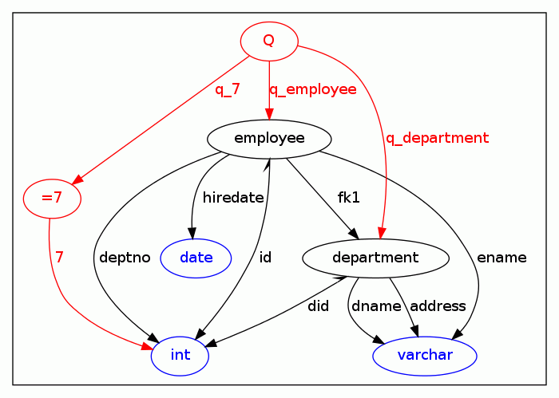
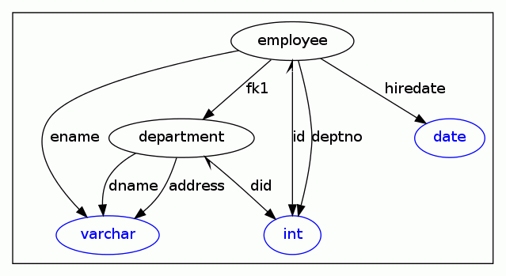
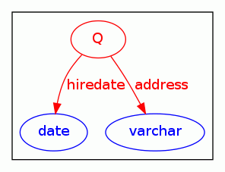
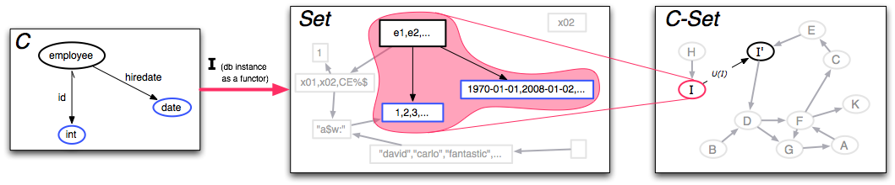

Category Theory as a Unifying Database Formalism
David Spivak, Carlo A. Curino
Massachusetts Institute of Technology
HISTORY OF A PROBLEM:
The relational model is based on logic and set-theory (150 year old math)
DB success motivated many system and theory advances
Foundational fragmentations resulted from many (independent) extensions to the core theory.
OBSERVATIONS:
A parallel fragmentation naturally occurred in pure math (e.g., algebra, geometry, logic)
Category theory invented as a unifying formalism for pure math.
Category theory is used as a formal underpinning of much programming language theory, linguistics, physics.
THE SOLUTION
We propose category theory as a unifying formalism for database theory
Schemas and Queries as Categories and Functors
Schema
Query
CREATE TABLE employee(
id int, ename varchar,
hiredate date, deptno int,
PRIMARY KEY (id),
FOREIGN KEY fk1 (deptno)
REFERENCES department(did)
);
CREATE TABLE department(
did int, dname varchar,
address varchar, PRIMARY KEY (did)
);
SELECT e.hiredate, d.address
FROM employee e, department d
WHERE e.deptno = d.did AND e.id="7";
COMMUTE:
deptno = did•fk1;
7•q_7 = id•q_employee
did•q_department =
deptno•q_employee;
COMMUTE:
deptno = did•fk1;
F: (obvious inclusion, i.e., object and arrow labels are preserved)
G: (object labels are preserved)
hiredate ➔hiredate•q_employee
address ➔ address•q_department
Instances and Updates as Functors
Schema (C)
DB Instance (I)
Update (U)
CREATE TABLE employee(
id int, hiredate date,
PRIMARY KEY (id),
);
e1,1,1970-01-01
e2,2,2008-01-02
e3,3,1987-02-09
...
INSERT INTO employee
VALUES (e4,4,2011-01-28);
The awesome results we don’t have yet
Math Background
Existing category theory proofs can be imported (e.g., functor composability is equivalent to classical DB mapping composition)
We can leverage proof-assistants (e.g., COQ)
Better interaction with PL (the category of Types)
Unifying theory for updates, transactions, aggregates, triggers, 2PC, 2PL, etc...
C-Set is the category of functors from C➔Set; its morphisms are sometimes called “homomorphisms” in database theory.
C-Set is a topos: it has an internal logic that supports the Lambda calculus.
A functor C➔D induces migrations functors between C-Set and D-Set, which can be used both to migrate data, or as a query (see above).

