Slide 1


Team Name: DevAgentix
Use Case Name: Enterprise Knowledge Assistant (RAG + Agentic Workflow)
Team Members:
Ashish Nathavani (ashish@devangles.com)
Vikram Sanghvi (vikram@devangles.com)
Aditya Bhatt (aditya.bhatt@devangles.com)
Digvijay Jakhaniya (digvijay.jakhaniya@devangles.com)
Sakshi Dhondkar (sakshi@devangles.com)
Krishna Gokani (krishna@devangles.com)
CLICK HERE TO WATCH OUR PITCH VIDEO

Slide 2
Problem Understanding & Objectives
Problem Statement - Large IT enterprises suffer from critical knowledge fragmentation across scattered PDFs, wiki pages, and historical support tickets. This creates "tribal knowledge" silos that result in redundant ticket creation, extended resolution times, and inefficient onboarding of new engineers.
Core Objectives - Build a reasoning-capable 'Expert-in-the-pocket' that retrieves and validates internal data with 100% source-citation, ensuring DPDP/GDPR compliance via automated PII redaction before data reaches the LLM.
Key Stakeholders - IT Support Engineers, New Hires, HR & Operations Teams, Enterprise Leadership
Solution Need - RAG has shifted from experimental to production-critical to ensure real-time accuracy and compliance.
Social Impact - Promotes adoption of AI tools aligned with global privacy laws like India's DPDP Act and GDPR.

Slide 3
Market Size & Business Impact
Market Opportunity & Statistics
Enterprise Search Market: Projected to grow from $4.9B (2023) to $8.85B (2030).
Steady Growth: Maintaining a 8.9% CAGR through the decade.
Accelerated KM Growth: Knowledge Management Software is outperforming at a ~13.6% CAGR.
The AI Catalyst: Growth is primarily fueled by AI solutions designed to eliminate organizational knowledge silos.
Impact Assessment
Efficiency: 99% reduction in query latency (30 mins → <10 seconds).
Cost Saving: 40%+ ticket deflection through agentic self-service.
Trust: 100% source verification with clickable metadata citations.
Accelerated onboarding and measurable productivity gains at enterprise scale.
Investment Level
Moderate; focuses on high-ROI open-source models and modular code to avoid vendor lock-in.
Source: Grand view research for Enterprise Search(2023 - 2030). & McKinsey Digital Report on Knowledge Work Productivity.

Slide 4
Existing Solutions in the market
Current Landscape | The Critical Gaps | Our Technical Edge
Manual Search: 30+ min wasted in fragmented portals/wikis. | Multi-Hop Failure: Standard tools cannot link a Technical SOP to a Jira Ticket resolution. | Confidence Guardrails: Hard Score < 0.65 logic; triggers Human-in-the-Loop instead of hallucinating.
Legacy Chatbots: "Naive RAG" lacks context & multi-step reasoning. | Hallucination Risk: LLMs "guess" when data is missing, creating a reliability gap. | PII Shield: NER-based scrubbing for 100% DPDP/GDPR Compliance before data hits the LLM.
Existing Tools: Glean, Kendra, Coveo. (Search-first "Black Boxes" with limited reasoning). | Compliance Vacuum: Lack of auditable redaction aligned with India's DPDP Act. | Agentic Workflow: Built on LangGraph (ReAct pattern) for autonomous tool routing.
 |  | BGE-Reranker: Precision accuracy; Verified Citations via metadata tracking.

Slide 5
Proposed Solution Approach
Solution Overview
A stateful Agentic system built on LangGraph using the ReAct pattern. Moving beyond Naive RAG, our Agent reasons to select the best tool (Search, Lookup, or Summarize) while utilizing auditable layers for PII redaction and reranking.
Key Layers
Data Ingestion: Documents are parsed, chunked, embedded, and stored in a vector database with metadata for traceable retrieval.
Agentic Reasoning: A LangGraph orchestrator selects the right tool for each query, such as document search, ticket lookup, or summarization.
Retrieval & Reranking: Vector search finds candidate chunks, then BGE-Reranker prioritizes the most relevant results before generation.
Generation & Guardrails: The model returns grounded answers with inline citations, or “Answer not found” when confidence is too low.
Dependencies: Data Access & Quality, Model Availability, Infrastructure.
Assumptions: Document Readability, English Language Primary, Stable Schema, Historical tickets contain valid "Resolution" data.

Slide 6
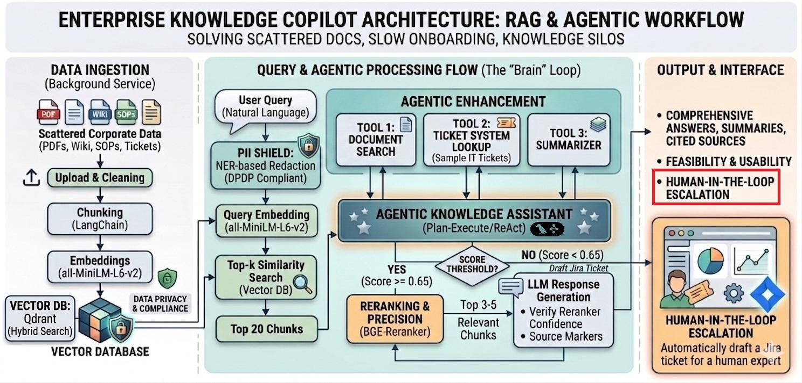
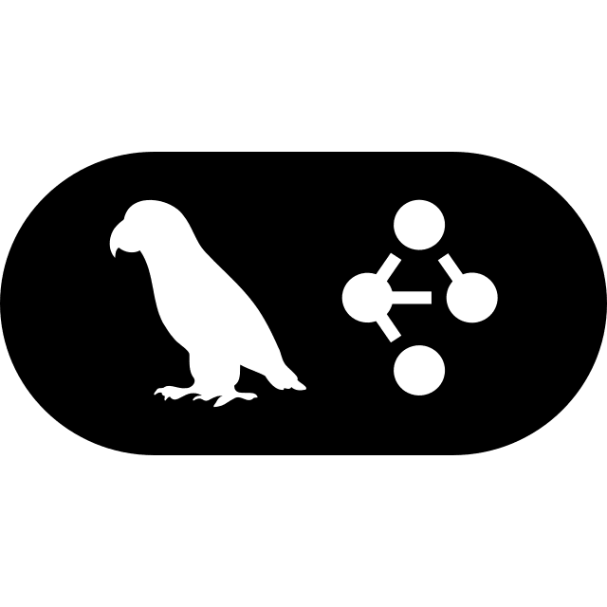
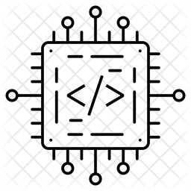


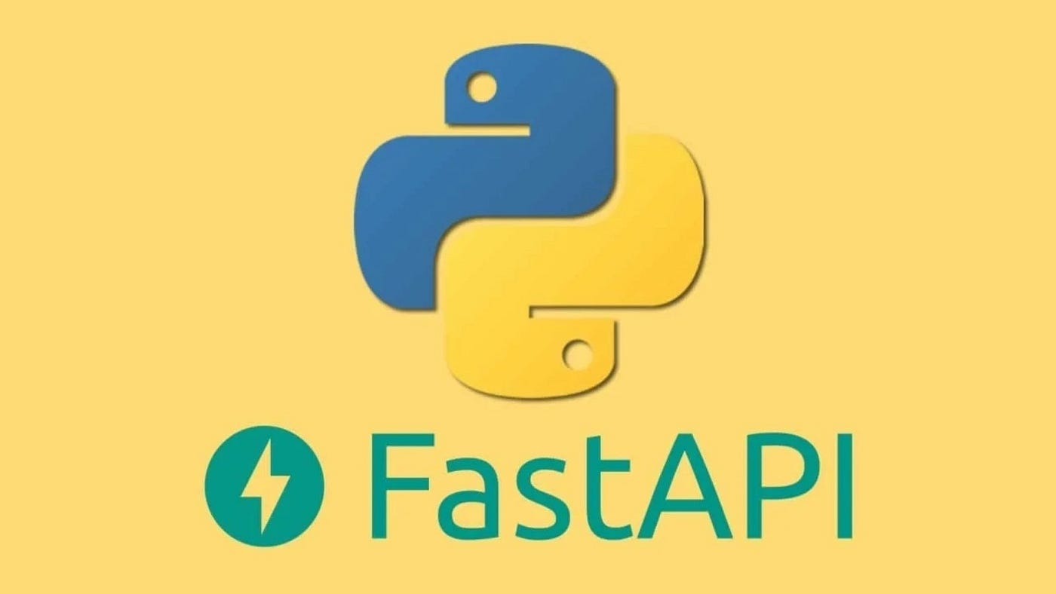



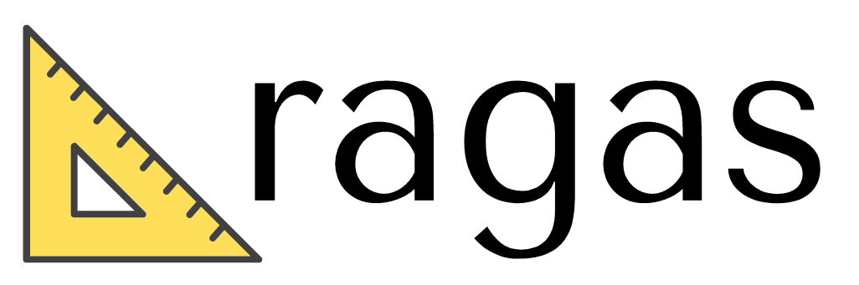
High-Level Solution Design
all-MiniLM-L6-v2
BGE-Reranker

Slide 7
Technical Details
Technical Feasibility Assessment
Proven Frameworks: The solution utilizes LangChain for robust document parsing (PDFs, CSVs) and recursive chunking to ensure context preservation during ingestion.
High-Precision Retrieval: Employs Qdrant for high-speed vector storage and integrates a BGE-Reranker to locally refine search results, ensuring accuracy before generation.
Performance Targets: The architecture is designed to maintain end-to-end latency under 10 seconds, meeting enterprise expectations for real-time query resolution.
Business Viability
Measurable ROI: Targets a reduction in query resolution time from 15-30 minutes to under 10 seconds, with an expected 40%+ ticket deflection rate through self-service knowledge access.
Market Alignment: Addresses the growing $8.85B enterprise search market by specifically eliminating "tribal knowledge" silos that hinder productivity.
Open-Source Strategy: Focuses on high-ROI open-source models (e.g., Llama 3) to minimize licensing costs and avoid vendor lock-in.

Slide 8
Technical Details
Solution Security Considerations
Privacy Compliance: Integrated PII redaction (e.g., NER-based PII Scrubbing) before hitting the inference engine ensures the system aligns with global data protection laws, including India's DPDP Act and GDPR.
Hallucination Guardrails: Implements confidence-threshold guardrails; if the reranker confidence score falls below 0.65, the system automatically escalates or returns "Answer not found" to prevent misinformation.
Auditability: Every generated answer includes inline source citations backed by metadata tracking, providing 100% verification for compliance audits.
Solution Scalability Considerations
Model-Agnostic Design: Built on LangGraph, allowing the enterprise to switch seamlessly between proprietary models (Gemini) and open-source alternatives (Llama 3) as requirements evolve.
Deployment Readiness: Utilizes Docker and Docker Compose for consistent, containerized deployment across diverse enterprise cloud or on-premise environments.
Stateful Orchestration: The LangGraph orchestrator provides secure, stateful management of complex user sessions and multi-turn dialogues.

Slide 9
Technical Details
Technical Complexity & Evaluation
Agentic Reasoning (ReAct): Built on LangGraph, the system autonomously selects between Document Search, Jira Ticket Lookup, or Summarization based on query intent.
Multi-Hop Anaysis: Solves complex queries that require linking disparate data types, such as connecting a historical resolution in a support ticket to a current technical SOP.
Query: "Why is VPN failing for the Mumbai branch?"
Agent Logic: 1. Pulls Mumbai Network SOP —> 2. Checks Jira Tickets for recent branch outages —> 3. Synthesizes a unified resolution.
Precision Reranking: Utilizing BGE-Reranker to move beyond simple vector similarity, ensuring only the most contextually relevant chunks are processed.
Rigorous Benchmarking (RAGAS & SQUAD):
Answer Faithfulness: > 0.85 (Ensuring zero hallucination).
Mean Reciprocal Rank (MRR): > 0.80 (Ensuring top-tier retrieval accuracy).
Human-in-the-loop: Any reasoning path with a confidence score < 0.65 is automatically flagged for human expert intervention to ensure 100% reliability.

Slide 10
THANK YOU
WATCH OUR 2-MIN PITCH VIDEO

