Slide 1

Credit One Starting Insights
David Splawn

Slide 2
Business Question
Fundamental Business Question: Understand why the number of customers who default on loans in increasing and how to prevent it. Understanding how much credit to give and whether or not to approve or not.
Stakeholders Need for Project: Defaulting in loans results in loss of money for the company.
Resources Needed: Bank Loan Data
Impact of Initiative: (Will quantify how much money is resulting in loss because of defaults in EDA)

Slide 3
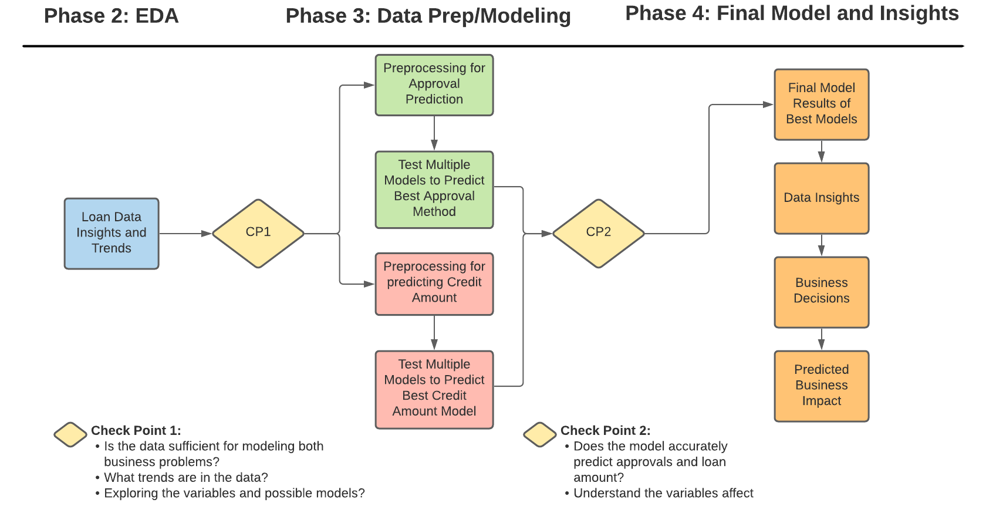
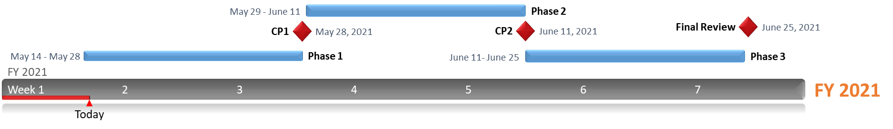
Analysis Plan

Slide 4
Data Collection and Management
Where is the data from- SQL Credit One Relational Database
First Pass Data Description Data
 | ID | LIMIT_BAL | SEX | EDUCATION | MARRIAGE | AGE | PAY_0 | PAY_2 | PAY_3 | PAY_4 | PAY_5 | PAY_6
Volume | 30203 | 30203 | 30203 | 30203 | 30203 | 30203 | 30203 | 30203 | 30203 | 30203 | 30203 | 30203
Null Amount | 0 | 0 | 0 | 0 | 0 | 0 | 0 | 0 | 0 | 0 | 0 | 0
Data Type | Object | Object | Object | Object | Object | Object | Object | Object | Object | Object | Object | Object
Unique | 30002 | 83 | 4 | 6 | 6 | 58 | 13 | 13 | 13 | 13 | 12 | 12
Duplicates | 201 | 201 | 201 | 201 | 201 | 201 | 201 | 201 | 201 | 201 | 201 | 201
Mode |  | 50000 | female | university | 2 | 29 | 1 |  | 0 | 0 | 0 | 0
Frequency of Mode | 1 | 3365 | 18112 | 14030 | 15964 | 1605 | 14737 | 15730 | 15764 | 16455 | 16947 | 16286
Value | Unique Identifyer | Amount Given IN loan | Gender | Education | Marriage | Age | Repayment Sept 2005 | Repayment Aug 2005 | Repayment July 2006 | Repayment June 2006 | Repayment May 2007 | Repayment Apr 2007
 | BILL_AMT1 | BILL_AMT2 | BILL_AMT3 | BILL_AMT4 | BILL_AMT5 | BILL_AMT6 | PAY_AMT1 | PAY_AMT2 | PAY_AMT3 | PAY_AMT4 | PAY_AMT5 | PAY_AMT6 | defaultpaymentnextmonth
Volume | 30203 | 30203 | 30203 | 30203 | 30203 | 30203 | 30203 | 30203 | 30203 | 30203 | 30203 | 30203 | 30203
Null Amount | 0 | 0 | 0 | 0 | 0 | 0 | 0 | 0 | 0 | 0 | 0 | 0 | 0
Data Type | Object | Object | Object | Object | Object | Object | Object | Object | Object | Object | Object | Object
Unique | 22725 | 22348 | 22028 | 21550 | 21012 | 20606 | 7945 | 7901 | 7520 | 6939 | 6899 | 6941 | 4
Duplicates | 201201 | 201 | 201
Mode | 0 | 0 | 0 | 0 | 0 | 0 | 0 | 0 | 0 | 0 | 0 | 0 | not default
Frequency of Mode | 2008 | 2506 | 2870 | 3195 | 3506 | 4020 | 5249 | 5396 | 5968 | 6408 | 6703 | 7173 | 23364
Value | Repayment Sept 2005 | Repayment Aug 2005 | Repayment July 2005 | Repayment June 2005 | Repayment May 2005 | Repayment Apr 2005 | amount paid in Sept 2005 | amount paid in Aug 2005 | amount paid in July 2005 | amount paid in June 2005 | amount paid in May 2005 | amount paid in Apr 2005 | Ultimate Business Variable

Slide 5
Problems with Data and Solutions
- 201 duplicates- 'SELECT DISTINCT * FROM credit’
- 2 rows of headers- passing a list of wanted names or reset index
- Header in the dataset- create mask that searches and filter out
- Numerical Data is in object dtype- use the .apply(pd.to_numeric)
- Categorical Data – sk.preprocessing one hot encoding
- Pay_0 = Pay_1
- Change “default payment next month” index name

Slide 6
Data Description After 1st Cleansing
 | ID | LIMIT_BAL | SEX | EDUCATION | MARRIAGE | AGE | PAY_1 | PAY_2 | PAY_3 | PAY_4 | PAY_5 | PAY_6
Volume | 30000 | 30000 | 30000 | 30000 | 30000 | 30000 | 30000 | 30000 | 30000 | 30000 | 30000 | 30000
Data Type | int64 | int64 | object | object | int64 | int64 | int64 | int64 | int64 | int64 | int64 | int64
Unique | 30000 | 81 | 2 | 4 | 4 | 56 | 11 | 11 | 11 | 11 | 10 | 10
Value | Unique Identifyer | Amount Given IN loan | Gender | Education | Marriage | Age | Repayment Sept 2005 | Repayment Aug 2005 | Repayment July 2006 | Repayment June 2006 | Repayment May 2007 | Repayment Apr 2007
mean | NaN | 167484.3227 | NaN | NaN | NaN | 35.4855 | -0.0167 | -0.13377 | -0.1662 | -0.22067 | -0.2662 | -0.2911
std | NaN | 129747.6616 | NaN | NaN | NaN | 9.217904 | 1.123802 | 1.197186 | 1.196868 | 1.169139 | 1.133187 | 1.149988
min | NaN | 10000 | NaN | NaN | NaN | 21 | -2 | -2 | -2 | -2 | -2 | -2
0.25 | NaN | 50000 | NaN | NaN | NaN | 28 | -1 | -1 | -1 | -1 | -1 | -1
0.5 | NaN | 140000 | NaN | NaN | NaN | 34 | 0 | 0 | 0 | 0 | 0 | 0
0.75 | NaN | 240000 | NaN | NaN | NaN | 41 | 0 | 0 | 0 | 0 | 0 | 0
max | NaN | 1000000 | NaN | NaN | NaN | 79 | 8 | 8 | 8 | 8 | 8 | 8
Range | NaN | 990000 | NaN | NaN | NaN | 58 | 10 | 10 | 10 | 10 | 10 | 10
Variance | NaN | 16834460000 | NaN | NaN | 0.2724523 | 84.96976 | 1.26293 | 1.433254 | 1.432492 | 1.366885 | 1.284114 | 1.322472
Skewness | NaN | 0.992867 | NaN | NaN | -0.018742 | 0.732246 | 0.731975 | 0.790565 | 0.840682 | 0.999629 | 1.008197 | 0.948029
Mode | NaN | 50000 | female | university | 2 | 29 | 0 | 0 | 0 | 0 | 0 | 0
Frequency of Mode | 1 | 3365 | 18112 | 14030 | 15964 | 1605 | 14737 | 15730 | 15764 | 16455 | 16947 | 16286

Slide 7
Data Description After 1st Cleansing Cont.
 | BILL_AMT1 | BILL_AMT2 | BILL_AMT3 | BILL_AMT4 | BILL_AMT5 | BILL_AMT6 | PAY_AMT1 | PAY_AMT2 | PAY_AMT3 | PAY_AMT4 | PAY_AMT5 | PAY_AMT6 | defaultpaymentnextmonth
Volume | 3.00E+04 | 30000 | 30000 | 30000 | 30000 | 3.00E+04 | 30000 | 30000 | 30000 | 30000 | 30000 | 30000 | 30000
Data Type | int64 | int64 | int64 | int64 | int64 | int64 | int64 | int64 | int64 | int64 | int64 | int64 | object
Unique | 22723 | 22346 | 22026 | 21548 | 21010 | 20604 | 7943 | 7899 | 7518 | 6937 | 6897 | 6939 | 2
Value | Repayment Sept 2005 | Repayment Aug 2005 | Repayment July 2005 | Repayment June 2005 | Repayment May 2005 | Repayment Apr 2005 | amount paid in Sept 2005 | amount paid in Aug 2005 | amount paid in July 2005 | amount paid in June 2005 | amount paid in May 2005 | amount paid in Apr 2005 | Ultimate Business Variable
mean | 5.12E+04 | 49179.08 | 47013.15 | 43262.95 | 40311.4 | 3.89E+04 | 5663.5805 | 5921.163 | 5225.682 | 4826.077 | 4799.388 | 5215.503 | NaN
std | 73635.86 | 71173.77 | 69349.39 | 64332.86 | 60797.16 | 59554.10754 | 16563.28035 | 23040.87 | 17606.96 | 15666.16 | 15278.31 | 17777.47 | NaN
min | -165580 | -69777 | -157264 | -170000 | -81334 | -339603 | 0 | 0 | 0 | 0 | 0 | 0 | NaN
0.25 | 3558.75 | 2984.75 | 2666.25 | 2326.75 | 1763 | 1256 | 1000 | 833 | 390 | 296 | 252.5 | 117.75 | NaN
0.5 | 22381.5 | 21200 | 20088.5 | 19052 | 18104.5 | 17071 | 2100 | 2009 | 1800 | 1500 | 1500 | 1500 | NaN
0.75 | 67091 | 64006.25 | 60164.75 | 54506 | 50190.5 | 49198.25 | 5006 | 5000 | 4505 | 4013.25 | 4031.5 | 4000 | NaN
max | 964511 | 983931 | 1664089 | 891586 | 927171 | 961664 | 873552 | 1684259 | 896040 | 621000 | 426529 | 528666 | NaN
Range | 1130091 | 1053708 | 1821353 | 1061586 | 1008505 | 1301267 | 873552 | 1684259 | 896040 | 621000 | 426529 | 528666 | NaN
Variance | 5.42E+09 | 5.07E+09 | 4.81E+09 | 4.14E+09 | 3.7E+09 | 3546692000 | 274342300 | 530881700 | 3.1E+08 | 2.45E+08 | 2.33E+08 | 3.16E+08 | NaN
Skewness | 2.663861 | 2.705221 | 3.08783 | 2.821965 | 2.87638 | 2.846645 | 14.668364 | 30.453817 | 17.21664 | 12.90499 | 11.12742 | 10.64073 | NaN
Mode | 0 | 0 | 0 | 0 | 0 | 0 | 0 | 0 | 0 | 0 | 0 | 0 | not default
Frequency of Mode | 2008 | 2506 | 2870 | 3195 | 3506 | 4020 | 5249 | 5396 | 5968 | 6408 | 6703 | 7173 | 23364

