Slide 1
MLFLOW

Slide 2
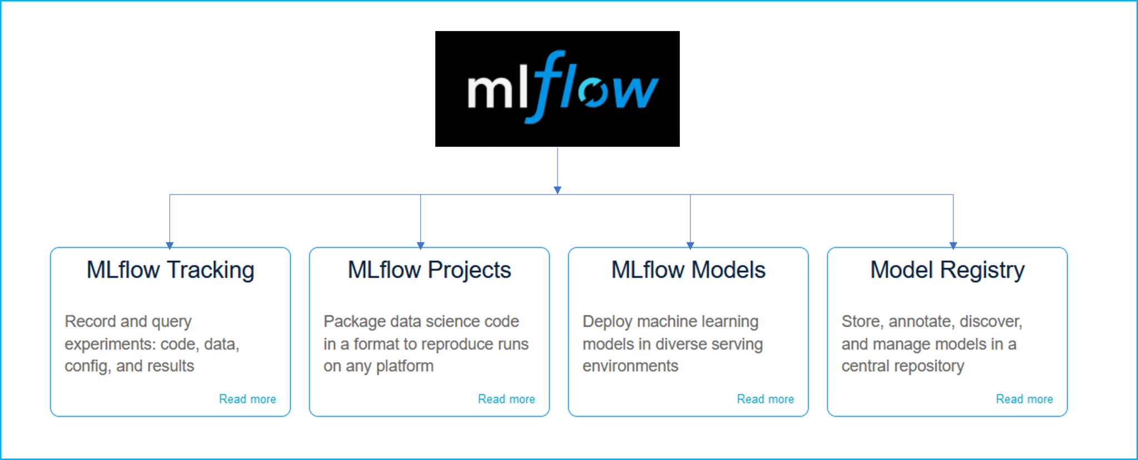

Slide 3
Core Components
1. MLflow Tracking
Experiment tracking: Log parameters, metrics, tags, and artifacts
Visual comparison: Compare runs across experiments
API support: Python, Java, R, and REST APIs
2. MLflow Projects
Packaging format for reproducible runs
Supports Conda, Docker, and system environments
3. MLflow Models
Standard format for packaging models
Supports multiple flavors (Python functions, PyTorch, TensorFlow, etc.)

Slide 4
MLflow Model Tracking and Experiments
MLflow is an open-source platform for managing the machine learning lifecycle, including experimentation, reproducibility, and deployment.

Slide 5
VectorAssembler
feature engineering tool that packs multiple columns into one "features" vector column required by Spark ML algorithms.

Slide 6
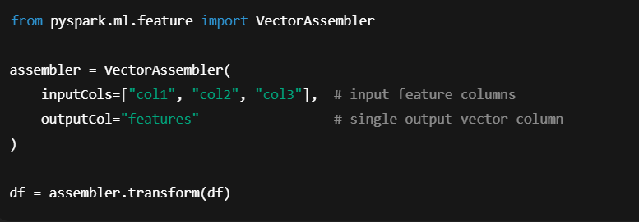
Vector Assembler

Slide 7
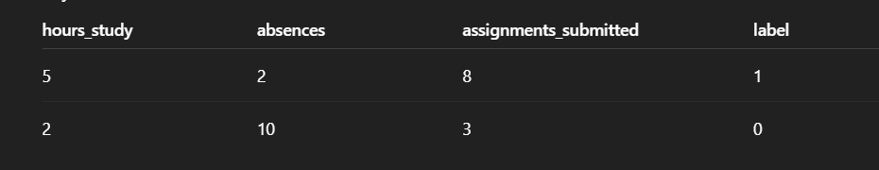
Sample Data

Slide 8
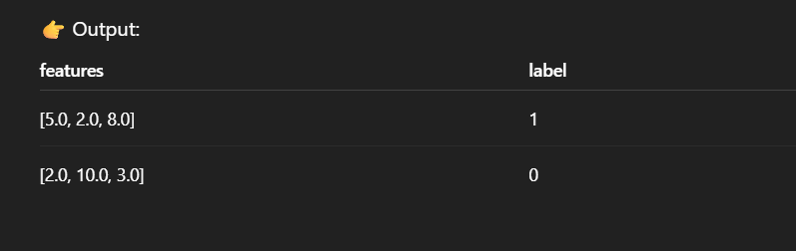
Using vector assembler
assembler = VectorAssembler(
inputCols=["hours_study", "absences", "assignments_submitted"],
outputCol="features"
)
df = assembler.transform(df).select("features", "label")
df.show(truncate=False)

Slide 9
model.transform(test_df) in Spark ML
When you train a model in PySpark MLlib (like Logistic Regression, Decision Tree, etc.), the result is a model object (e.g., LogisticRegressionModel).
This trained model has a .transform() method.
What .transform(test_df) does
It takes a DataFrame of features (test_df) and:
Applies the trained model to each row.
Adds new columns to the DataFrame:
rawPrediction → raw scores before probability (log-odds for logistic regression).
probability → predicted probability for each class.
prediction → final class label (0/1) based on the default threshold (0.5 for binary classification).

Slide 10
What is ML Pipeline Automation?
An automated ML pipeline is a workflow that handles the ML lifecycle end-to-end:
Ingest & preprocess data (ETL/ELT with Spark/Delta tables).
Train multiple models (e.g., Logistic Regression, Random Forest, XGBoost).
Track experiments (params, metrics in MLflow).
Select best model (e.g., highest AUC).
Register best model into MLflow Model Registry (Unity Catalog).
Promote alias (staging → production) automatically.
Deploy model (Databricks Model Serving endpoint or batch inference).
Monitor & retrain when performance drops (drift detection).

Slide 11
Pipeline Overview
Ingest student dataset (from CSV or manually create a dataframe)
Preprocess data (VectorAssembler, feature encoding, train-test split)
Train ML model (Logistic Regression / RandomForest)
Log metrics & model to MLflow
Register model in MLflow Registry
Automate via Databricks Jobs

