Slide 1
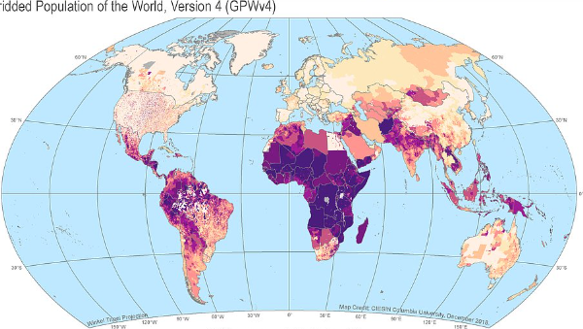
World Demographic Analysis 2021
Group Members :
Shankara Parameshwari Navya Sri Dameruppula (FE56296)
Sukruthi Yakkala (XW77619)
Under Guidance:
604 : DATA MANAGEMENT
Dr. Sarika Rajeev

Slide 2
INTRODUCTION:
In this SQL Analysis, We have web scrapped the data from Different sources , they are mentioned.The main aim of this Web scraping instead of getting the database was due to lack of information with required columns that was pre built in one dataset.Every column was been bought from different website and formed created a database with 3 Tables. The columns Names and Datatypes are mentioned. I used sqlite for the respective analysis. Used pandas,seaborn and matplotlib for visualization .This is a real life data where conclusion’s can be drawn for the analysis prepared.

Slide 3
Tools used:
Web scraping : Extract content and data from a Website using selenium in Python and Pandas
SQL : Joining two different tables with unique primary key and implementing problem statements.
Python : Visualization & Plotting Graphs

Slide 4
Columns:
Different Countries as Primary Key.
1. https://en.wikipedia.org/wiki/List_of_countries_by_number_of_births(Column name : Number of Birth),
2. https://worldpopulationreview.com/country: (-rankings/suicide-rate-by-country (Column name : Suicide Rate ),
https://en.wikipedia.org/wiki/List_of_countries_by_number_of_deaths(Column name : Number of Death),
3. https://www.cia.gov/the-world-factbook/field/total-fertility-rate/country-comparison(Colum n name : Fertility Rate),
4. https://en.wikipedia.org/wiki/List_of_countries_by_life_expectancy(Column name : Life-Expectancy)
Which is connected to other datasets with the link:
https://worldpopulationreview.com/countries. Columns Population, Area, Density).

Slide 5
Problem Faced : While changing the datatype of every column, I have web scrape into SQl. To overcome this there are two solution’s we need to create a table with proper datatype’s for each column or use alter datatype as per our requirment’s.
Other solution , Using pandas we need to load the csv then change the datatype via pandas and use pd.read_sql for use the table’s for analysis.

Slide 6
DATASET Table1
Country VARCHAR(32) NOT NULL PRIMARY KEY
Number_of_births_2021 INTEGER NOT NULL
Number_of_deaths_2021 INTEGER NOT NULL
Suicide_Rate INTEGER NOT NULL
Fertility_Rate INTEGER NOT NULL
Life_expectancy INTEGER NOTNULL

Slide 7
DATASET TABLE 2
Country VARCHAR(32) NOT NULL PRIMARY KEY
Population INTEGER NOT NULL
Area INTEGER NOT NULL
Density INTEGER NOT NULL

Slide 8
Project Table
Country VARCHAR(32) NOT NULL PRIMARY KEY
Number_of_births_2021 INTEGER NOT NULL
Number_of_deaths_2021 INTEGER NOT NULL
Suicide_Rate INTEGER NOT NULL
Fertility_Rate INTEGER NOT NULL
Life_expectancy INTEGER NOTNULL
Population INTEGER NOT NULL
Area INTEGER NOT NULL
Density INTEGER NOT NULL
This table is formed from inner join of Table 1 and Table 2

Slide 9
Queries :
Find the Top 10 countries with the highest Number of Birth.
Find the countries and Areas if countries have an area greater than 5,00,000 km.
Find the 10 least suicide rates in countries with a max fertility rate Select TOP 10 .
Find the Number of birth and country name in each country with minimum Life expectancy.
Find the density and population across countries where Max number of deaths took place

Slide 10
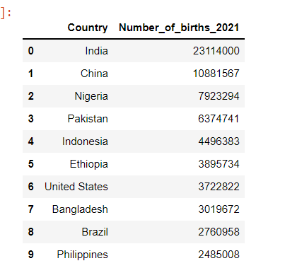
1.Top 10 countries with the highest Number of Birth.
Problem_1= pd.read_sql_query('SELECT Country,Number_of_births_2021 from PROJECT order by Number_of_births_2021 DESC LIMIT 10;',conn)

Slide 11
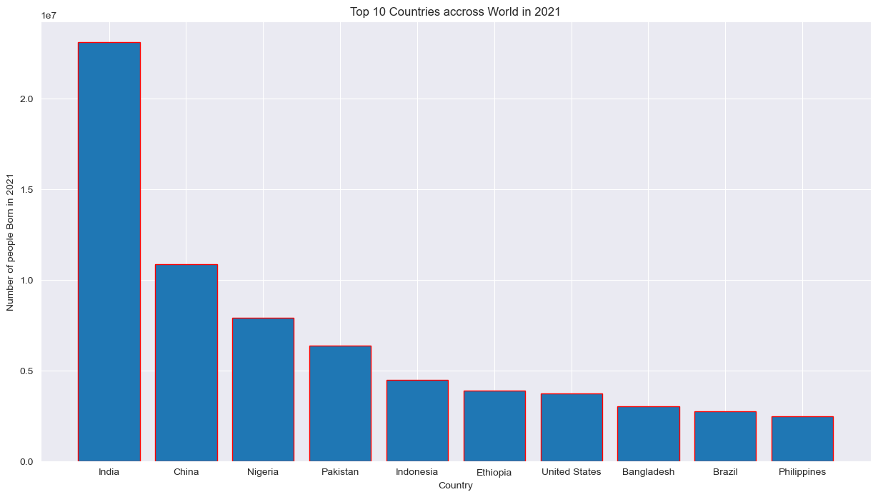
Top 10 countries across world in 2021

Slide 12
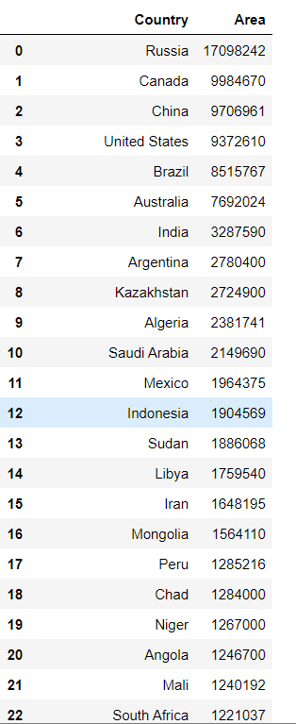
2. The countries with area greater than 5,00,000 km.
Problem_2 = pd.read_sql_query('Select Country,Area from Project where area > 500000 order by Area DESC;',conn)

Slide 13
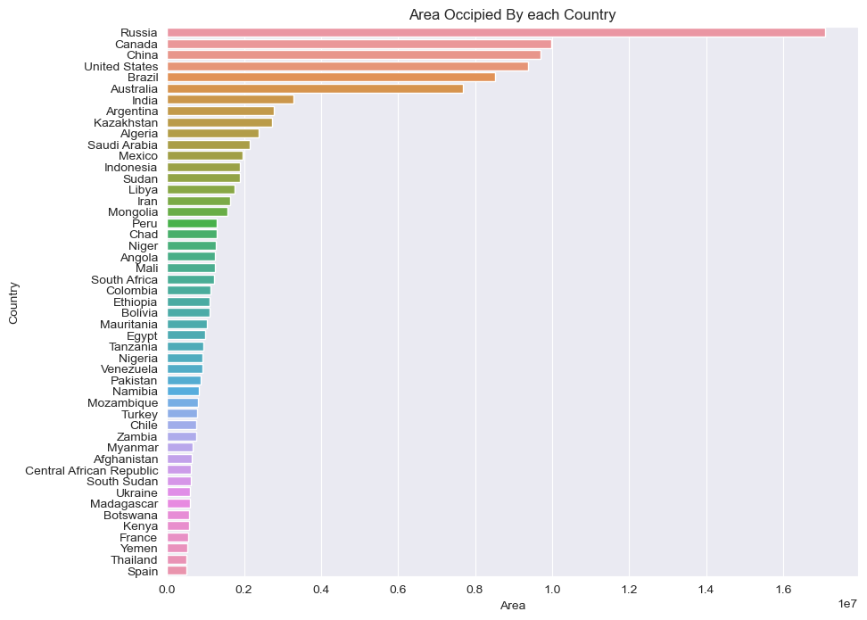
Area occupied by each country

Slide 14
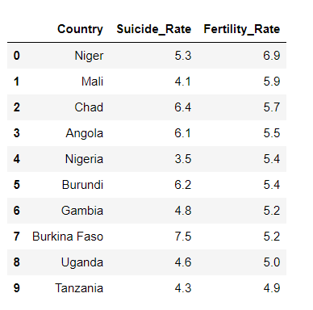
3. The 10 least suicide rates in countries with a max fertility rate Select TOP 10 .
Problem_3 = pd.read_sql_query('SELECT country,Suicide_Rate,Fertility_Rate from PROJECT order by Fertility_Rate DESC,Suicide_Rate ASC LIMIT 10;',conn)

Slide 15
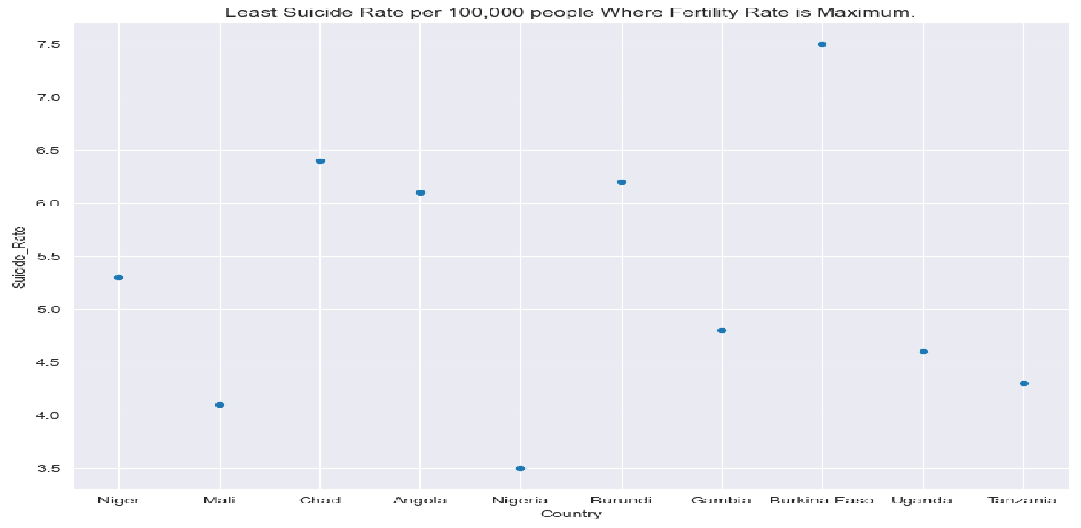
Least Suicide Rate per 100,000 people where Fertility Rate is Maximum.

Slide 16
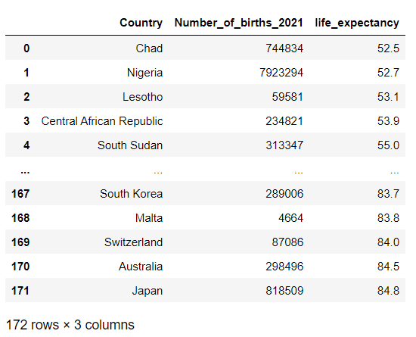
4. The Number of births count and Country names with minimum Life expectancy.
Problem_4 = pd.read_sql_query("Select Country,Number_of_births_2021,life_expectancy from PROJECT order by life_expectancy;",conn)

Slide 17
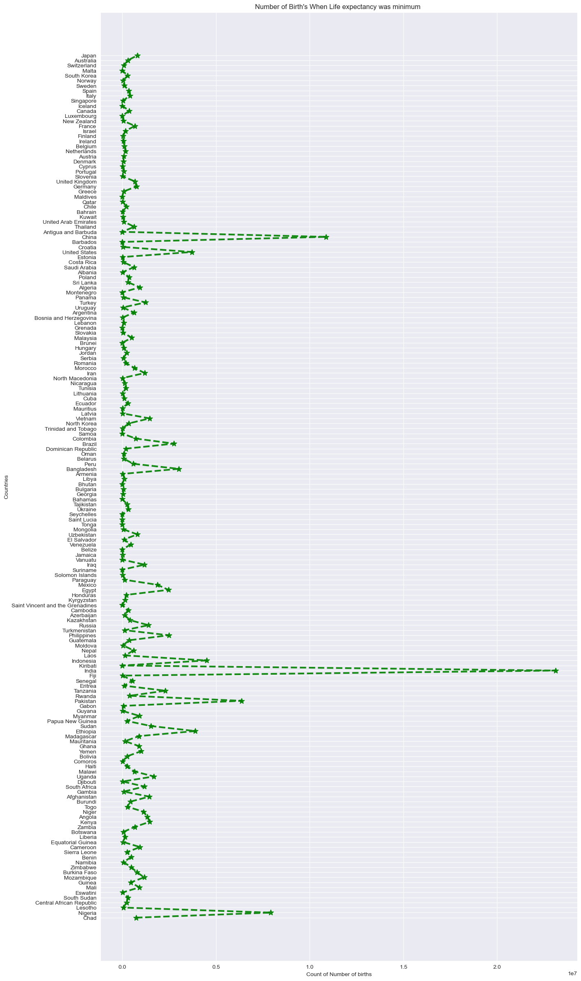
Number of Births When Life expectancy was minimum.

Slide 18
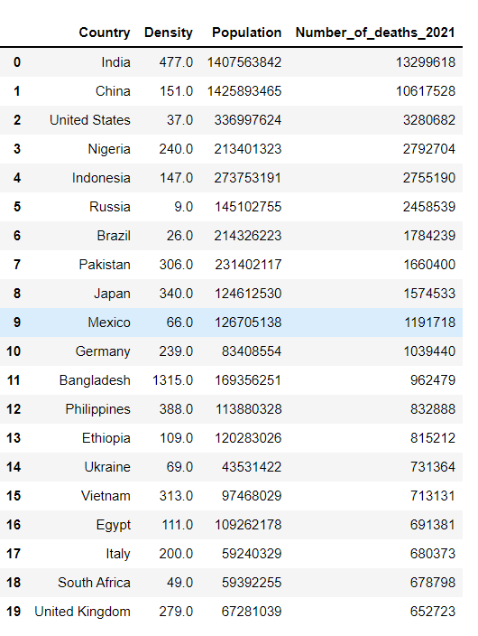
5. The Density and Population across countries where Max number of deaths took place
Problem_5 = pd.read_sql_query("Select country,Density,Population,Number_of_deaths_2021 from PROJECT order by Number_of_deaths_2021 DESC LIMIT 20;",conn)

Slide 19
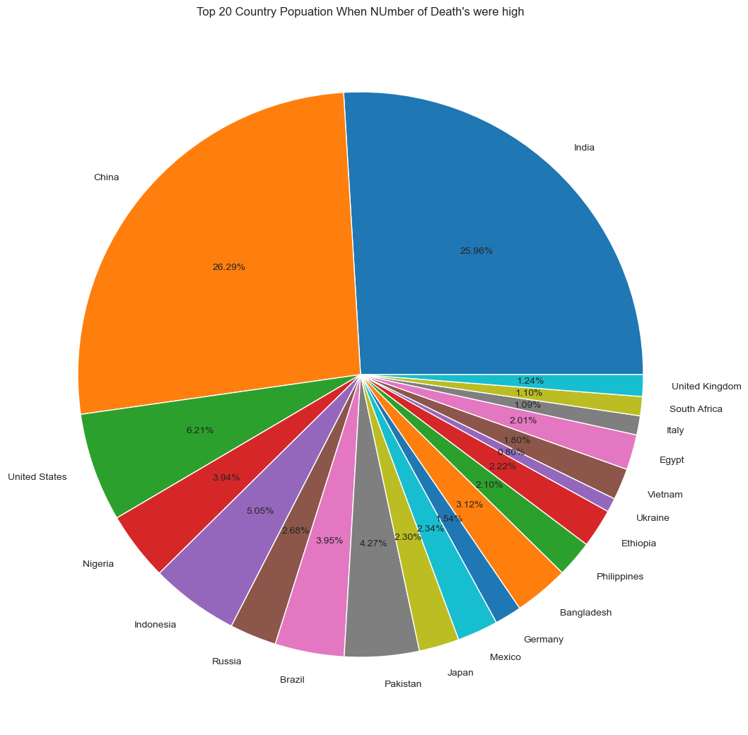
Top 20 Country Population When Number of Deaths were high

Slide 20
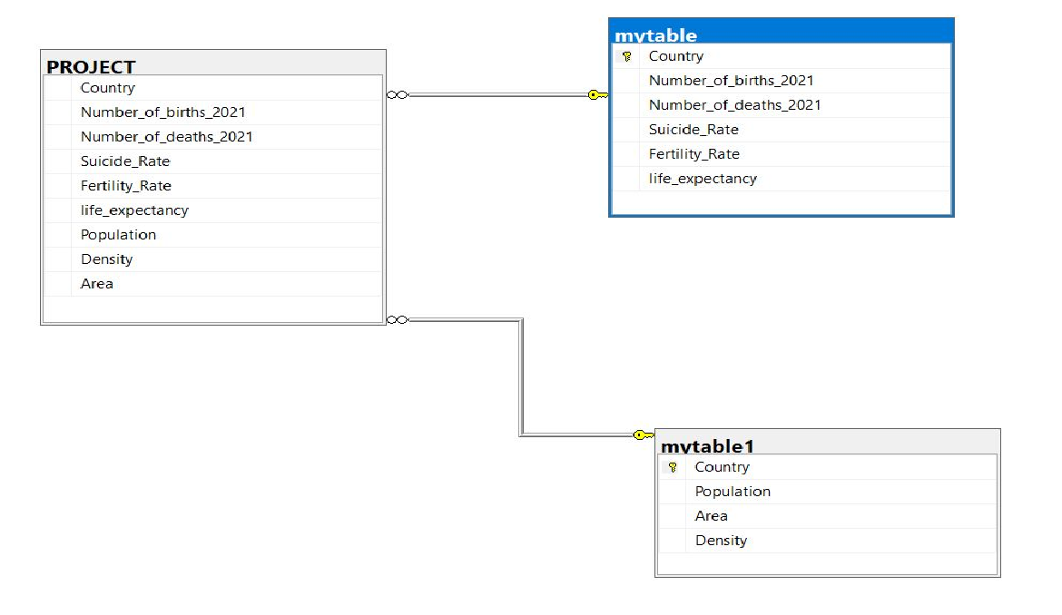
E-R DIAGRAM

Slide 21
CONCLUSION:
From this analysis We can jot down few predictions such as ,
1. India was ranking highest in terms of Number of Births.
2. Russia is having the largest Area next comes Canada and so on.
3. Nigeria has the lowest sucide rate , but has maximum fertility rate.(The higher the fertility rate the lower the suicide rate.) This is a fact we can see in the graph.
4. ( If long life is valued and death control is established, then either the birth rate must come down to match the new death rate, or population must rise.)The Number of birth took place when the life expectancy was minimum () has the highest number of births. That’s the case happening in those rising country.
5. (The Mortality Rate(Death’s) Increases, the population growth decreases), where india and china could make up to withstand the population.
I learnt that SQL using on real world datasets with all math and calculations are predicting the fact’s with all those number’s , The relations between the countries
based on the demographic calculations.

Slide 22
THANK YOU

