Slide 1
LINQ in C#
Salvatore Sorrentino

Slide 2
Novità introdotte con C# 2.0

Slide 3
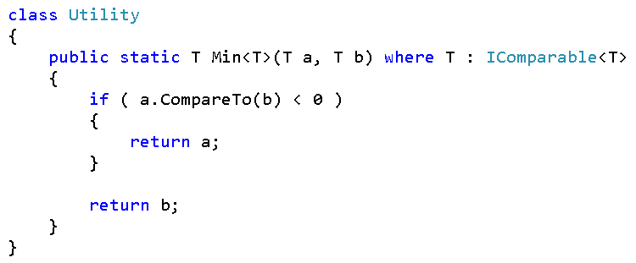


Ripartiamo da generics
Type Inference

Slide 4
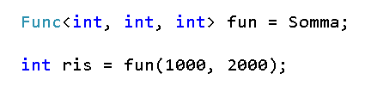
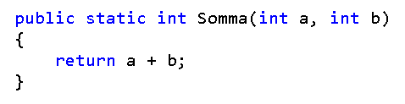
Generic Delegates
Un delegate è una classe che incapsula un metodo.
Da un punto di vista astratto è come se fosse un contenitore di codice che può essere passato attraverso funzioni.

Slide 5
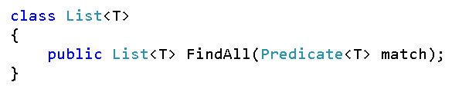
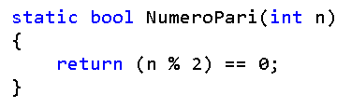
Anonymous Methods
Anonymous Method

Slide 6
Novità introdotte con C# 3.0

Slide 7
Lambda Expressions

Slide 8
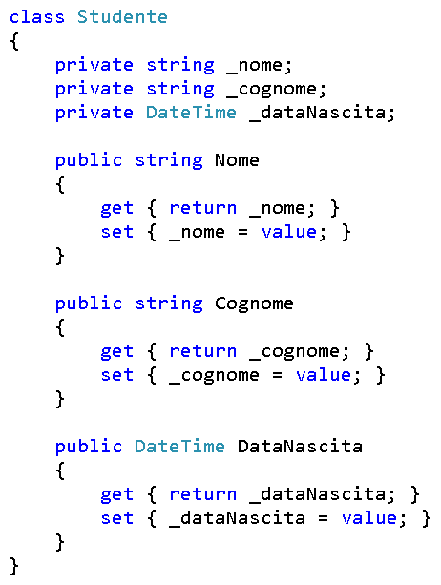
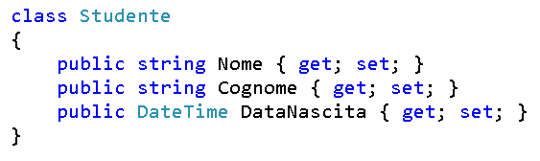
Automatic Properties

Slide 9
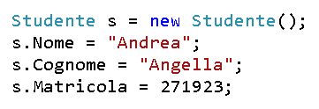
Object Initialization Expressions

Slide 10
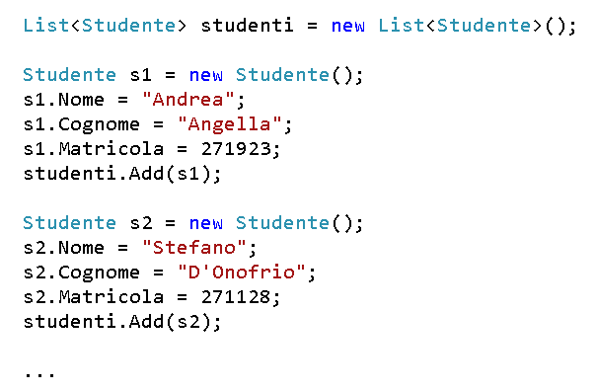
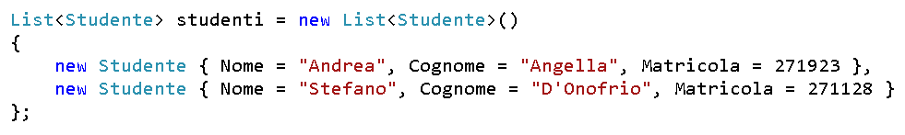
Object Initialization Expressions

Slide 11

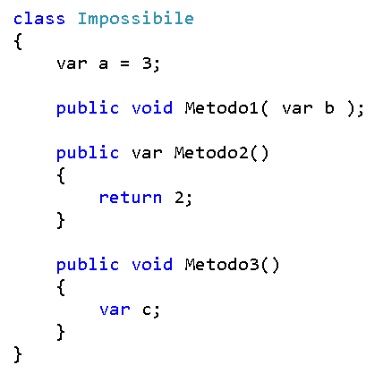

Local type inference

Slide 12

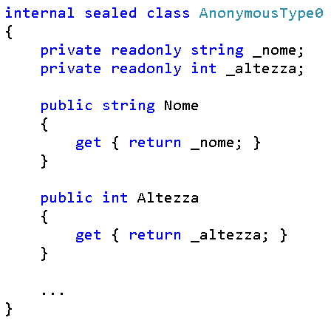
Anonymous Types
Lo sviluppatore non conosce il nome del tipo generato

Slide 13
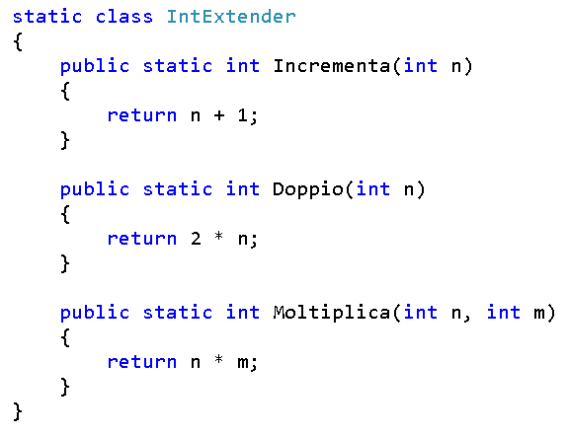
Extension Methods
Cosa fà questo statement ?

Slide 14
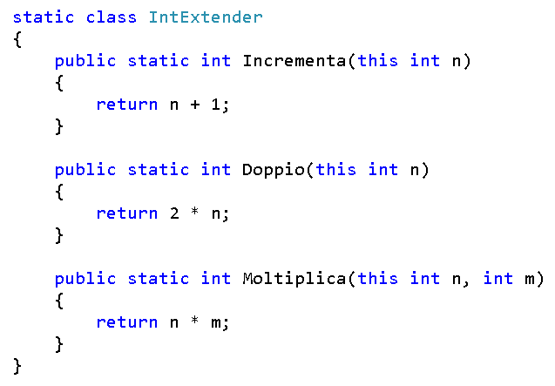
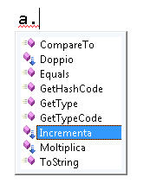
Extension Methods

Slide 15
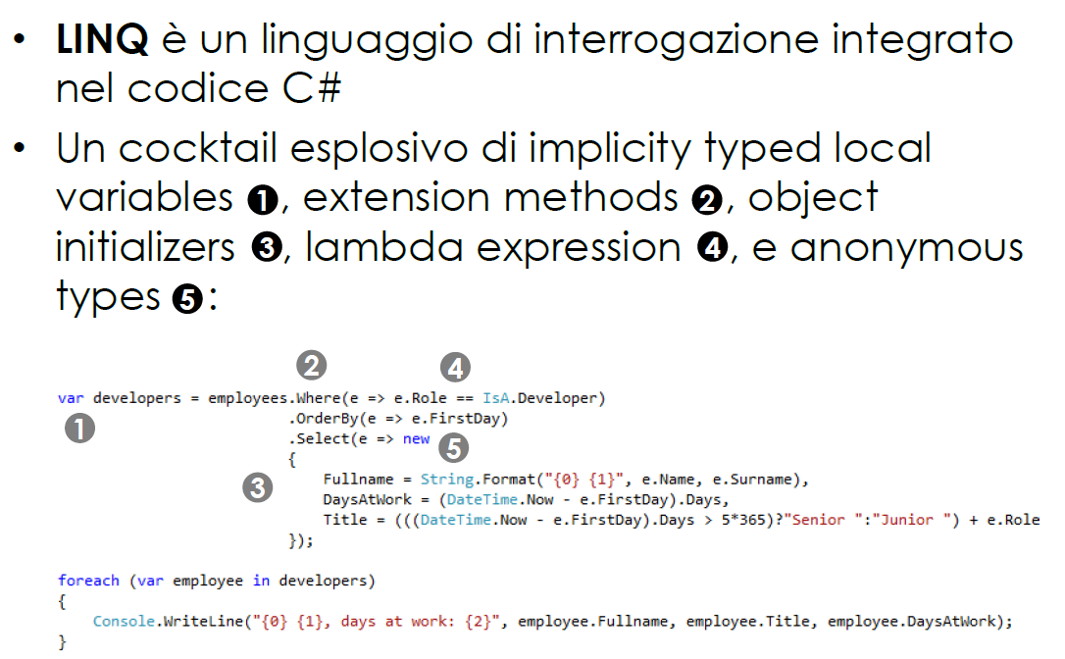
LINQ

Slide 16
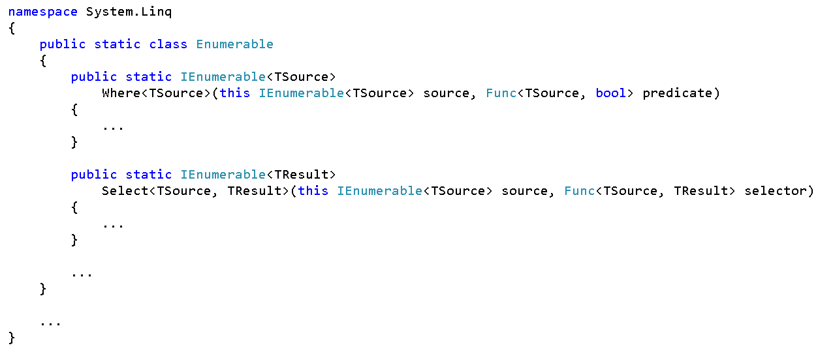
LINQ Internals
Extension Methods su IEnumerable<T>

Slide 17
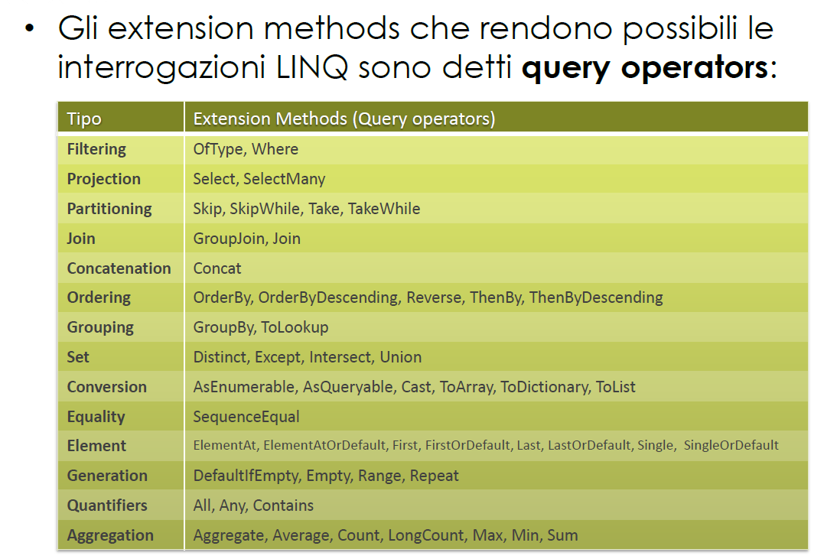
Query Operators

Slide 18
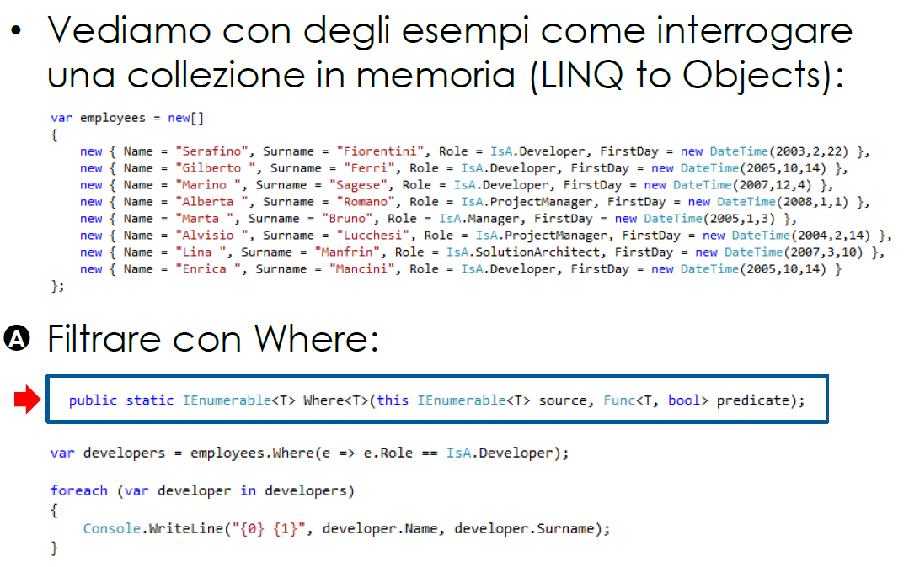
Esempi

Slide 19
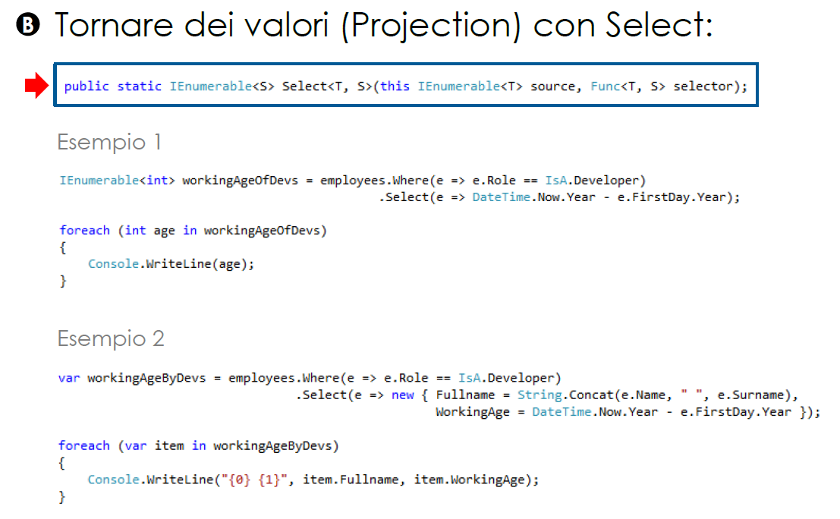

Slide 20
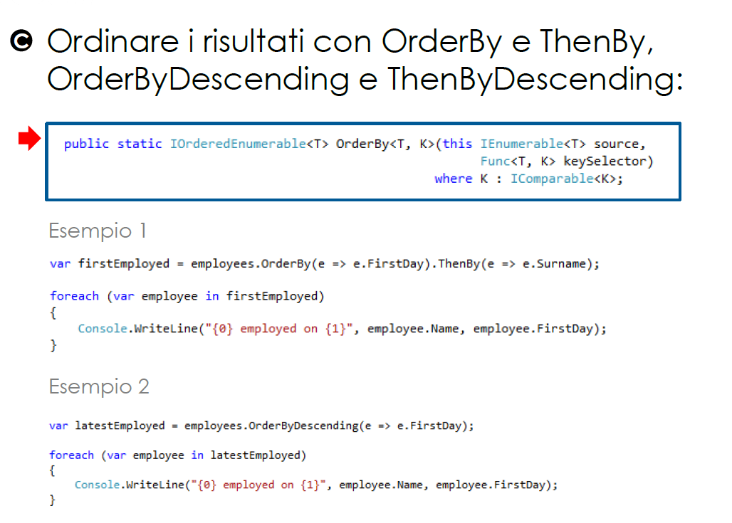

Slide 21
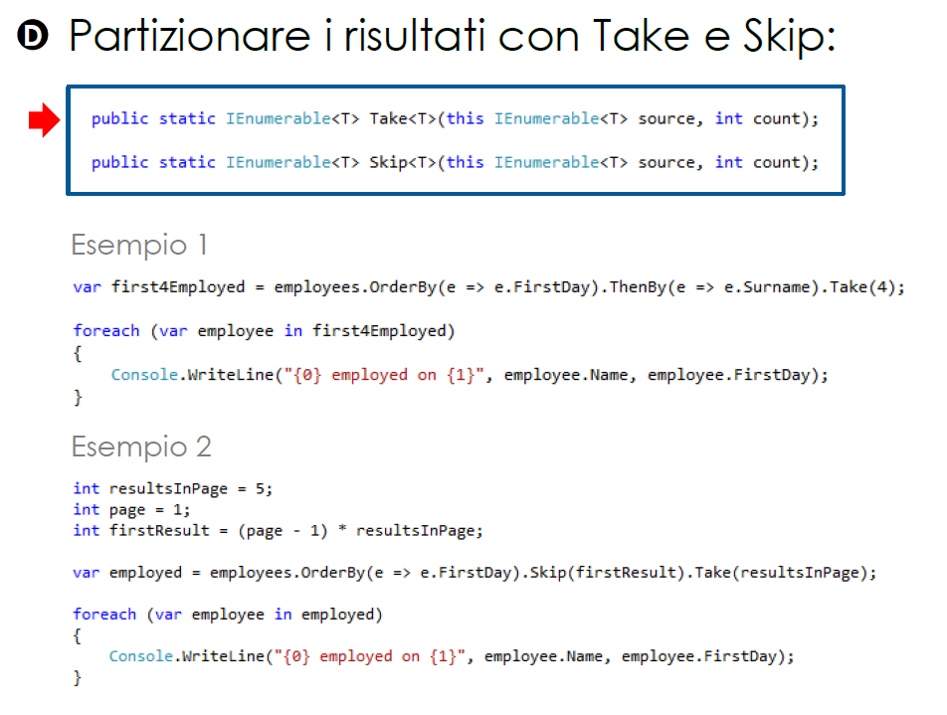

Slide 22
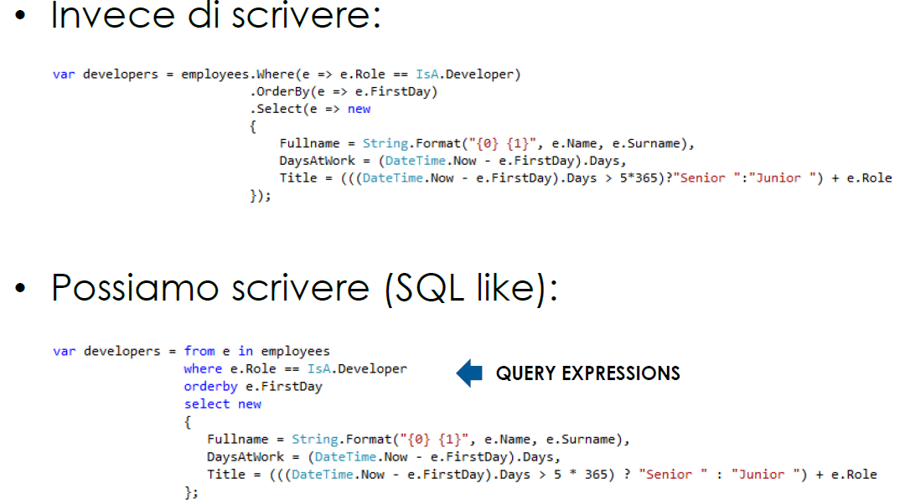
Query Expressions

Slide 23
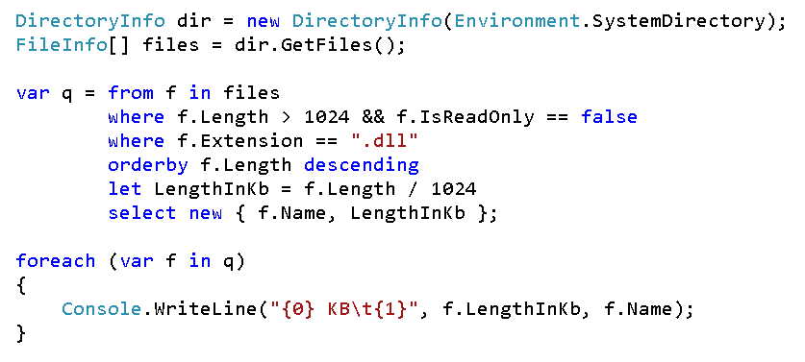
Linq to File System

Slide 24
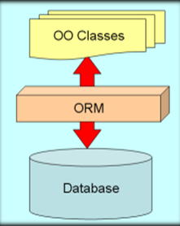

Intro alle tecnologie ORM (Object-Relational Mapping)

Slide 25
ORM Technologies
Object-Relational Mapping (ORM) is a programming technique for automatic mapping data and database schema
Map relational DB tables to classes and objects
ORM creates a "virtual object database"
Used from the programming language (C#, Java, PHP, …)
ORM frameworks automate the ORM process
A.k.a. Object-Relational Persistence Frameworks

Slide 26
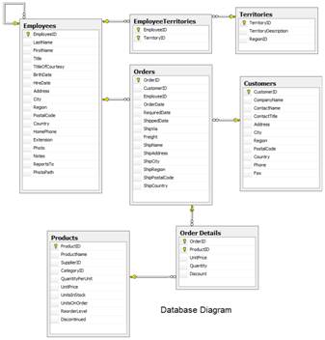
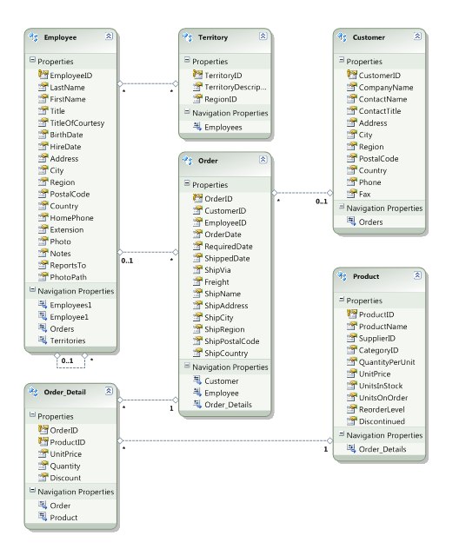




ORM Mapping
Relational database schema
ORM Entities
(C# classes)
ORM
Framework

Slide 27
Entity Framework – ORM for .NET
Entity Framework (EF) is the standard ORM framework for .NET
Maps relational database to C# object model
Powerful data manipulation API over the mapped schema
CRUD operations and complex querying with LINQ
Database first approach: from database to C# classes
Code first approach: from classes to DB schema
Visual Studio generates EF data models
Data mappings consist of C# classes, attributes and XML

Slide 28
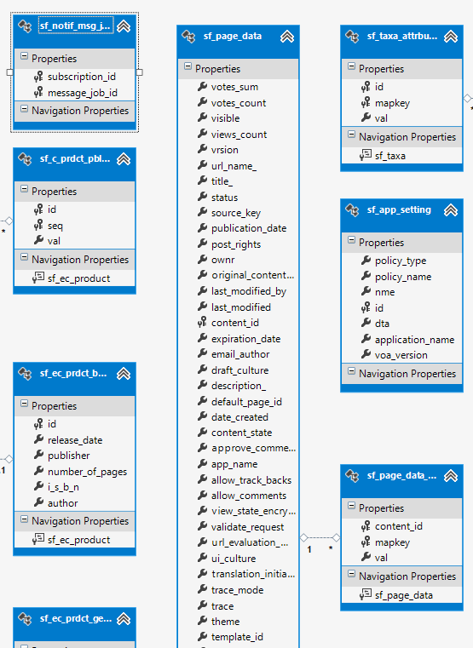
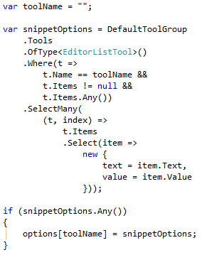
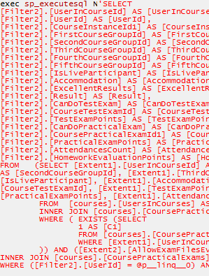
EF – Basic workflow
Define the data model (use a DB visual designer or code first)
Write & execute query over IQueryable
EF generates & executes an SQL query in the DB

Slide 29
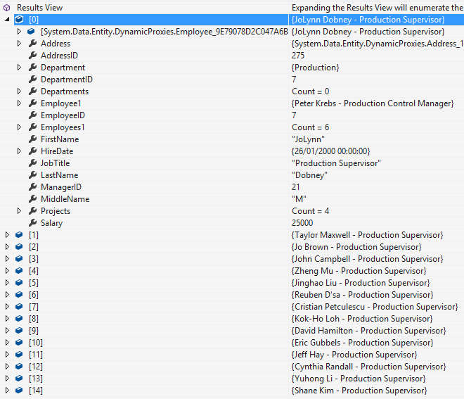
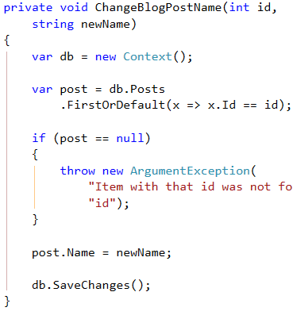
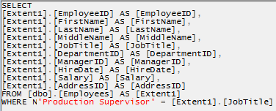
EF – Basic Workflow
EF transforms the query results into .NET objects
Modify data with C# code and call "Save Changes"
Entity Framework generates & executes SQL command to modify the DB

Slide 30
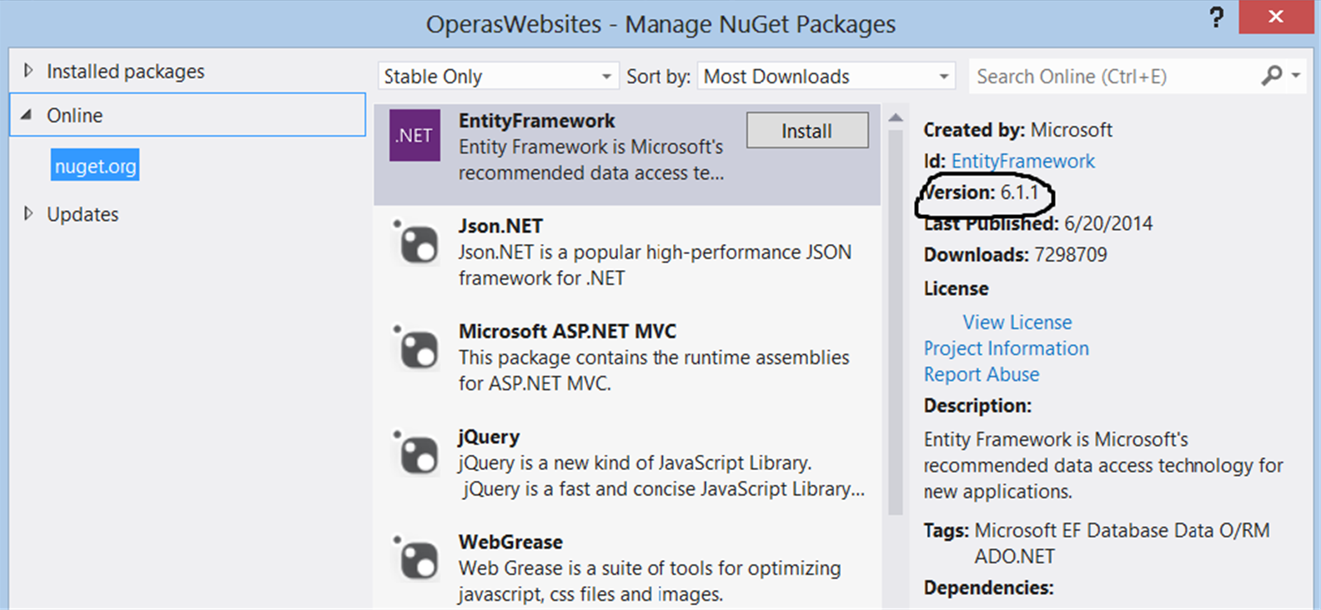
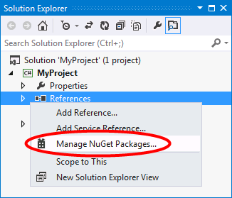
Installing Entity Framework
Install Entity Framework through the NuGet package manager

Slide 31
Demos

