Slide 1

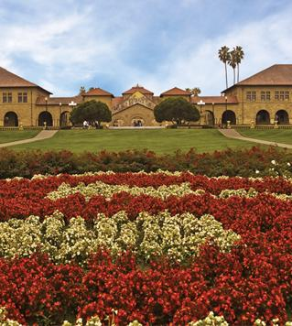
QACNNnet - CNNs and self-attention for Question Answering
GAETANO SIGNORELLI
DANIELE SIROCCHI

Slide 2
Question Answering
One of the most interesting and challenging NLP tasks.
The goal is to find an answer to a given user’s question.
Most common techniques:
RNNs
Transformers
CNNs

Slide 3
Dataset - SQuAD v1.1
The network is trained on the SQuAD dataset, and it consists of:
A context
One or more questions
One or more answers
Limited dataset difficulty:
Each questions always has at least one answer
The answer in always in the context
Remains a very good dataset for testing architectures.

Slide 4
Dataset - Preprocessing
Several preprocessing techniques implemented and tested:
Lower case
Strip
Stopwords
Lemmatization
Special characters removal (/(){}\[\]\|@,;:".!?\-)

Slide 5
Dataset – Implementation details
Embeddings:
Pretrained GloVe word embeddings (300d)
Learned from scratch character embeddings (64d)
OOVs mapped to a single trainable vector
Additional details:
Context, question and answers limited to fixed lengths
Padding and truncation applied when necessary
10% of the training set used as validation set

Slide 6
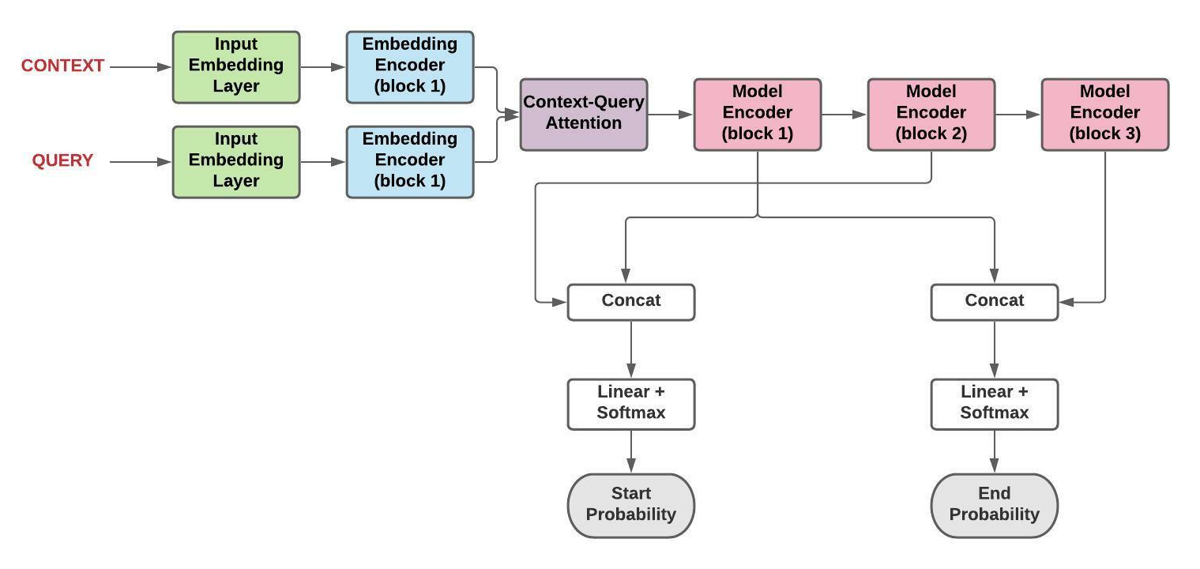
Architecture Overview

Slide 7
QACNNet Input

Slide 8
Input Embedding Layer
Convert tokenized inputs to embedding vectors

Slide 9
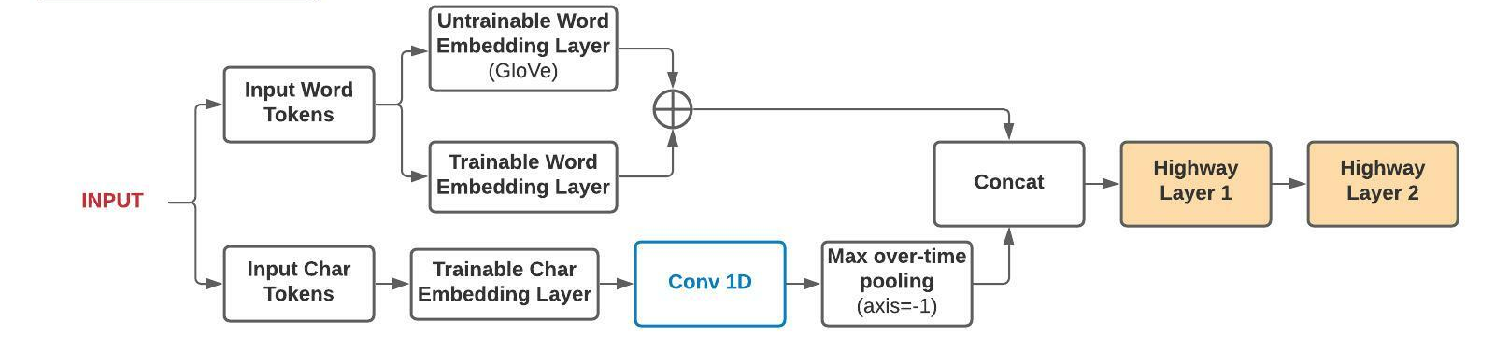
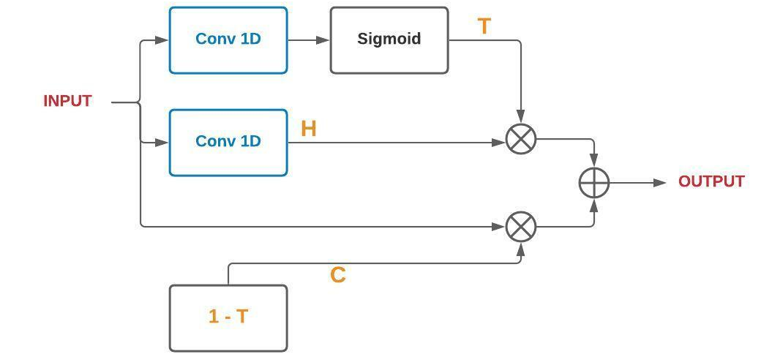
Input Embedding Layer

Slide 10
Embedding Encoder
Extract high-level input features

Slide 11
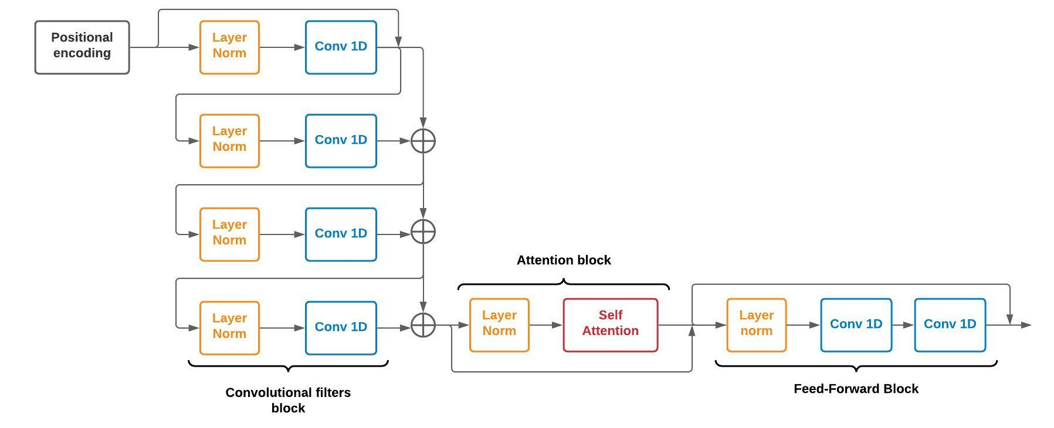
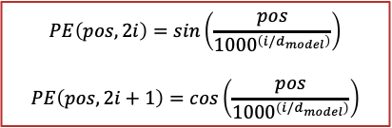
Embedding Encoder

Slide 12
Context-Query Attention
Create a query-dependant context representation

Slide 13
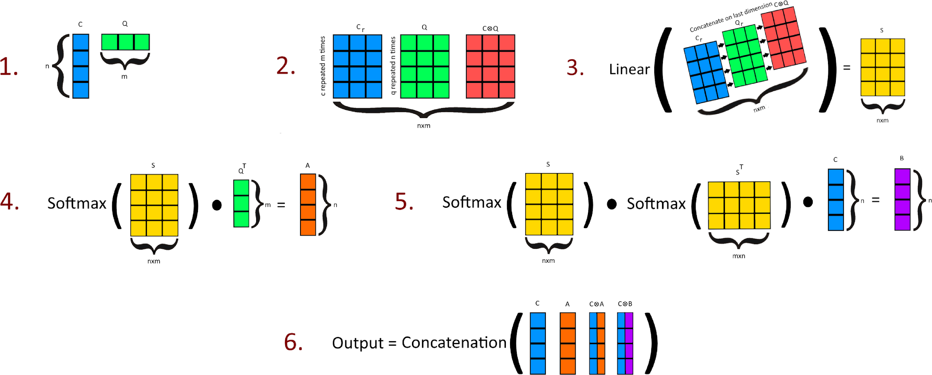
Context-Query Attention
Trilinear function
Context-to-query attention
Query-to-context attention

Slide 14
Model Encoder
Extract high-level input features

Slide 15
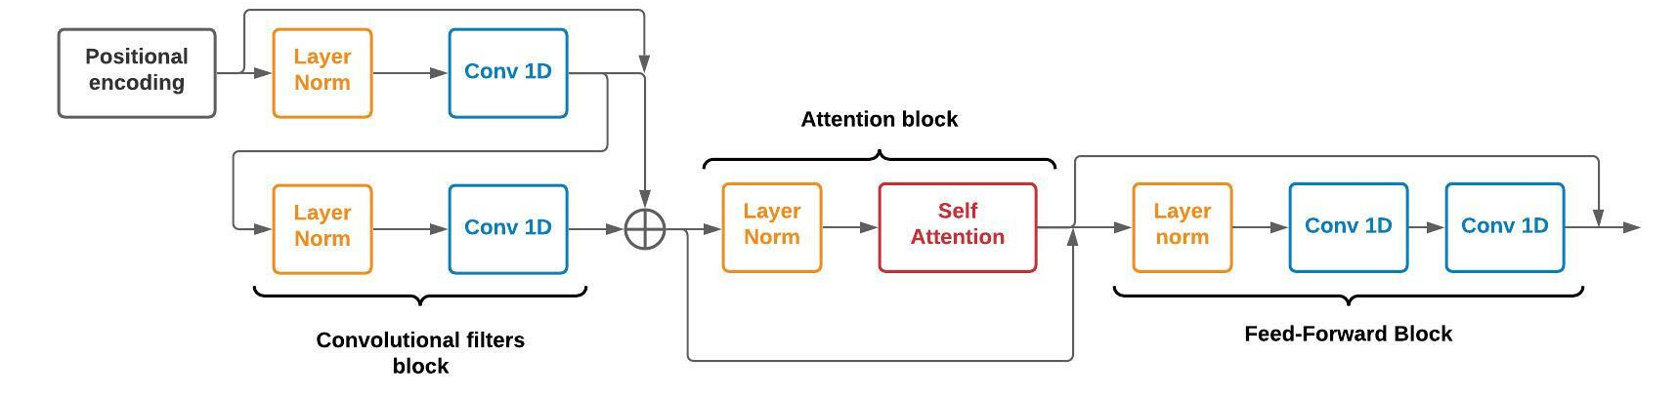
Model Encoder

Slide 16
QACNNet Output
Predict answer’s start and end index probability distributions

Slide 17
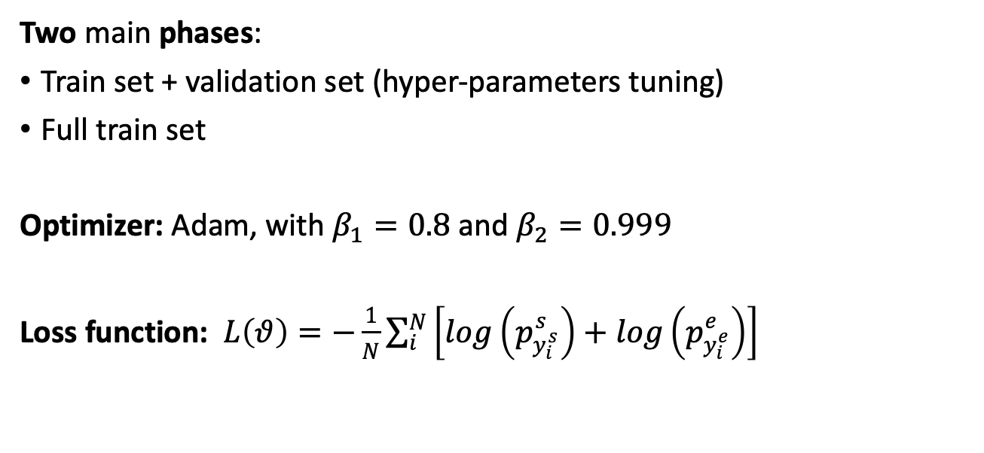
Training

Slide 18
Training Details
Several techniques applied and tested:
Overfitting:
L2 regularization
Dropout
Stochastic dropout
LR schedules (e.g., warmup learning and exponential decay)
Gradient Clipping
Exponential moving average

Slide 19
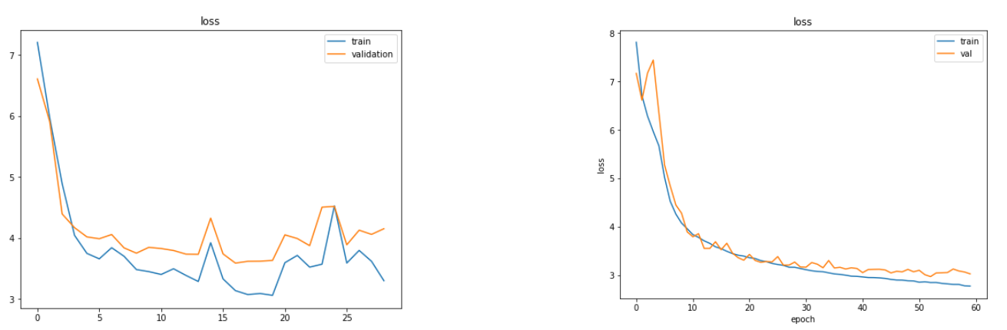
Ablation studies
Loss history for train and validation sets with no countermeasures against the overfitting
Loss history for train and validation sets using all the techniques against the overfitting

Slide 20
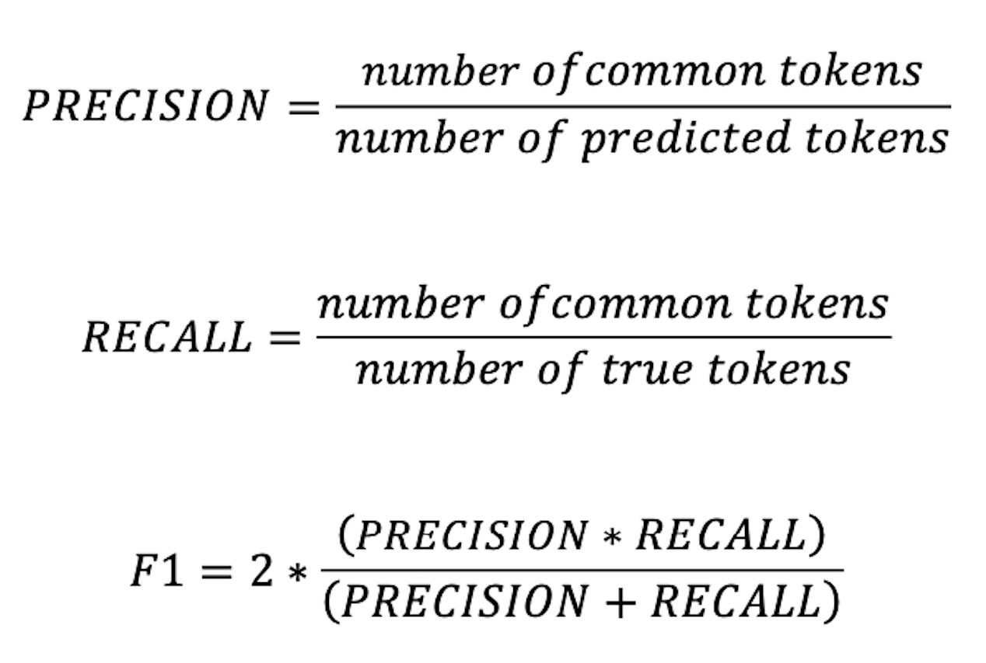
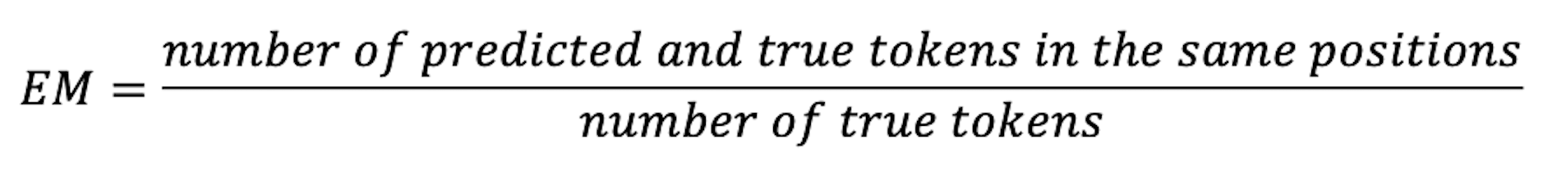
Metrics
F1 Score
EM score
Considers the tokens in common between those predicted by the model and the ground truth, regardless of their positions
Considers the exact overlapping between answer’s tokens predicted by the model and the ground truth

Slide 21
Metrics Details
Inference algorithm
Removed punctuations and articles

Slide 22
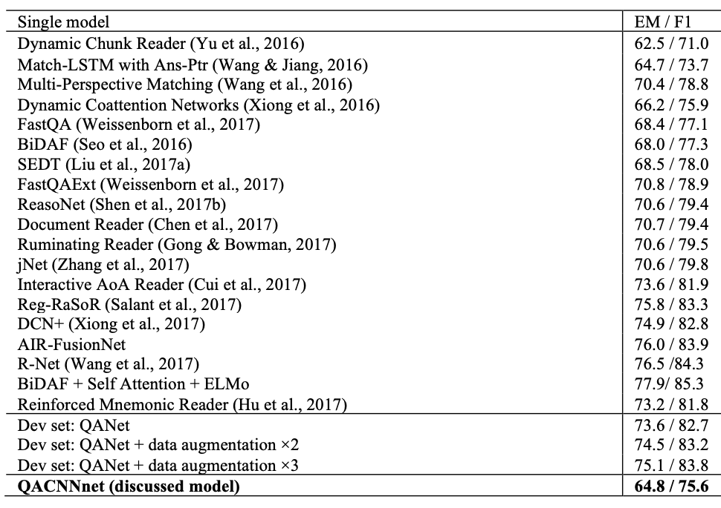
Results

Slide 23
Error Analysis – Statistical approach
Answers classification:
Solved
Partially solved
Unsolved
Considered features:
Most frequent tokens
Answers’ lengths
Type of questions

Slide 24
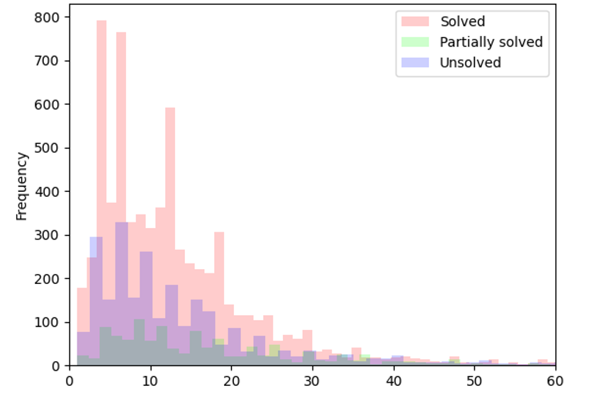
Error Analysis – Answers’ lengths
The answers' lengths distribution

Slide 25
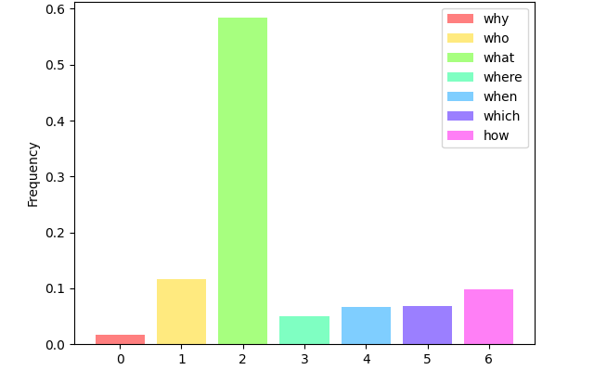
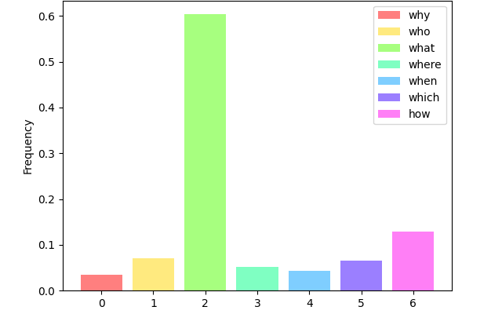
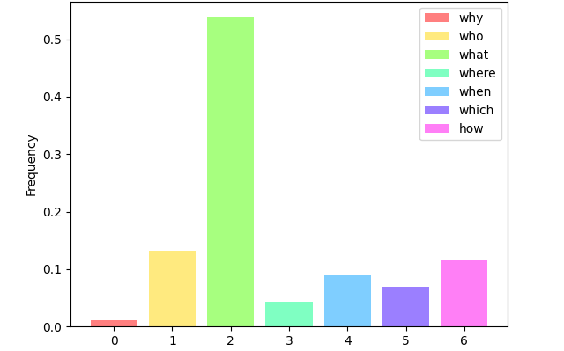
Error Analysis – Type of questions
Solved
Partially Solved
Unsolved
What, Where and Which: no sensible effects on the model’s outcomes
Who: the most difficult ones
How: negative effects on both F1 and EM

Slide 26
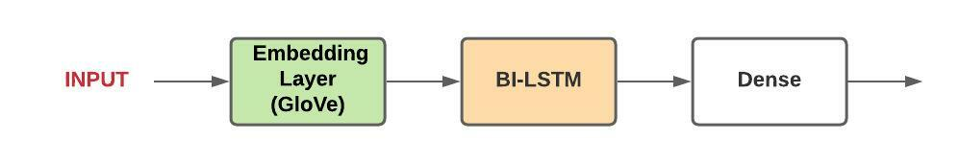
Error Analysis – neural approach
Statistical analysis is not enough
Created a new NN for question classification
3 classes: easy (solved), medium (partially solved), difficult (unsolved)

Slide 27
Error Analysis – neural approach
Advantages:
a priori know which questions are difficult for the QACNNnet
Use these information for creating more difficult datasets with adversarial learning
Use seq-to-seq models for enhancing the question features

Slide 28
Possible improvements
Increase the network capacity:
Hidden layer size
Number of attention heads
…and many other dimensions that could be scaled up
Dataset:
Enhance the question features (error analysis)
Data augmentation

Slide 29
Conclusions
Satisfied with the results, considering the architecture’s limitations
Nice improvement with respect to RNNs approaches, especially for the training time
Experimented, tested and learned several DL and NLP techniques

