Slide 1
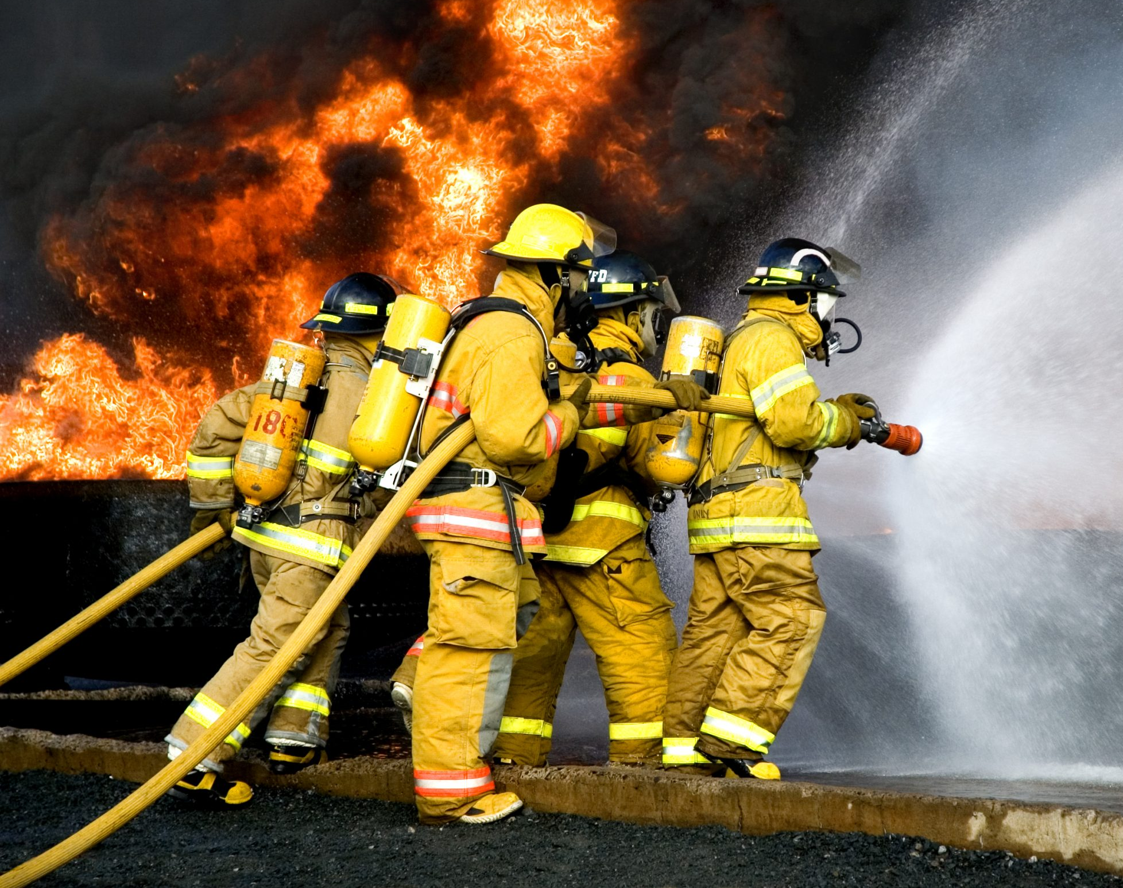
Cloud-Based Firefighter/Emergency Responders Tracking System Design
Group 9: Mansi Joshi
Lohit Allaparti
Nikhil Bharadwaj Narayanam

Slide 2
Key Aspects
Global Users:
Ensure the system is accessible globally to support emergency responders worldwide. Deploy the application on a cloud provider with a global presence, such as AWS and use Content Delivery Networks (CDNs) for low-latency access.
Multiple Interfaces:
Web Interface: Develop a responsive web interface accessible from browsers to provide a comprehensive view for dispatchers and central command.
Smartphone App: Create native apps for iOS and Android devices for field responders. The app should include real-time tracking, communication features, and access to critical information.
Computational Needs:
Utilize cloud-based computational resources for real-time tracking, geospatial analytics, and communication. Consider serverless computing for scalability and efficiency during peak emergency situations.
Storage Needs:
Relational Database: Use a relational database (e.g., Amazon RDS, Azure SQL Database) for storing structured data like user profiles, incident reports, and communication logs.
Object Storage: Leverage object storage (e.g., Amazon S3, Azure Blob Storage) for storing multimedia data, such as images and videos related to incidents.

Slide 3
Information Flow:
Implement a real-time data pipeline for efficient information flow. Utilize pub/sub systems (e.g., Amazon SNS/SQS, Azure Service Bus) for asynchronous communication between different components. Integrate with Geographical Information System (GIS) services for mapping and location-based services.
Cloud Design Considerations:
Security: Implement end-to-end encryption for communication. Utilize Identity and Access Management (IAM) to control access to sensitive information. Consider compliance with industry standards such as HIPAA for healthcare-related data.
Scalability: Design the system to scale horizontally during emergencies. Use auto-scaling features to handle sudden increases in user activity.
Fault Tolerance: Implement redundancy for critical components. Utilize multiple availability zones to ensure high availability. Implement health checks and automatic failover mechanisms.
Cost Optimization: Leverage cloud provider tools for cost monitoring and optimization. Utilize serverless architecture to pay only for actual usage during emergencies.
Reference Architecture:
Explore reference architectures for real-time tracking systems and emergency response solutions provided by cloud providers. For example, AWS has solutions like the "AWS Disaster Response Hub."
Application Design Methodology:
Adopt an iterative and user-centric design methodology. Involve emergency responders in the development process to gather feedback and improve usability. Use Agile practices for quick feature releases and updates.

Slide 4
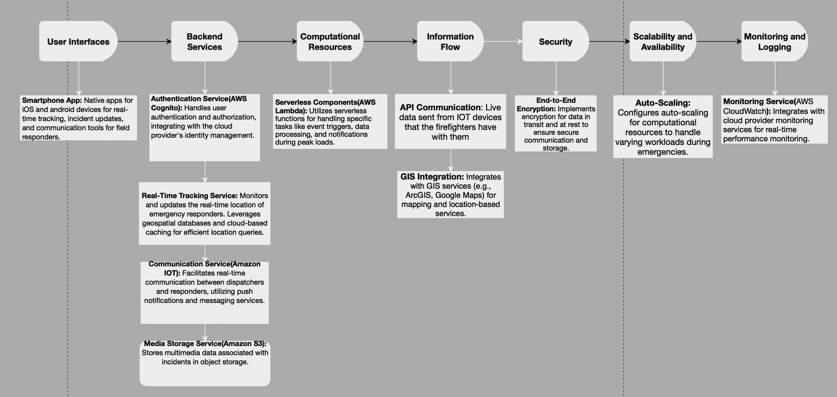
AWS Architecture

