Slide 1
gradlew tasks
>gradlew clean
>gradlew stageWar
>gradlew newDB
>gradlew updateDB
>gradlew classes
>gradlew intTest
>gradlew task1 task2

Slide 2
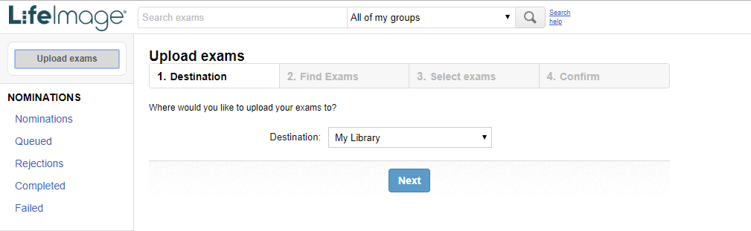
Destination Selection

Slide 3
Destination Selection

Slide 4
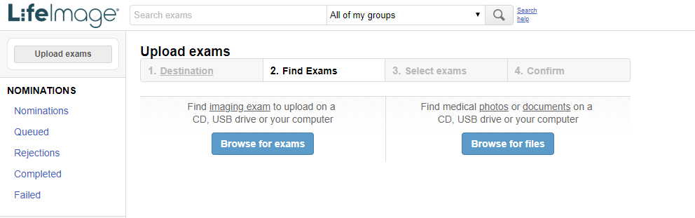
Fin Exam in DICOM/FILE

Slide 5
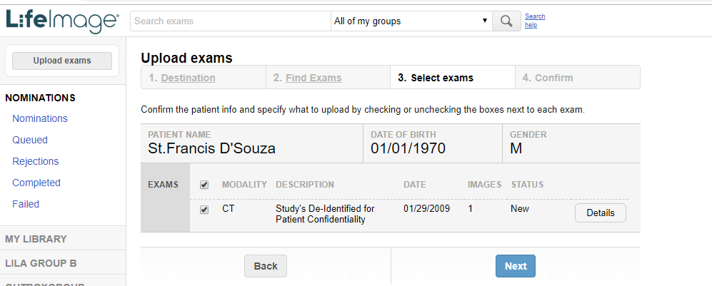
Select and Verify the exam

Slide 6
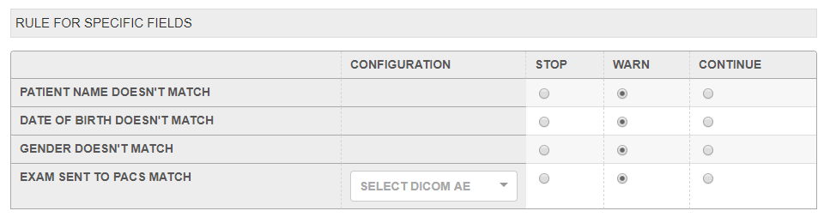
--
Sample Rule page to configure rules

Slide 7
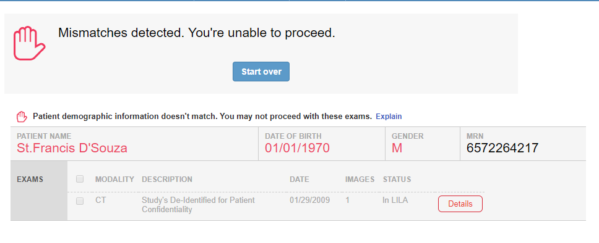
EMR uploader workflow hard stop

Slide 8
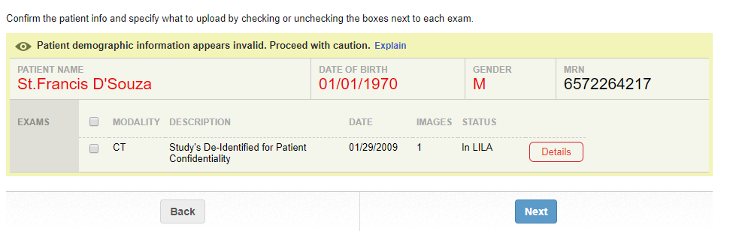
EMR uploader workflow warning

Slide 9
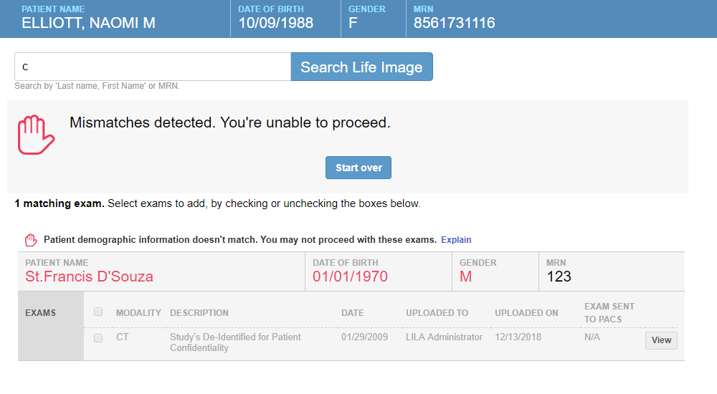
EMR claim workflow hard stop

Slide 10
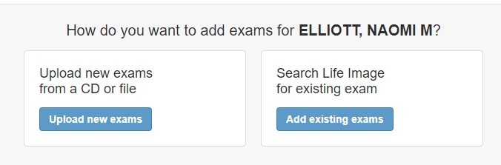
EMR uploader vs claim workflow

Slide 11
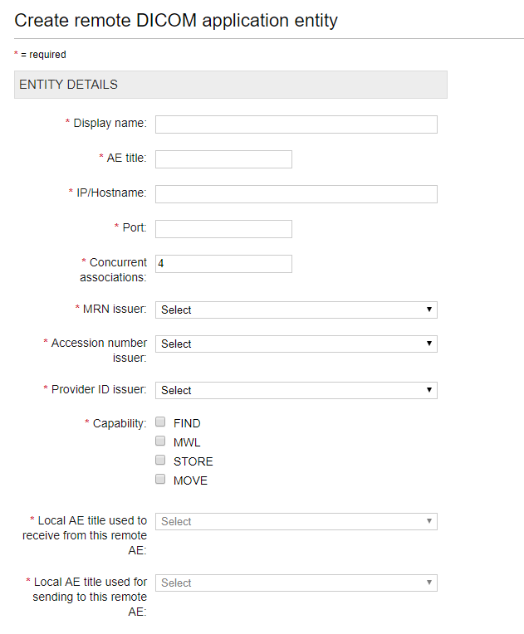
DICOM application entities

Slide 12
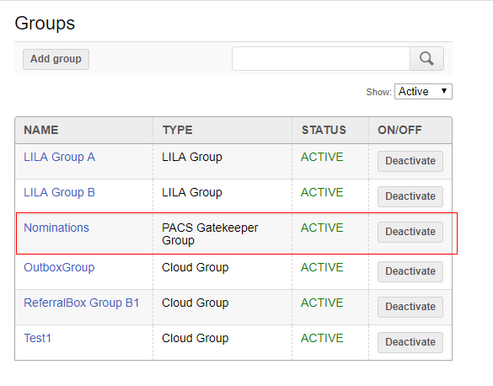
Nomination Group

Slide 13
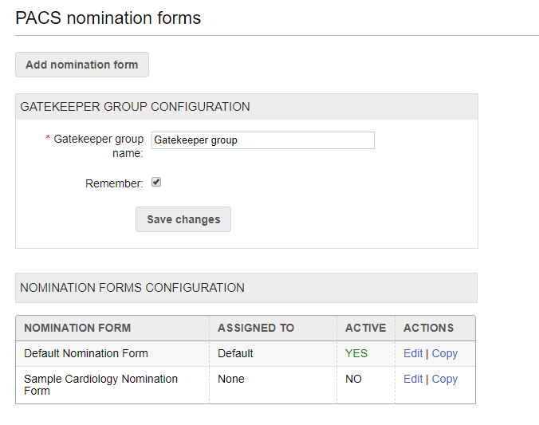
Nomination Form

Slide 14
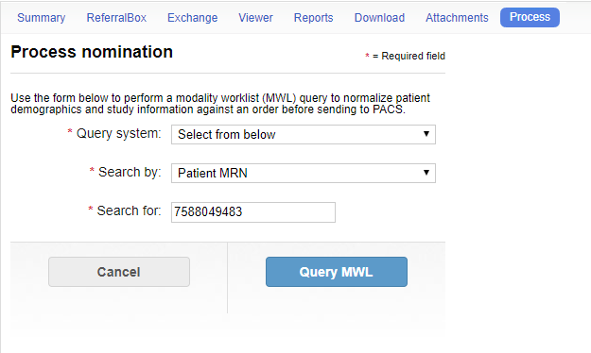
--
Nomination MWL and CFIND workflow

Slide 15
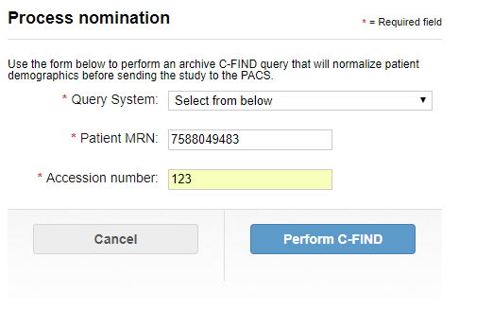
Nomination MWL and CFIND workflow

Slide 16
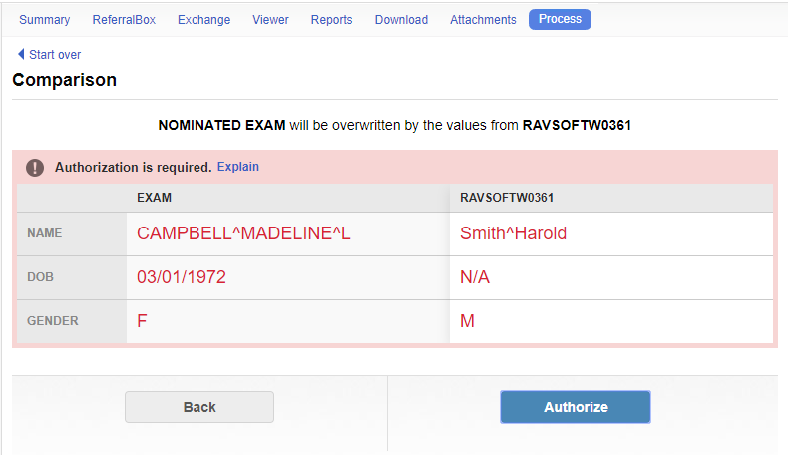
PACS workflow soft stop

Slide 17
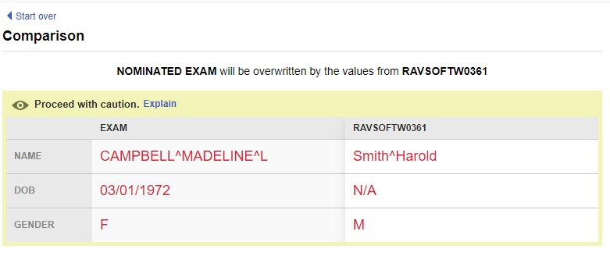
PACS workflow warning

Slide 18
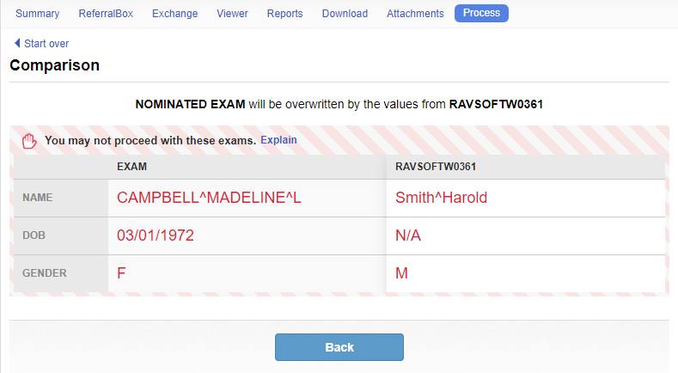
PACS workflow hard stop

Slide 19
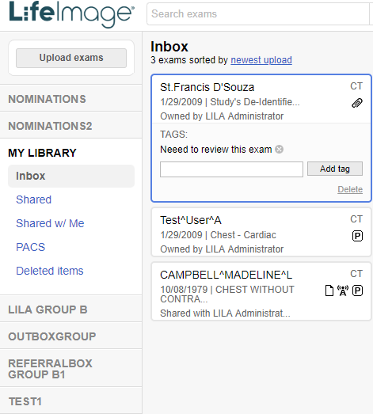
Exam slug- Tagging

Slide 20
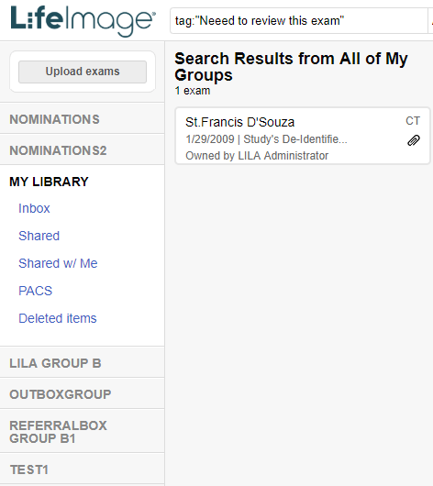
Exam slug- Tagging

Slide 21
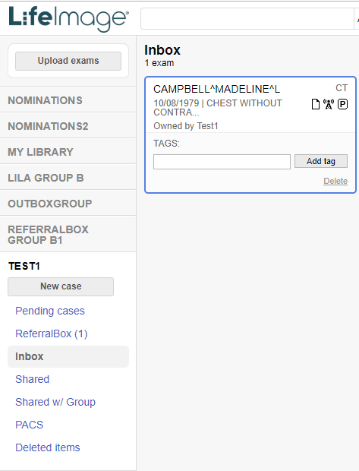
Exam sulg - icons

Slide 22
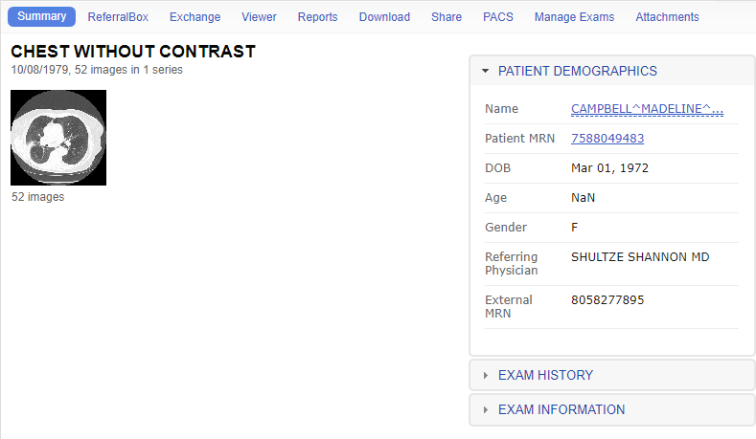
Exam Slug tabs

Slide 23
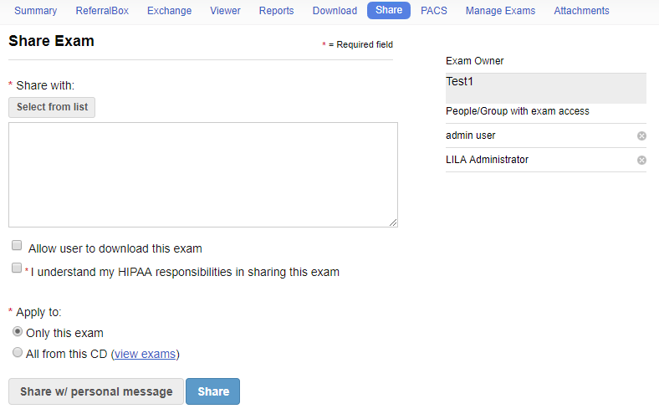
Exam slug - share tab

Slide 24
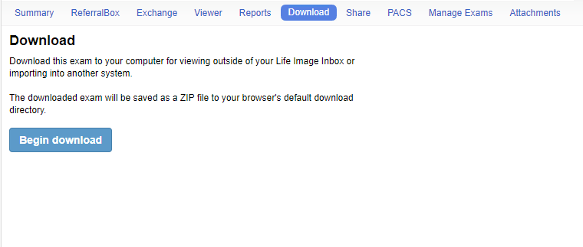
Exam slug - Download tab

Slide 25
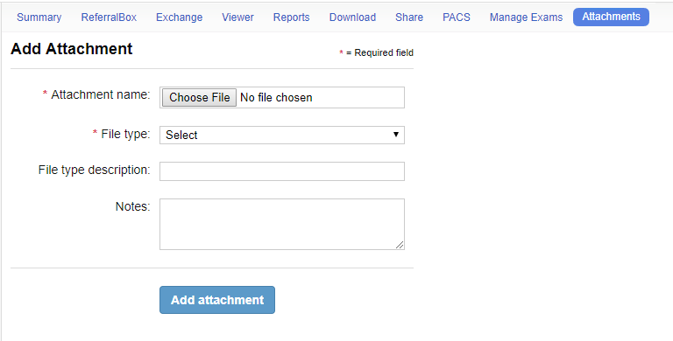
Exam slug - Attachment tab

Slide 26
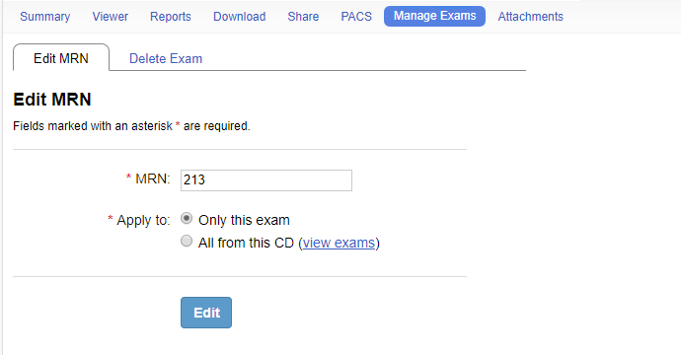
Exam slug - Edit MRN tab

Slide 27
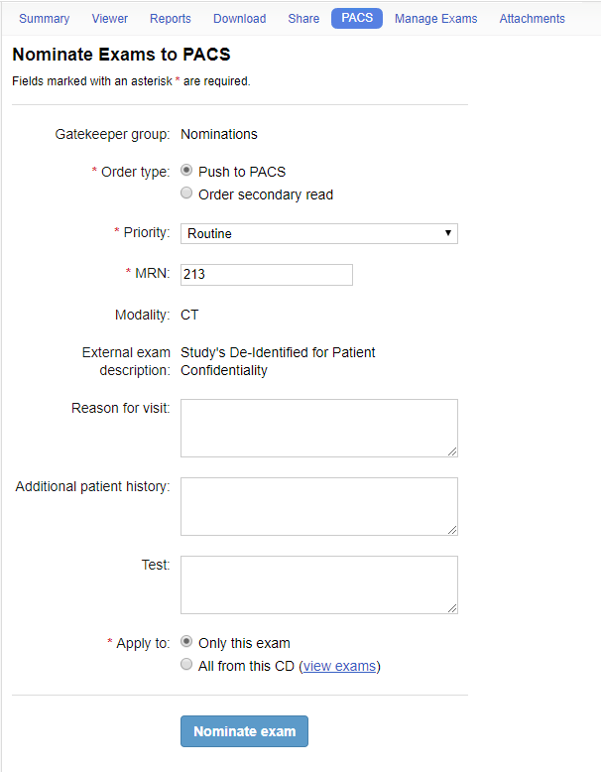
Exam slug - PACS tab

Slide 28
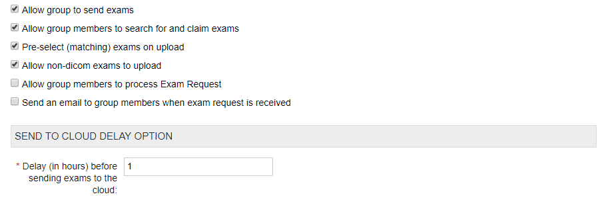
Send to connection workflow

Slide 29
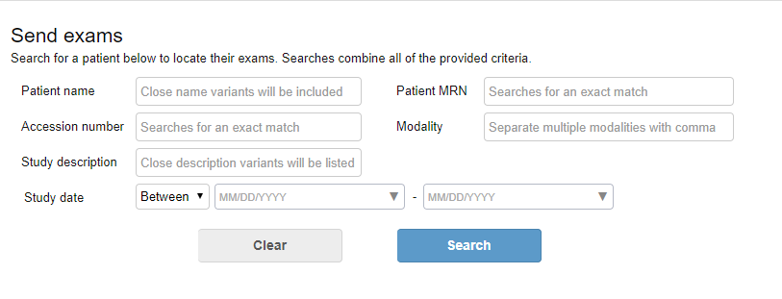
Send to connection workflow

Slide 30
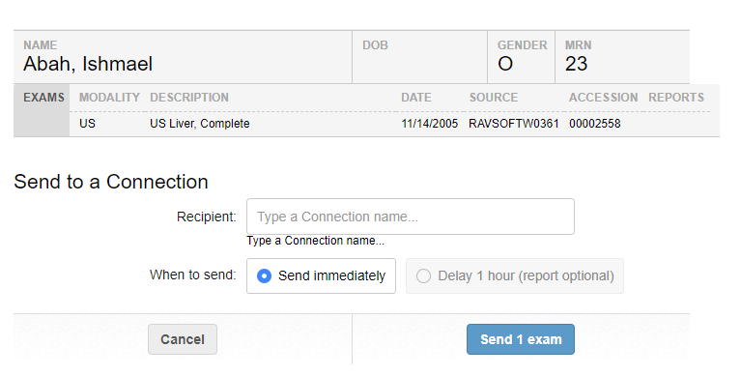
Send to connection workflow

Slide 31
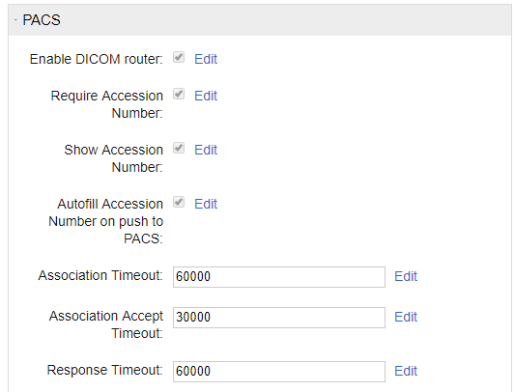
Send to local group workflow

Slide 32
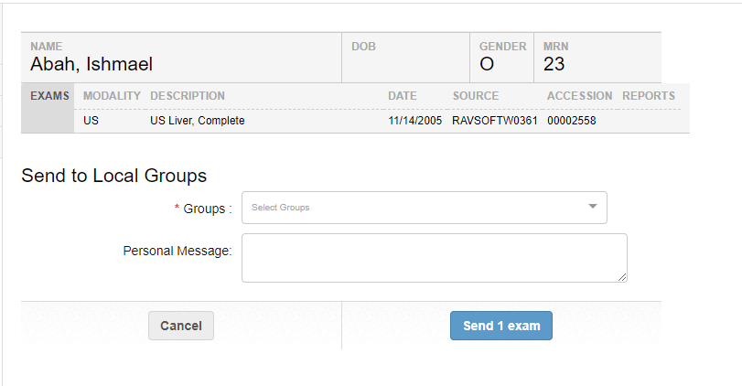
Send to local group workflow

Slide 33
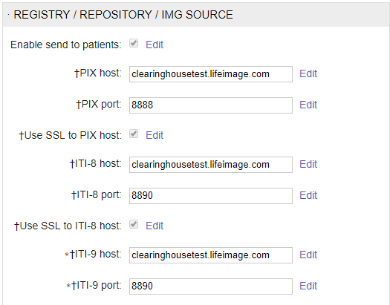
Send to cleaning house workflow

Slide 34
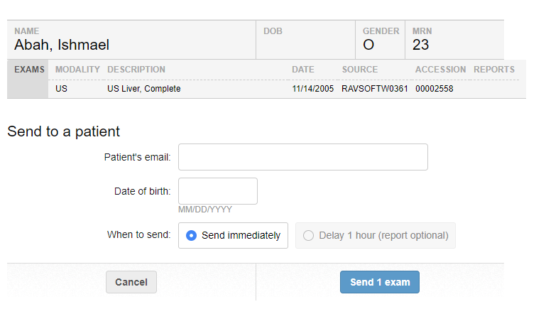
Send to cleaning house workflow

Slide 35
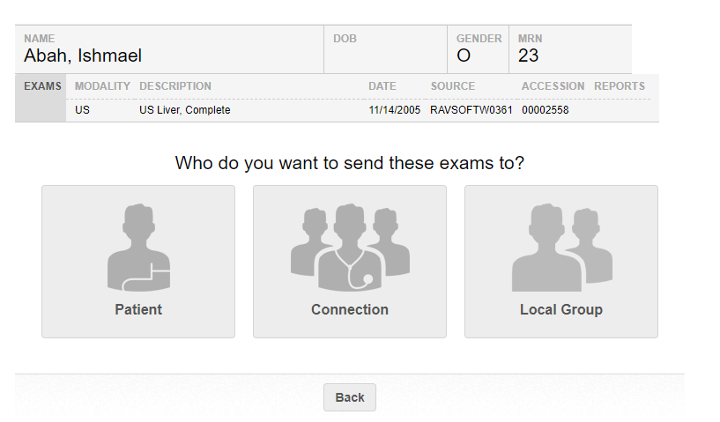
Send to Patient vs Send to cleaning house vs Send to Local Groups workflow

