Slide 1

Dual Enrollment
Medicare –Medicaid
By: Richard DiazDeLeon

Slide 2
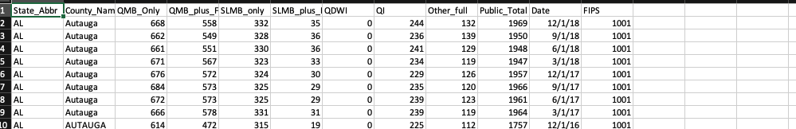
About the data
The provided data offers valuable insights into the number of dual enrollees, categorized by various eligibility criteria at both state and county levels. A crucial aspect to understand is that these numbers are not cumulative; they represent unique counts for each month. This distinction is vital for accurate analysis and interpretation of trends over time.
This links is also available at CDC Database: https://www.cdc.gov/datastatistics/index.html

Slide 3
Business Proposition - Healthcare
Gaining a deeper understanding of dual enrollees is crucial for businesses, especially in strategizing marketing efforts to attract new memberships. Typically, account managers or sales teams work on a contractual basis with businesses. In some cases, they focus on tracking specific members to not only boost memberships but also to develop more effective marketing strategies. This project aims to provide a comprehensive overview of dual enrollees from a causal inference standpoint, offering valuable insights for targeted business strategies.
Provider is connected | 2. Membership is selected through provider | 3. Connection is made through agreement.
High level: Different companies/services offer connection (Setup) | High level: Member chooses best option dependent on Market. (Options) | High Level: Time window to make a decision dependent on enrollment.
Providers List Price | Market Segment | Close

Slide 4
II. Healthcare Assumptions
These submissions are a critical source of information, as they furnish monthly snapshot data on individuals enrolled in both Medicare and Medicaid.
All submissions are made on time
Data is accurate to the grain
Future pricing

Slide 5
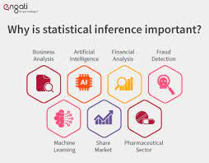

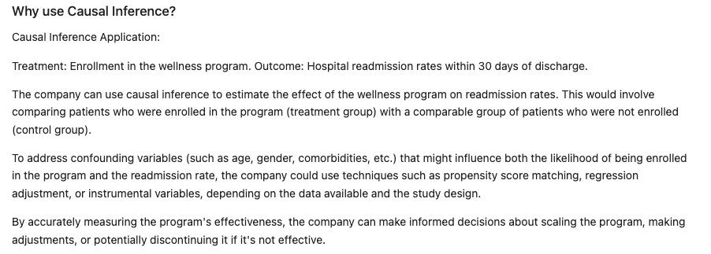
III. Proposal – Marketing Strategy
This project aims to provide a comprehensive overview of dual enrollees from a causal inference standpoint, offering valuable insights for targeted business strategies.

Slide 6
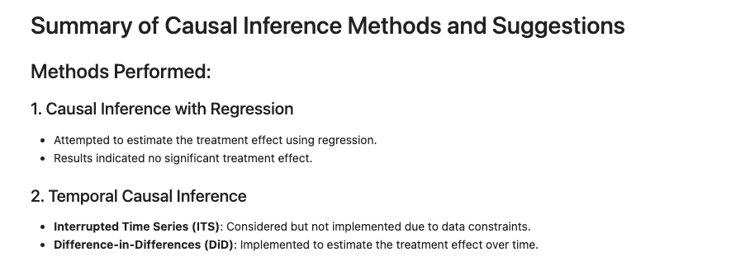
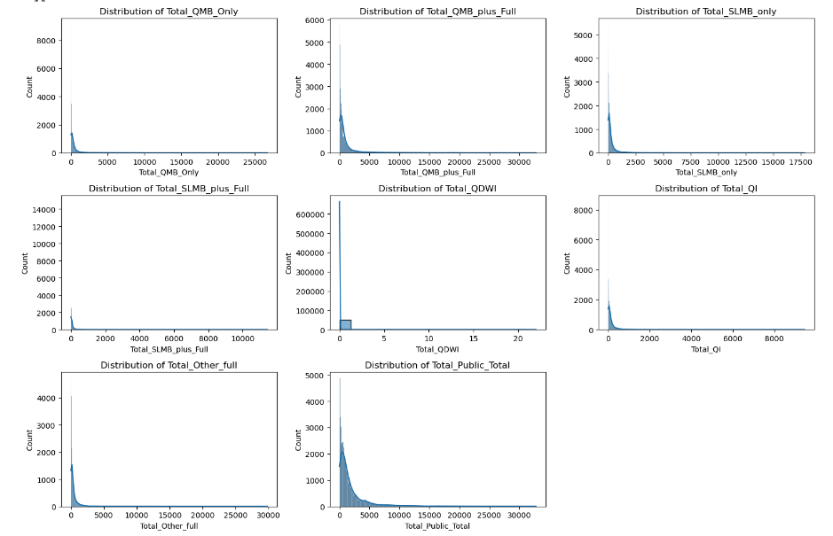
Reporting – Statistical Inference

Slide 7
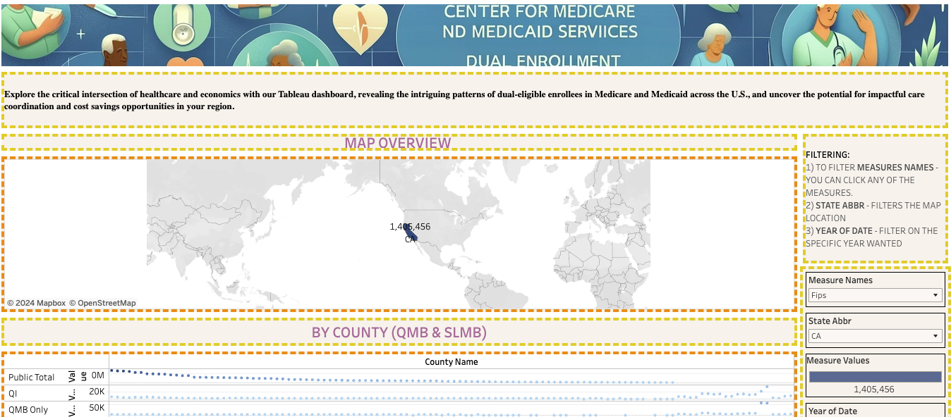
Visualization using Tableau: https://public.tableau.com/shared/XG5B5Z97C?:display_count=n&:origin=viz_share_link

