Slide 1
AED Project Person_Management_System
Fall 2015
-
Divyansh Srivastava
Course Guide: Prof. Kal Bugrara

Slide 2
Idea :
As a part of learning in AED, we have seen many roles and in real world, we encounter many roles.
Idea used for this project is to create a model which can connect people based on their roles.
As an example, I have used healthcare sector where doctor is connected to us in real time.

Slide 3
Problem
We have various devices with us which are able to monitor our every moment in the daily life. No matter what happens, in case we fall sick, we have to go to hospital for checkup no matter how small the illness is.
We need a connection between us and the doctor on a real time basis and connect with him every time we see a threat to our health so that we can detect the problem with help of health manager.

Slide 4
Real world structure and needs
World is already a big group of networks which is group of countries.
In the era of internet, we need to connect with every person with the help of the devices we use.
Many device sensors like health monitoring band are some of the devices which people use for their individual purpose.
We need to convey these details to our health manager on real time basis to stay fit and healthy.

Slide 5
Application Solution
As a part of final project in AED, I have tried to simulate real users and tried to connect them on the basis of their life roles.
Every individual including a doctor or any other professional is a part of ecosystem as a citizen of some city, state and country.
Application is basically focused on connecting every individual first on a single platform. Every individual is a family person, a citizen and then he connects with the world in some role like health manager, accountant, employee, employer etc.
The model provides every individual to connect as a social person and then they can add their doctor etc. or play doctor themselves.

Slide 6
The application simulates one of the scenario where a normal citizen connects with the doctor.
The device sensors provide his real time heart rate, respiratory rate, blood pressure etc. and share it with his doctor.
To connect with his doctor, he can search for a doctor in his city sent him request to add his doctor.
Doctor can view patients real time medical data with his previous vital signs and prescription provided to him previously.
Based on his data, doctor can add him, schedule appointment with him when the user wants. As patients data is already with the health manager (doctor), he can prepare his advice before appointment.

Slide 7
Network, Enterprises and Organizations
Country is taken as network. Current app can allow US and India networks to be created by alpha (System Admin Role).
System admin creates network and network admins. [Network admins are same as admins but they are country specific and must register first in created country]
Network Admins can create enterprises
In current scenario, two enterprises are taken into consideration:
1- State Enterprise
2- Health Enterprise
--Similarly, Security, Finance etc. can have their enterprises on state levels.

Slide 8
State Enterprise: {State Admin Role}
State enterprises can create new organization within the state for the type Citizen and users of city will be citizens
City Organization [City specific] – has City Admin created by State Admin
City has multiple families
Health Enterprise : {Health Admin Role}
Health enterprises can create new organization within the state for the type Doctor and users of city will be doctors.
Doctor Organization [City specific] – Health enterprise admins add doctor role on users request.
Health enterprise can have other organizations of nurses, pharmacist etc in the future but for now, Only doctor organization is used for the demo.

Slide 9
In all roles defined above, every user first must register in a city to get the role requested.

Slide 10
Application features
User registers and provides his basic details
User can update his basic details and update profile picture
User can add/ update his health manager
Schedule the meeting with manager
Be a part of family. Add new members in family
Share real time vital report with health manager.
Add/ view prescriptions with image
Add/ view/ read vital signs
Every request completion sends sms to users registered number.

Slide 11
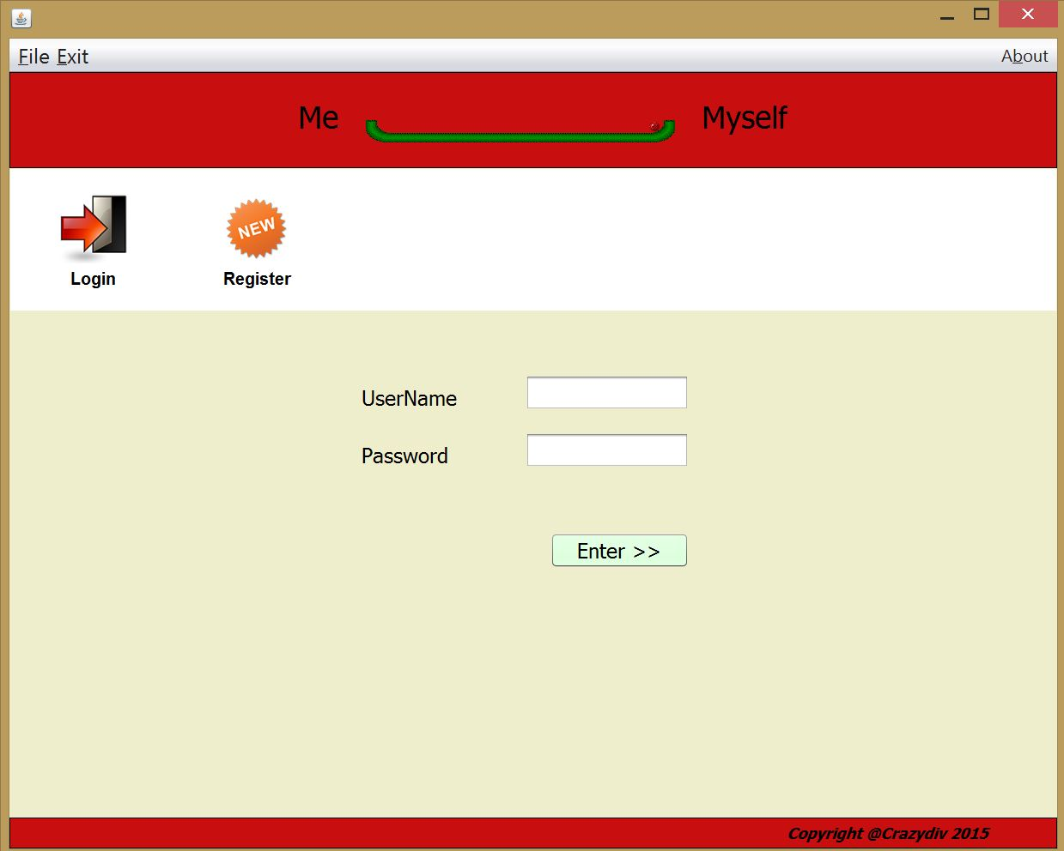
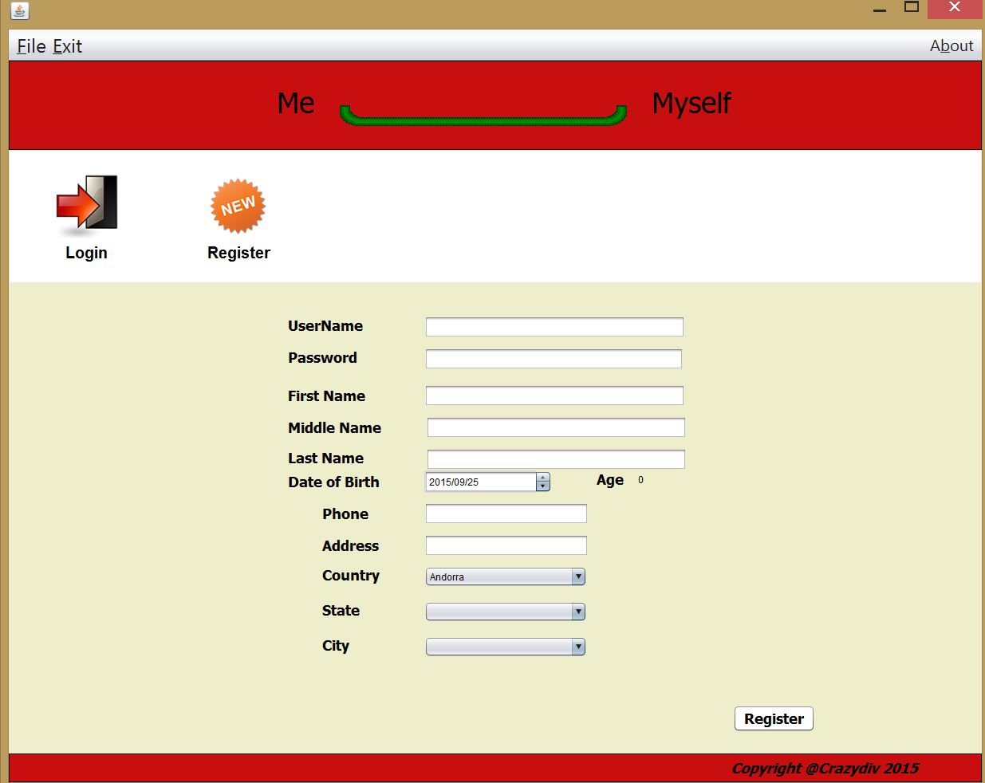
Screenshots – Login / Register

Slide 12
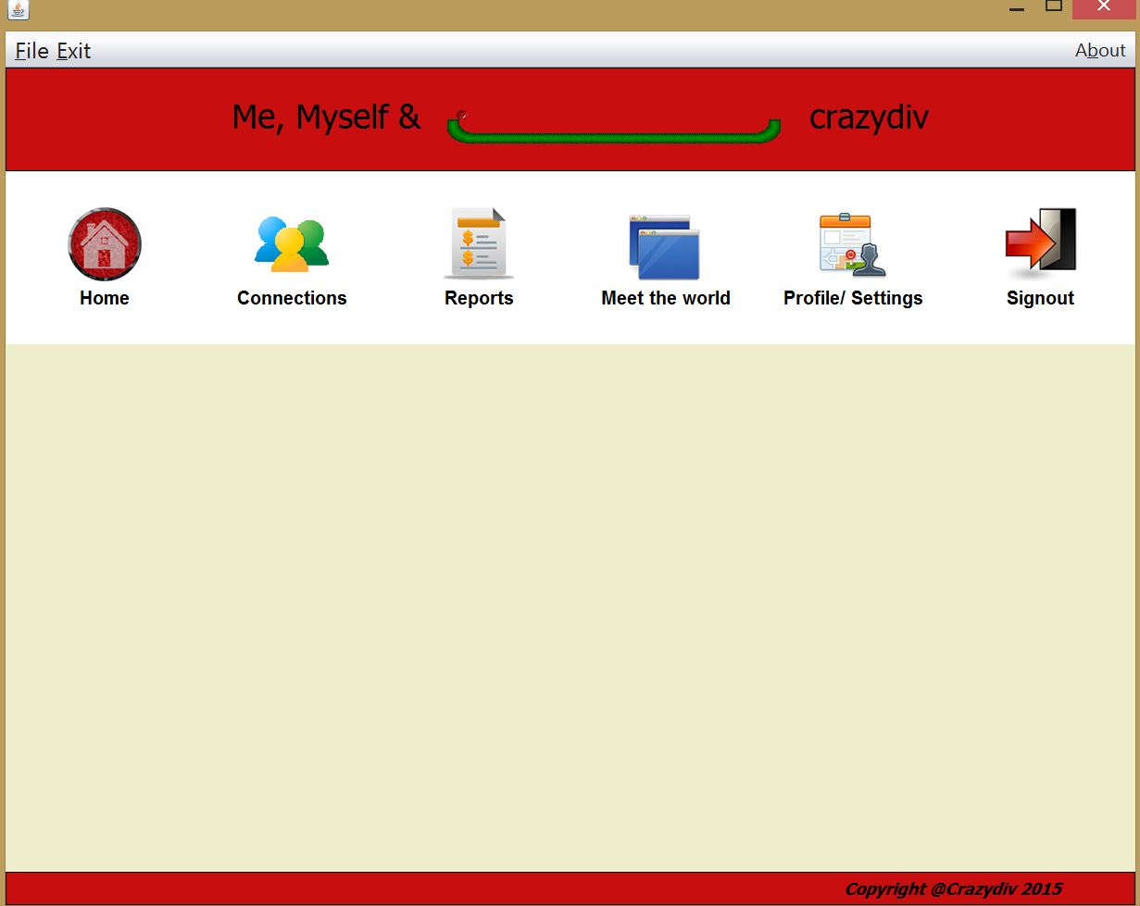
Main User application

Slide 13
Future Enhancements & real idea
In same way as we have an health enterprise, we can add as many enterprises as possible.
Every user will still be same.
One scenario is doctor and patient. On other ways, it can be shop keeper and customer; student and teacher; citizen and police etc
Basic features of application will be same. Modification will be on adding and deleting the roles.
On finance scenario : person can add his finance manager. Who will keep track of every transaction done if the Debit/ credit card or bank is linked with the application.
Application model supports a large area of scope so there can be many sensors and devices can be linked.
As we see sharing of data between doctor and citizen. Then, we can share data between two roles where data will be collected by devices and sensors.

Slide 14
Key learnings
Learned about internet of things and which inspired to create a model where more types of devices and people can be connected
Flow of data between organizations and Users using Work Queue and different types of work requests.
Start to think in terms of application engineering and designing model than just coding without following a set structure which can connect more users. Devices.
Java swing, using files (saving and retrieving) in java. Sharing of same objects between different instances of same JFrame by using session variable.
Design for the future technologies and people

Slide 15
Thank you

