Slide 1
Final Project
Database design and management -INFO 6210
Divyansh Srivastava, Sneha Ravikuma, Taj Poovaiah Palecanda GROUP 11

Slide 2
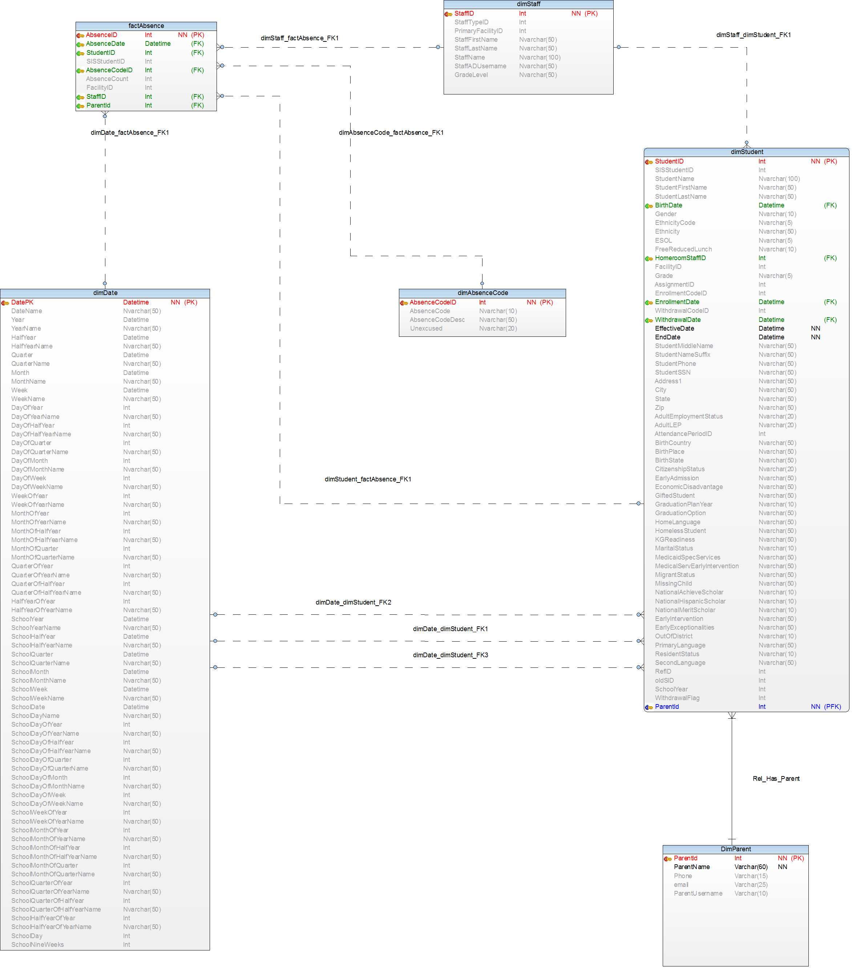
Absence Dimensional Model

Slide 3
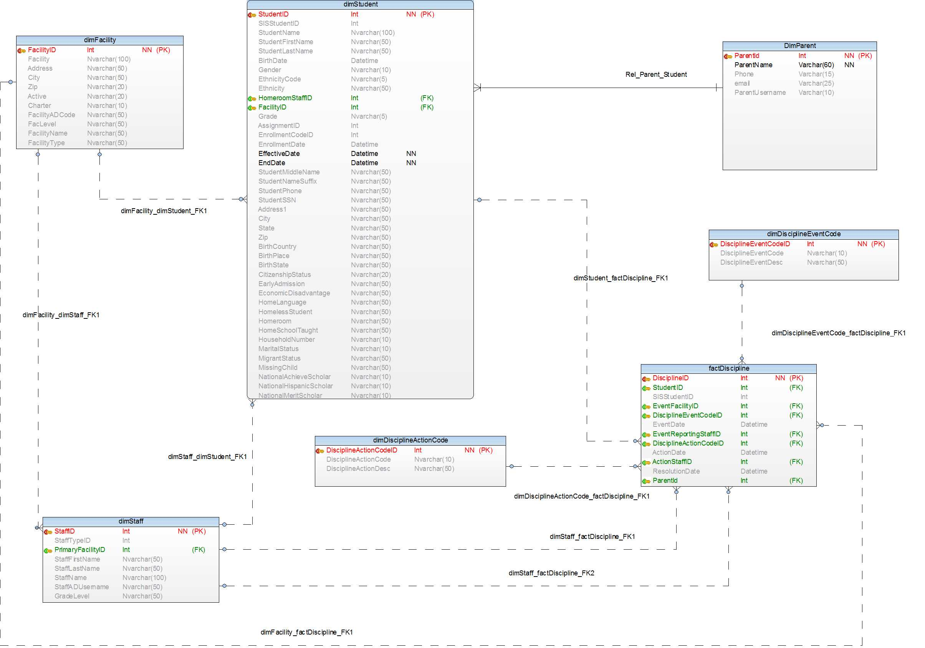
Discipline Dimensional Model

Slide 4
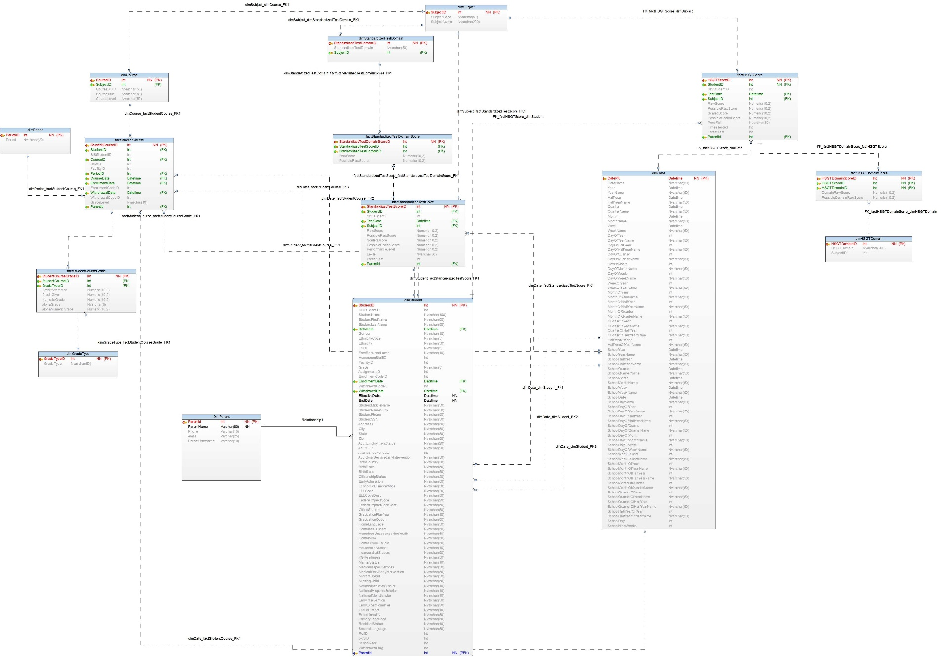
Performance Dimensional Model

Slide 5
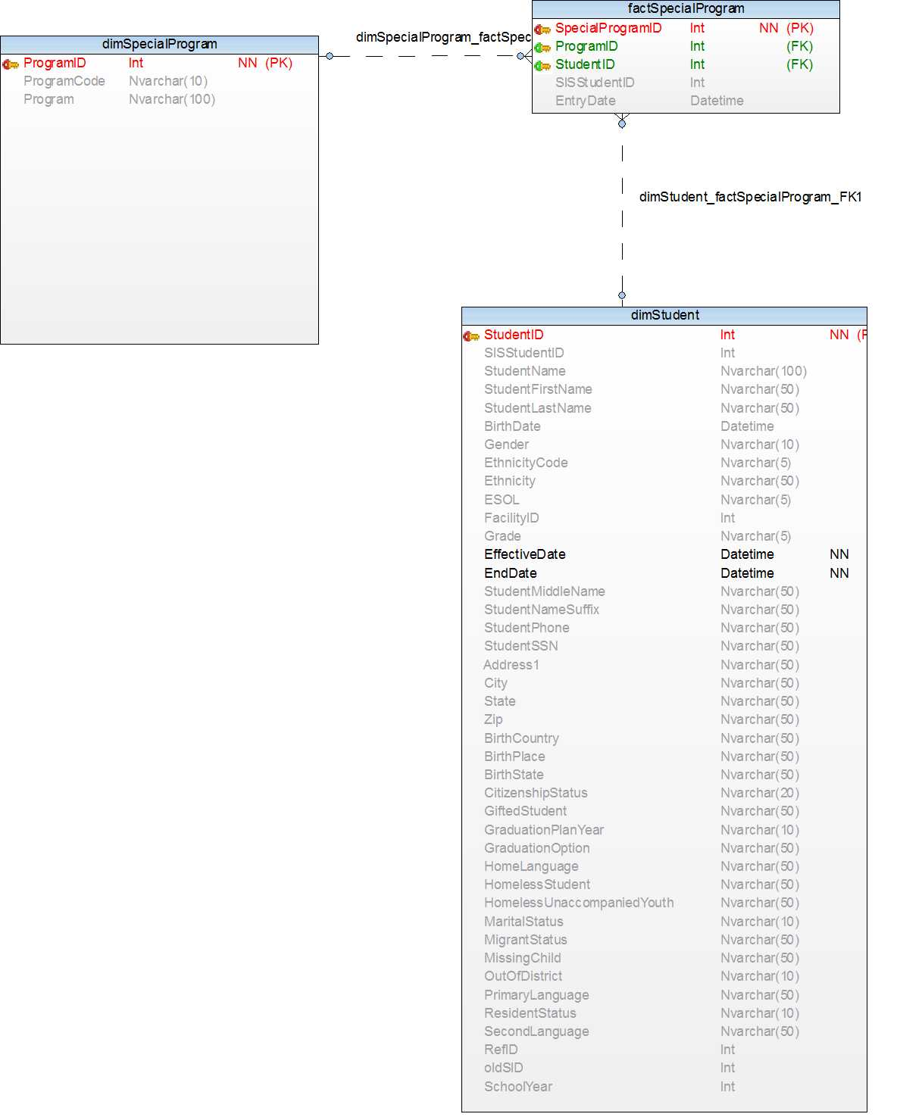
Performance Dimensional Model

Slide 6
Role Based Queries & Results
Question Number 2 and 4

Slide 7
School Administrator
Task and description: List of faculty - Filters Faculty information Student Enrollment List of student – Filters Get student details Discipline Absence Course (addition/ deletion) Subject (addition/ deletion) Discipline event
The school Administrator can view the list of faculty in school, view the details of each faculty member, manage the student enrollment, view the list and details of students, fetch student details such as discipline and absence, manage and monitor the facilities of the school, modify the courses and subjects, and manage the rules and regulations of the school through the disciplinary event.

Slide 8
Teacher
Task and description: List of Student in class-Filters Student Information Course Information Subject Information Adding Test Scores Update Test Scores Update Grade Adding Assignments Grading the Performance of Assignments Monitor the Absence of the student in class Monitor the discipline of the student in Class
A teacher has the access to view his student information based on different criteria like course/ subject etc. Teacher has read access to student’s basic personal information but write access to other information like updating test scores, updating grades etc. A teacher can add/ update/ delete assignments and grade the performance of the student. He can monitor the student performance too. Similarly, Teacher can add/ modify student’s absence in the class and take any disciplinary action against the student.

Slide 9
Parent
Task and description: Student Information Monitor the performance of student Monitor the Absence of the student Monitor the discipline of the student
Parents can access only the details of their own child/children. Each parent will be associated with one or more student ID. The student table will have the parent(s) ID. The following functions can be performed by the parent for the students they have access to: Child’s grade, absence, discipline.

Slide 10
OLAP Cubes

Slide 11
Created OLAP cubes using Microsoft Visual Studio – Analysis Services Multidimensional BI project
Imported data source
Created Data source view
Created cubes using the data source view
Cube contains measures and dimension and which we used for BI visualizations
Following slides have screenshots for the cube structures of each cube created out of data view

Slide 12
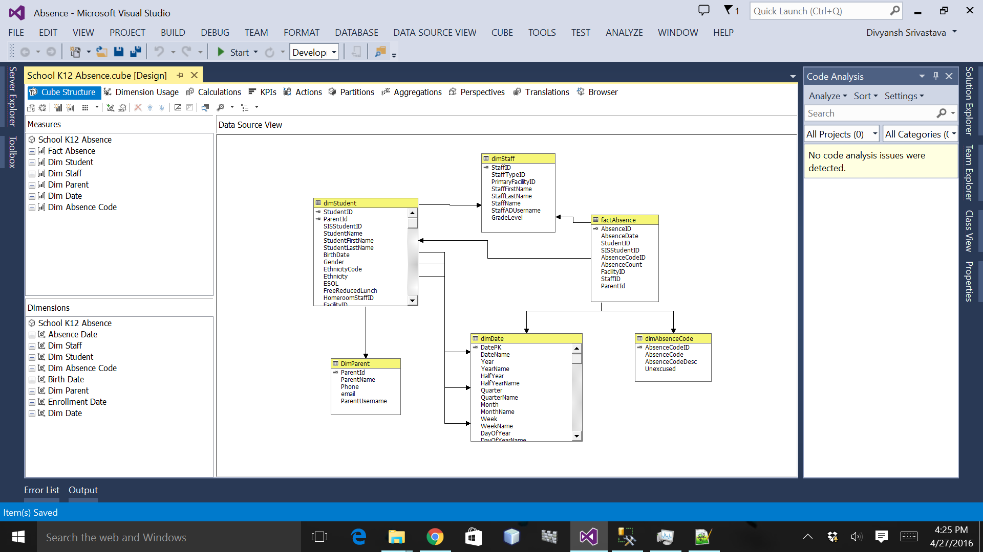
Absence

Slide 13
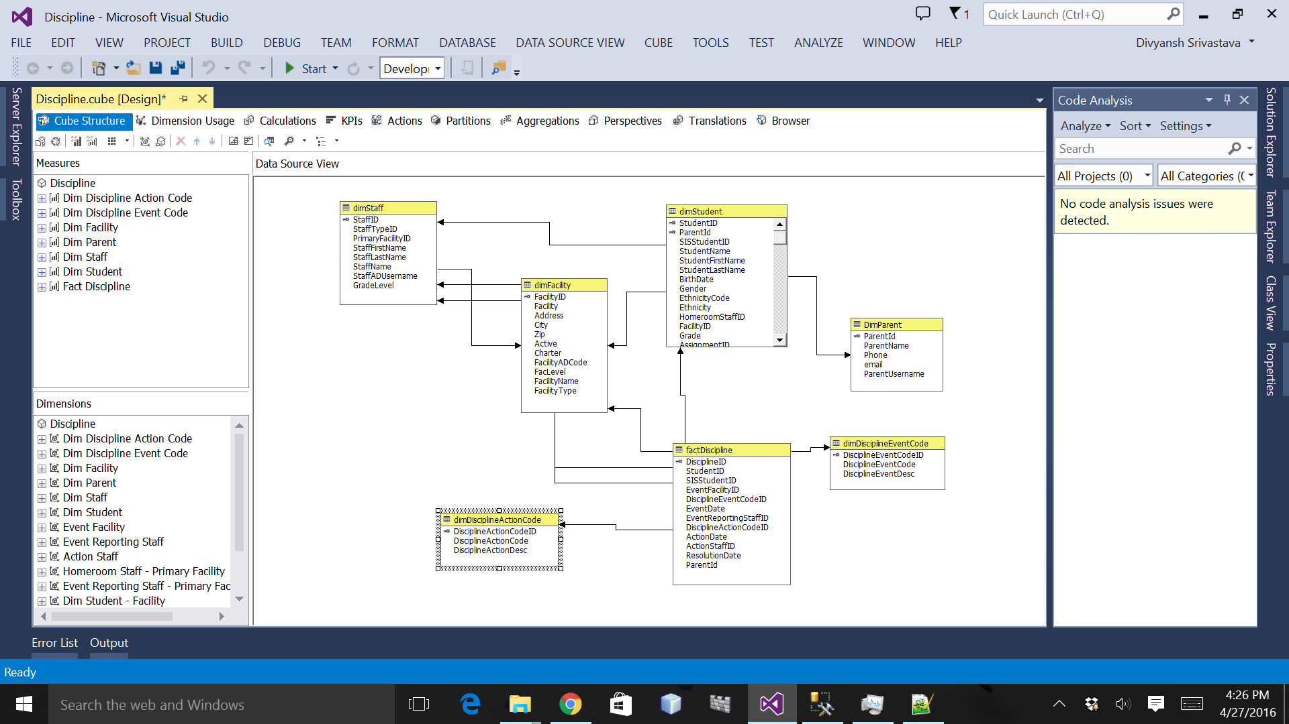
Discipline

Slide 14
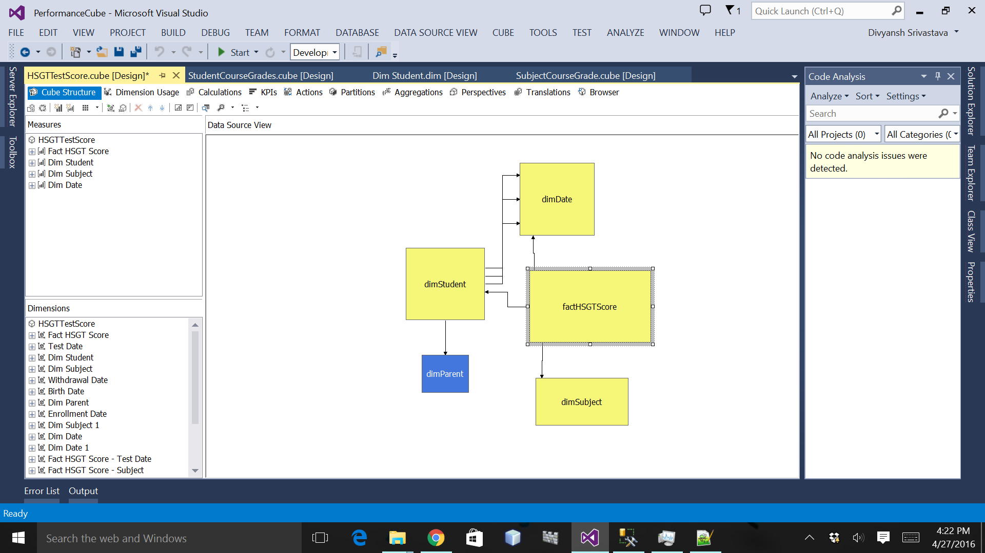
Performance

Slide 15
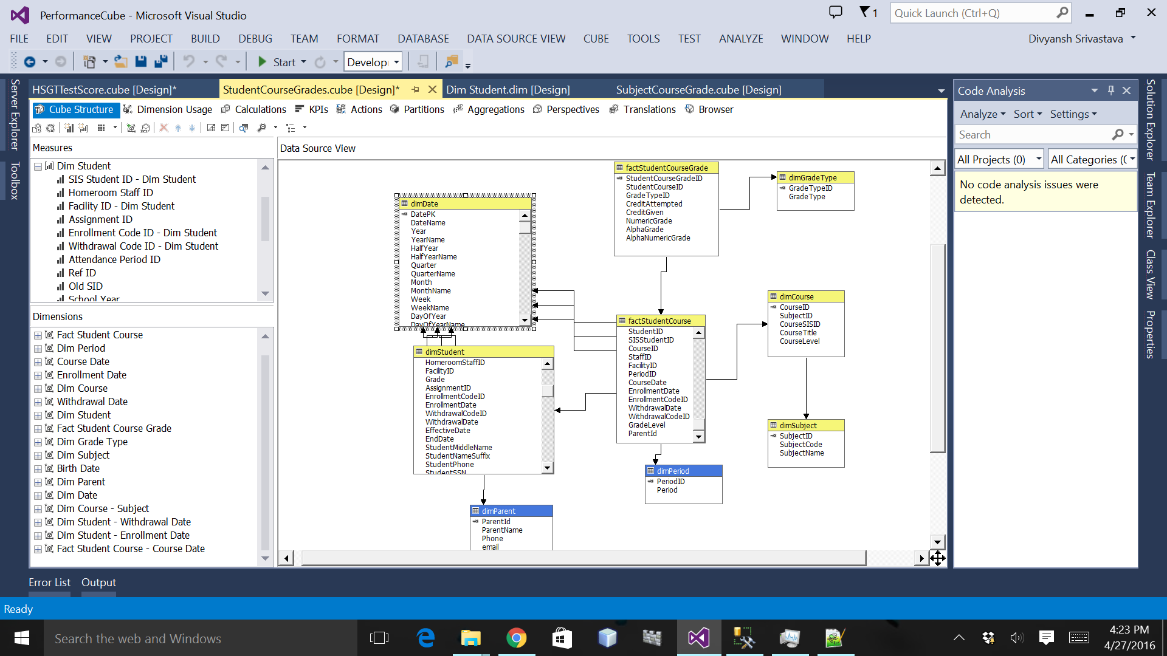

Slide 16
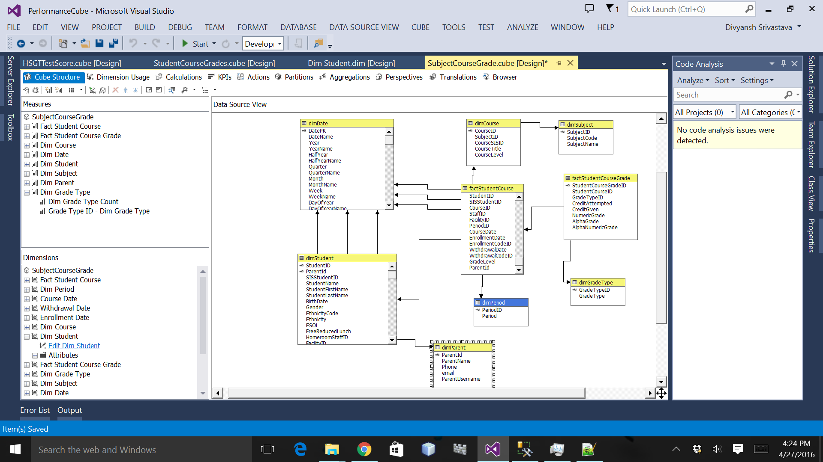

Slide 17
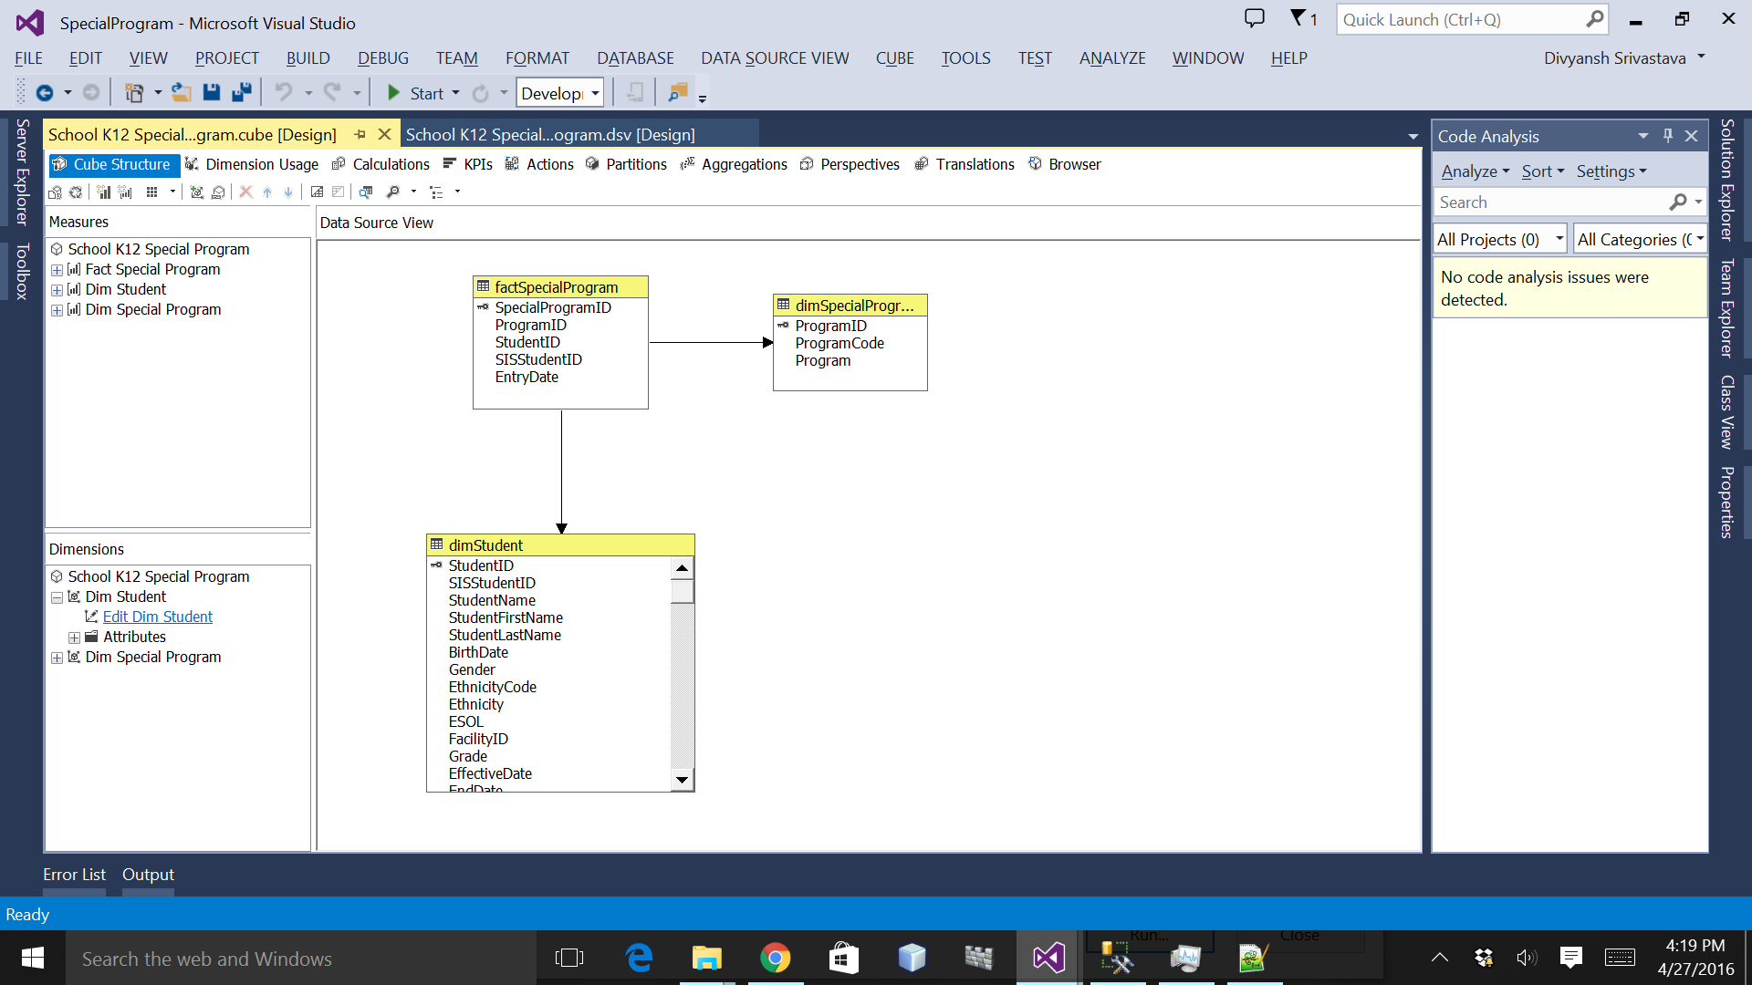
Special Program

Slide 18
Visualizations
Power BI

Slide 19
OLAP in Power BI
Data from the OLAP cubes was imported into PowerBI
The imported cubes, when queried must return the same results when executed on the relational tables if the cube is built in the right manner
Cubes were built for each of the following:
Absence
Performance
Special Programs
Discipline

Slide 20
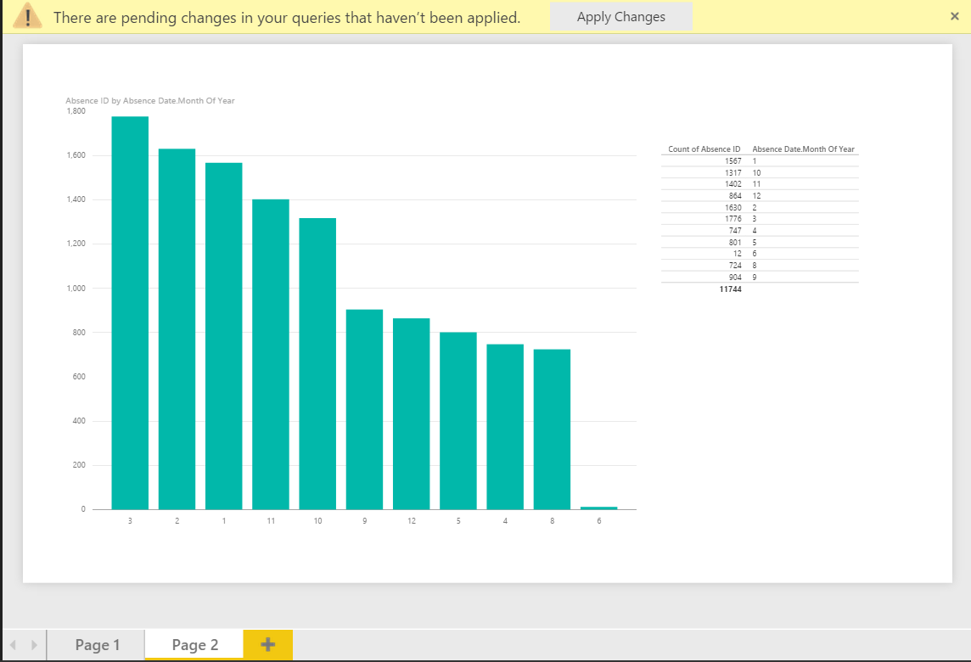
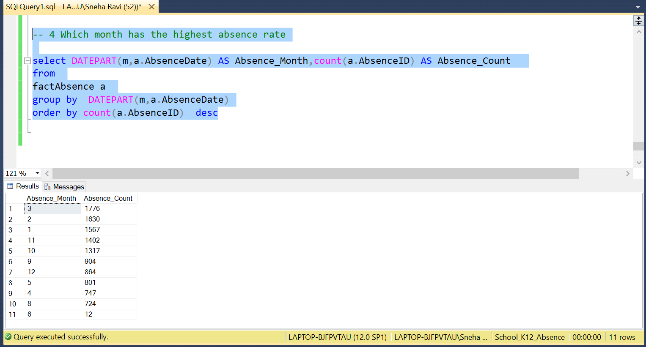
Visualizing the cube
The required columns were selected and aggregations were applied to obtain the results
As the cubes were intact, the queries gave the same results as the visualization tools

Slide 21
Question 6 Data Migration using Flat Files & Migration Tools
For MySql Data Migration, we used the flat files to import the data into the database and performed the required queries.
For PostGres Data Migration, we used the ESF Data Migration toolkit to import the data into the database and performed the required queries.

