Slide 1
Final Project
Database Management -INFO 6210

Slide 2
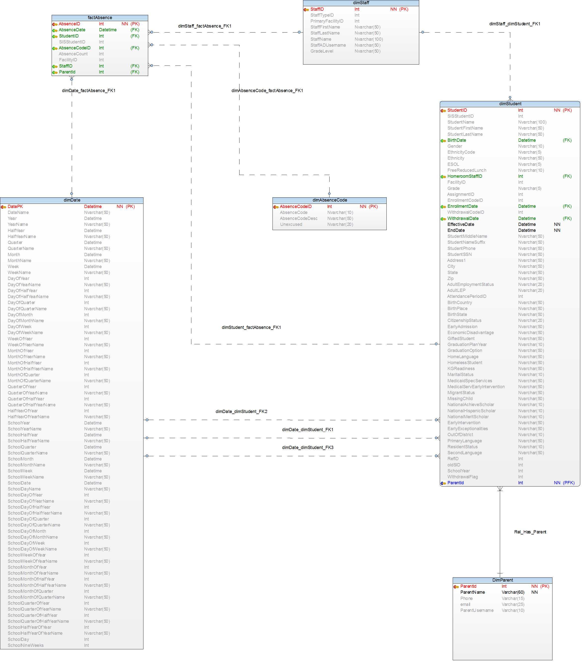
Absence Dimensional Model

Slide 3
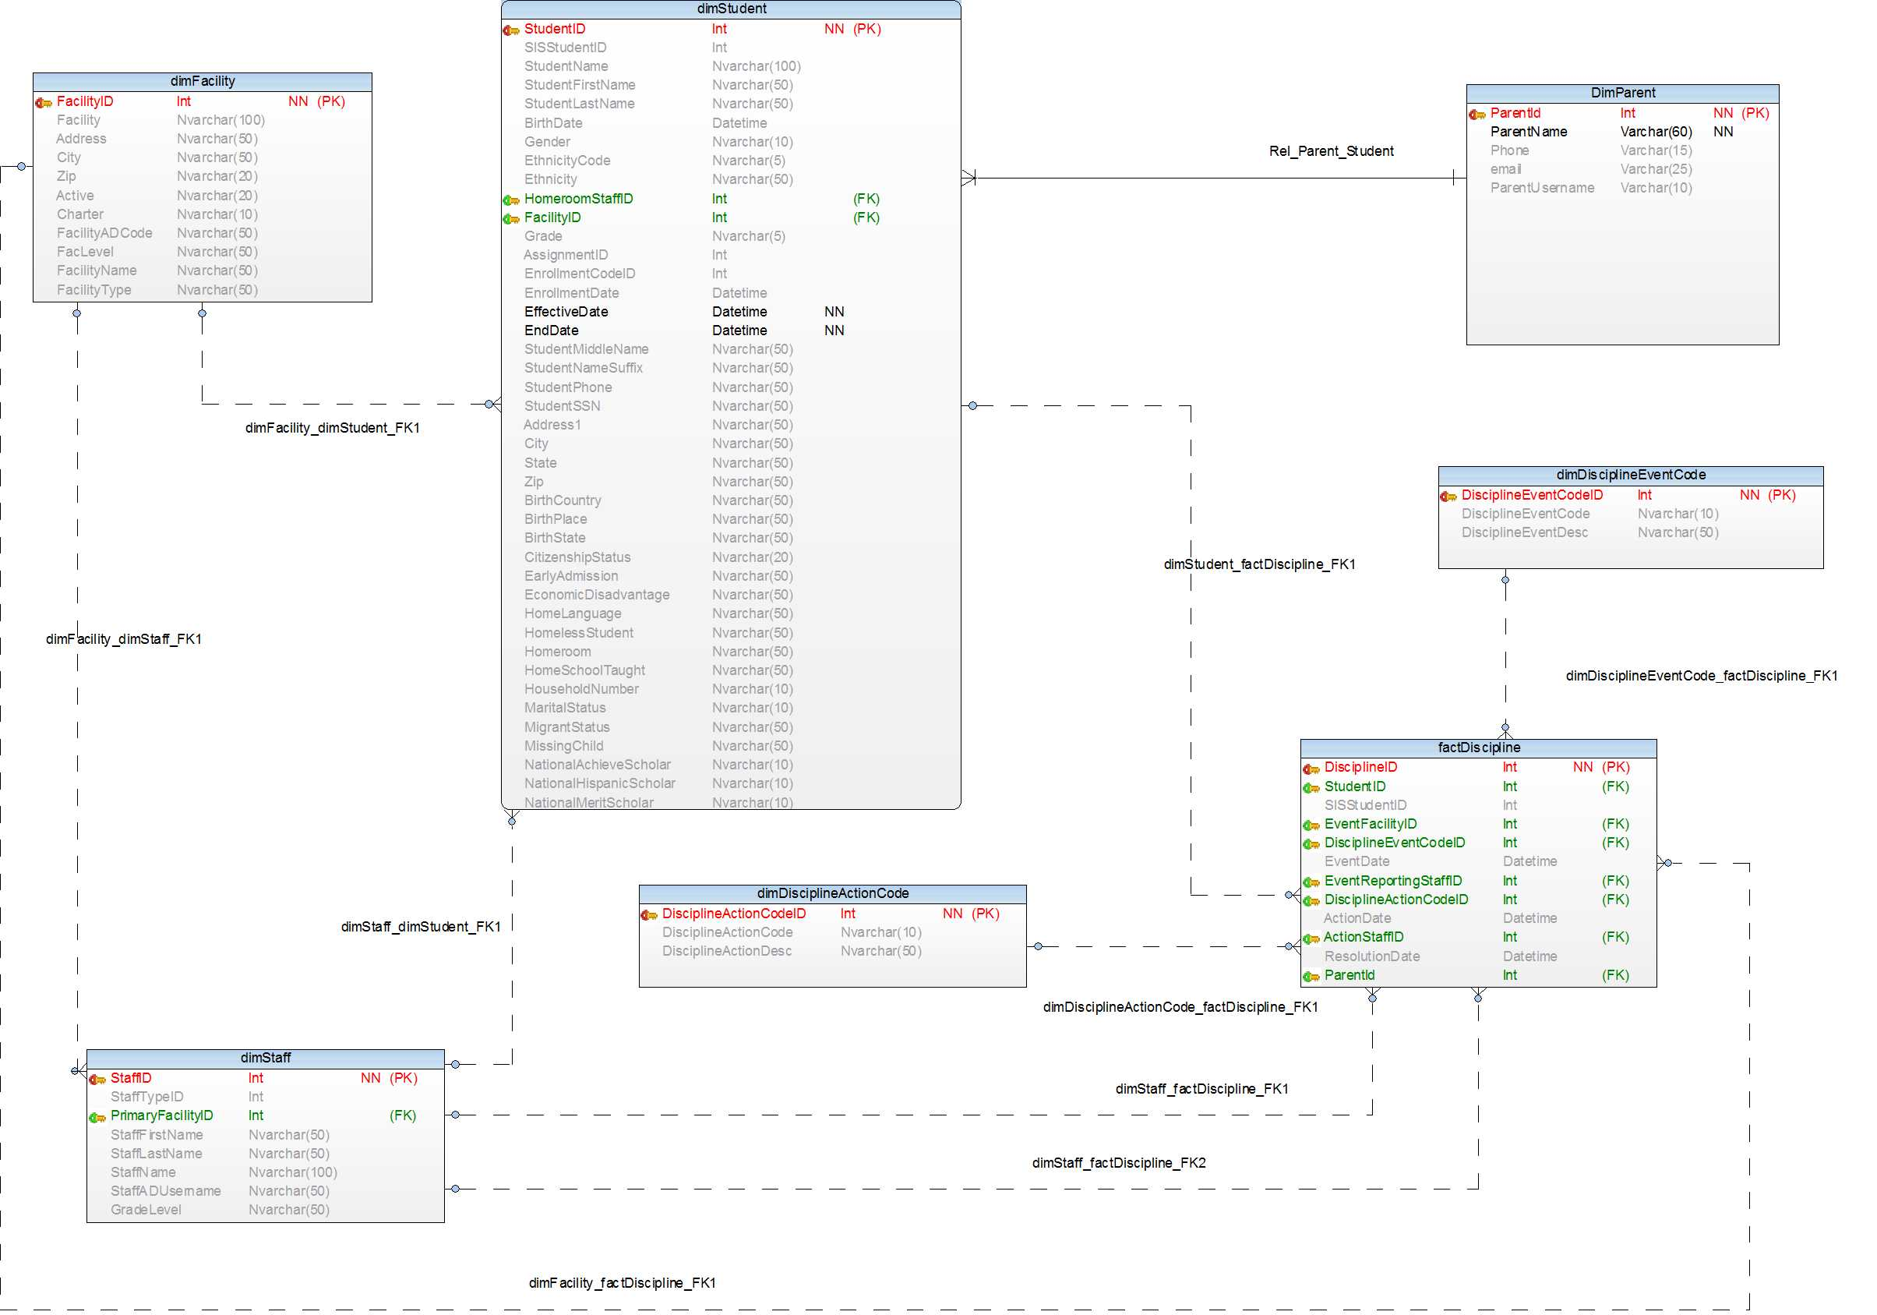
Discipline Dimensional Model

Slide 4
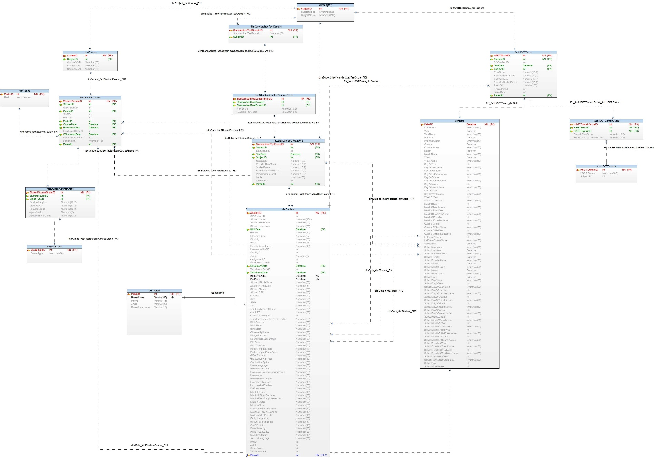
Performance Dimensional Model

Slide 5
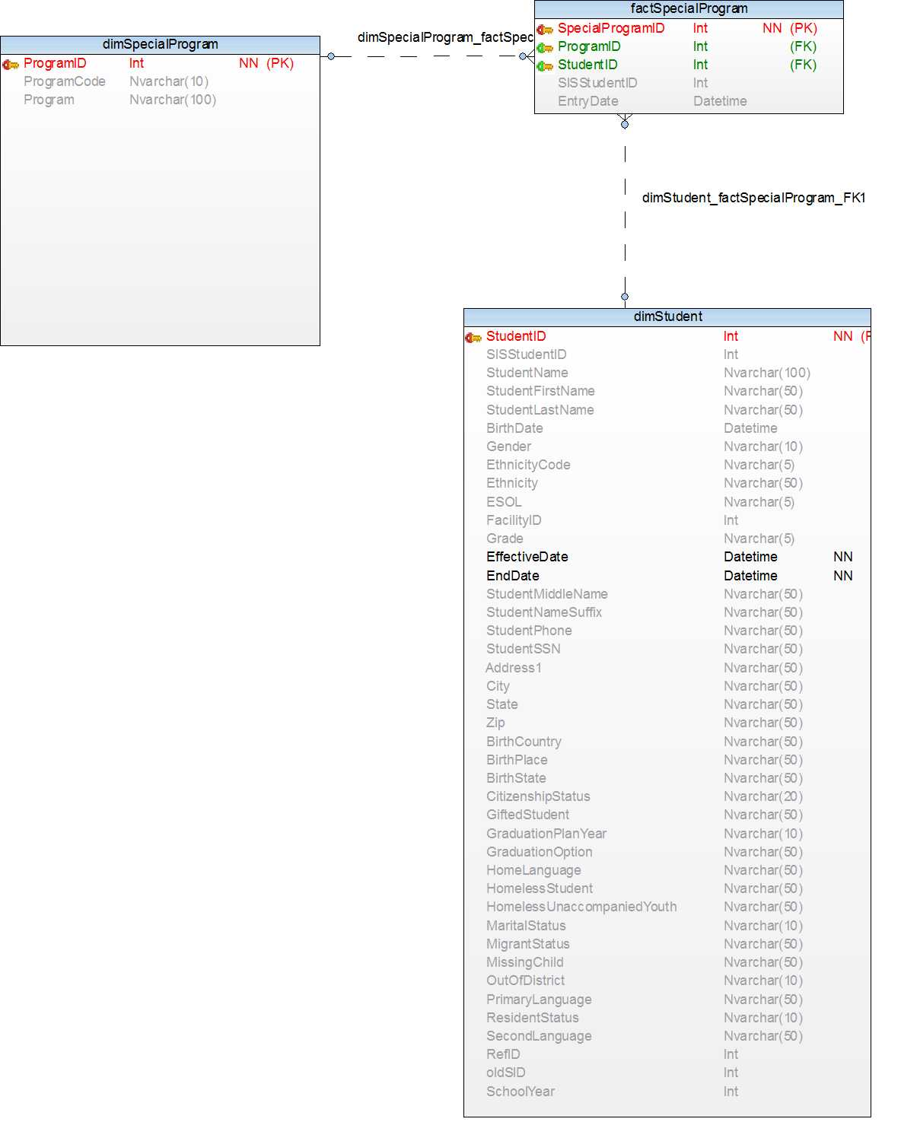
Performance Dimensional Model

Slide 6
Visualizations
Power BI

Slide 7
OLAP in Power BI
Data from the OLAP cubes was imported into PowerBI
The imported cubes, when queried must return the same results when executed on the relational tables if the cube is built in the right manner
Cubes were built for each of the following:
Absence
Performance
Special Programs
Discipline

Slide 8
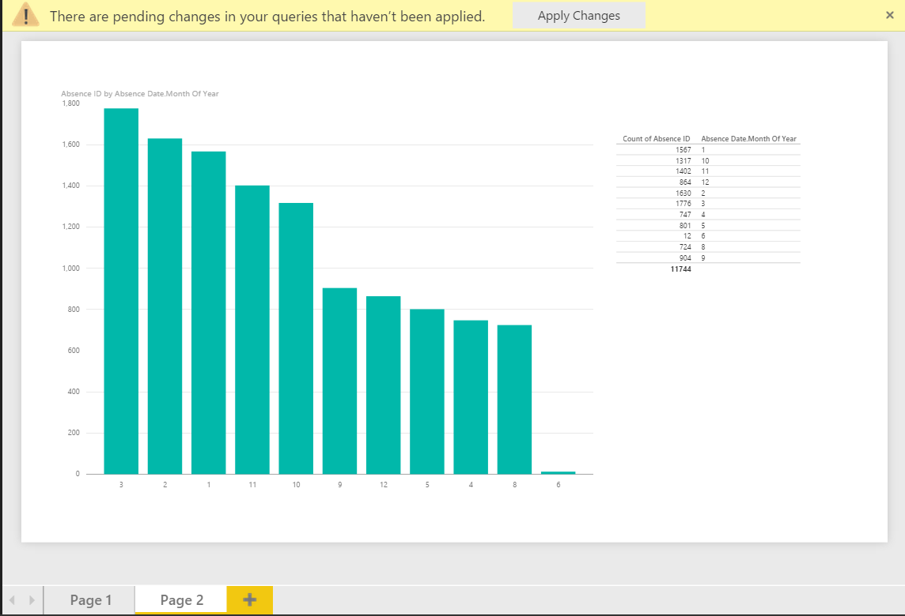
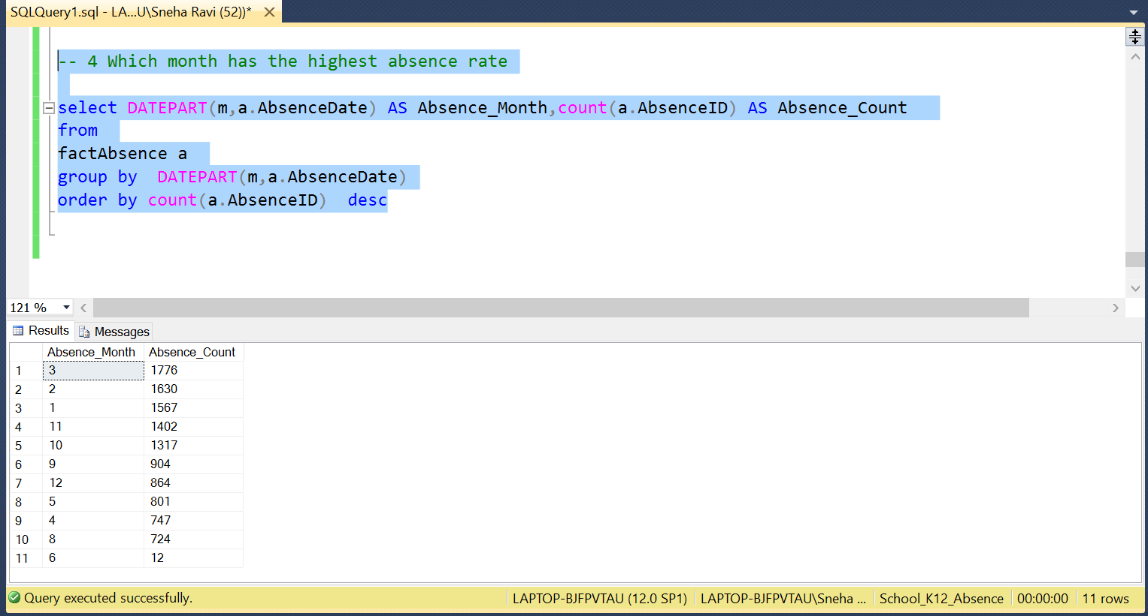
Visualizing the cube
The required columns were selected and aggregations were applied to obtain the results
As the cubes were intact, the queries gave the same results as the visualization tools

