Slide 1
Flu Trends Analysis by States, Age Group and Virus Types
TEAM MEMBERS
Anthony Lopez
Rashi Agarwal
Richard Encarnacion
Iram Anwar

Slide 2
OBJECTIVES
Develop an interactive dashboard that allows users to visualize flu data trends by season, region, and virus type.
Provide a clear, user-friendly interface with filters for selecting different age groups, regions, and virus types.
Create visualizations such as bar charts, line charts, and choropleth maps that illustrate trends and facilitate comparisons.
Offer insights and support for public health interventions through the visualization of flu case trends.

Slide 3
DATA SOURCE
https://www.cdc.gov/fluview/overview/fluview-interactive.html
Data was accessed across various parameters for week 40 (starting OCT 1, 2024) to week 48 (ending NOV 30th, 2024).

Slide 4
PROJECT STRUCTURE
Data was stored in postgresql and was extracted using SQL Alchemy.
Data was cleaned,related tables were joined and analyzed.
Analysis was conducted to explore
trends in mortality rates by state and week
virus type distribution across age groups and states
activity levels of flu like illnesses across various regions
number of flu cases for virus types and age groups.

Slide 5
TOOLS AND LIBRARIES
Python Libraries:
Pandas: For data manipulation and analysis.
Matplotlib: For creating static visualizations.
Plotly/Dash: For interactive visualizations and dashboards.
Postgres to store data

Slide 6
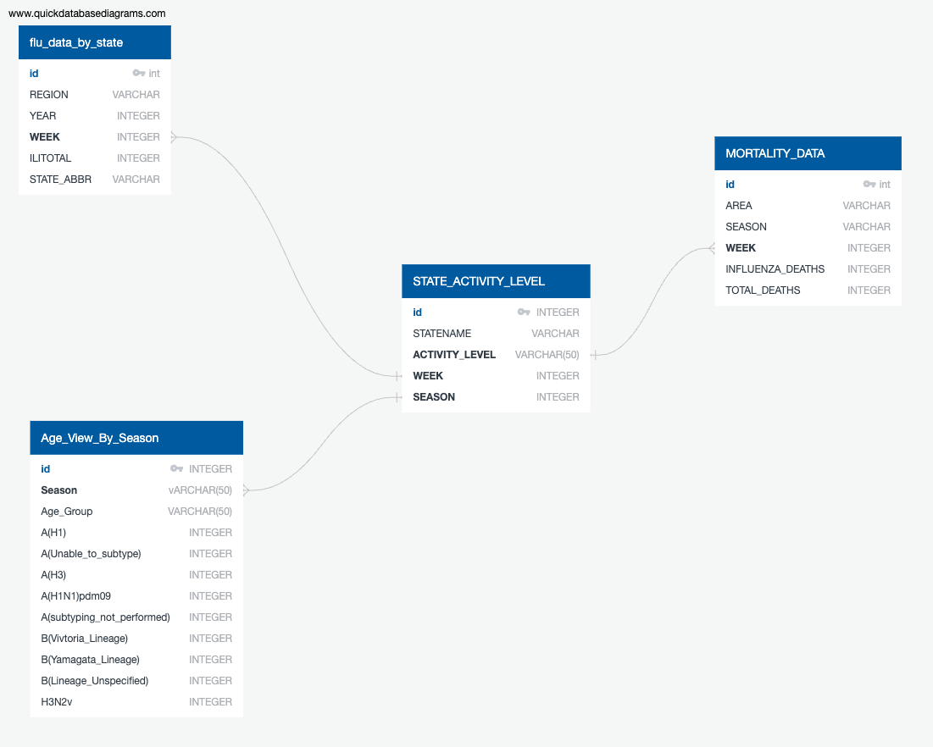
DATABASE DIAGRAM

Slide 7
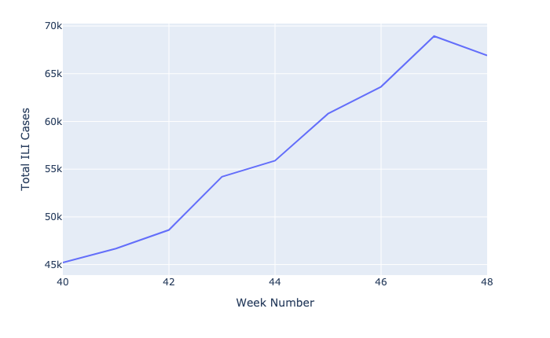
WEEKLY FLU CASES ACROSS ALL STATES
This line graph depicts an increase in the number of flue cases from week 40 to 48.

Slide 8
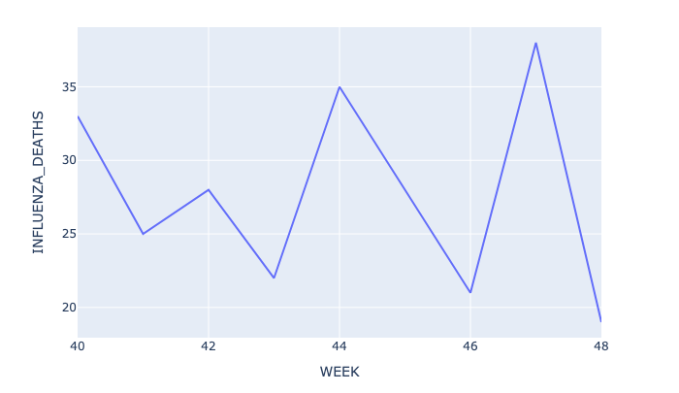
INFLUENZA DEATHS OVER TIME
This line-graph shows trends in mortality rates from week 40 to week 48 for all 50 US states and it demonstrates an increase in number of influenza related deaths from week 45.

Slide 9
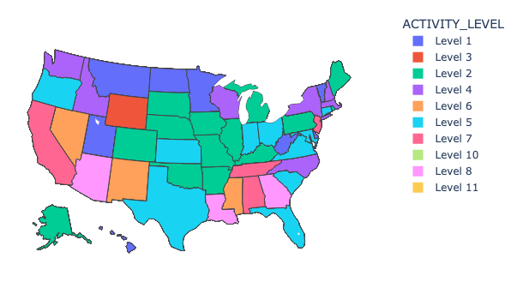
INFLUENZA ACTIVITY LEVELS BY STATE OVER TIME
This choropleth map provides a visual summary of how influenza activity fluctuates, helping to understand which areas are most affected.

Slide 10
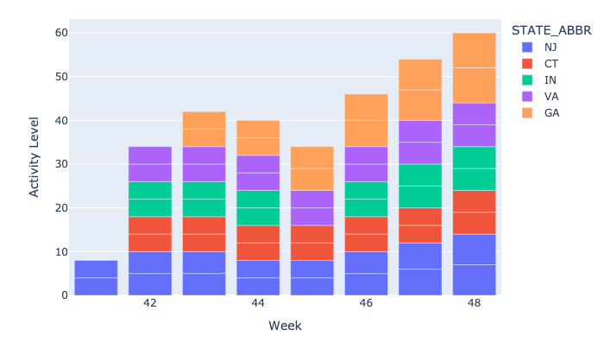
TOP 5 STATES WITH HIGHEST ACTIVITY LEVELS BY WEEK
This bar graph plots top 5 highest active states namely Connecticut, Indiana, New Jersey, New York and Wisconsin which is consistently highest for 5 weeks.

Slide 11
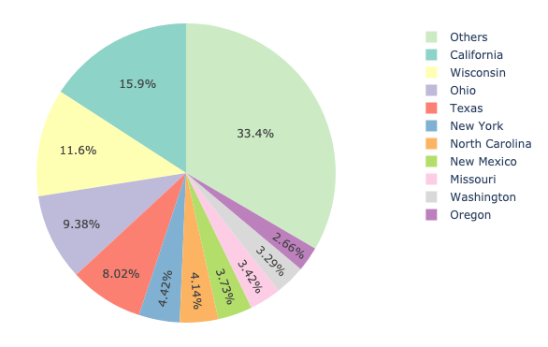
TOTAL SPECIMENS BY STATE
The pie chart provides insights into the distribution of specimens by state, allowing us to identify key patterns and trends, like states with larger slices may have high population density or have more robust sampling efforts or higher prevalance of the disease.

Slide 12
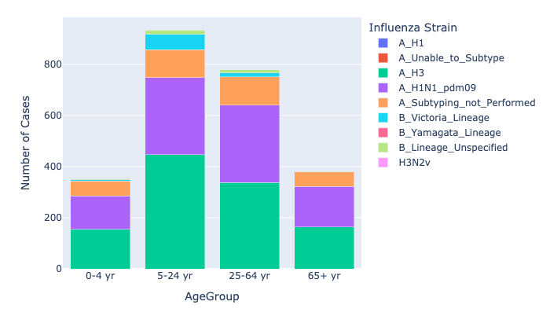
INFLUENZA STRAIN CASES BY AGE GROUP
This bar chart plots various Influenza strains by Age group.A_H3 and A_H1N1 are predominant across all ages. The distribution of flu strains does not vary drastically between the different age groups, suggesting that flu affects all age groups in a somewhat similar manner, with A (H3) being the primary strain.

Slide 13
CONCLUSIONS
We can identify weeks when influenza activity reaches its peak and thus requires heightened public health intervention.
The distribution of different virus types can help identify which types are most prevalent and potentially more harmful.
Some states may consistently show higher activity levels, suggesting that these areas face more significant influenza outbreaks compared to others and how regional public health measures and climate affect influenza spread.
By comparing total deaths and influenza-specific deaths, we can assess how influenza contributes to overall mortality.
By analysis of Specimen count, we can identify disparities in specimen collection due to non availability of resources or lack of testing infrastructure thus resulting in gaps in surveillance.

Slide 14
RECOMMENDATIONS
Increase monitoring and response efforts in the weeks leading up to peak activity periods identified in the analysis.
Vaccination Campaigns: Target vaccination drives more aggressively in age groups or regions identified as being at higher risk.
Develop educational campaigns to provide guidance on flu prevention, symptoms to watch for, and when to seek medical attention.
Implement state-specific health policies that consider varying activity levels and response needs.
Based on the virus types most seen, encourage the development and deployment of vaccines targeting those specific strains.

Slide 15
THANK YOU!

