Slide 1
PVSystem and PVSystem 2 Scenarios
OpenDSS: Version 8.6.2.1 (64-bit build)
Authors: Paulo Radatz and Celso Rocha

Slide 2
Scenarios with PF=1

Slide 3
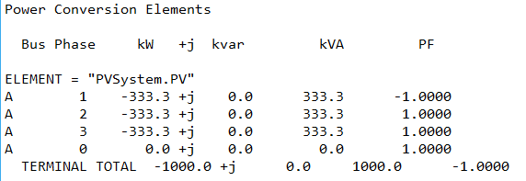
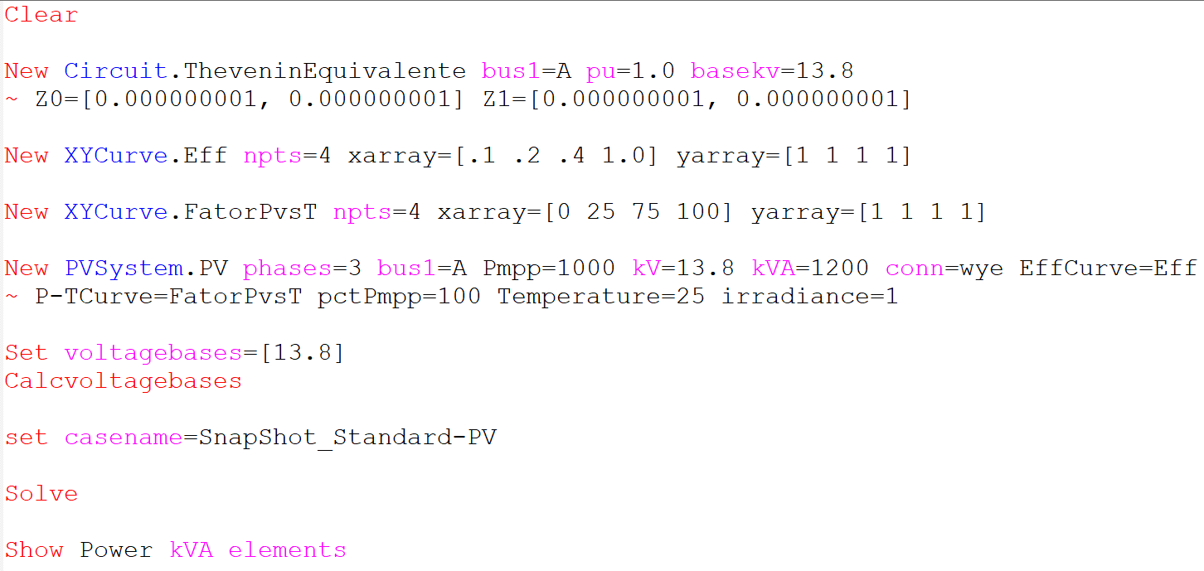
Scenario 1-PV: Snapshot with no power limitation
Simulation Mode: Snapshot
Irradiance = 1.0kW/m^2
pctPmpp = 100%
Pmpp = 1000kW
kVA = 1200kVA
Results:
OpenDSS code (SnapShot_Standard-PV.dss)
Key points:
It works as expected
Pmpp*pctPmpp does not limit the active output power
kVA does not limit the apparent output power

Slide 4
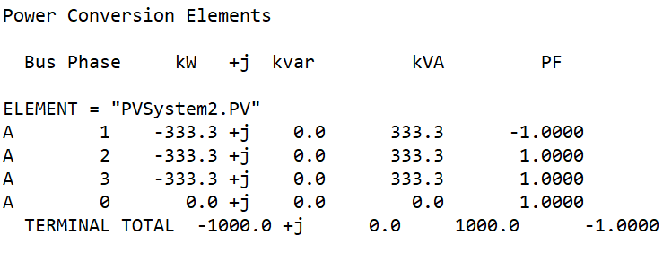
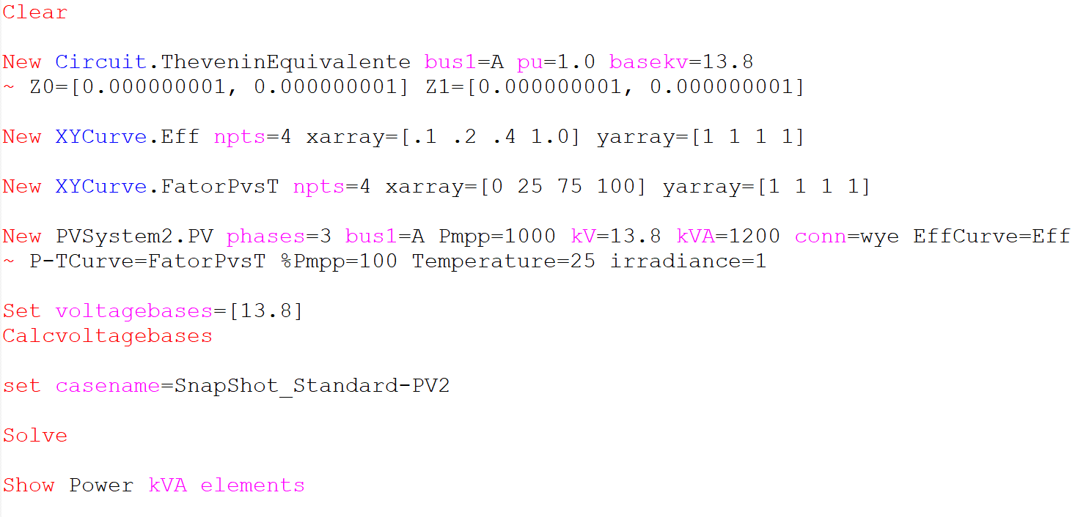
Scenario 1-PV2: Snapshot with no power limitation
Simulation Mode: Snapshot
Irradiance = 1.0kW/m^2
pctPmpp = 100%
Pmpp = 1000kW
kVA = 1200kVA
Results:
OpenDSS code (SnapShot_Standard-PV2.dss)
Key points:
It works as expected
New property name

Slide 5
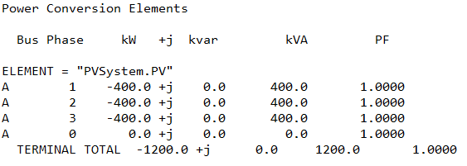
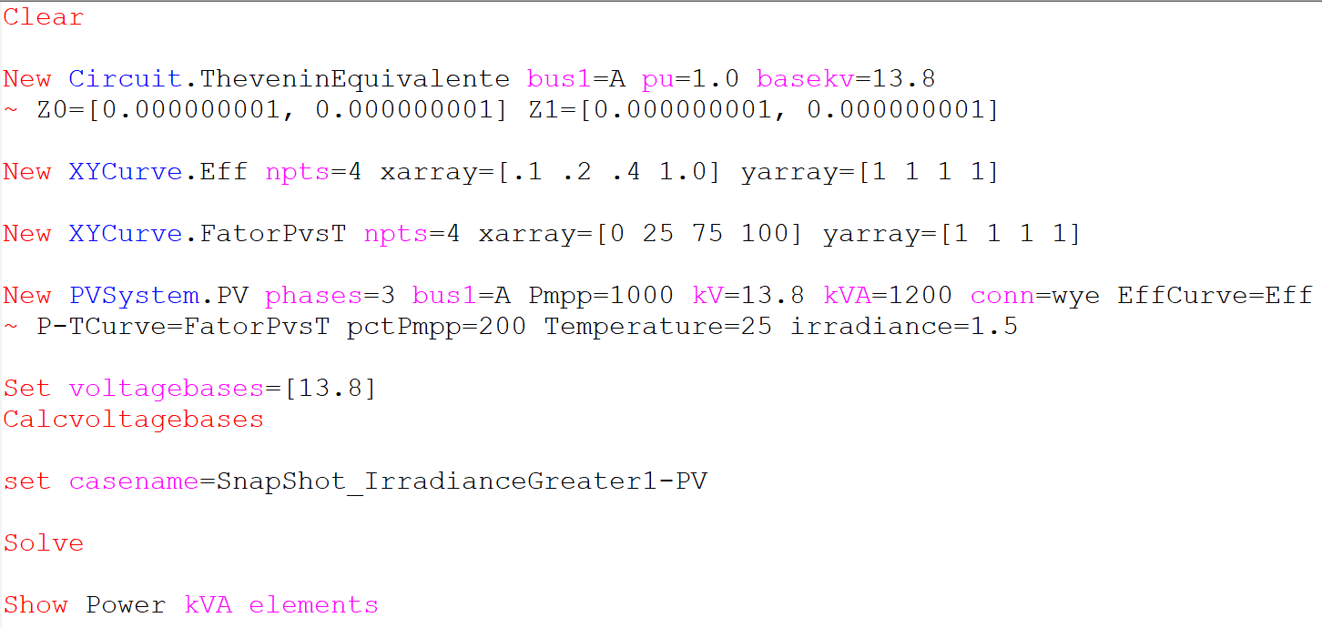
Scenario 2-PV: Snapshot with kVA limitation only (no limit on kW by Pmpp*pctPmpp)
Simulation Mode: Snapshot
Irradiance = 1.5kW/m^2
pctPmpp = 200%
Pmpp = 1000kW
kVA = 1200kVA
Results:
OpenDSS code (SnapShot_IrradianceGreater1-PV.dss)
Key points:
It works as expected
Output active power is not limited by Pmpp*pctPmpp that is 2000kW
Output active power is limited by the inverter kVA rating
As can be seen, PVSystem can operate with an irradiance greater than 1kW/m^2 and not be limited by Pmpp*pctPmpp. That`s because pctPmpp is higher than 100.

Slide 6
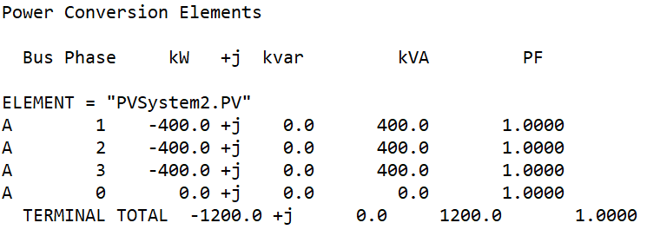
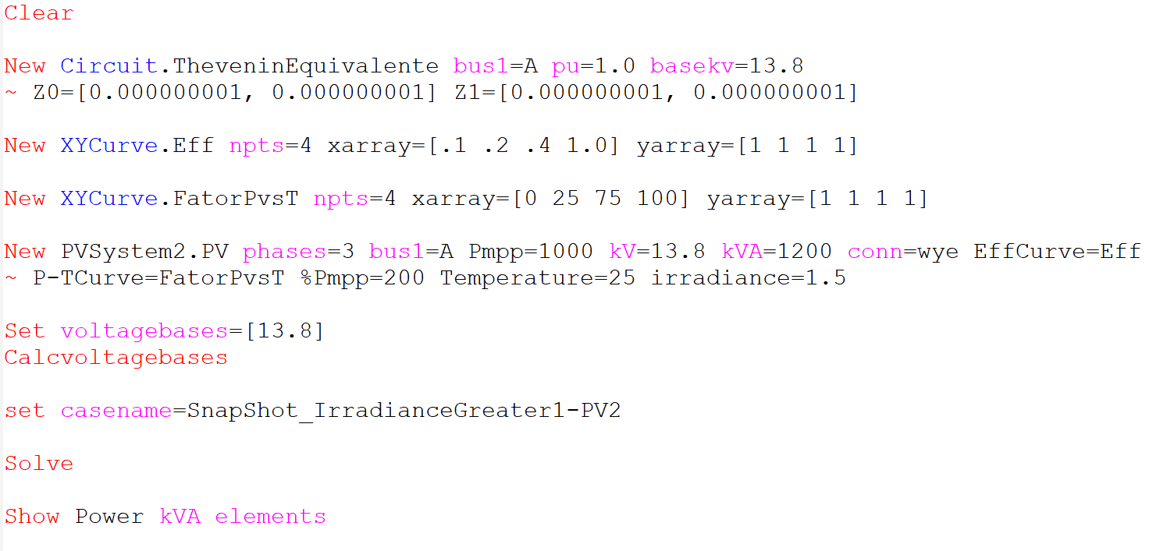
Scenario 2-PV2: Snapshot with kVA limitation only (no limit on kW by Pmpp*%Pmpp)
Simulation Mode: Snapshot
Irradiance = 1.5kW/m^2
pctPmpp = 200%
Pmpp = 1000kW
kVA = 1200kVA
Results:
OpenDSS code (SnapShot_IrradianceGreater1-PV2.dss)
Key points:
It works as expected

Slide 7
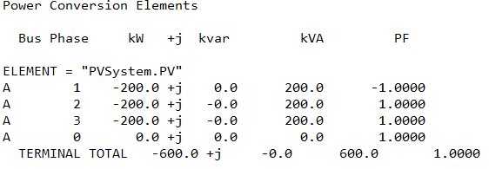
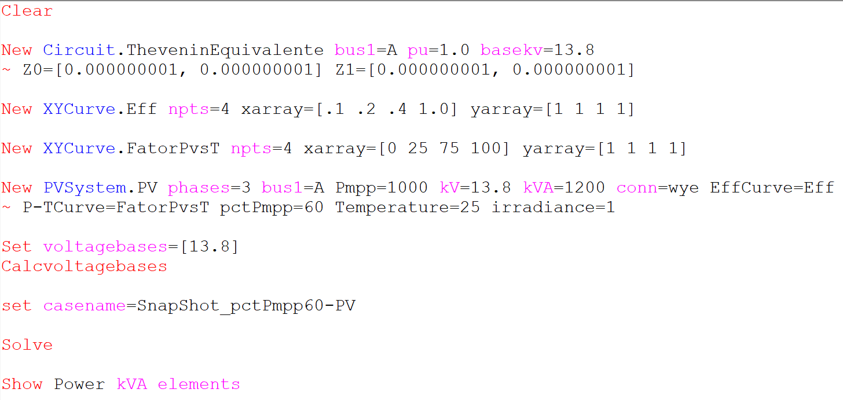
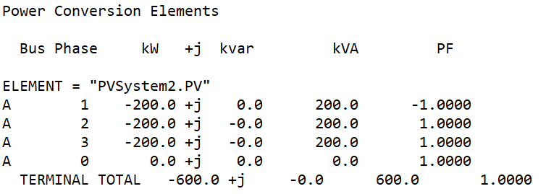
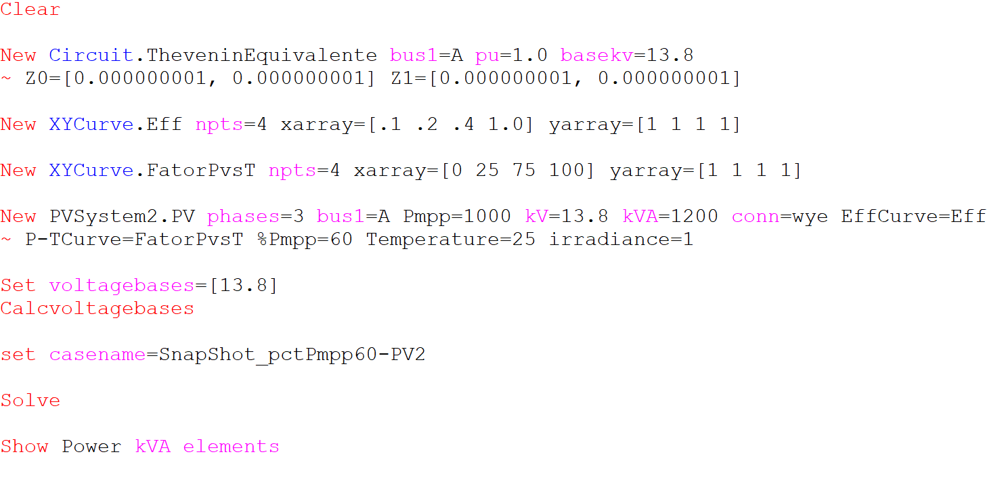
Scenario 3: Snapshot with kW limited by pctPmpp*Pmpp only (no limit by inverter`s kVA rating)
Results:
Simulation Mode: Snapshot
Irradiance = 1.0kW/m^2
pctPmpp = 60%
Pmpp = 1000kW
kVA = 1200kVA
OpenDSS code (SnapShot_pctPmpp60-PV.dss)
OpenDSS code (SnapShot_pctPmpp60-PV2.dss)
Key points:
It works as expected
Output active power is limited by Pmpp * pctPmpp (1000 x 60/100 = 600kW)

Slide 8
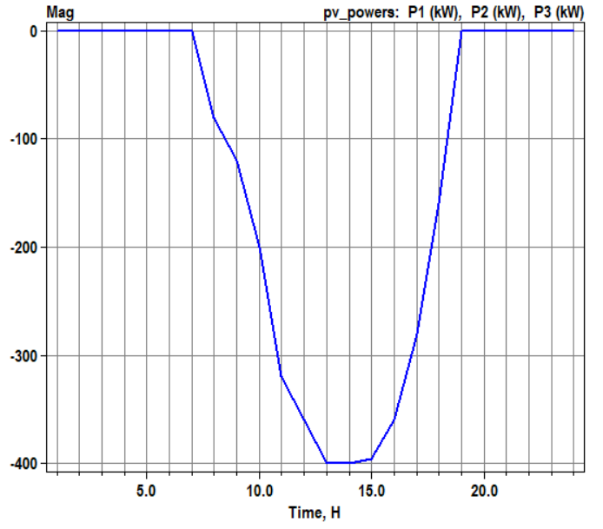
Scenario 4: Daily with no power limitation
Simulation Mode: Daily
Irradiance = 1.0kW/m^2
pctPmpp = 100%
Pmpp = 1200kW
kVA = 1200kVA
Results:
OpenDSS codes:
Daily_Standard-PV.dss
Daily_Standard-PV2.dss
1200kW @ 13 and 14 pm
Key points:
It works as expected
Pmpp*pctPmpp does not limit the active output power
kVA does not limit the apparent output power

Slide 9
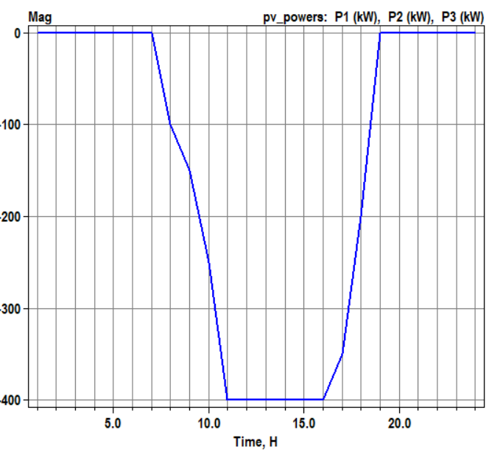
Scenario 5: Daily with kVA limitation only (no limit on kW by Pmpp*pctPmpp)
Simulation Mode: Daily
Irradiance = 1.5kW/m^2
pctPmpp = 200%
Pmpp = 1000kW
kVA = 1200kVA
Q priority
Results:
OpenDSS code:
Daily_IrradianceGreater1-PV.dss
Daily_IrradianceGreater1-PV2.dss
Key points:
It works as expected
Output active power is not limited by Pmpp*pctPmpp
Output active power is limited by the inverter`s kVA rating
As can be seen, PVSystem can operate with an irradiance greater than 1kW/m^2 and not be limited by Pmpp*pctPmpp. That`s because pctPmpp is higher than 100.

Slide 10
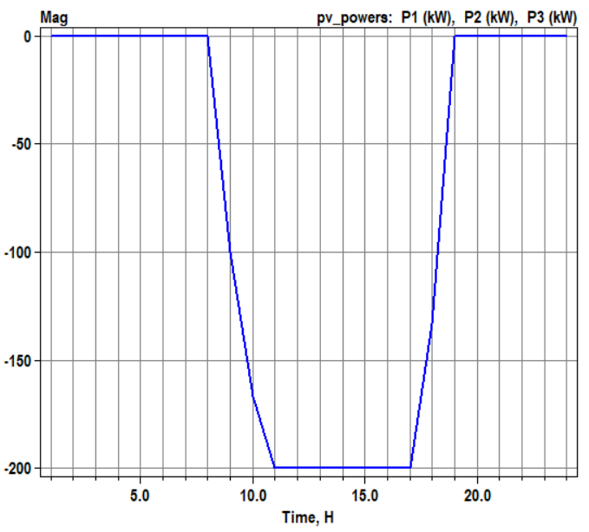
Scenario 6: Daily with kW limited by pctPmpp*Pmpp only (no limit by inverter`s kVA rating)
Simulation Mode: Daily
Irradiance = 1.0kW/m^2
pctPmpp = 60%
Pmpp = 1000kW
kVA = 1200kVA
Results:
OpenDSS code:
Daily_pctPmpp60-PV.dss
Daily_pctPmpp60-PV2.dss
Key points:
It works as expected
Output active power is limited by Pmpp x pctPmpp (1000 x 60/100 = 600kW)

Slide 11
Scenarios with non-unitary PF

Slide 12
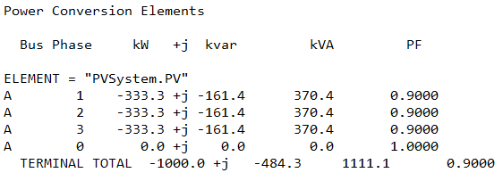
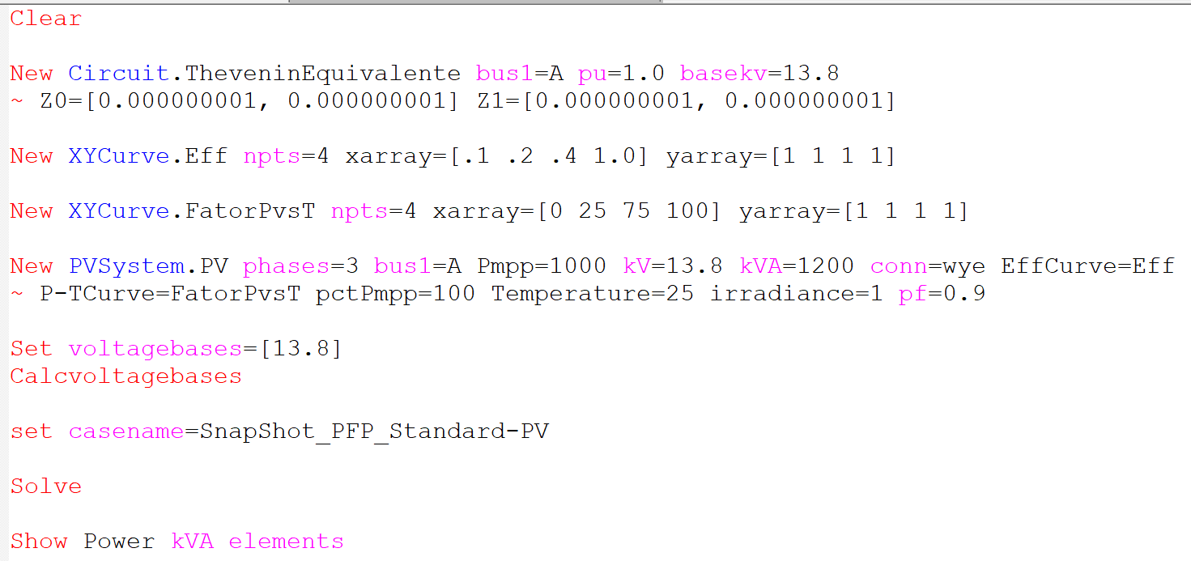
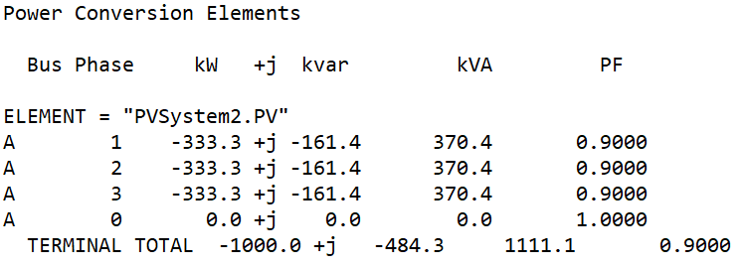
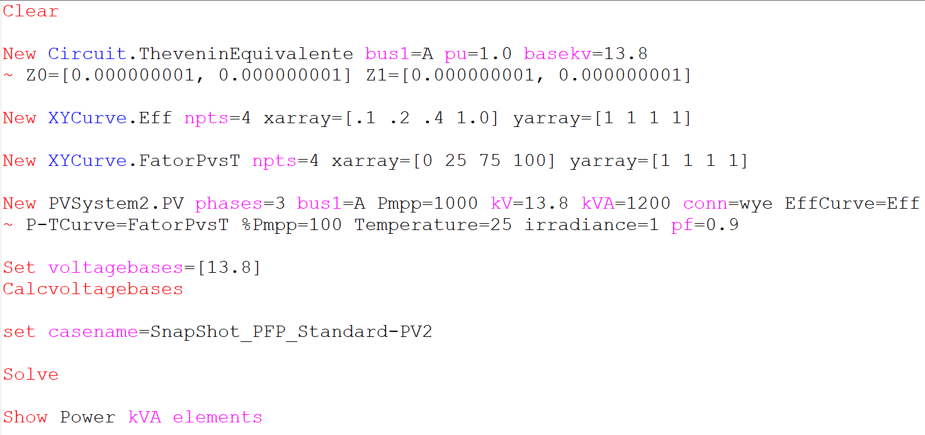
Scenario 7: Snapshot with pf=0.9
Results:
OpenDSS code (SnapShot_PFP_Standard-PV.dss)
OpenDSS code (SnapShot_PFP_Standard-PV2.dss)
Key points:
It works as expected!
Constant power factor is equal to 0.9

Slide 13
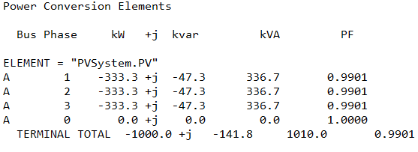
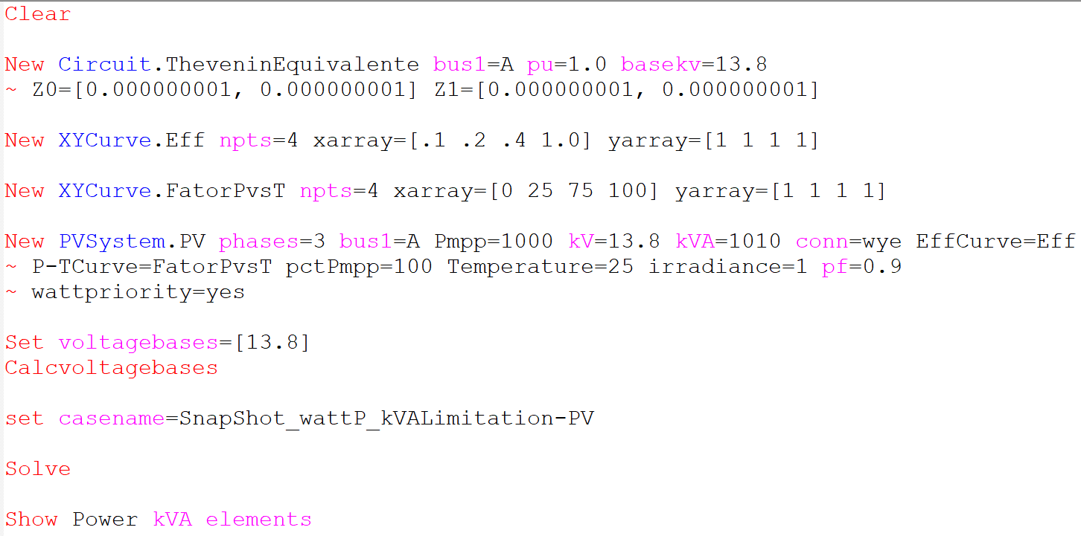
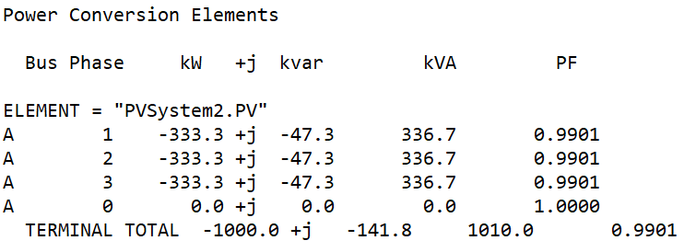
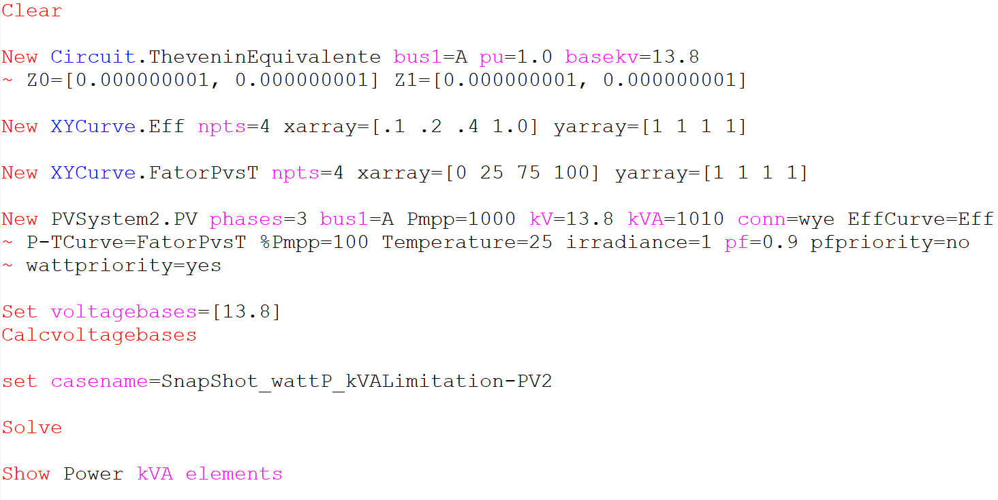
Scenario 8: Snapshot with pf=0.9 and kVA limitation (watt priority)
kVA = 1010kVA
Pfpriority=no
Wattpriority=yes
Results:
OpenDSS code (SnapShot_wattP_kVAlimitation-PV.dss)
OpenDSS code (SnapShot_wattP_kVAlimitation-PV2.dss)
Key points:
It works as expected!
New property

Slide 14
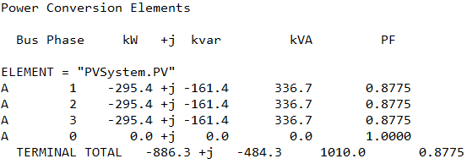
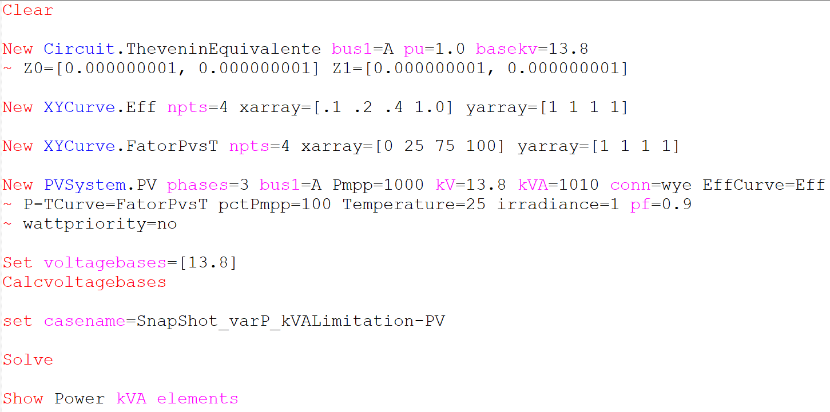
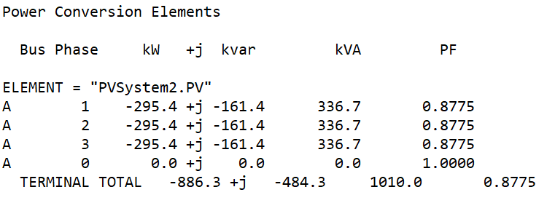
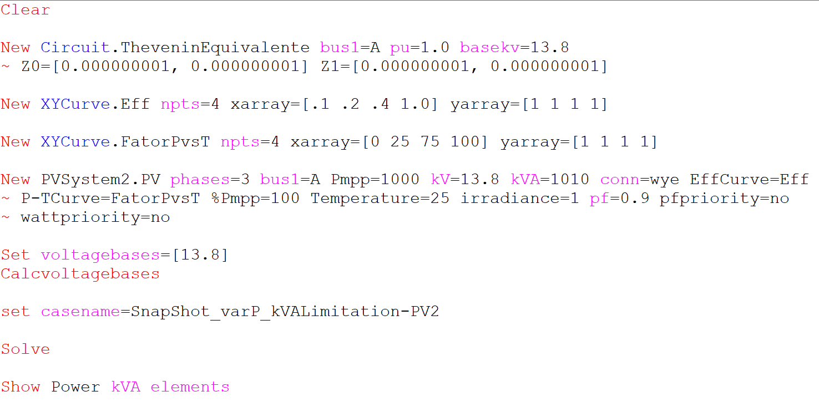
Scenario 9: Snapshot with pf=0.9 and kVA limitation (var priority)
kVA = 1010kVA
Pfpriority=no
Wattpriority=no
Results:
OpenDSS code (SnapShot_varP_kVAlimitation-PV.dss)
OpenDSS code (SnapShot_varP_kVAlimitation-PV2.dss)
Key points:
It works as expected!
Kvar_out = 1000 * sqrt(1/pf^2-1). 1000 is the kw_out desired before kVA rating check

Slide 15
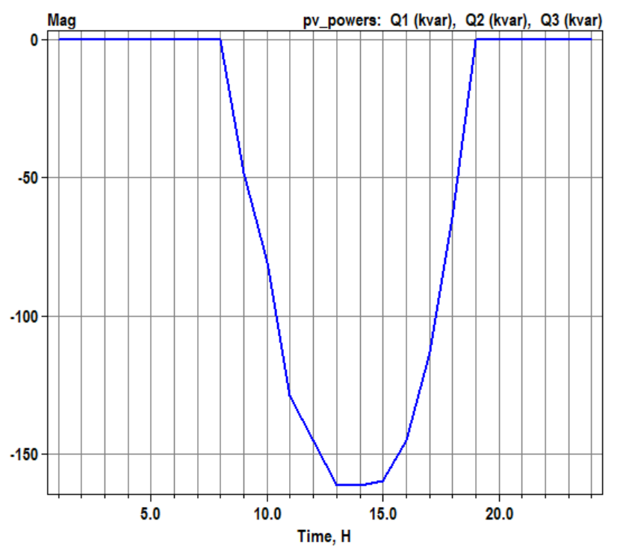
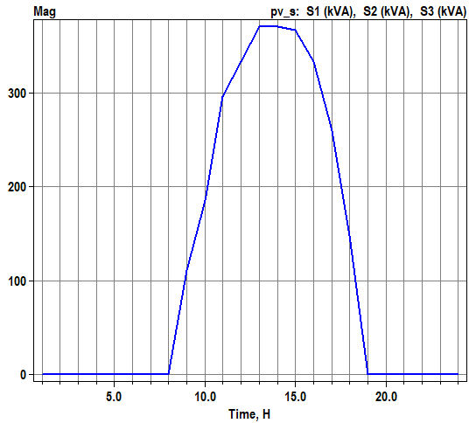
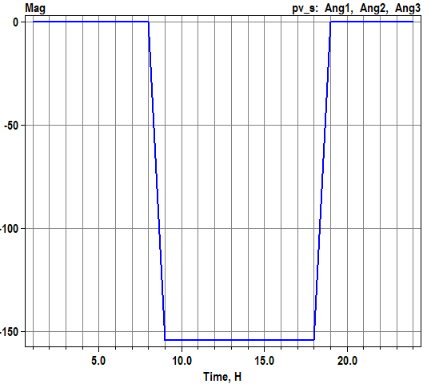
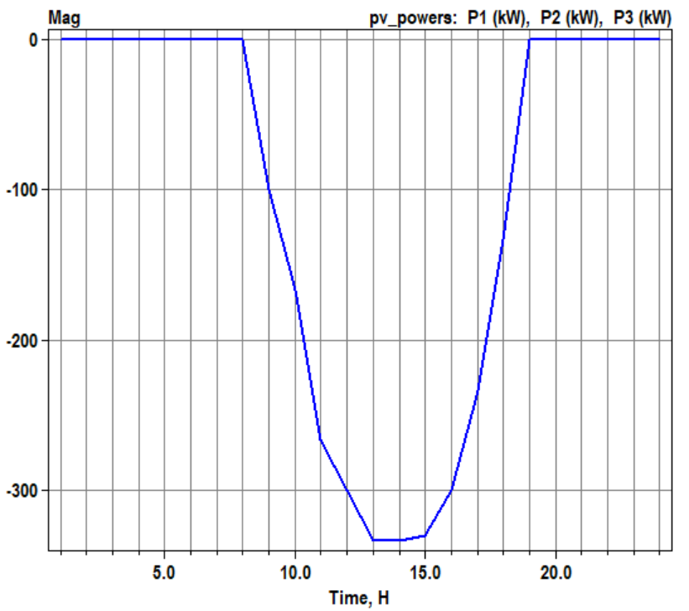
Scenario 10: Daily with pf=0.9
Key points:
It works as expected!
PF constant
OpenDSS code:
Daily_PFP_Standard-PV.dss
Daily_PFP_Standard-PV2.dss
Results:

Slide 16
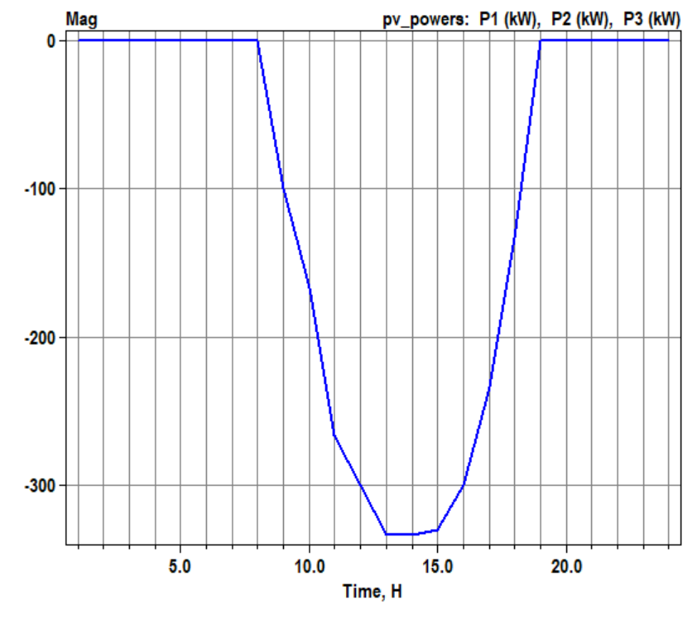
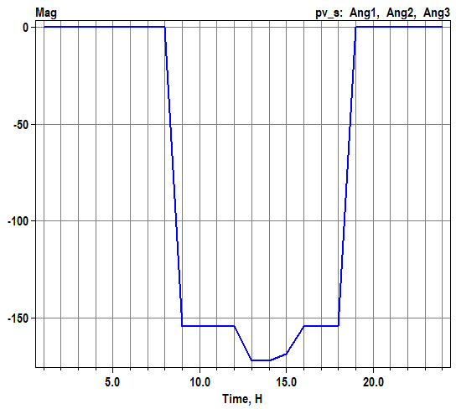
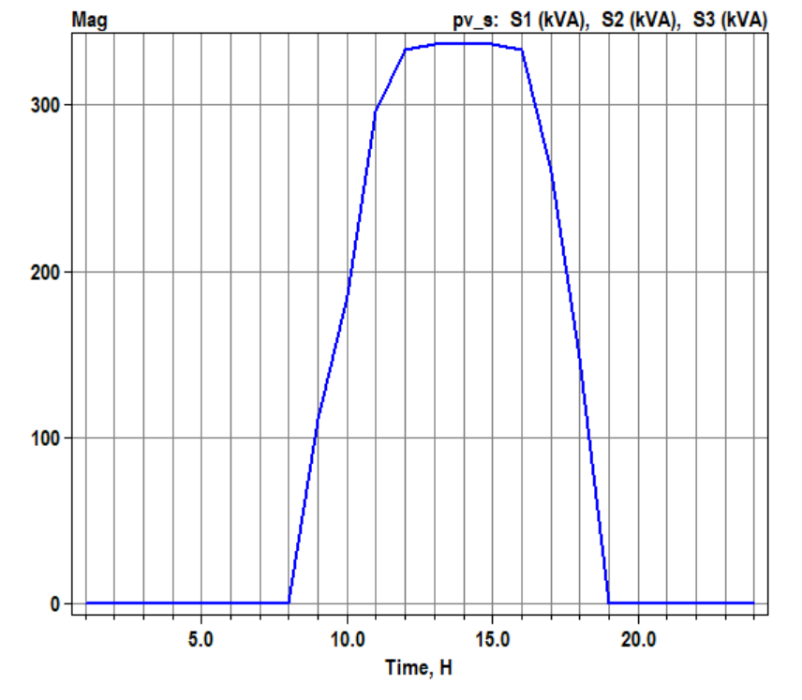
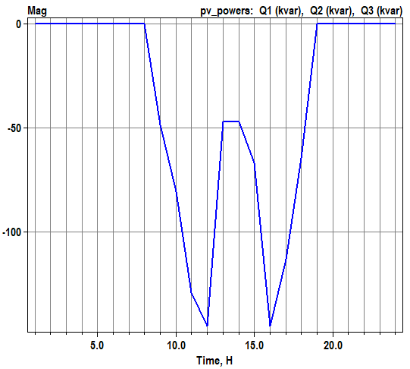
Scenario 11: Daily with pf=0.9 and kVA limitation (watt priority)
kVA = 1010kVA
Pfpriority=no
Wattpriority=yes
Key points:
It works as expected!
Equal to Scenario 10
Results:
OpenDSS code:
Daily_wattP_kVAlimitation-PV.dss
Daily_wattP_kVAlimitation-PV2.dss

Slide 17
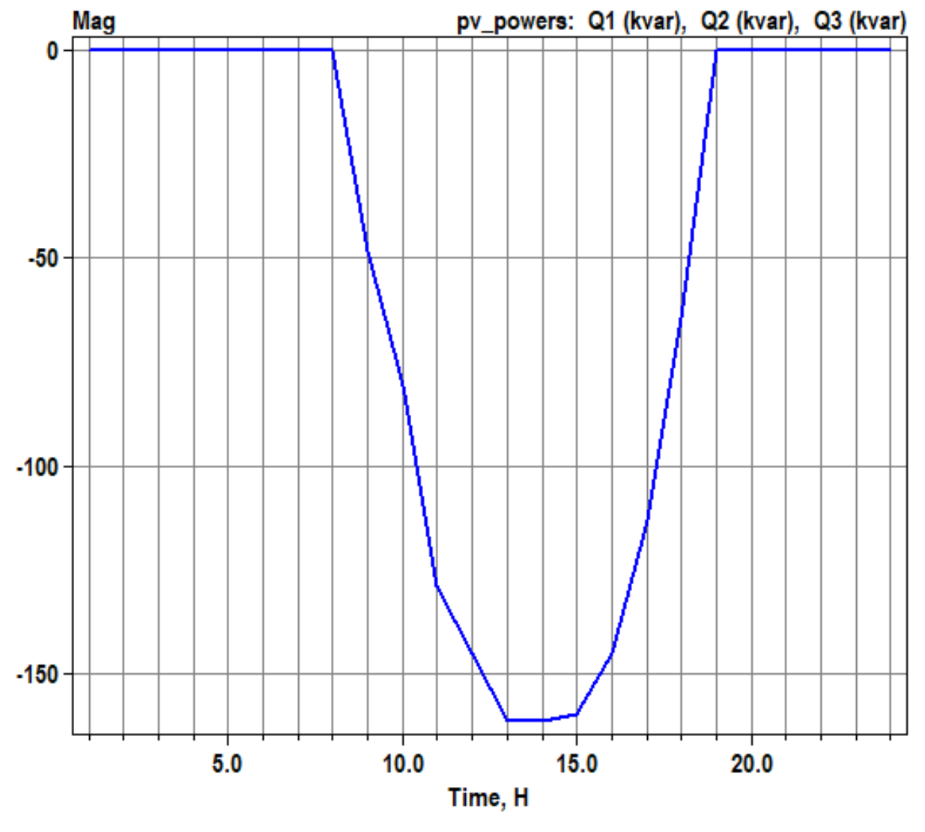
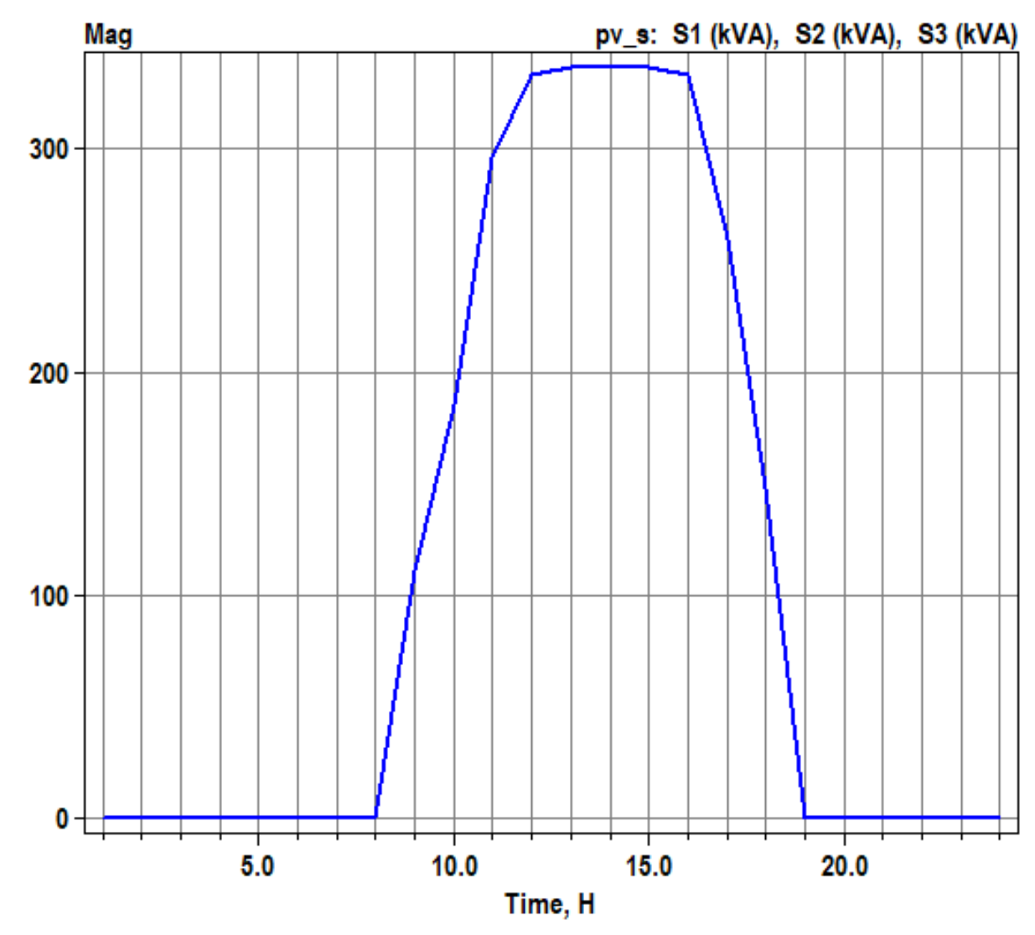
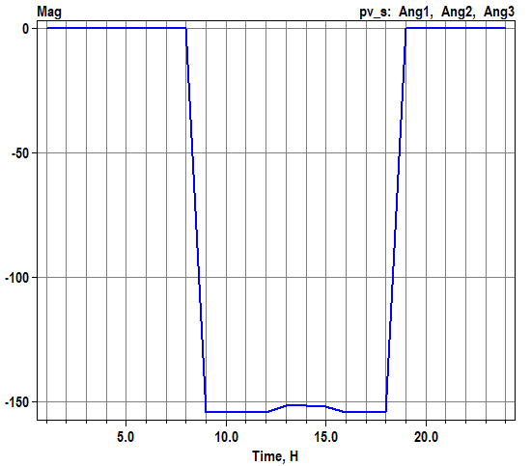
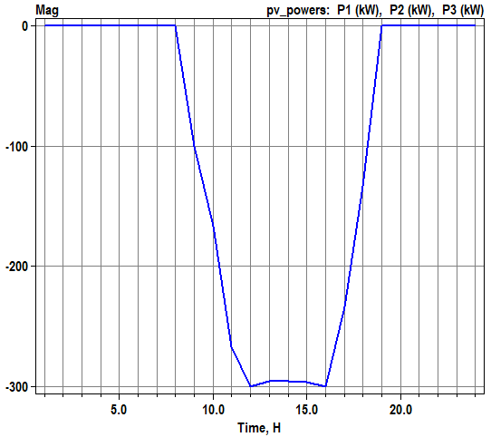
Scenario 12: Daily with pf=0.9 and kVA limitation (var priority)
kVA = 1010kVA
Pfpriority=no
Wattpriority=no
Key points:
It works as expected!
Equal to Scenario 10
Results:
OpenDSS code:
Daily_varP_kVAlimitation-PV.dss
Daily_varP_kVAlimitation-PV2.dss

