Slide 1
Volt-var Scenarios
OpenDSS: Version 8.6.6.1 (64-bit build)
Authors: Paulo Radatz and Celso Rocha

Slide 2
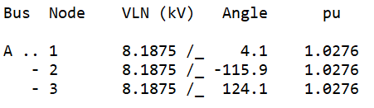
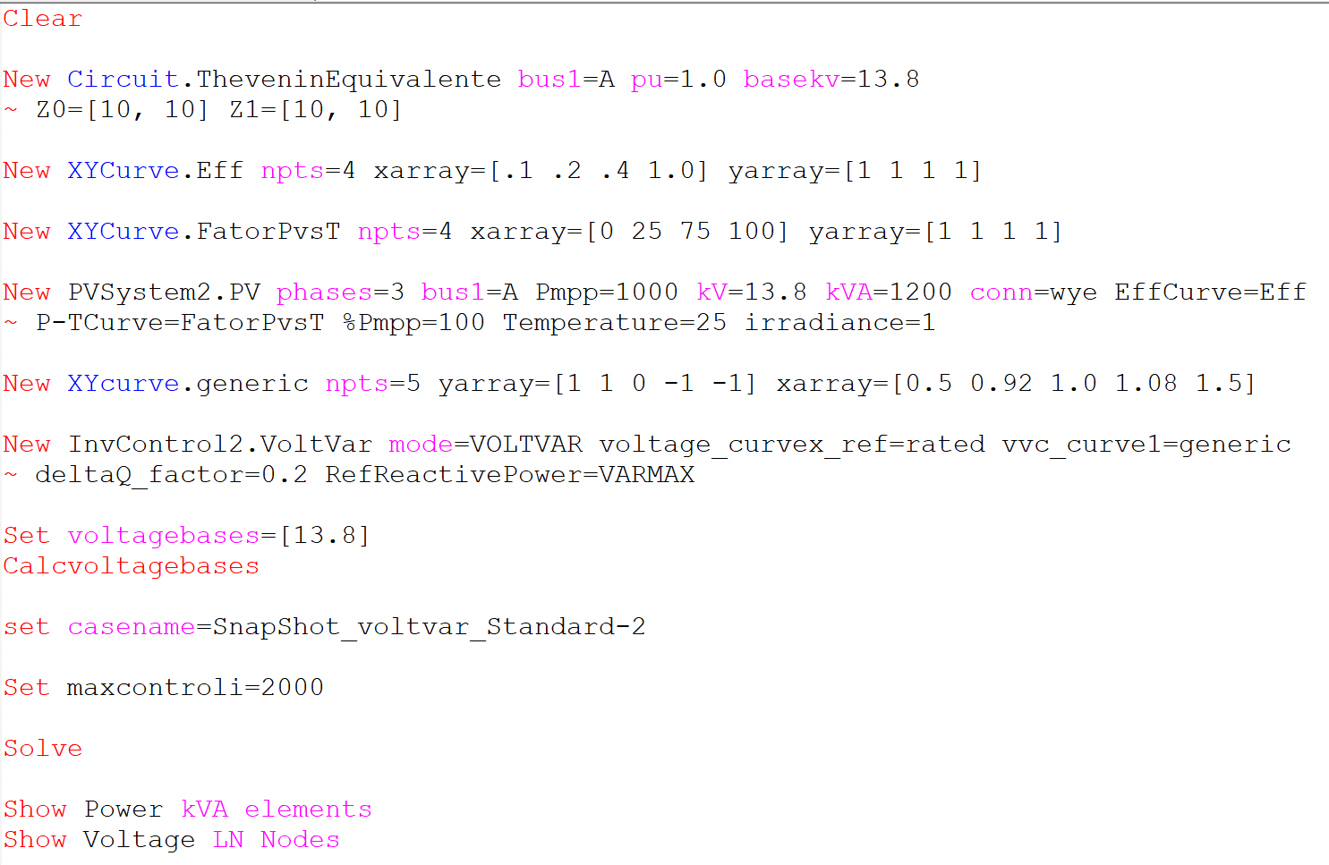
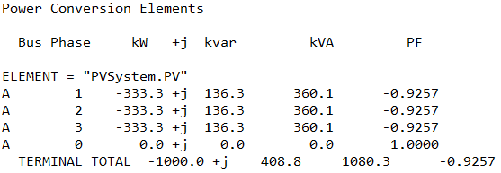
Scenario 1.1: Snapshot with no power limitation
OpenDSS code (SnapShot_voltvar_Standard-2.dss)

Slide 3
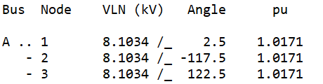
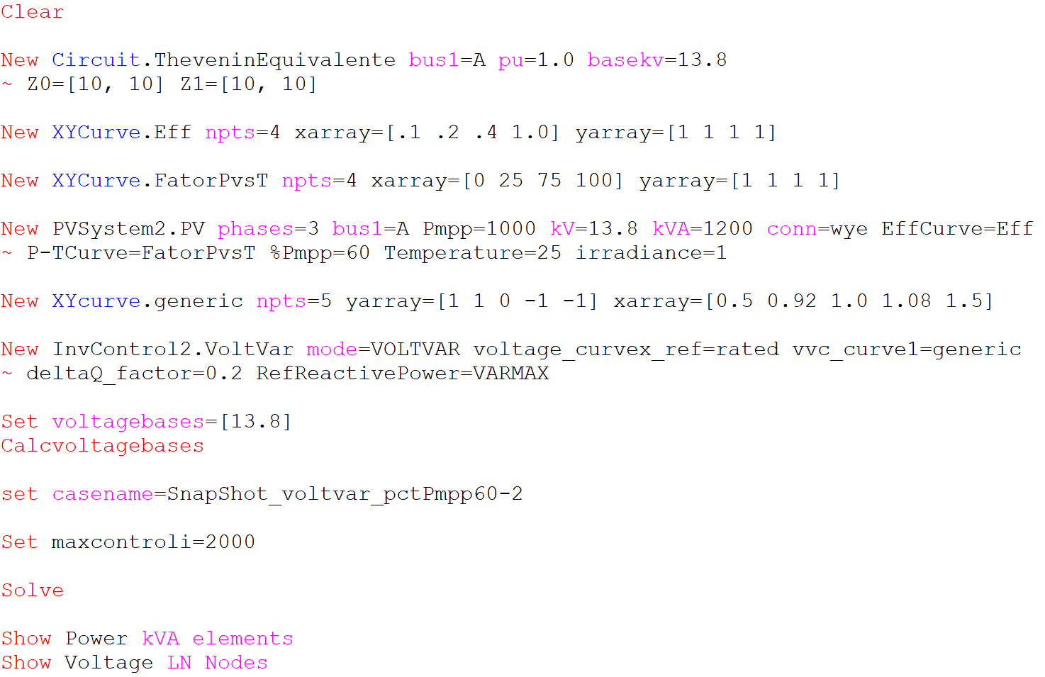
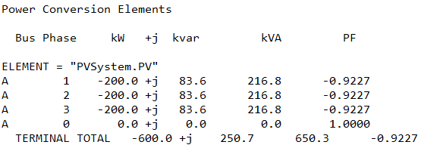
Scenario 1.2: Snapshot with kW limited by pctPmpp*Pmpp only (no limit by inverter`s kVA rating)
OpenDSS code (SnapShot_voltvar_pctPmpp60-2.dss)

Slide 4
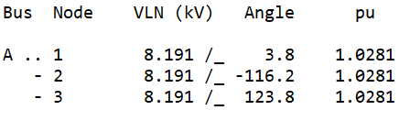
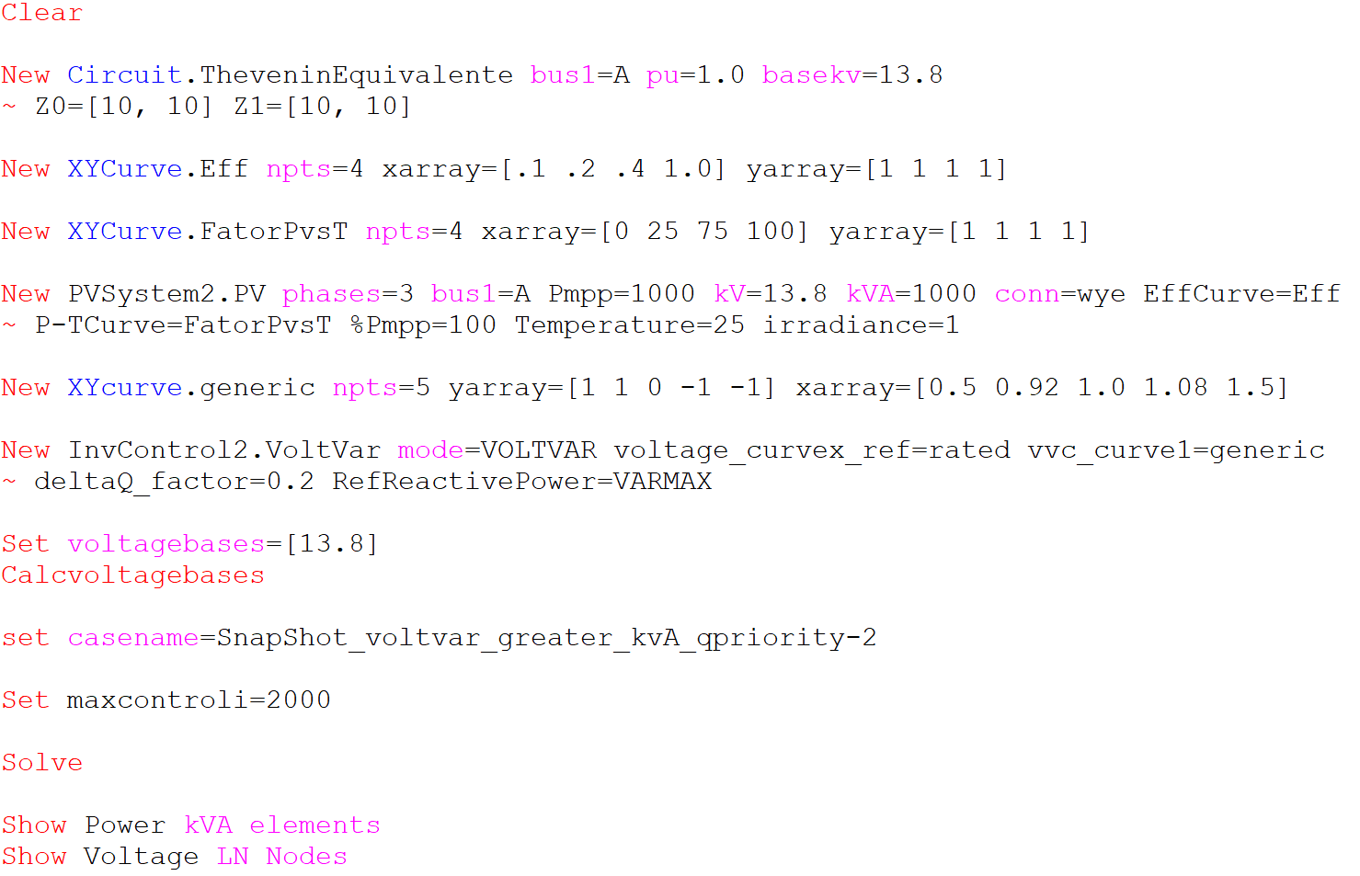
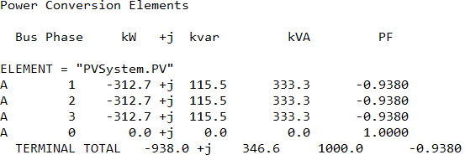
Scenario 1.3: Snapshot with kVA limitation only (no limit on kW by Pmpp*pctPmpp) – Q priority
OpenDSS code (SnapShot_voltvar_greater_kvA_qpriority-2.dss)

Slide 5
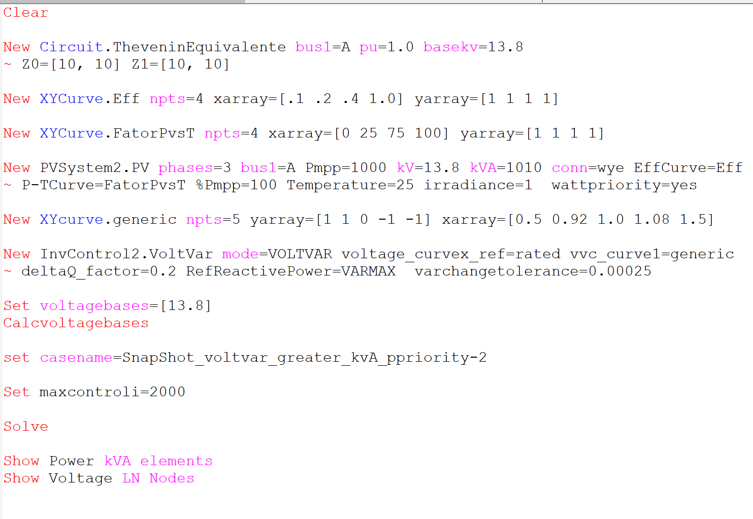
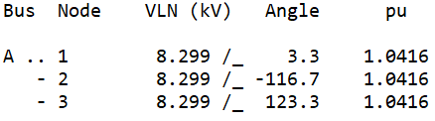
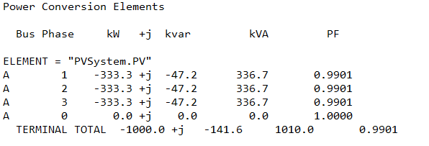
Scenario 1.4: Snapshot with kVA limitation only (no limit on kW by Pmpp*pctPmpp) – P priority
OpenDSS code (SnapShot_voltvar_greater_kvA_ppriority-2.dss)

Slide 6
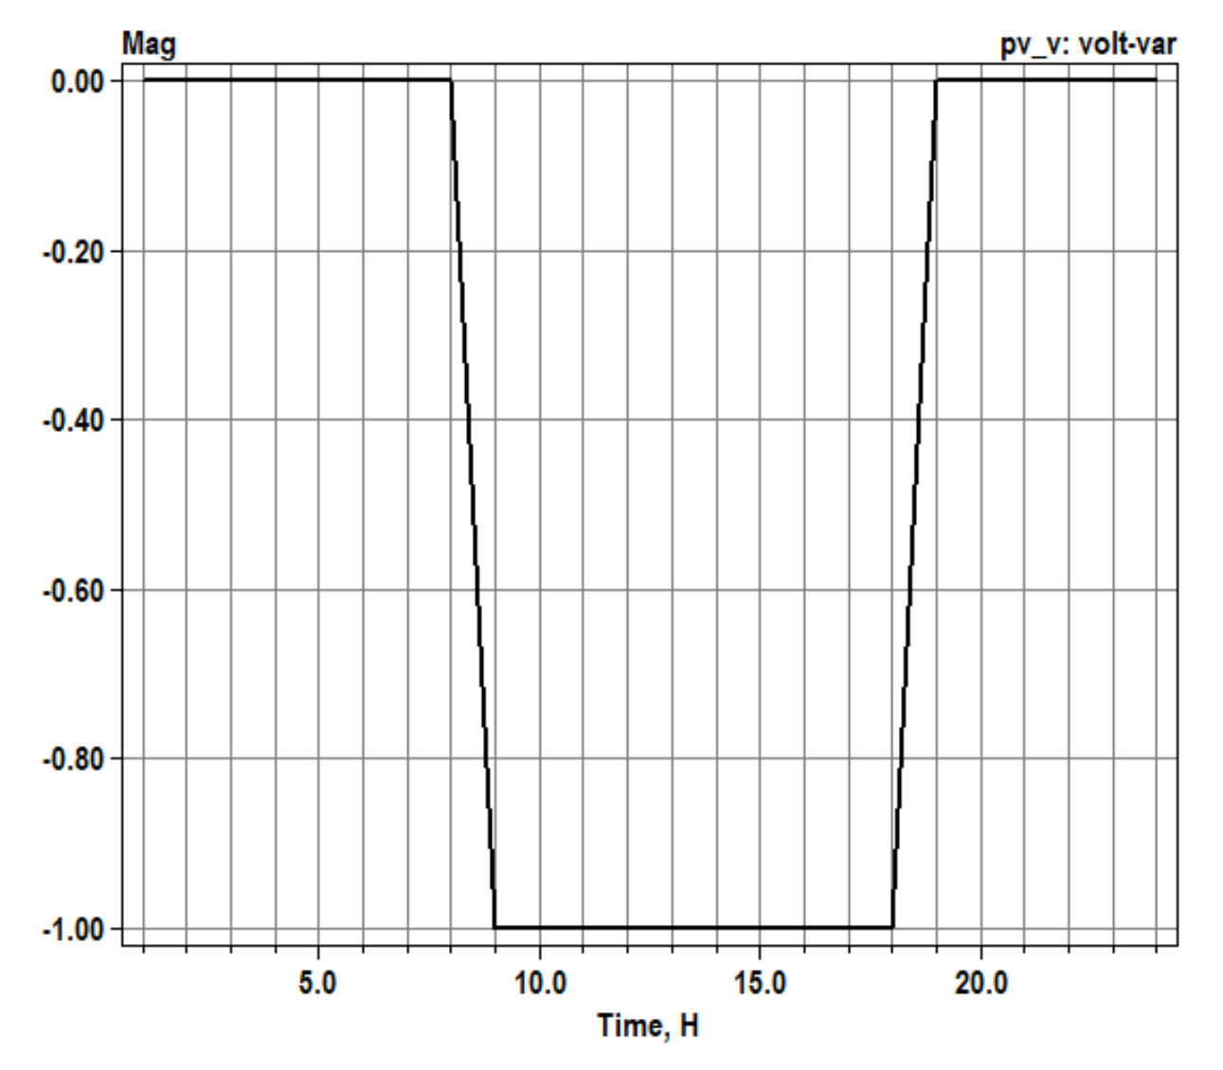
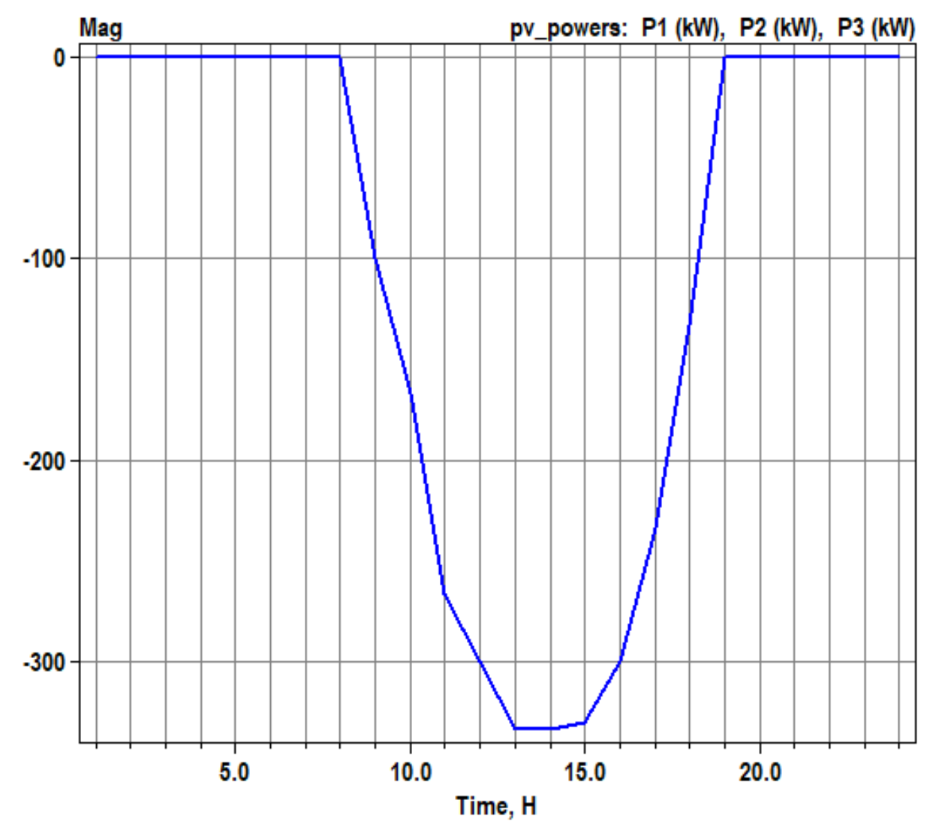
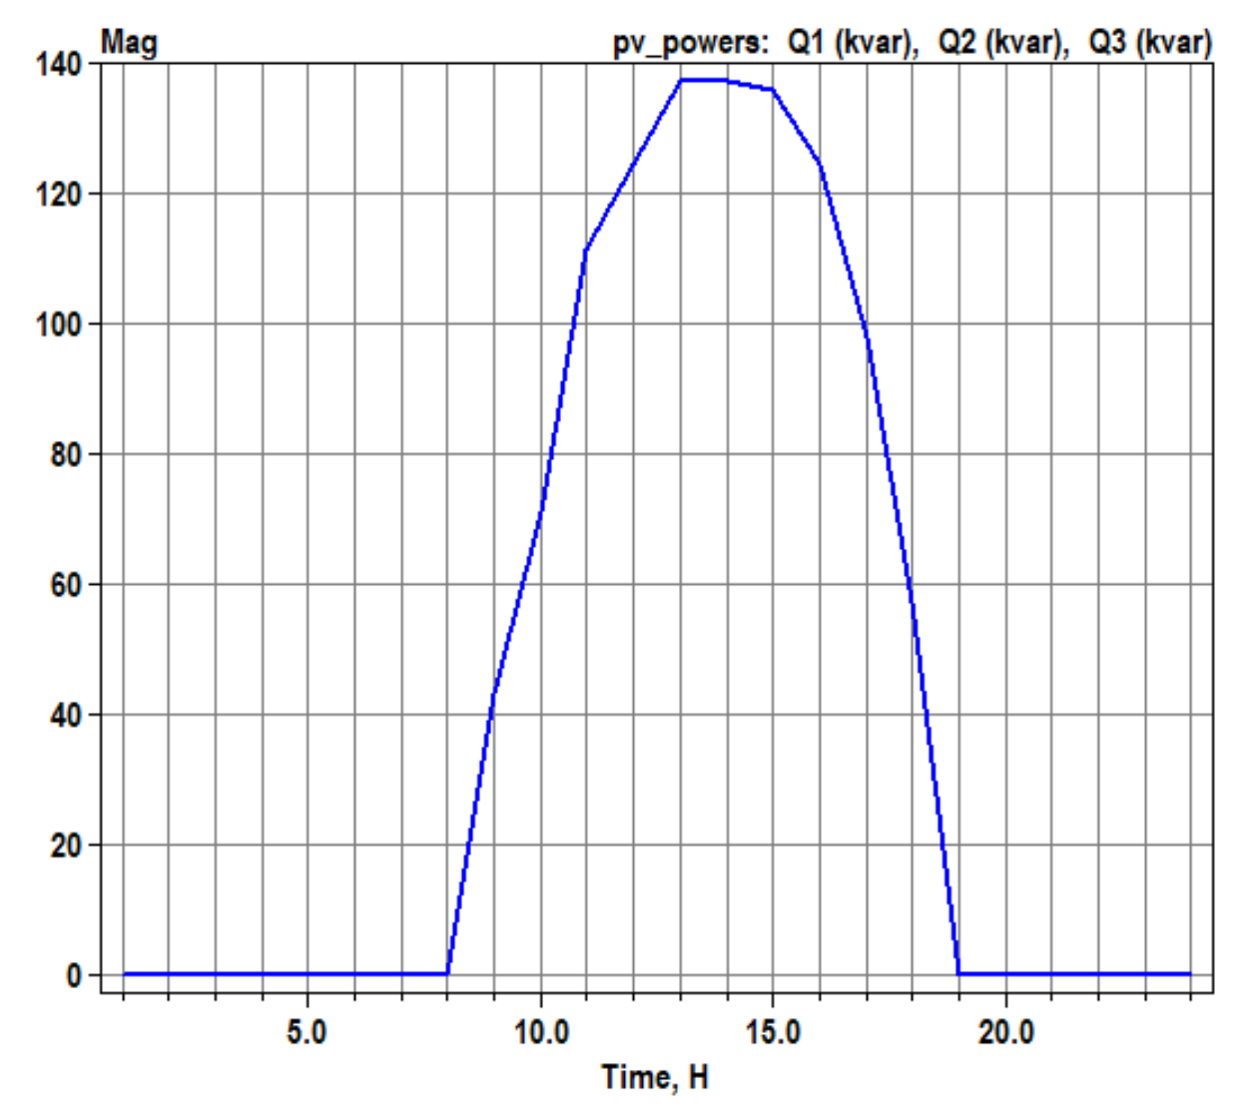
Scenario 1.5: Daily with no power limitation
volt-var operation
OpenDSS code (Daily_voltvar_Standard-2.dss)
Active power generation
Reactive power absorption
Negative value: var absorption
Positive value : var generation
1.0: volt-var operating as it supposed to
0.6: volt-var limited by inverter’s kVA rating
0.2: volt-var limited by varmax/varmaxabs property of the PC element

Slide 7
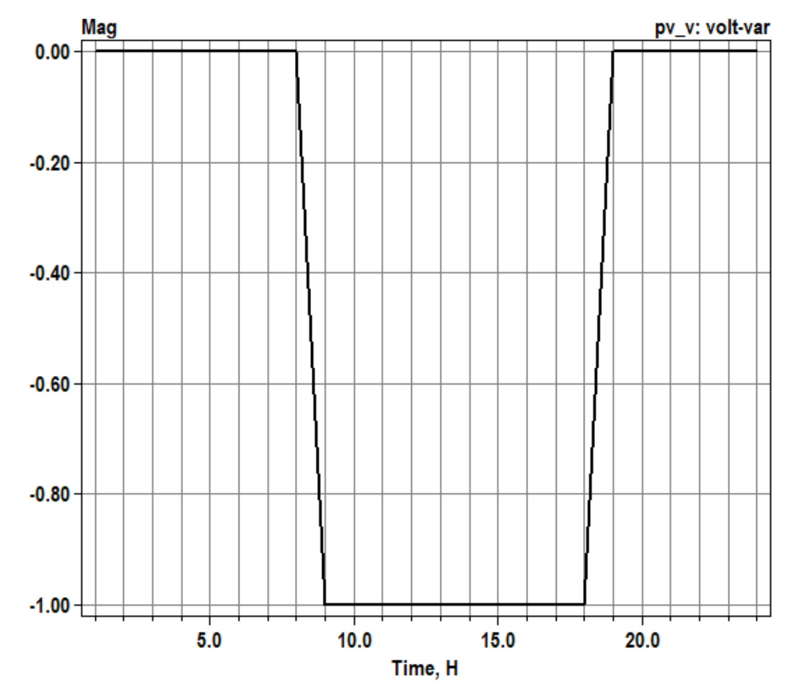
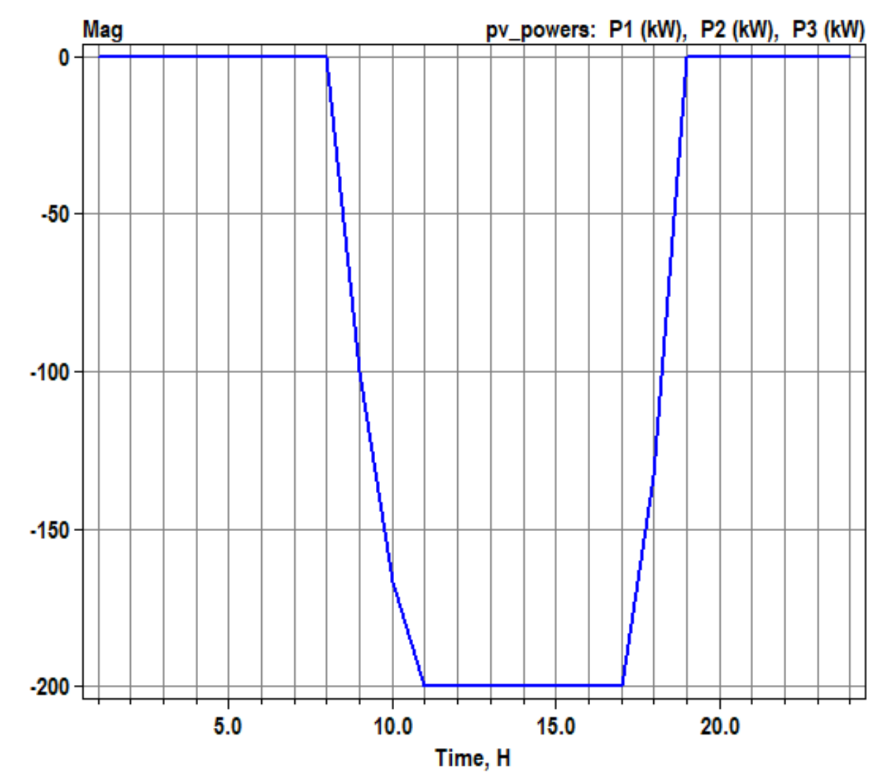
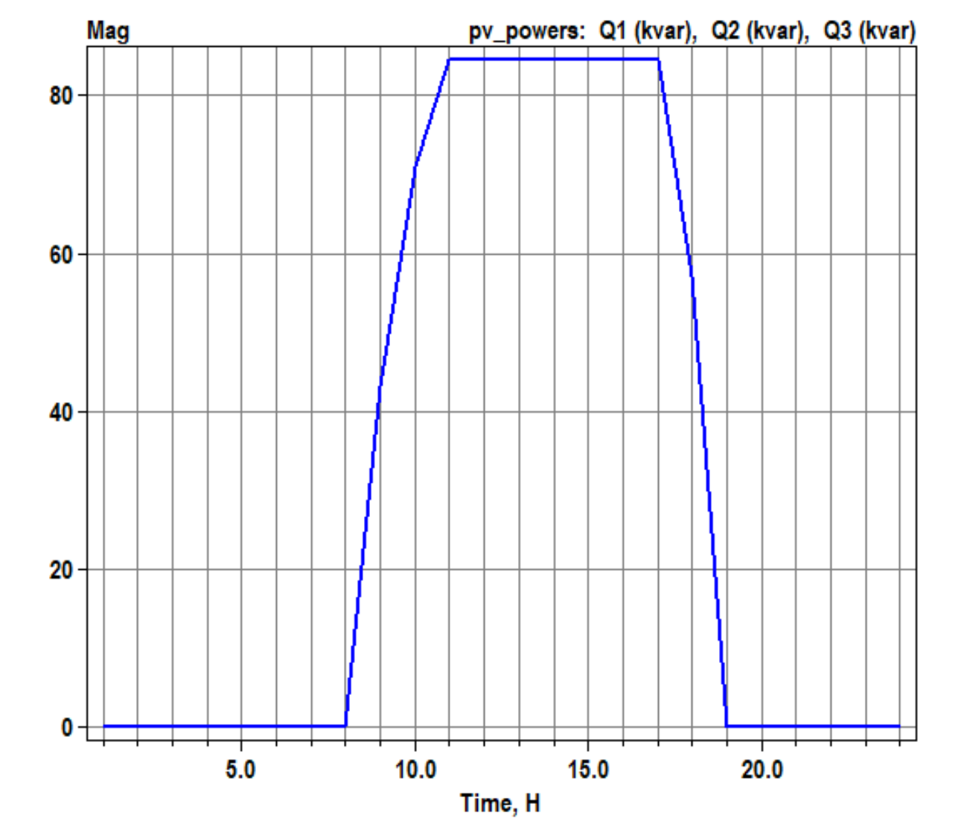
Scenario 1.6: Daily with kW limited by pctPmpp*Pmpp only (no limit by inverter`s kVA rating)
volt-var operation
OpenDSS code (Daily_voltvar_pctPmpp60-2.dss)
Active power generation
Reactive power absorption
Negative value: var absorption
Positive value : var generation
1.0: volt-var operating as it supposed to
0.6: volt-var limited by inverter’s kVA rating
0.2: volt-var limited by varmax/varmaxabs property of the PC element

Slide 8
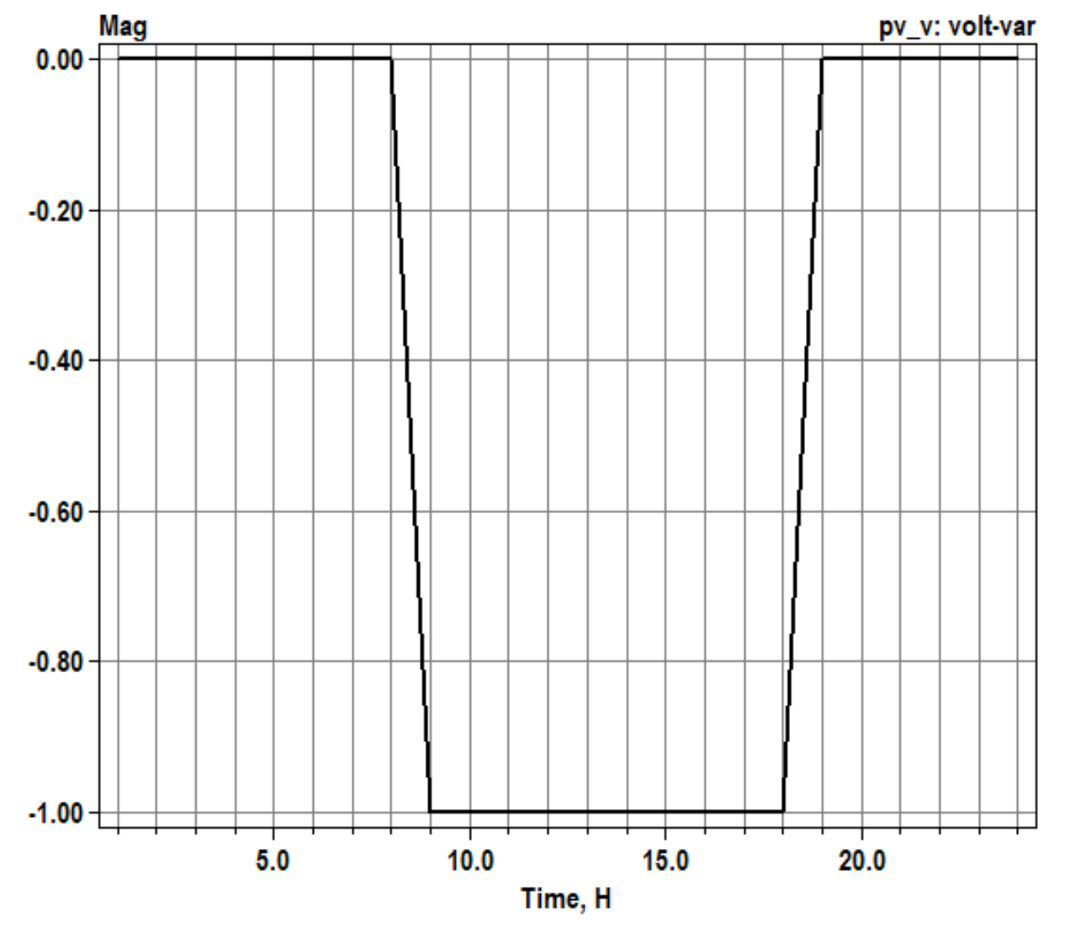
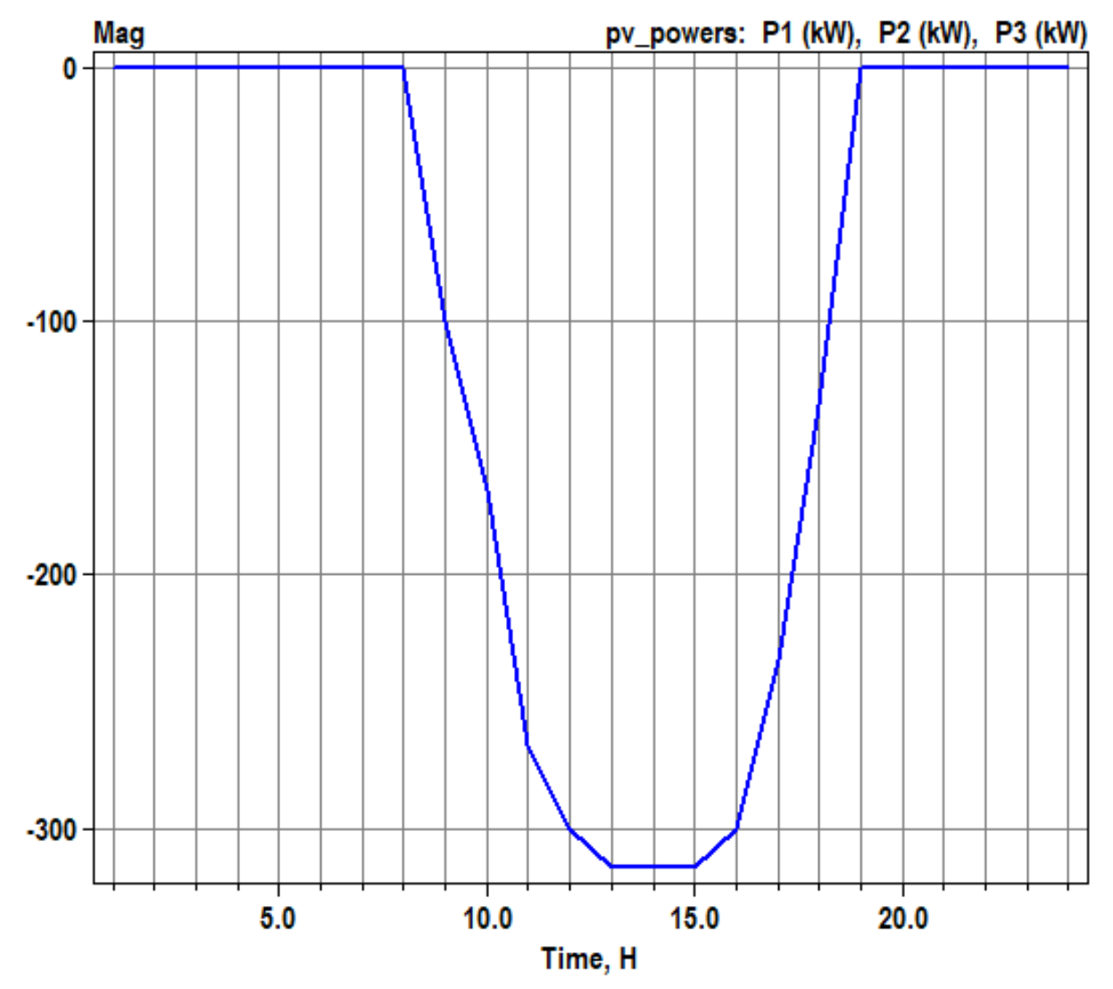
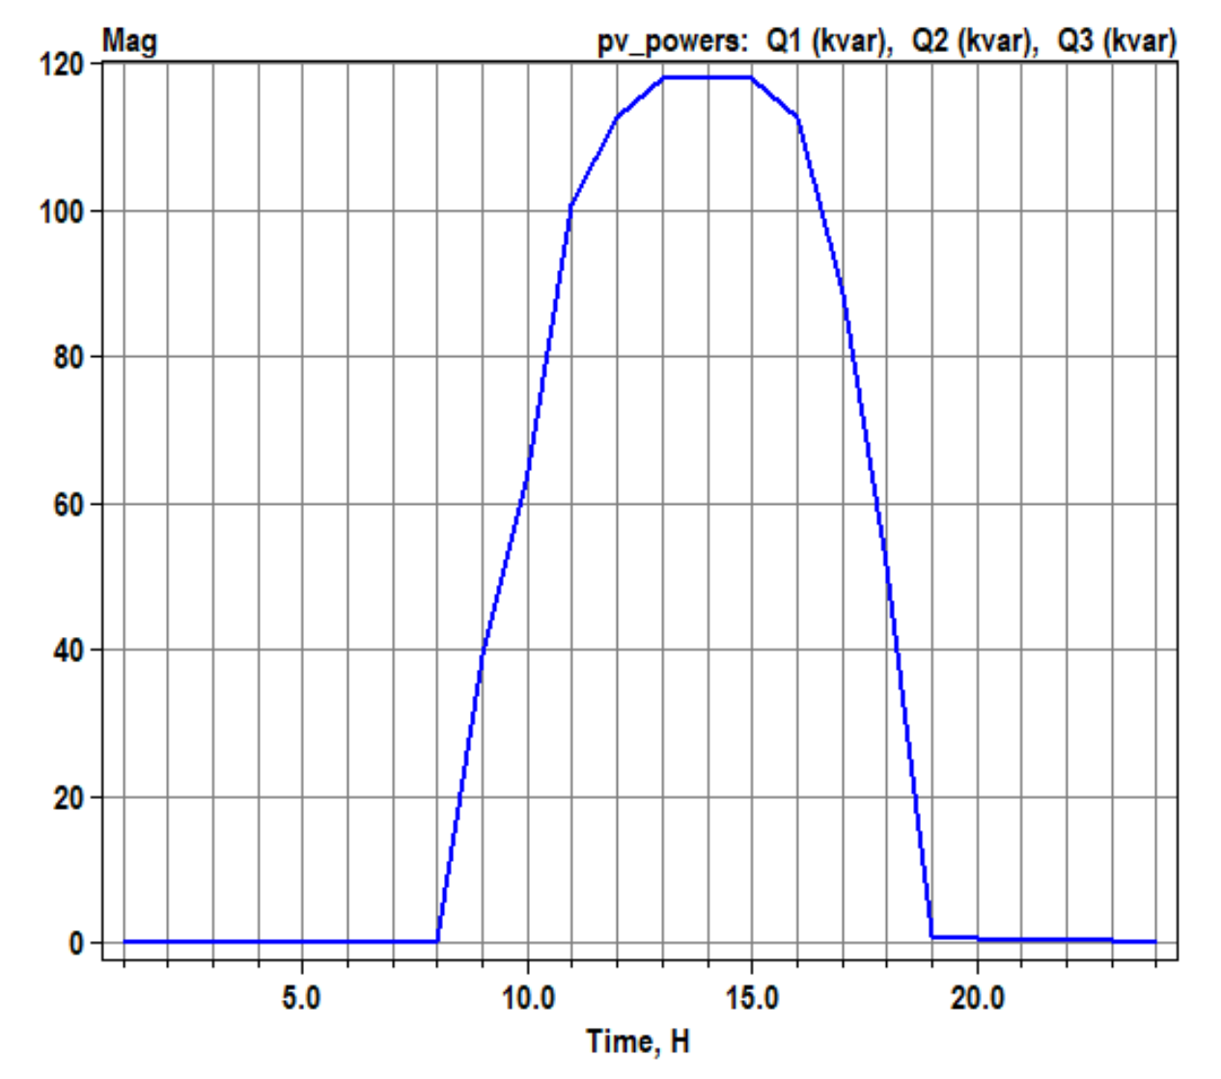
Scenario 1.7: Daily with kVA limitation only (no limit on kW by Pmpp*pctPmpp) – Q priority
volt-var operation
OpenDSS code (Daily_voltvar_greater_kVA_qpriority-2.dss)
Active power generation
Reactive power absorption
Negative value: var absorption
Positive value : var generation
1.0: volt-var operating as it supposed to
0.6: volt-var limited by inverter’s kVA rating
0.2: volt-var limited by varmax/varmaxabs property of the PC element

Slide 9
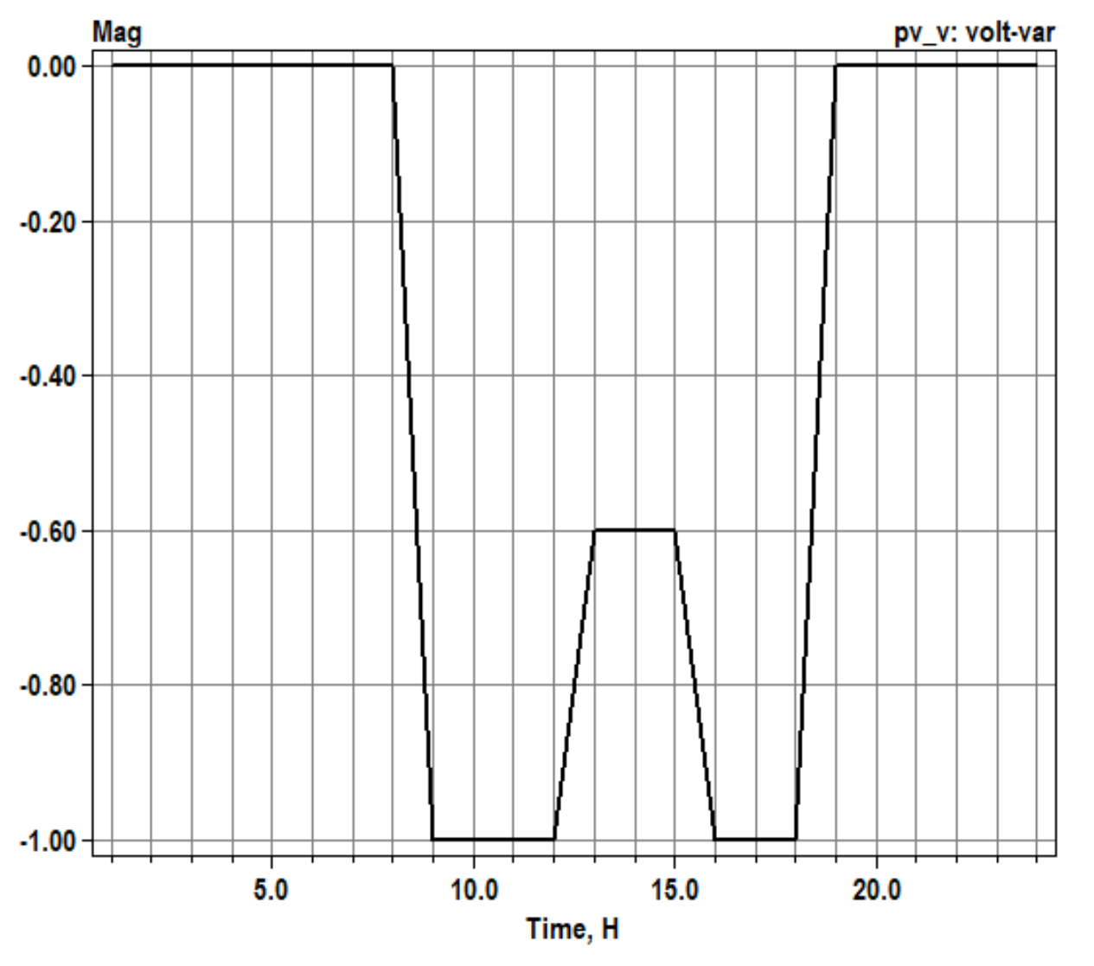
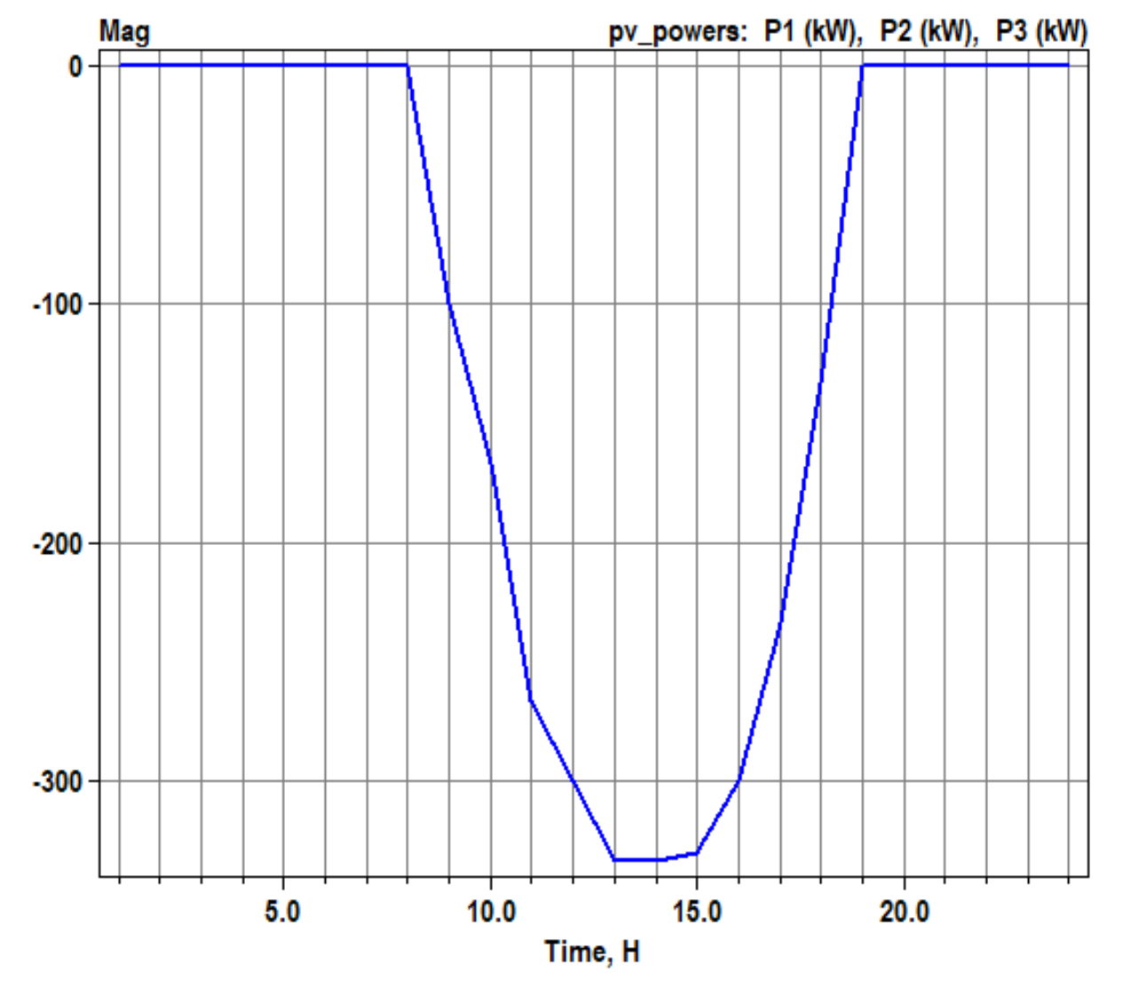
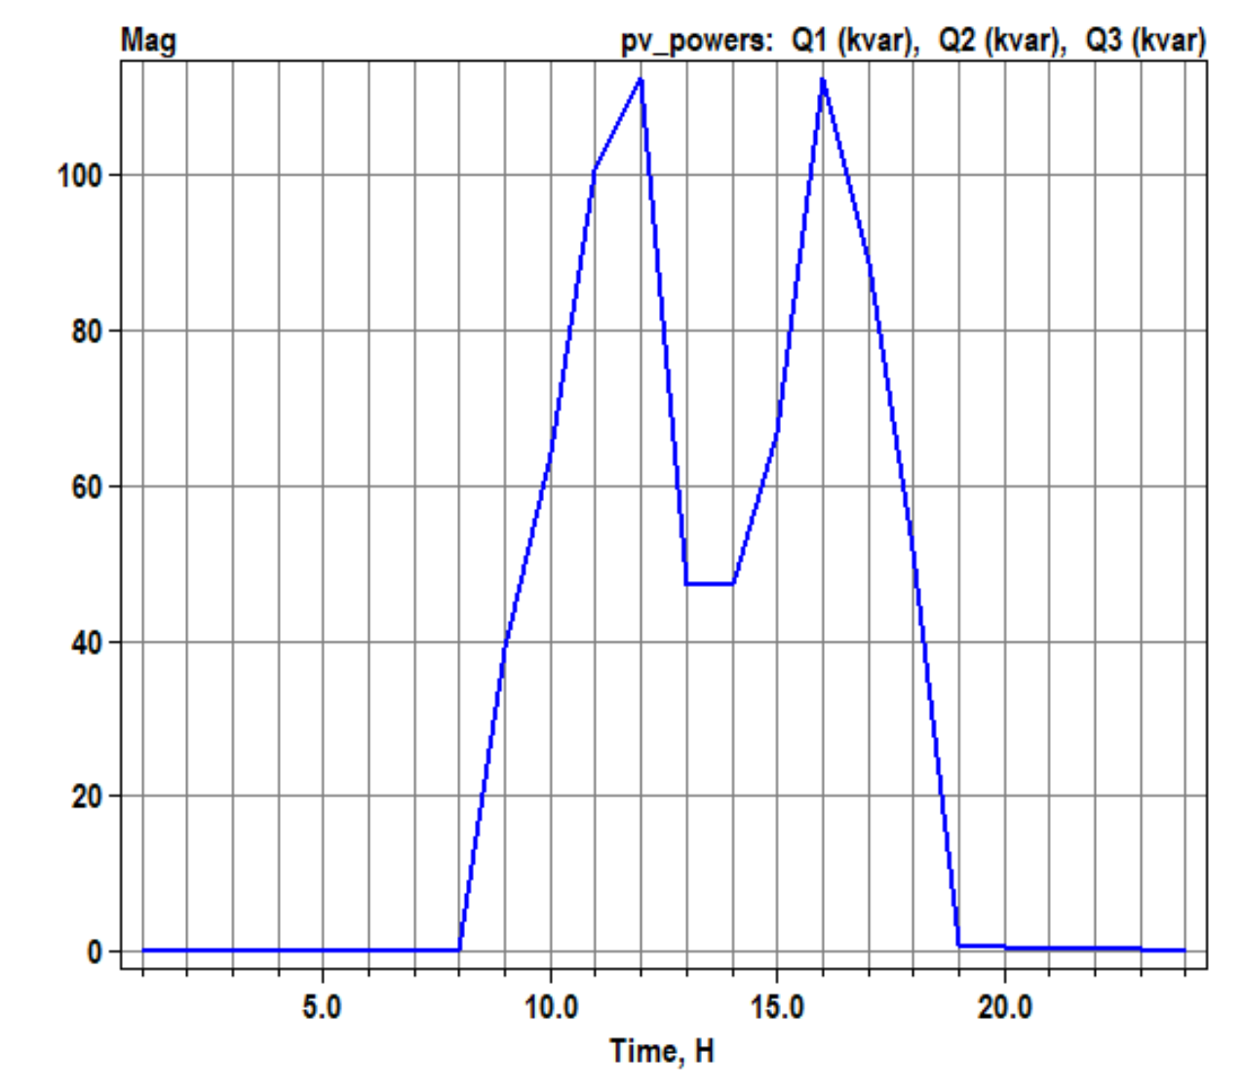
Scenario 1.8: Daily with kVA limitation only (no limit on kW by Pmpp*pctPmpp) – P priority
volt-var operation
OpenDSS code (Daily_voltvar_greater_kVA_ppriority-2.dss)
Active power generation
Reactive power absorption
Negative value: var absorption
Positive value : var generation
1.0: volt-var operating as it supposed to
0.6: volt-var limited by inverter’s kVA rating
0.2: volt-var limited by varmax/varmaxabs property of the PC element

Slide 10
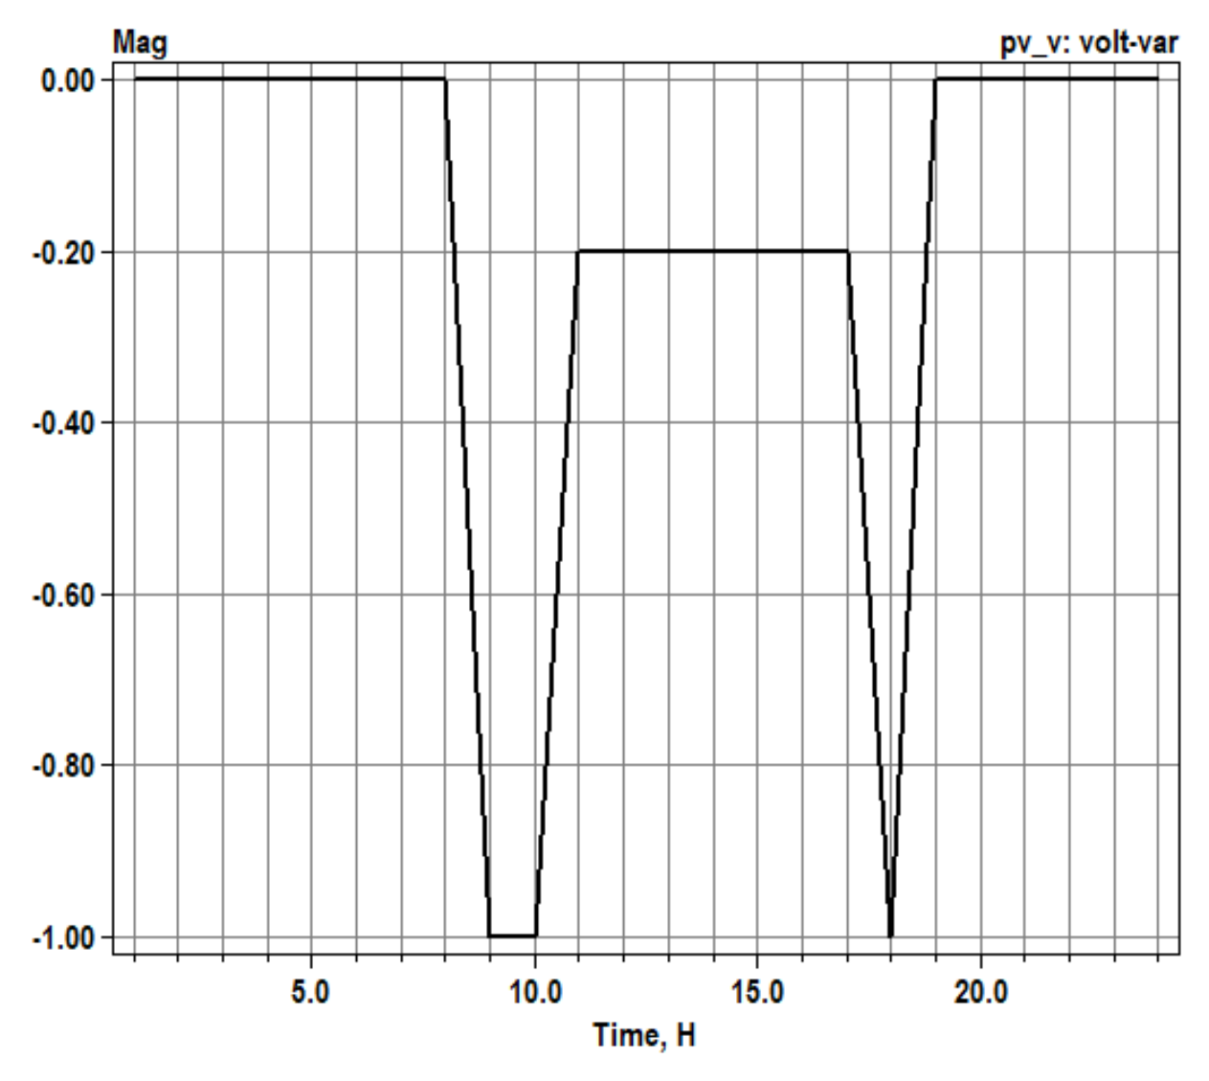
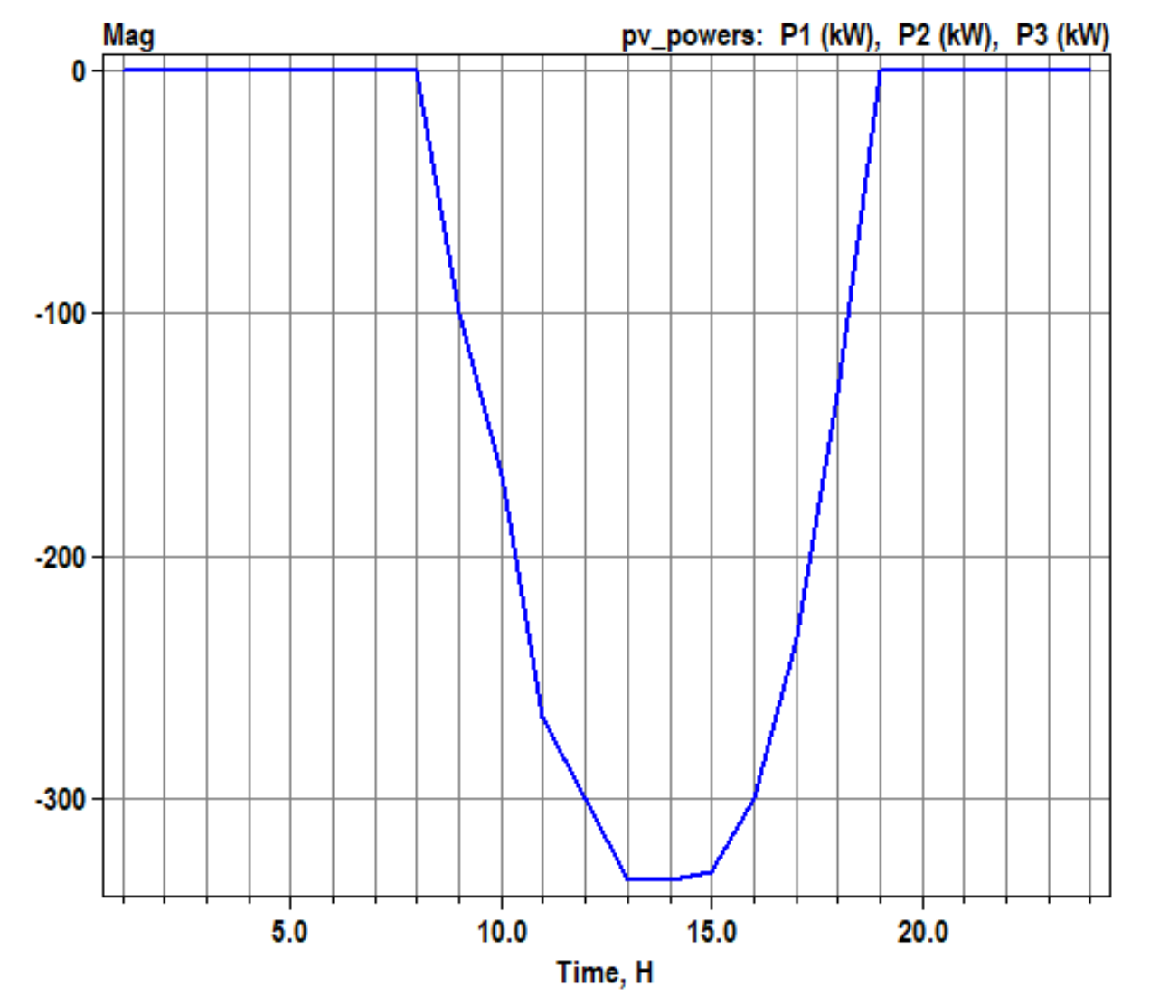
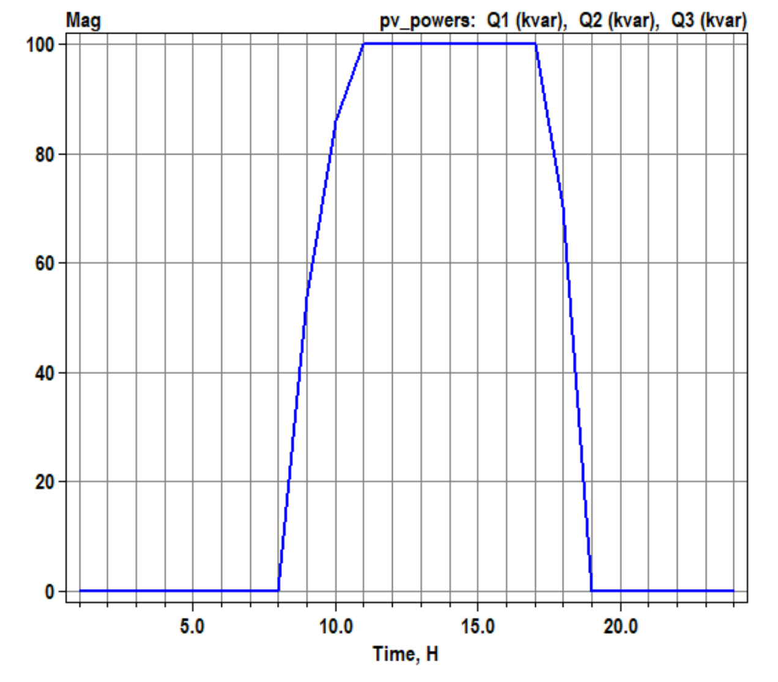
Scenario 1.8: Daily with kvar limitation
volt-var operation
OpenDSS code (Daily_voltvar_kvarlimit-2.dss)
Active power generation
Reactive power absorption
Negative value: var absorption
Positive value : var generation
1.0: volt-var operating as it supposed to
0.6: volt-var limited by inverter’s kVA rating
0.2: volt-var limited by varmax/varmaxabs property of the PC element

