Slide 1
Volt-var Scenarios
OpenDSS: Version 8.6.6.1
Authors: Paulo Radatz and Celso Rocha

Slide 2
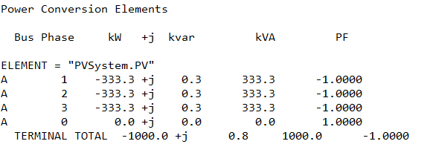
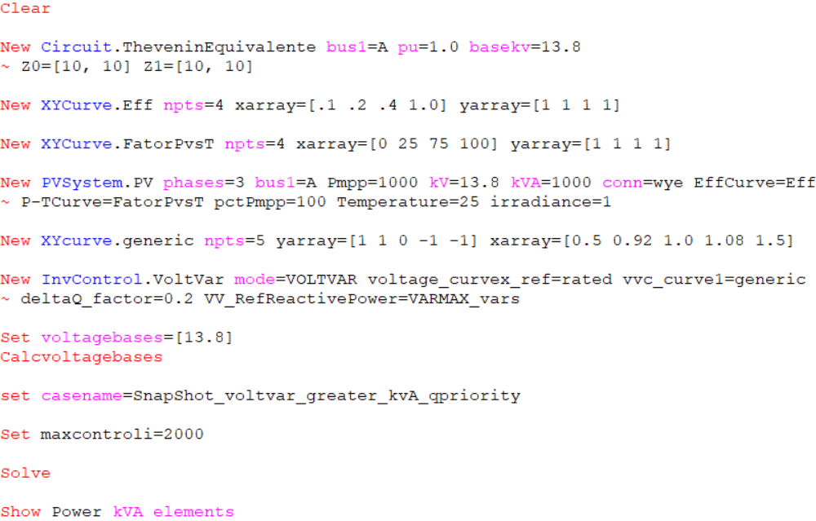
Scenario 1: Snapshot with kVA limitation only (no limit on kW by Pmpp*pctPmpp) – Q priority
OpenDSS – 64bits
Simulation Mode: Snapshot
Irradiance = 1.0kW/m^2
pctPmpp = 100%
Pmpp = 1000kW
kVA = 1000kVA
Q priority
Results:
OpenDSS code (SnapShot_voltvar_greater_kvA_qpriority.dss)
Key points:
Does not work as expected!
Output reactive power has not been given priority

Slide 3
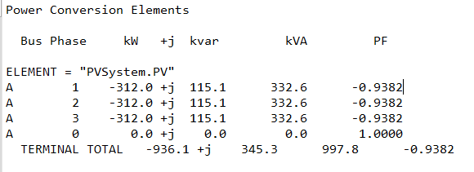
Scenario 1: Snapshot with kVA limitation only (no limit on kW by Pmpp*pctPmpp) – Q priority
OpenDSS – 32bits
Simulation Mode: Snapshot
Irradiance = 1.0kW/m^2
pctPmpp = 100%
Pmpp = 1000kW
kVA = 1000kVA
Q priority
Results:
OpenDSS code (SnapShot_voltvar_greater_kvA_qpriority.dss)
Key points:
Does not work as expected!
Output power is less than kVA rating

Slide 4
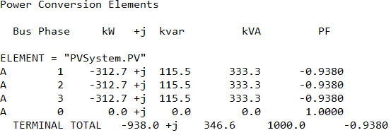
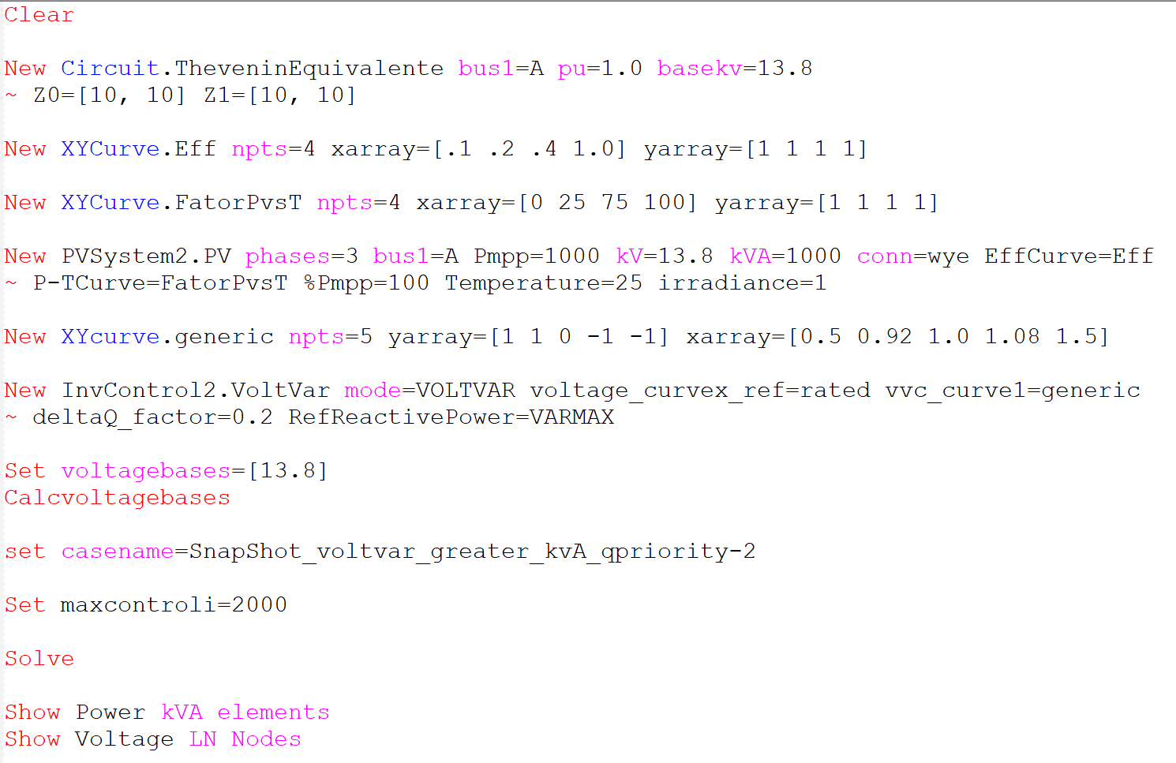
Scenario 1: Snapshot with kVA limitation only (no limit on kW by Pmpp*pctPmpp) – Q priority
Simulation Mode: Snapshot
Irradiance = 1.0kW/m^2
pctPmpp = 100%
Pmpp = 1000kW
kVA = 1000kVA
Q priority
Results:
OpenDSS code (SnapShot_voltvar_greater_kvA_qpriority-2.dss)
Key points:
It works as expected
kVA is limited with var priority

Slide 5
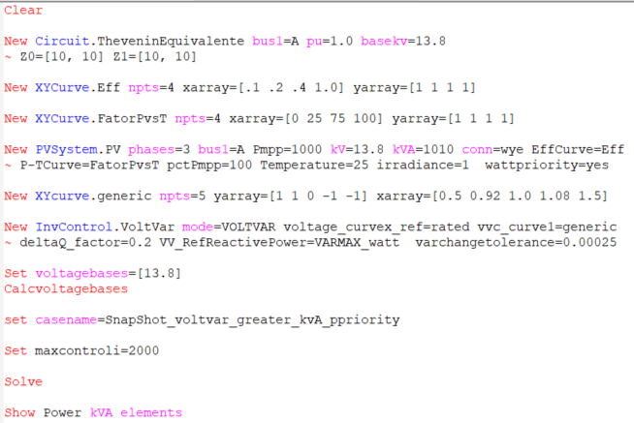
Scenario 2: Snapshot with kVA limitation only (no limit on kW by Pmpp*pctPmpp) – P priority
Simulation Mode: Snapshot
Irradiance = 1.0kW/m^2
pctPmpp = 100%
Pmpp = 1000kW
kVA = 1010kVA
Results:
Max Control iterations exceeded
OpenDSS code (SnapShot_voltvar_greater_kvA_ppriority.dss)
Key points:
It does not work as expected!
default Varchangetolerance is 0.025

Slide 6
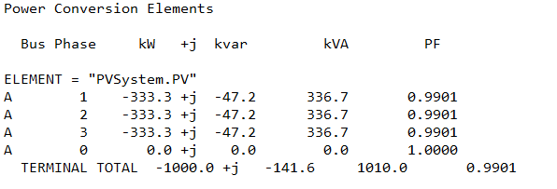
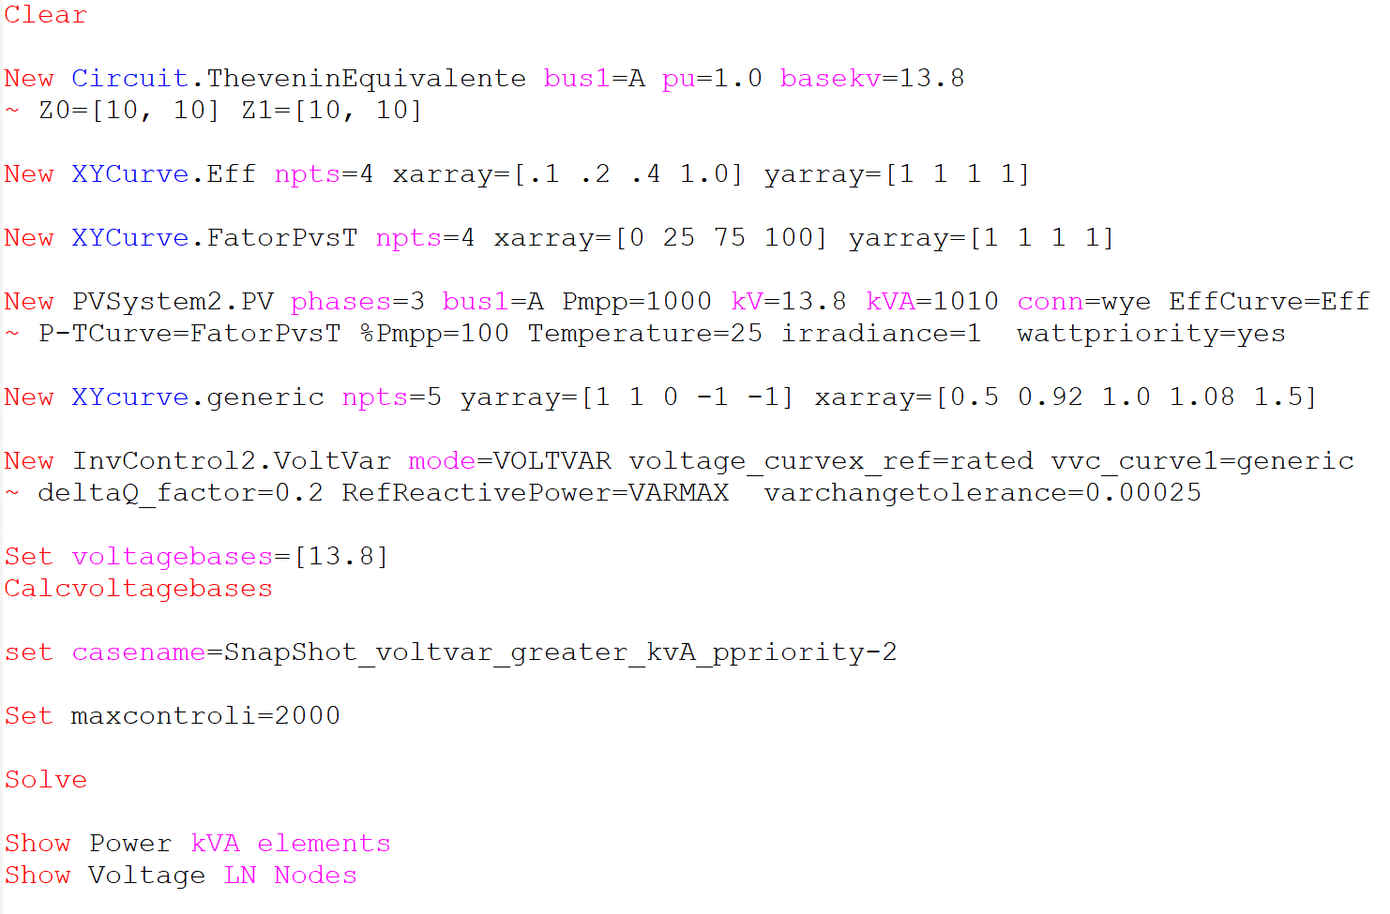
Scenario 2: Snapshot with kVA limitation only (no limit on kW by Pmpp*pctPmpp) – P priority
Simulation Mode: Snapshot
Irradiance = 1.0kW/m^2
pctPmpp = 100%
Pmpp = 1000kW
kVA = 1010kVA
Results:
OpenDSS code (SnapShot_voltvar_greater_kvA_ppriority-2.dss)
Key points:
It works as expected!
When varchangetolerance is default
kVA is 1008.9 and kvar is -133.9
Varchangetolerance impacts results and total iterations. Let’s keep this in mind
default Varchangetolerance is 0.025

