Slide 1
Min Reactive Power Capabilities PVSystem2 and InvControl2 and PVSystem2
OpenDSS: Version 8.6.6.1
Authors: Paulo Radatz and Celso Rocha

Slide 2
New PVSystem2’s properties
%PminNoVars
Minimum active power as percentage of Pmpp under which there is no vars production/absorption
%PminkvarMax
Minimum active power as percentage of Pmpp that allows the inverter to produce/absorb reactive power up to its kvarMax or kvarMaxAbs
kvarMax
Indicates the maximum reactive power GENERATION (un-signed numerical variable in kvar) for the inverter (as an un-signed value). Defaults to kVA rating of the inverter
kvarMaxAbs
Indicates the maximum reactive power ABSORPTION (un-signed numerical variable in kvar) for the inverter (as an un-signed value). Defaults to kVA rating of the inverter

Slide 3
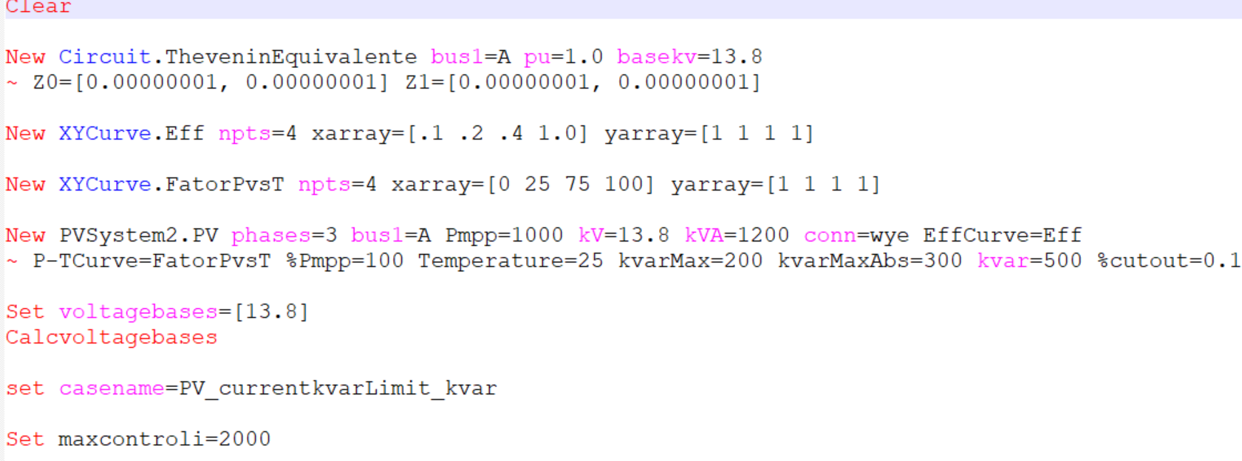
Base case DSS for kvar capacitive – PVSystem only – Scenarios 1.
OpenDSS code (PV_currentkvarlimit_kvar.dss)

Slide 4
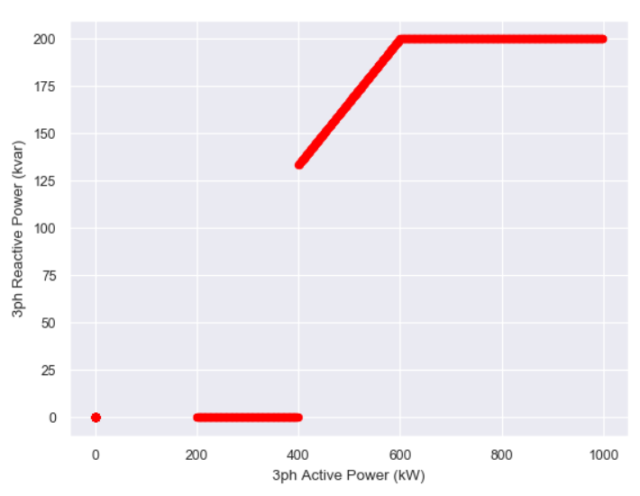
Scenario 1.1
%CutIn < %PminNoVars
%PminkvarMax = 60% (600kW)
%PminNoVars = 40% (400kW)
%CutIn = 16.666% of kVA (200kW)
OpenDSS results
Q
kvarMax
P
%CutIn
%PminNoVars
%PminkvarMax
Inv. OFF
Inv. ON

Slide 5
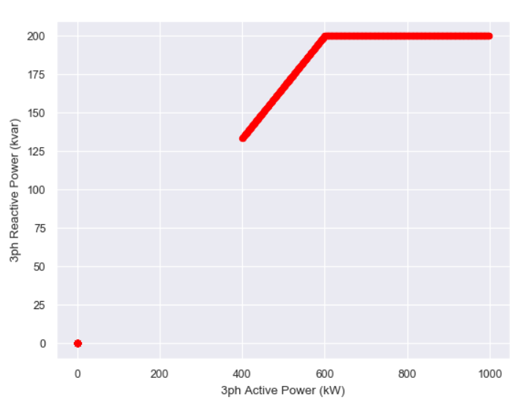
Scenario 1.2
%CutIn < %PminNoVars
%PminkvarMax = 60% (600kW)
%PminNoVars = 20% (200kW)
%CutIn = 33.333% of kVA (400kW)
OpenDSS results
Q
kvarMax
P
pctPminNoVars
%CutIn
%PminkvarMax
Inv. OFF
Inv. ON

Slide 6
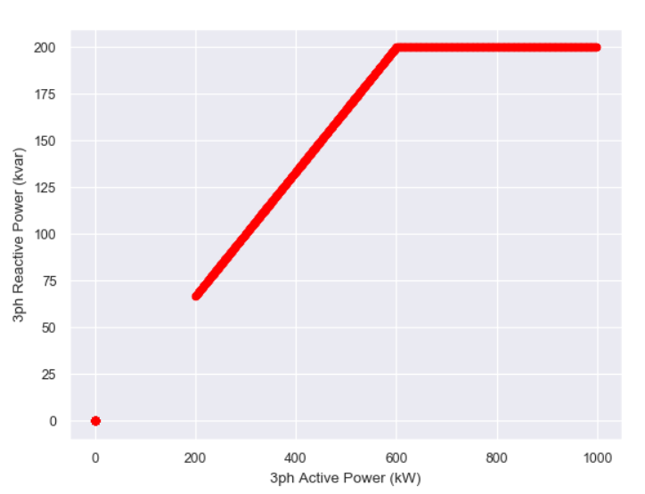
Scenario 1.3
%PminNoVars = -1
%PminkvarMax = 60% (600kW)
%CutIn = 16.666% of kVA (200kW)
OpenDSS results
Q
kvarMax
P
%CutIn
%PminkvarMax
Inv. OFF
Inv. ON

Slide 7
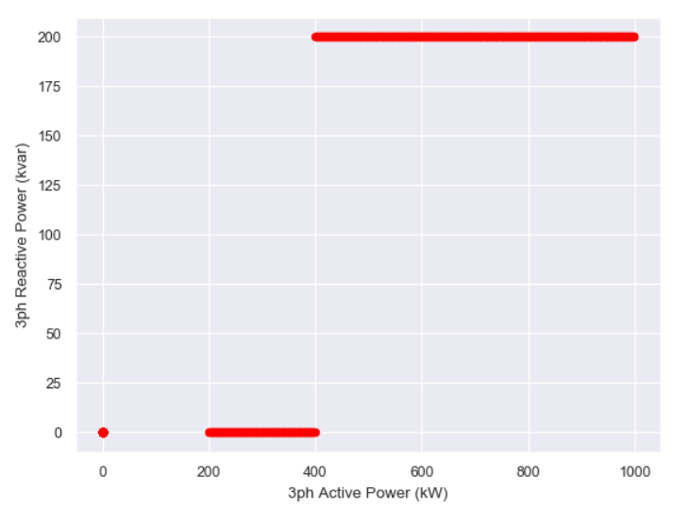
Scenario 1.4
%PminkvarMax = -1
%PminNoVars = 40% (400kW)
%CutIn = 16.666% of kVA (200kW)
OpenDSS results
Q
kvarMax
P
%CutIn
%PminNoVars
Inv. OFF
Inv. ON

Slide 8
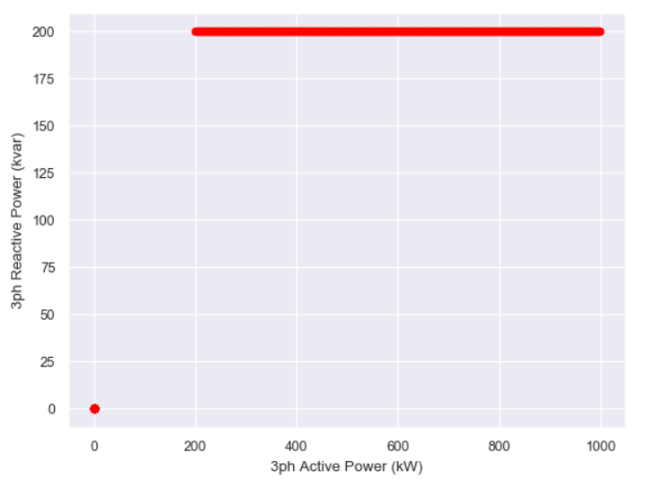
Scenario 1.5
%PminkvarMax = -1
%PminNoVars = -1
%CutIn = 16.666% of kVA (200kW)
OpenDSS results
Q
kvarMax
P
%CutIn
Inv. OFF
Inv. ON

Slide 9
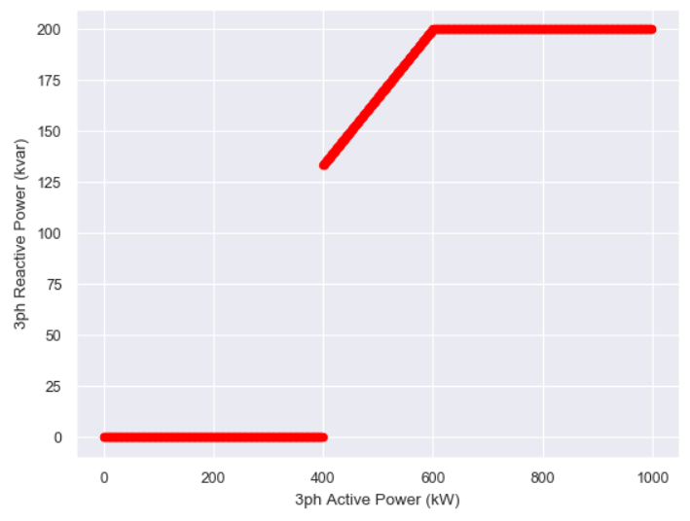
Scenario 1.6
%PminkvarMax = 60% (600kW)
%PminNoVars = 40% (400kW)
%CutIn = 0.01% of kVA
OpenDSS results

Slide 10
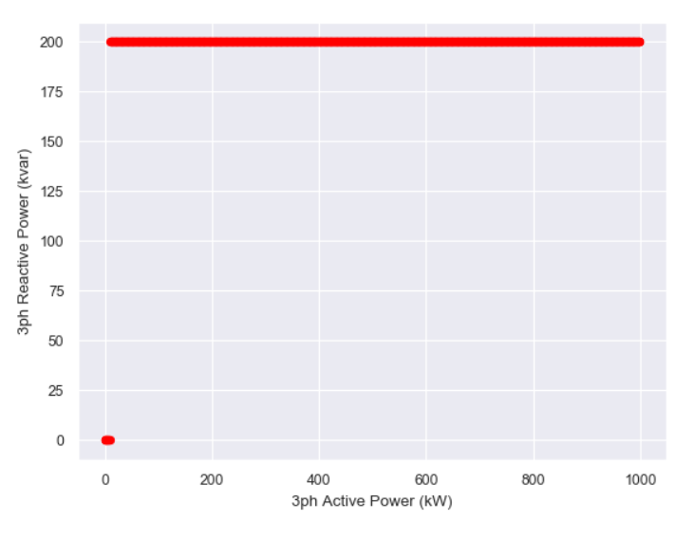
Scenario 1.7
%PminkvarMax = -1
%PminNoVars = -1
%CutIn = 0.01% of kVA
OpenDSS results

Slide 11
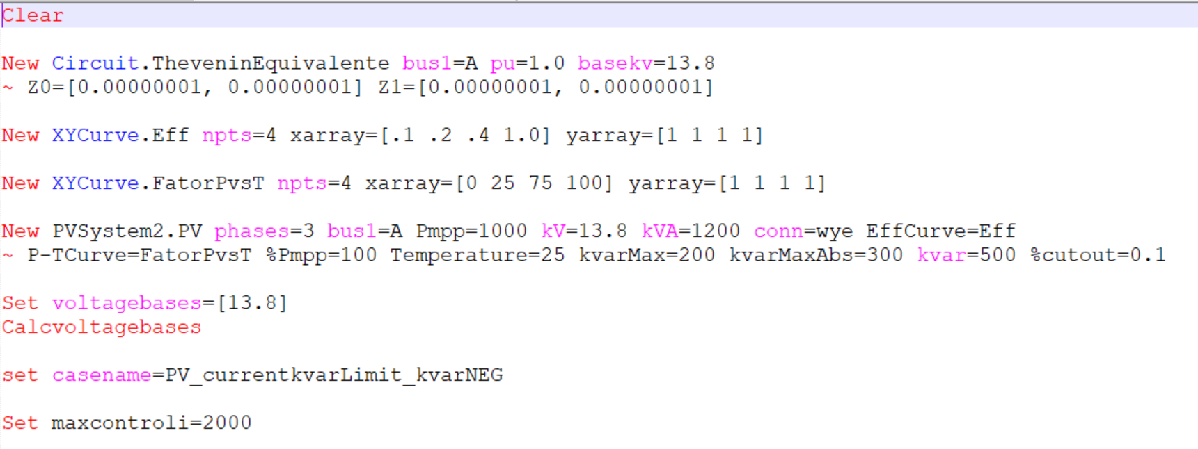
Base case DSS for kvar indutive – PVSystem only – Scenarios 2.
OpenDSS code (PV_currentkvarlimit_kvarNEG.dss)

Slide 12
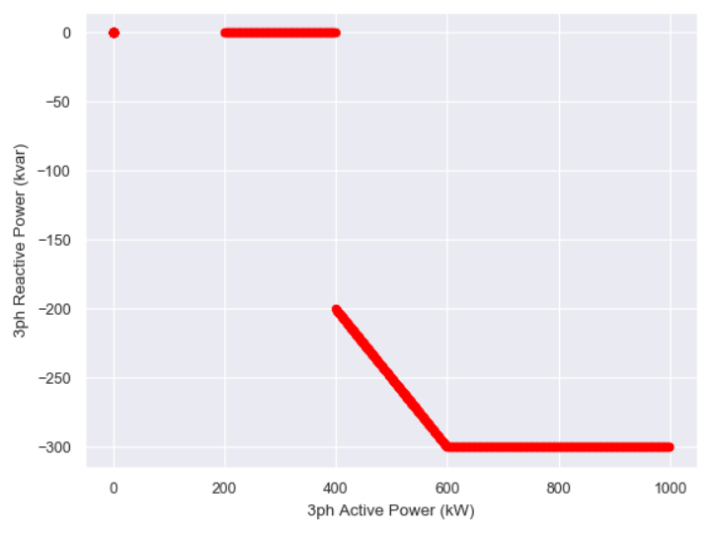
Scenario 2.1
%CutIn < %PminNoVars
%PminkvarMax = 60% (600kW)
%PminNoVars = 40% (400kW)
%CutIn = 16.666% of kVA (200kW)
OpenDSS results

Slide 13
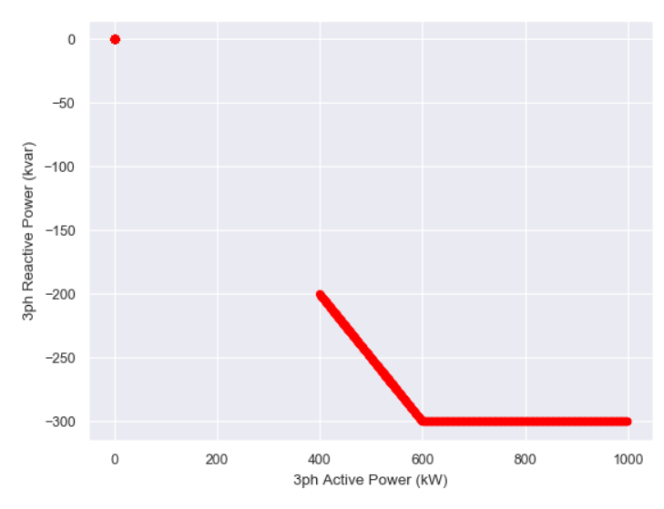
Scenario 2.2
%CutIn < %PminNoVars
%PminkvarMax = 60% (600kW)
%PminNoVars = 20% (200kW)
%CutIn = 33.333% of kVA (400kW)
OpenDSS results

Slide 14
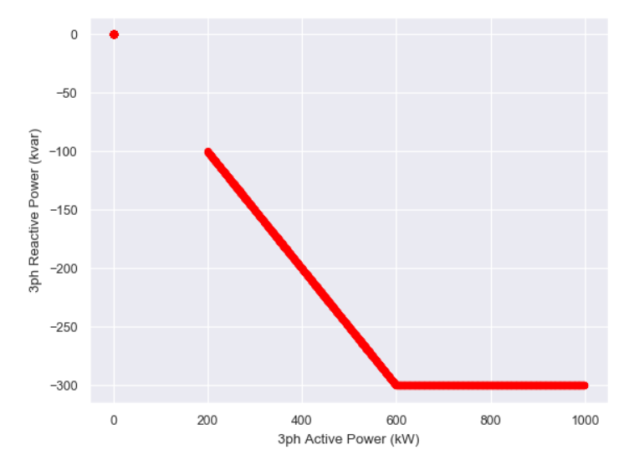
Scenario 2.3
%PminNoVars = -1
%PminkvarMax = 60% (600kW)
%CutIn = 16.666% of kVA (200kW)
OpenDSS results

Slide 15
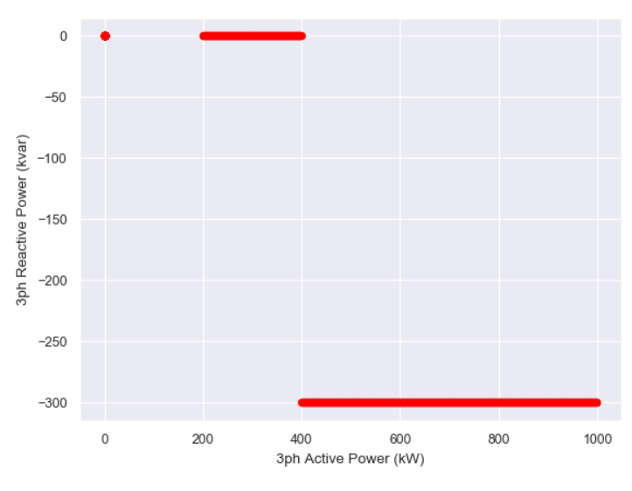
Scenario 2.4
%PminkvarMax = -1
%PminNoVars = 40% (400kW)
%CutIn = 16.666% of kVA (200kW)
OpenDSS results

Slide 16
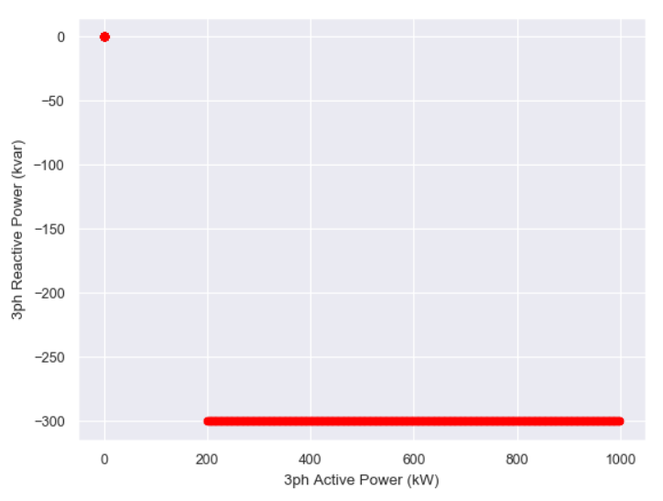
Scenario 2.5
%PminkvarMax = -1
%PminNoVars = -1
%CutIn = 16.666% of kVA (200kW)
OpenDSS results

Slide 17
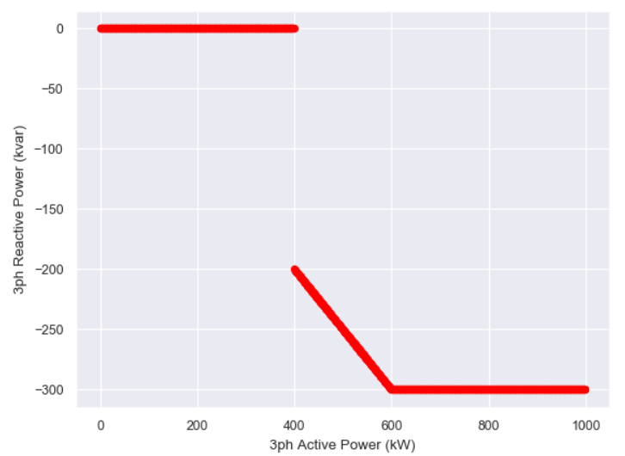
Scenario 2.6
%PminkvarMax = 60% (600kW)
%PminNoVars = 40% (400kW)
%CutIn = 0.01% of kVA
OpenDSS results

Slide 18
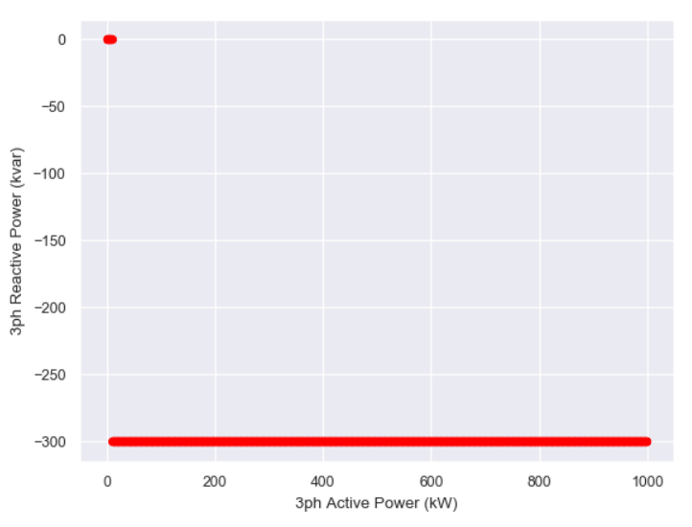
Scenario 2.7
%PminkvarMax = -1
%PminNoVars = -1
%CutIn = 0.01% of kVA
OpenDSS results

Slide 19
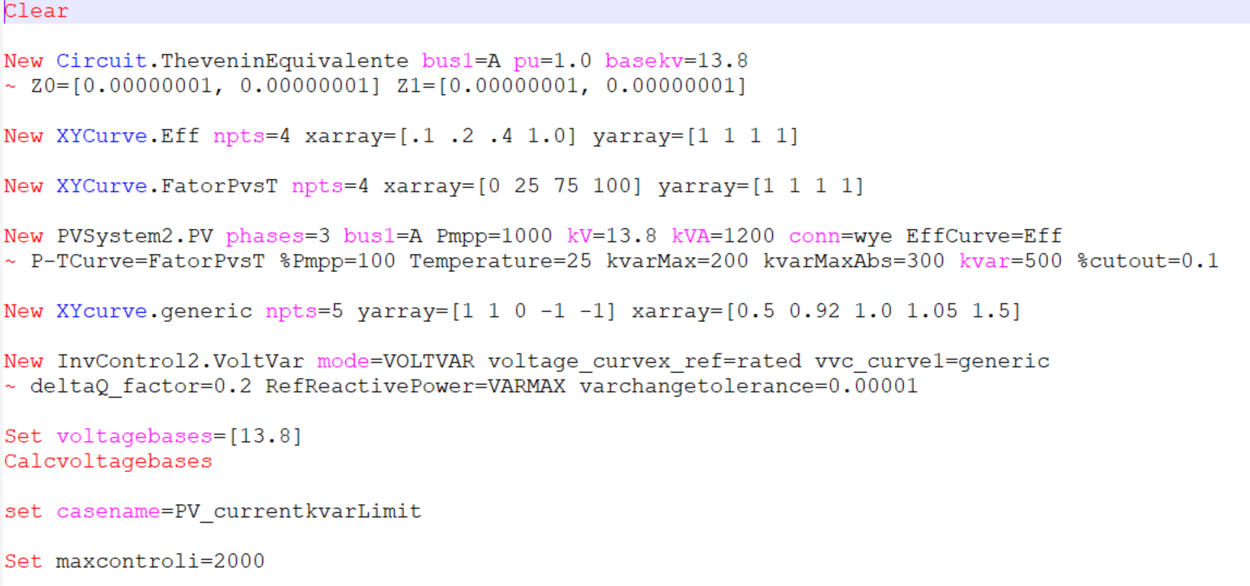
Base case DSS for kvar capacitive – PVSystem with InvControl with VV – Scenarios 3.
OpenDSS code (PV_currentkvarlimit_VV.dss)
pu is changed to 0.91

Slide 20
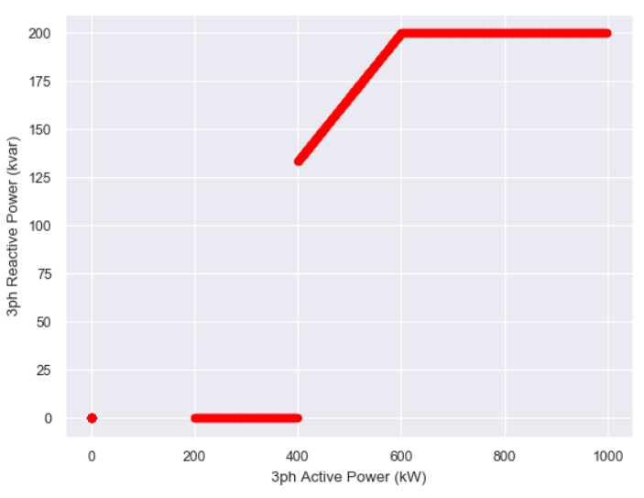
Scenario 3.1
%CutIn < %PminNoVars
%PminkvarMax = 60% (600kW)
%PminNoVars = 40% (400kW)
%CutIn = 16.666% of kVA (200kW)
OpenDSS results

Slide 21
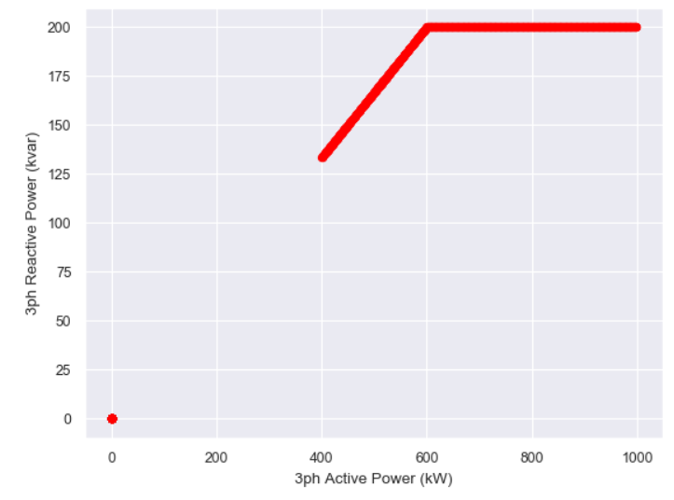
Scenario 3.2
%CutIn < %PminNoVars
%PminkvarMax = 60% (600kW)
%PminNoVars = 20% (200kW)
%CutIn = 33.333% of kVA (400kW)
OpenDSS results

Slide 22
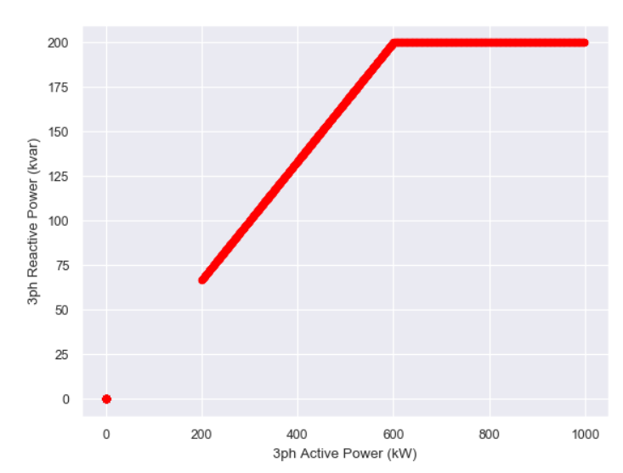
Scenario 3.3
%PminNoVars = -1
%PminkvarMax = 60% (600kW)
%CutIn = 16.666% of kVA (200kW)
OpenDSS results

Slide 23
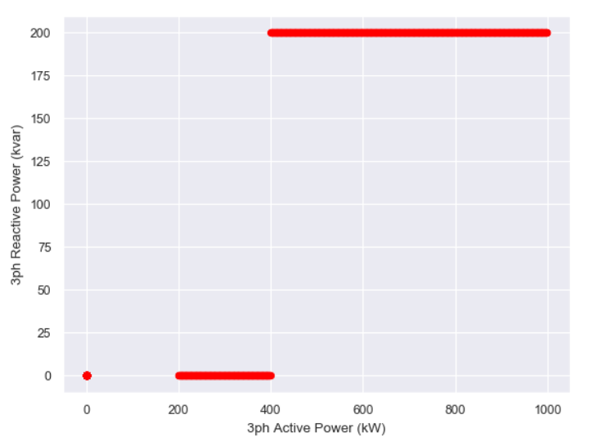
Scenario 3.4
%PminkvarMax = -1
%PminNoVars = 40% (400kW)
%CutIn = 16.666% of kVA (200kW)
OpenDSS results

Slide 24
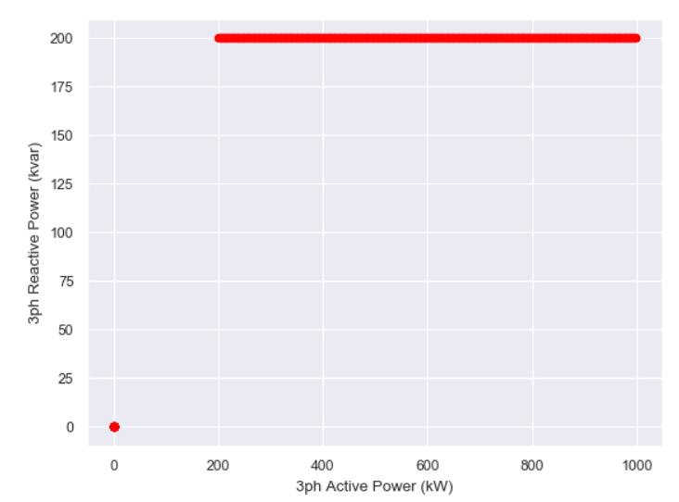
Scenario 3.5
%PminkvarMax = -1
%PminNoVars = -1
%CutIn = 16.666% of kVA (200kW)
OpenDSS results

Slide 25
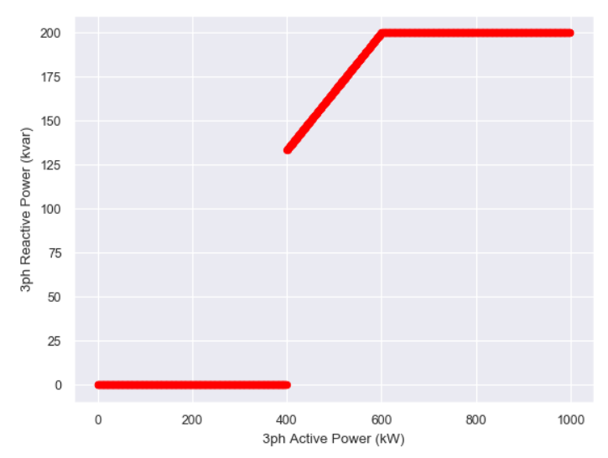
Scenario 3.6
%PminkvarMax = 60% (600kW)
%PminNoVars = 40% (400kW)
%CutIn = 0.01% of kVA
OpenDSS results

Slide 26
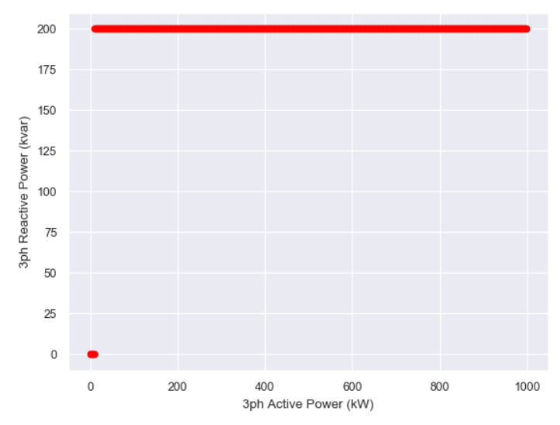
Scenario 3.7
%PminkvarMax = -1
%PminNoVars = -1
%CutIn = 0.01% of kVA
OpenDSS results

Slide 27
Base case DSS for kvar indutive – PVSystem with InvControl with VV – Scenarios 4.
OpenDSS code (PV_currentkvarlimit_VV.dss)
pu is changed to 1.06

Slide 28
Scenario 4.1
%CutIn < %PminNoVars
%PminkvarMax = 60% (600kW)
%PminNoVars = 40% (400kW)
%CutIn = 16.666% of kVA (200kW)
OpenDSS results

Slide 29
Scenario 4.2
%CutIn < %PminNoVars
%PminkvarMax = 60% (600kW)
%PminNoVars = 20% (200kW)
%CutIn = 33.333% of kVA (400kW)
OpenDSS results

Slide 30
Scenario 4.3
%PminNoVars = -1
%PminkvarMax = 60% (600kW)
%CutIn = 16.666% of kVA (200kW)
OpenDSS results

Slide 31
Scenario 4.4
%PminkvarMax = -1
%PminNoVars = 40% (400kW)
%CutIn = 16.666% of kVA (200kW)
OpenDSS results

Slide 32
Scenario 4.5
%PminkvarMax = -1
%PminNoVars = 40% (400kW)
%CutIn = 16.666% of kVA (200kW)
OpenDSS results

Slide 33
Scenario 4.6
%PminkvarMax = 60% (600kW)
%PminNoVars = 40% (400kW)
%CutIn = 0.01% of kVA
OpenDSS results

Slide 34
Scenario 4.7
%PminkvarMax = -1
%PminNoVars = -1
%CutIn = 0.01% of kVA
OpenDSS results

