Slide 1
Community Energy Storage Simulations
AEP Smart Grid Demo

Slide 2
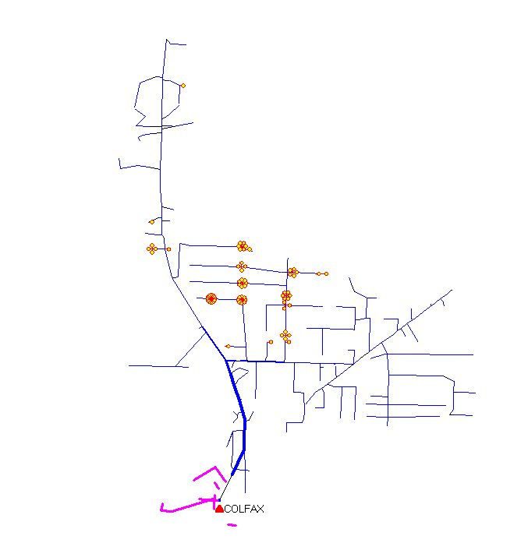
Circuit Diagram
84 Storage Elements
25 kW each

Slide 3
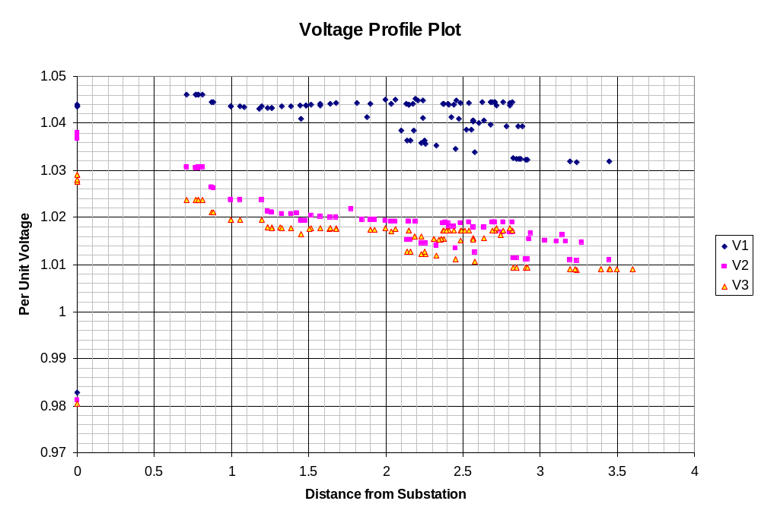
Voltage Profile

Slide 4
Storage Element Model in OpenDSS
Idle | Discharge | Charge
% Eff. Charge/Discharge
Other Key Properties
% Reserve
kWhRated
kWhStored
%Stored
kWRated
etc.
kW, kvar
Idling Losses
kWh STORED

Slide 5
StorageController Element in OpenDSS
Time + Discharge rate
Peak Shaving
Load Following
Loadshape
Discharge Mode
Charge Mode
kW Target
Discharge Time
Total Fleet kW Capacity
Total Fleet kWh
et. al.
Comm Link
V, I
Substation
Storage “Fleet”

Slide 6
Example Simulations
Investigating 25, 50, and 75 kWh storage options with various discharging schemes

Slide 7
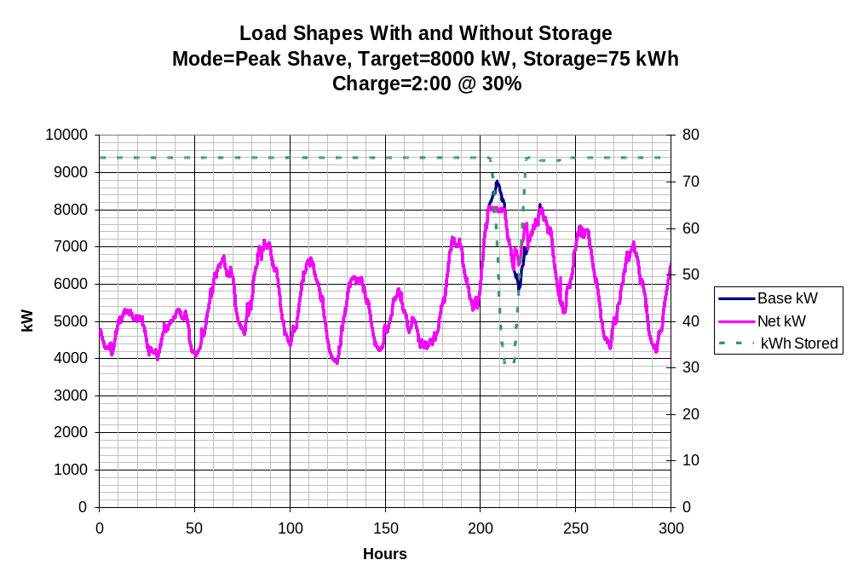

Slide 8


Slide 9
“Ran Out of Gas”

Slide 10
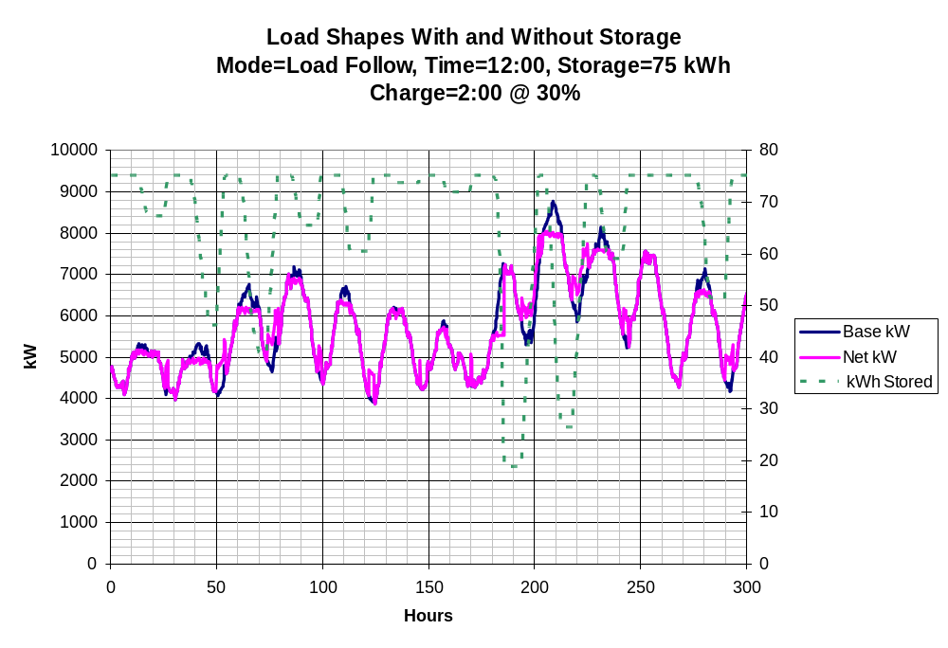

Slide 11
12:00 is too early
Load declines
after 12:00

Slide 12
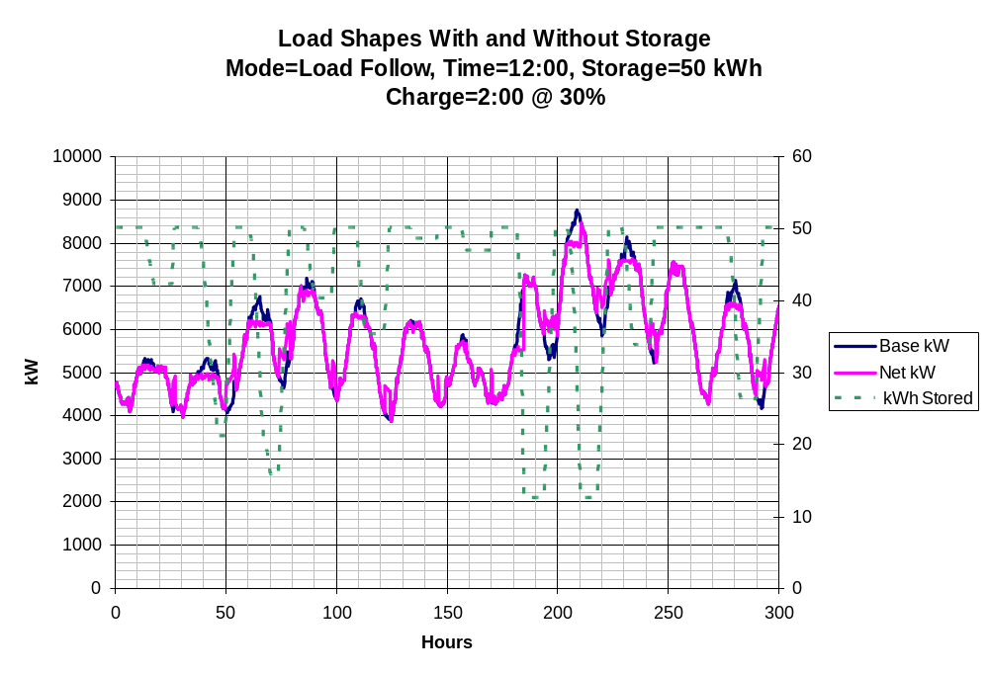

Slide 13
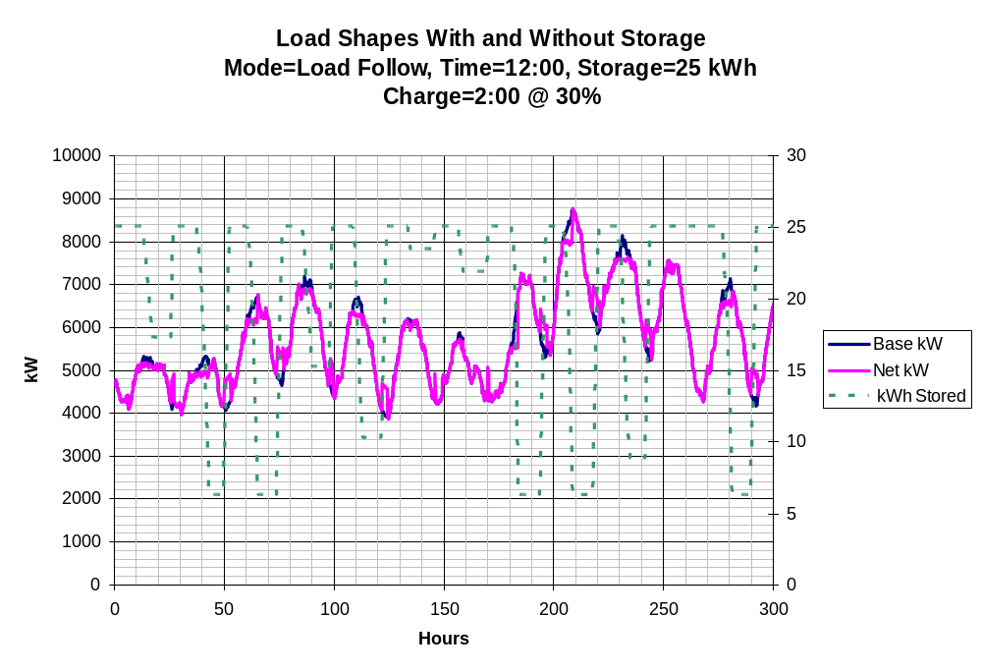

Slide 14
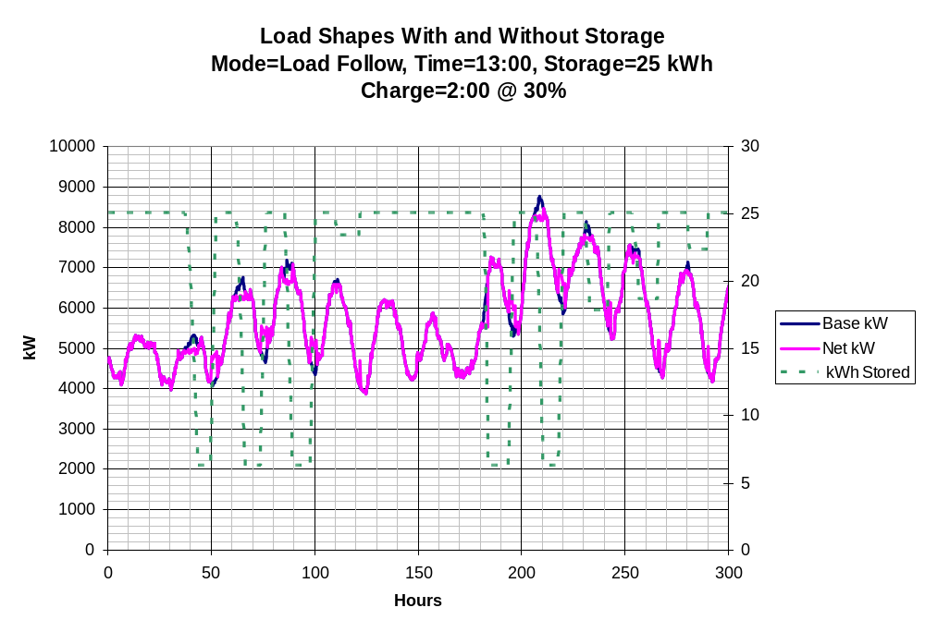

Slide 15
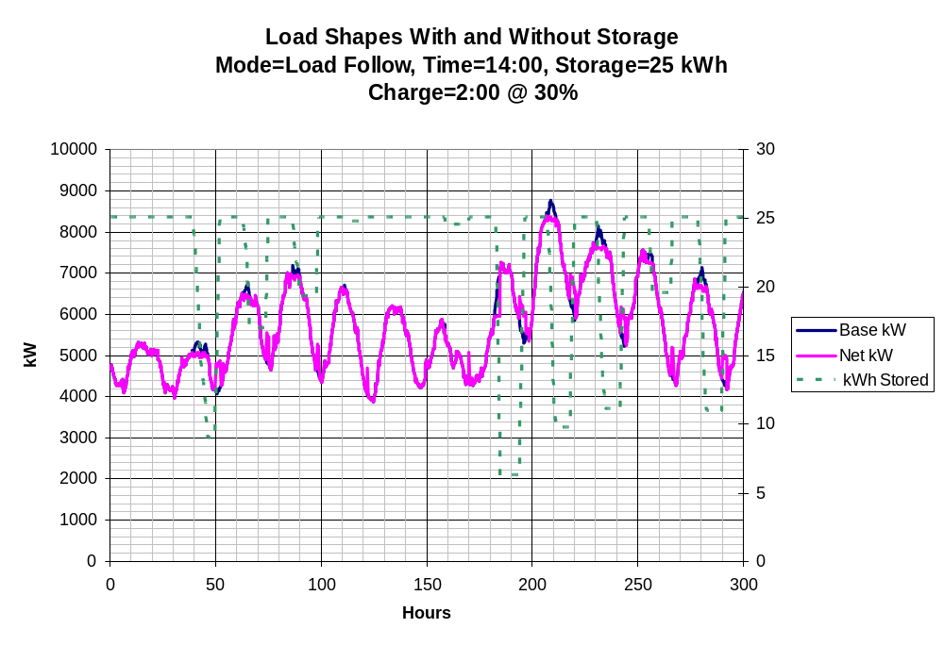

Slide 16
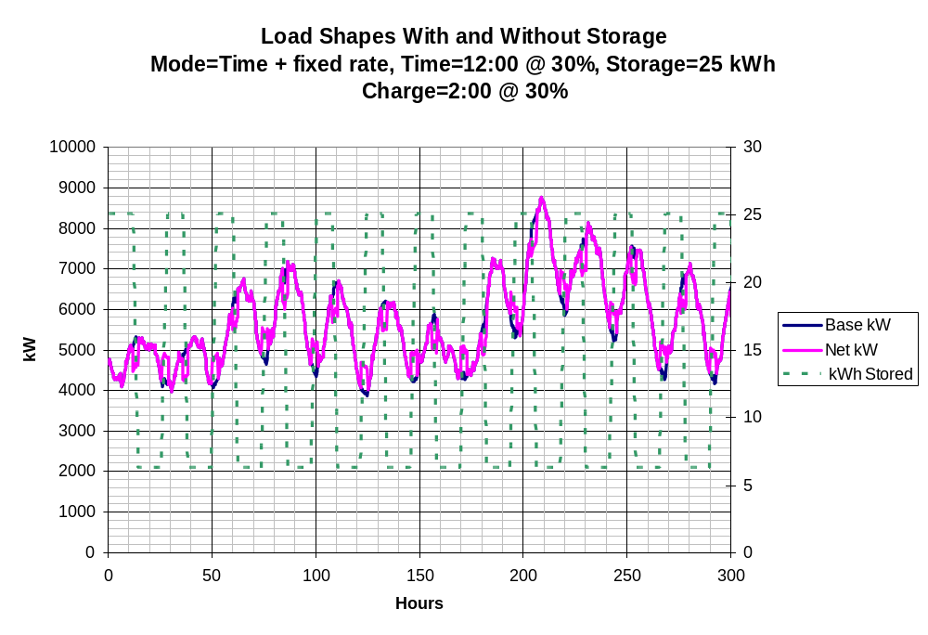

Slide 17
Quickly discharges to reserve kWh

Slide 18


Slide 19
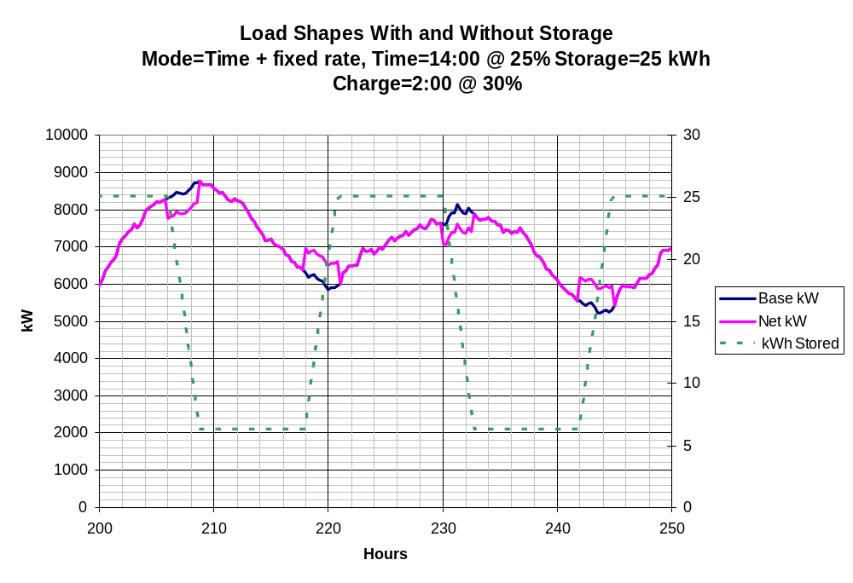
(Expanded Scale)

Slide 20
Conclusions
25 kWh storage is quickly depleted when used for day-to-day peak shaving
  Have to be very careful with discharge strategy
Load following with a later time trigger is likely more useful than a fixed discharge rate or an early time trigger
75 kWh would be “nice to have”

